Slide 1
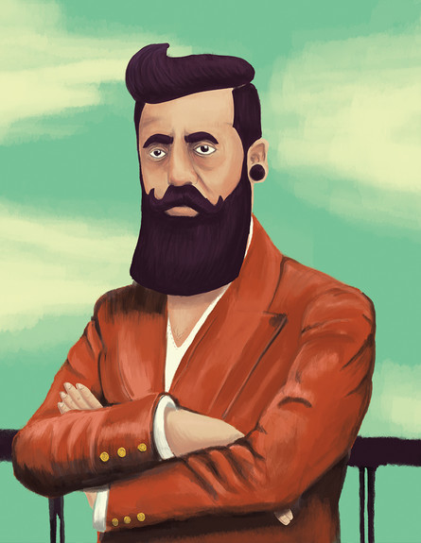
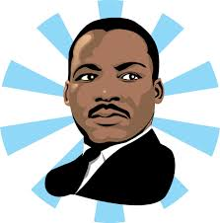
I have a Dream…

Slide 2
I Have a Dream ("Yesh Li Chalom")
I have a dream And it's much greater than anything else I have a dream And it's very ancient and also new Will come the day, very clear and sweet like honey I have a dream Deliver peace Mountains blue from depth to sea And sing suddenly Children will sing from nation to nation And not in a dream Their song will touch the heart of the whole world I have a dream I have a dream Which I received as an inheritance from my father From every abyss It knew to spread it's wings and ascend Comes a threat Arose purity from death and captivity I have a dream I have a dream Fixed like a spring in the heart of the hill This is the place From here will shoot forth and rise, and even become stronger And a song of peace Will blow from this stone to the whole site I have a dream

Slide 3
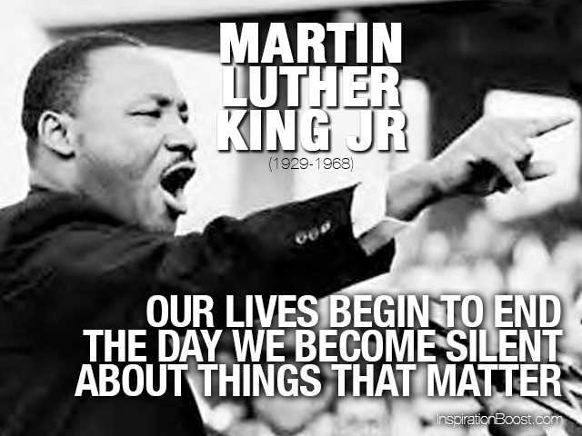
Martin Luther King JR

Slide 4
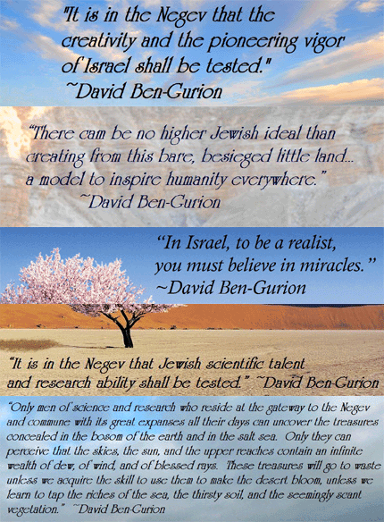
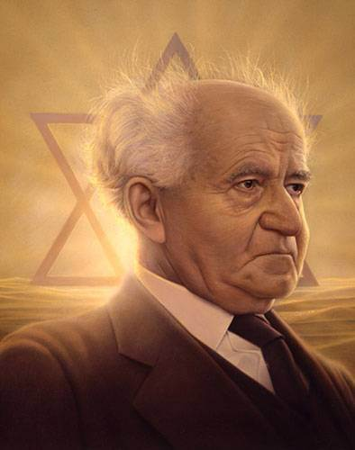
David Ben- Gurion

Slide 5
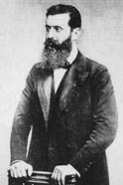
Herzl and the Zionist Idea
Theodor Herzl ( 1860 – 1904)
Khozeh HaMedinah: "Visionary of the State“.
He is considered to have been the father of modern political Zionism.
“If you will it,
it is no dream”.
“ At Basel I founded the Jewish State”.

Slide 6
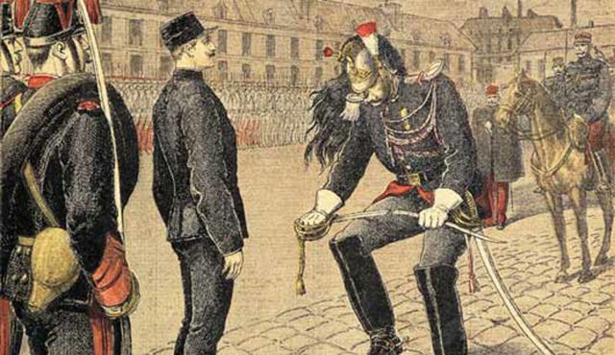
The Dreyfus Affair, a notorious anti-Semitic incident in France.
Herzl was witness to mass rallies in Paris following the Dreyfus trial, where many chanted "Death to the Jews!"
Jewish emancipation and assimilation
to believe that the Jews must create their own state

Slide 7
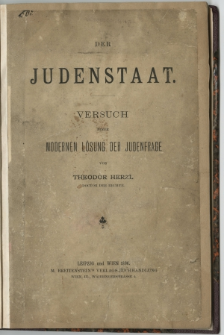
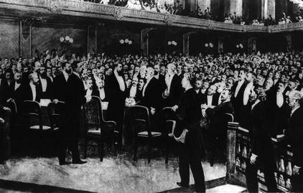
Beginning in late 1895, Herzl wrote Der Judenstaat (The Jewish State).
The book and Herzl's ideas spread rapidly throughout the Jewish world and attracted international attention.
The First Zionist Congress in Basel, Switzerland. He was elected president (a position he held until his death in 1904).

Slide 8
“At Basel I founded the Jewish State. If I said this out loud today l would be greeted by universal laughter. In five years perhaps, and certainly in fifty years, everyone will perceive it”.

Slide 9
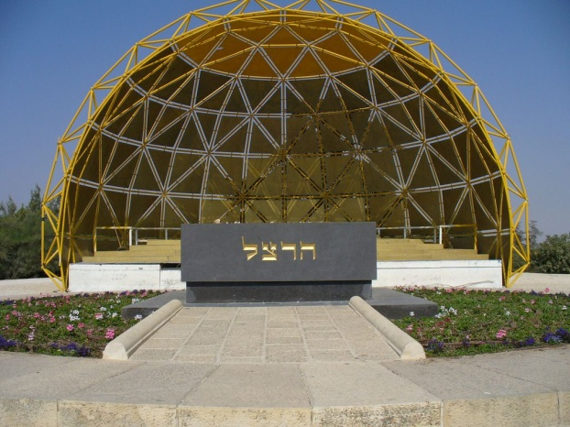
"Greet Palestine for me. I gave my heart's blood for my people”.
Herzl envisioned a Jewish state that combined modern Jewish culture with the best of the European heritage. Thus a "Palace of Peace" would be built in Jerusalem to arbitrate international disputes, and at the same time the Temple would be rebuilt on modern principles.

Slide 10
The Declaration of independence
The State of Israel will be open for Jewish immigration and for the Ingathering of the Exiles; it will foster the development of the country for the benefit of all its inhabitants; it will be based on freedom, justice and peace as envisaged by the prophets of Israel; it will ensure complete equality of social and political rights to all its inhabitants irrespective of religion, race or sex; it will guarantee freedom of religion, conscience, language, education and culture; it will safeguard the Holy Places of all religions; and it will be faithful to the principles of the Charter of the United Nations.

Slide 11
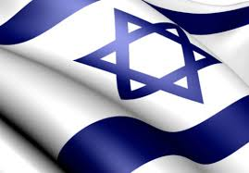
What is your vision for the state of Israel?

