Slide 1
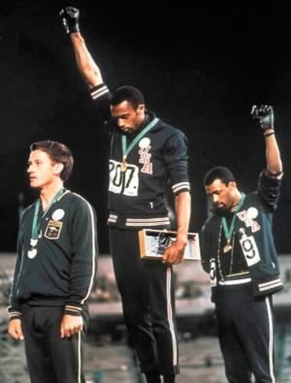
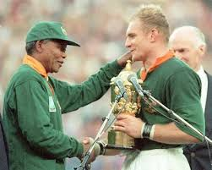
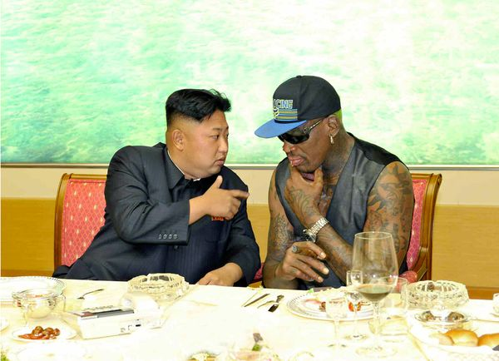
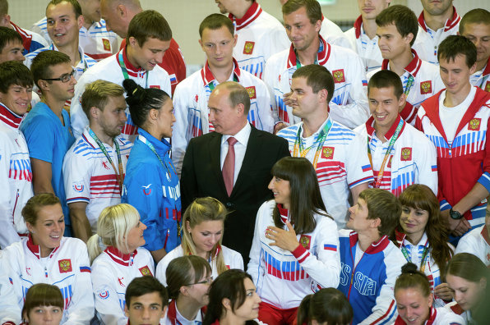
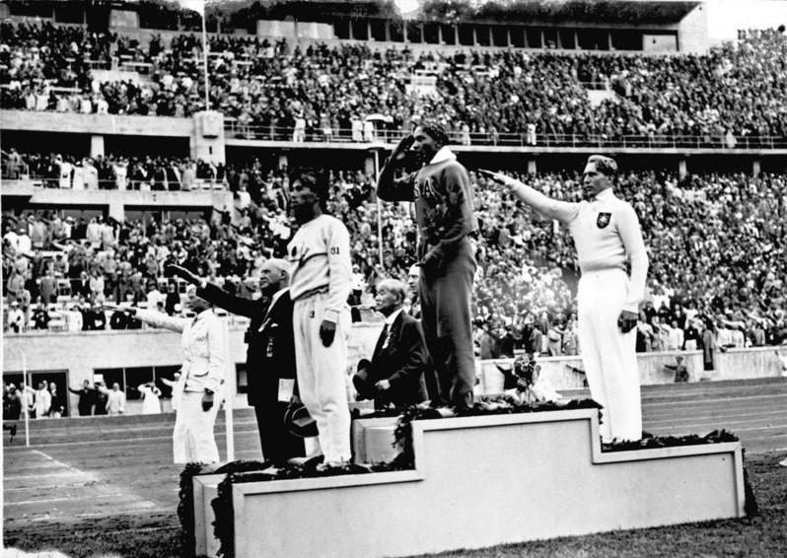
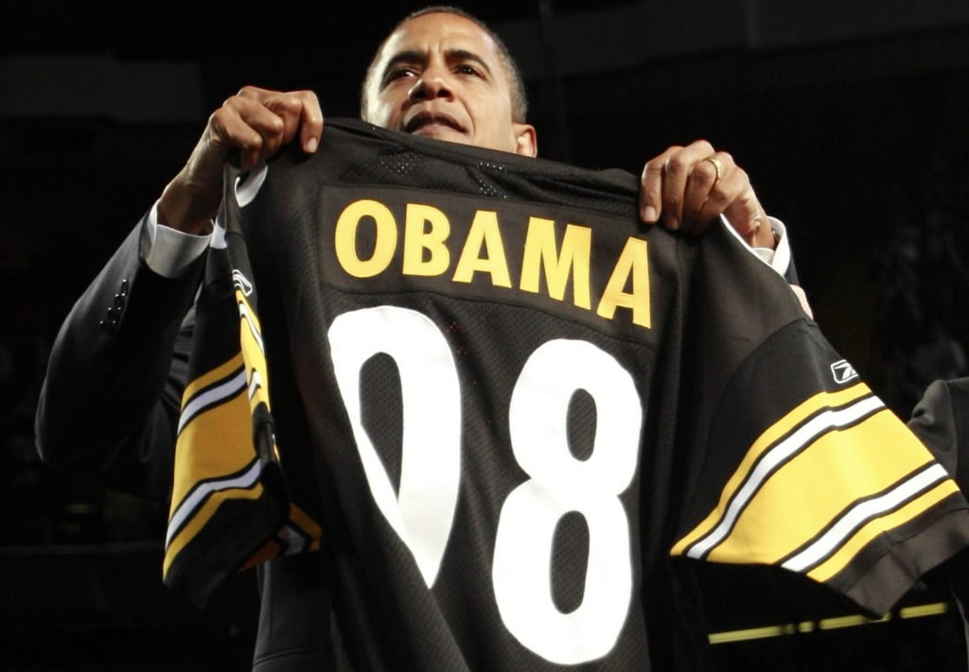
Sports and Politics
Is there a connection between sport and politics?

Slide 2
What are we going to talk about?
4 Layers of Modern Sport
Sport and the Jews
Sports in Israel
Lets Play Ball…

Slide 3
What is sport?
4 layers: and its everywhere!!!!
Metaphoric
Bureaucratic
Instrumental
Reflective

Slide 4
Metaphoric
Implying words from the world of sports into politics, such as: Playing the field, knockout, Homerun, the whole nine yards, The gloves are off.
And the other way around: Canon ball, Home stretch.

Slide 5
What is sport?
4 layers:
Metaphoric
Bureaucratic
Instrumental
Reflective

Slide 6
Bureaucratic
A lot of politics within.
In the sport world, like in politics no decision is made without considering benefits (Olympic games, World Cup)

Slide 7
What is sport?
4 layers:
Metaphoric
Bureaucratic
Instrumental
Reflective

Slide 8
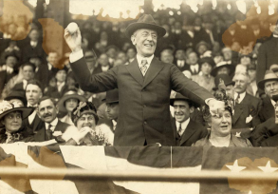
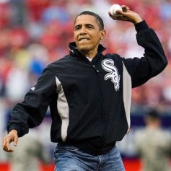
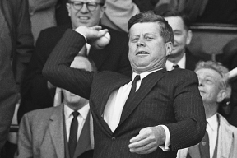
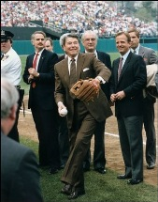
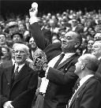
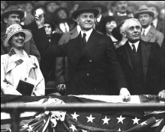
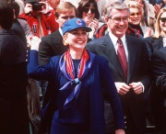

Instrumental
International – U.S bands USSR Olympic games in 1980.
Colonialism
National - Politicians using sport, and the love of the crowd for it, for political benefits.

Slide 9
What is sport?
4 layers:
Metaphoric
Bureaucratic
Instrumental
Reflective

Slide 10
Reflective
Learn about a society through the popular sport.
Baseball: in the U.S its all about personal statistics, in Japan its about team statistics.
Basketball: in the U.S more of an Individual game, not in European Basketball.

Slide 11
Sports and Jews
Is there a connection?
Allen Guttmann – 7 criterions of modern sport
Jews wanted to enter sport clubs, but couldn't enter university
Mostly individual sport, not team

Slide 12
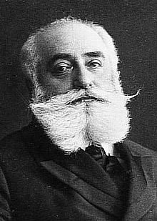
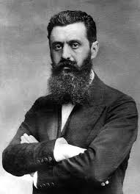
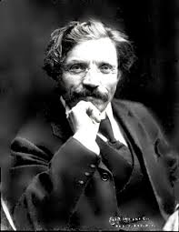
Sports and Jews
Max Nordau – “Muscular Judaism”
Theodor Herzl – The Old New Land (Altneuland)
Shalom Alichaim – Mesugaim (the Crazy)

Slide 13
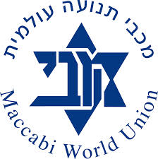
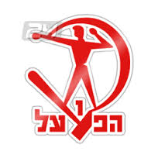


Sport in Israel
Maccabi
Maccabi Vs Hapoel (Right? Vs Left!)
Beitar
Elitzur

Slide 14
Sport and the Arabs in Israel
כשמדברים על ספורט אתני, אנו מזהים בדרך כלל אקט של בידול. אצל הערבים מזהים זאת תחילה אך בהמשך רצון להשתלב.

Slide 15
Questions?

