Slide 1
Peace process
Oz Naor
Israeli Emissary
January 2011

Slide 2
Israel’s Military Administration of the West Bank and Gaza
1967-1993
After the 1967 war, Israel immediately offered to exchange land for peace.
The Arab league’s response, known as the “Three Nos”:
“No peace with Israel,
No recognition of Israel,
No negotiations with Israel.”
–Arab League Khartoum Resolution, September 1, 1967

Slide 3
When the mind set changed?
The peace process with Egypt.
The first gulf war.
Madrid Conference in 1991.
Governments changed.

Slide 4
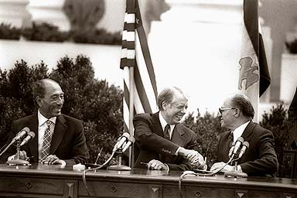
Israel’s Search for Peace
Israel was willing to make territorial compromise to gain peace
Since 1937
Israel accepted territorial compromise in 1937, 1947, 1979 and 2000.
1979–Peace with Egypt. Israel returned Sinai.

Slide 5
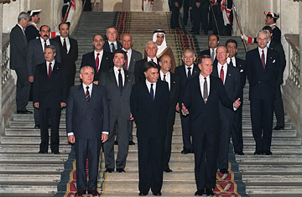
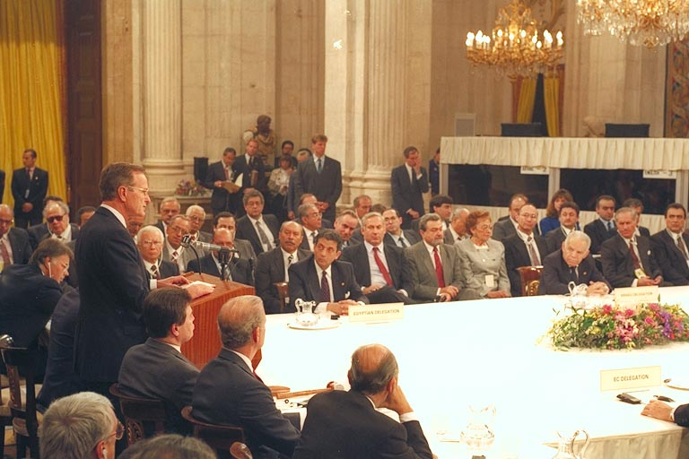
Madrid Conference of 1991
The Impact of the Madrid Peace Conference:
Israel's International status has improved and new diplomatic relations were developed with other countries like China, Oman, Qatar, Tunisia & Morocco.
The Madrid Conference also Paved the way for the Oslo Accords and direct negotiation with the PLO.

Slide 6
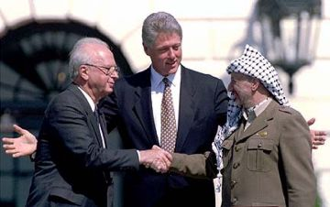
Israeli-Palestinian Peace Efforts
The Oslo process brought high hopes for Palestinian-Israeli peace, 1993
The PLO’s Yasser Arafat agreed to
a Palestinian government in the
West Bank and Gaza.
Israel agreed to give administrative control to the newly created Palestinian
Authority and to progressively withdraw from disputed territory.
“Final Status” issues, including final borders, refugees, Jerusalem settlements and security, were to be negotiated at the end of the peace process.

Slide 8
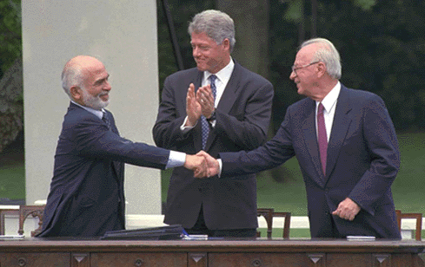
1994–Peace with Jordan
Discussions began in 1994. Israeli Prime Minister Yitzhak Rabin and Foreign Minister Shimon Peres informed King Hussein that after the Oslo Accords with the PLO, Jordan might be "left out of the big game".
The treaty was closely linked with the efforts to create peace between Israel and the Palestinian Authority.

Slide 9
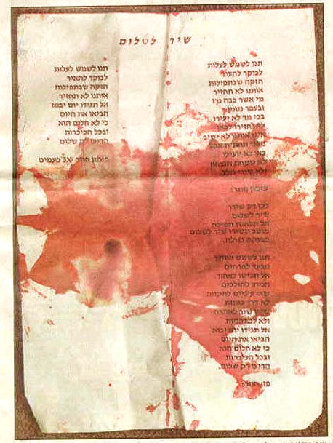
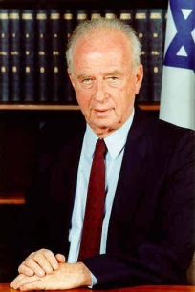
Rabin assassination
On 4 November 1995 Rabin was assassinated by Yigal Amir, a radical right-wing Orthodox Jew.

Slide 10
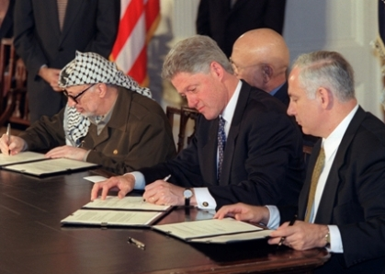
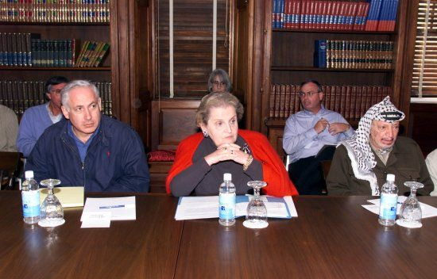
Wye River Memorandum
The Wye River Memorandum was an agreement negotiated between Israel and the Palestine Authority to implement the earlier Interim Agreement of 28 September, 1995.
With the outbreak of the Al-Aqsa Intifada in September 2000, the Wye River's understandings and goals remain un-implemented.

Slide 11
Hopes for Peace Lost (2000)
Hopeful Steps
PA created as Palestinian civil
government.
Yasser Arafat claims to renounce terror and is elected as President of PA.
98% of Palestinians governed by PA.
Israeli withdrawals from
80% of Gaza,
40% of West Bank.
Disappointments
Terrorism escalates–
1993-2000: 282 Israelis killed
1978-1993: 216 Israelis killed
Anti-Israel incitement mounts in
Palestinian media, schools
and mosques.
Israel delays withdrawals.
No agreements on borders.
Israeli communities expand in disputed territories.

Slide 12
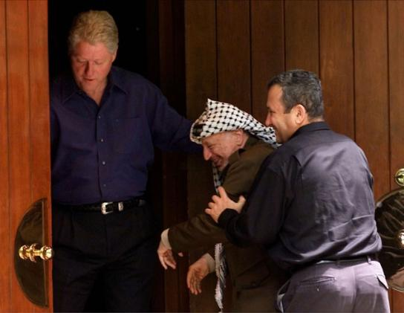
Camp David Summit, 11 July 2000
The Middle East Peace Summit at Camp David of July 2000 took place between United States President Bill Clinton, Israeli Prime Minister Ehud Barak, and Palestinian Authority Chairman Yasser Arafat.
Ultimately, it was an unsuccessful attempt to negotiate a "final status settlement" to the Israeli-Palestinian conflict.

Slide 13
Camp David Negotiations Fail July 2000
The Offer
100% of Gaza, 97% of West Bank
with land swap for extra 3%.
Uprooting Israeli settlements within new PA borders.
Shared capital of Jerusalem.
$30 billion in refugee resettlement fund.

Slide 14
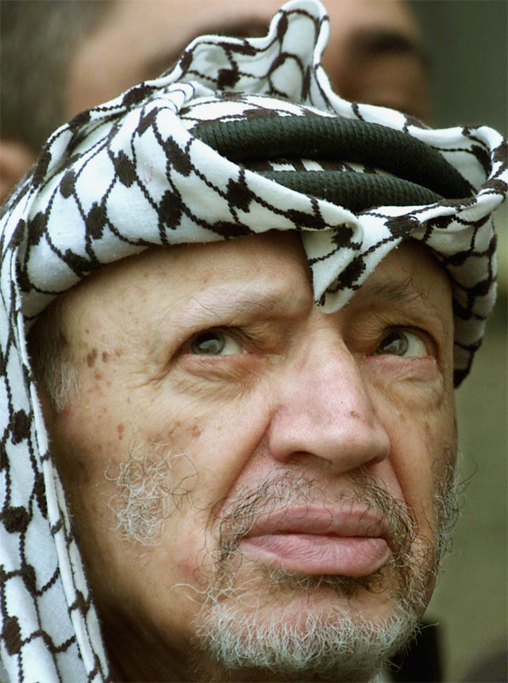
Arafat’s Response:
Arafat did not accept the offer, made no counteroffer and walked away from the negotiation.
Two months later, he launched the Second Intifada – the terrorist war against Israel

Slide 15
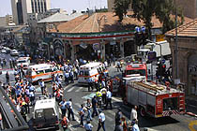
the Second “Intifada”
Sept. 28, 2000-Dec. 31, 2005:
147 suicide bombings
1,084 killed
7,454 injured/crippled
82% of dead and wounded were civilians
Targets: restaurants, dance clubs, buses, religious events, shopping malls, civilians in cars

Slide 16
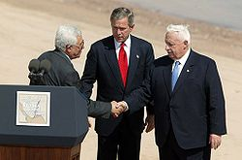
Road map for peace, June 2003
The "road map" for peace is a plan to resolve the Israeli-Palestinian conflict proposed by a "quartet" of international entities: the United States, the European Union, Russia, and the United Nations.
"The Roadmap represents a starting point toward achieving the vision of two states, a secure State of Israel and a viable, peaceful, democratic Palestine.

Slide 17
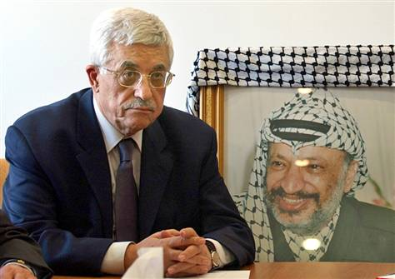
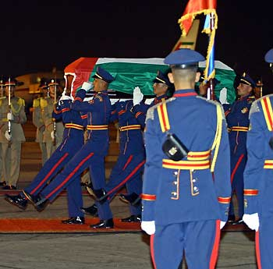
Palestinian presidential election, 2005
the first to be held since 1996 — took place on January 9, 2005 in the West Bank and Gaza Strip. Voters elected PLO chairman Mahmoud Abbas as the new President of the Palestinian Authority to replace Yasser Arafat, who died on November 11, 2004.

Slide 18
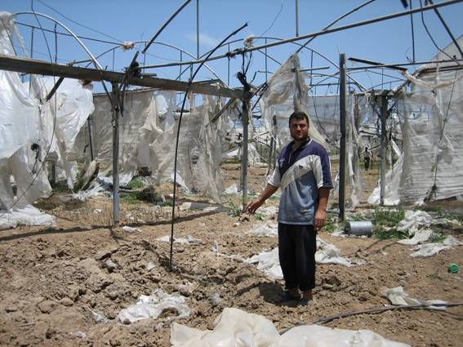
Israeli-Palestinian Peace Efforts
Post-Intifada Failed Peace Efforts
June 2003 Road map to peace
August 2005 Israel uproots all Israeli communities in Gaza
January 2006 Hamas elected in Gaza
June 2007 Hamas coup against Fatah in Gaza

Slide 19
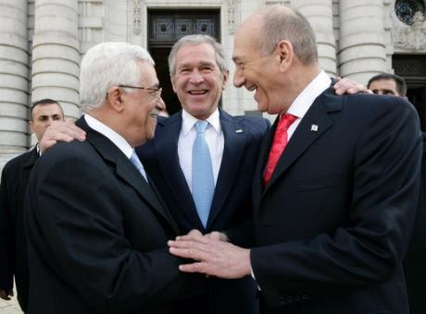
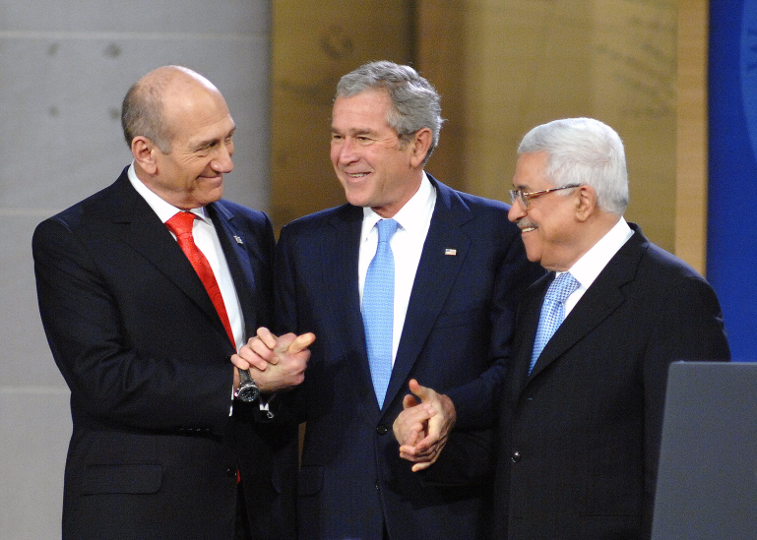
Annapolis Conference 2007
The Annapolis Conference was a Middle East peace conference held on November 27, 2007 at the United States Naval Academy in Annapolis.
The conference marked the first time a two-state solution was articulated as the mutually agreed-upon outline for addressing the Israeli-Palestinian conflict.

Slide 20
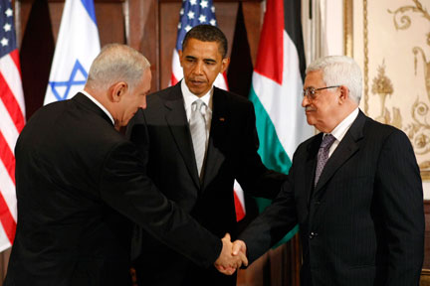
proximity talks 2010
2010, United States President Barack Obama, Israeli Prime Minister Benjamin Netanyahu, and Palestinian Authority Chairman Mahmud Abbas.
The ultimate aim of the direct negotiations is reaching an official "final status settlement" to the Israeli-Palestinian conflict by implementing a two-state solution, with Israel remaining a Jewish state, and the establishment of a state for the Palestinian people.

Slide 21
Discussion
In your opinion, what are the obstacles to get an agreement between Israel and the Palestinians?
A. there's a right wing government in Israel
B. the two state solution is not good for Israel, and if you think that way, explain.
C. Israel is not willing to compromise over territories any more.
D. there are no committed peace partners from both sides.
E. HAMAS vs. PLO: is it a problem or not?
F. the building in the settlements.

Slide 22
Oz Naor
Israeli Emissary
330 316 5699
December 2010

