Slide 1
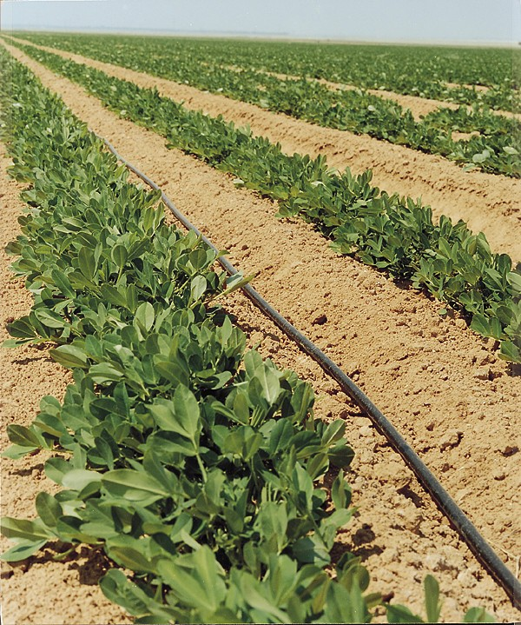
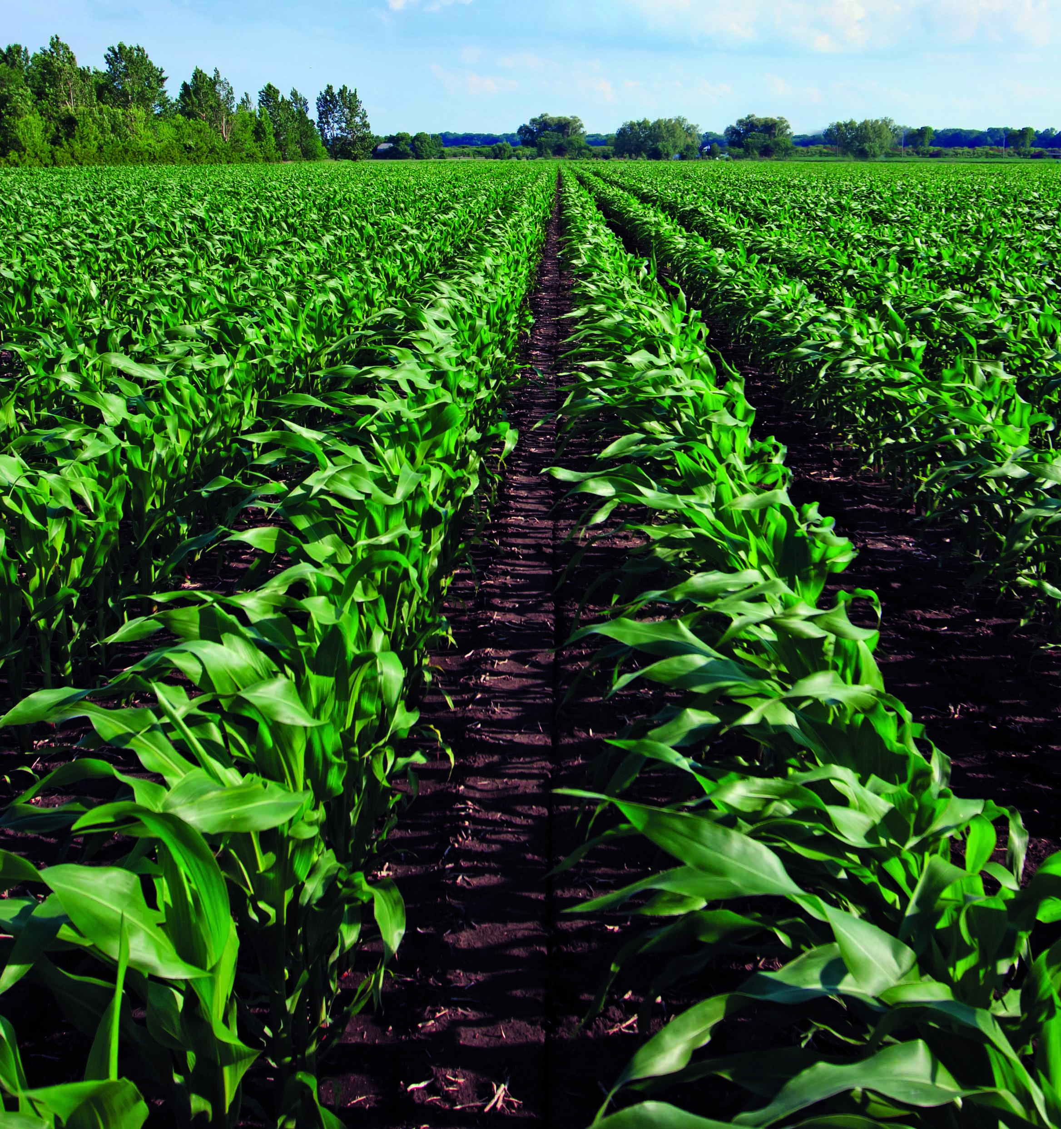
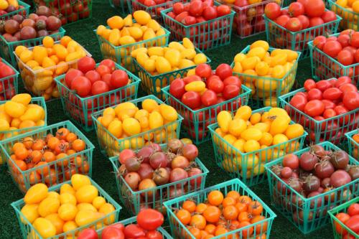
Agriculture in the Negev

Slide 2
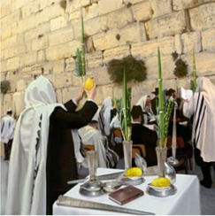
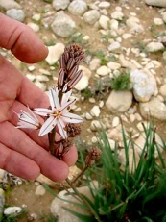
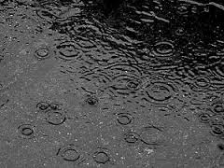
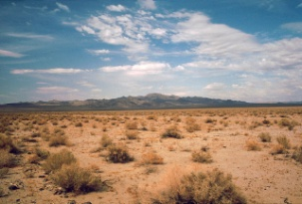
There is strong connection between Sukkot and Agriculture..
The holiday also has an agricultural theme. It is known as the "Feast of the Gathering," in which farmers collect their harvest of the past year.
In addition, it marks the official beginning of the rainy season in Israel. Both the prayers and the ritual of the four species contain many requests for sufficient amounts of rain for crops and for drinking.
The Torah explains that Jews must dwell in the sukkah for seven days to remember the huts that the ancient Israelites lived in during their forty years of sojourning in the desert.

Slide 3
10 facts about the Israeli Agriculture
1. The Israeli cows are the world’s champions in the amount of milk they produce
2. Israel’s usage for water is the world’s most effective
3. Israel leads in developing new species of fruits and vegetables
4. Israel leads in production of seeds for crops
5. The cotton industry is breaking records in output per dunam
6. Israel consider to be the world’s third flowers exporter
7. Israel is the only country in the world where the number of trees grow from year to year.
8. 1 dunam of land in Israel yields 30 times more than the average in any other place in the world
9. Citrus fruits consider to be the leaders in the European markets.
10. Israel has known to develop tomatoes who has a longer shelf life.
Notes:
1 dunam= ¼ acre=1200 square yards

Slide 4
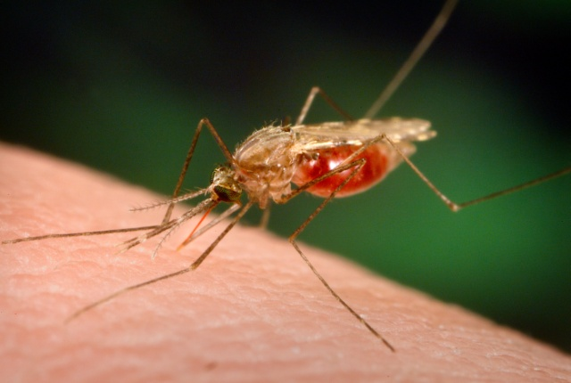
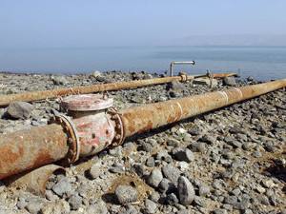
What do they all have in common?
Notes:
מדינה יבשה וחמה, מיעוט מים, מלריה- כולן בעיות מוכרות עימן התמודדנו כמידה בעיקר כחלק מאתגרי החקלאות. אך הרעיון הוא שלקחנו "קללות" והפכנו אותם לברכות בזכות המוח היהודי והיצירתי.

Slide 5
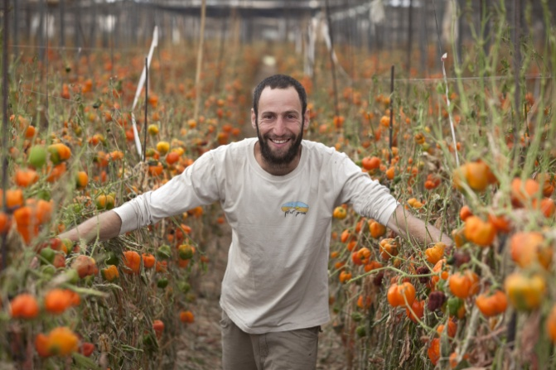
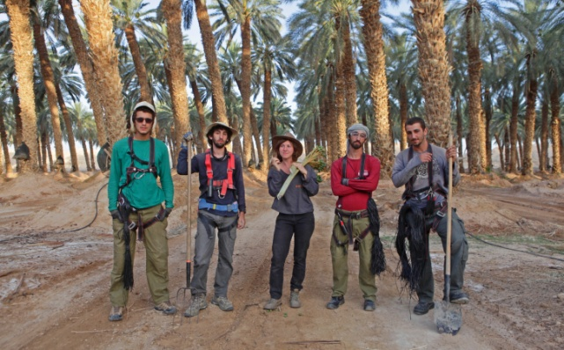
Making the desert bloom..
From Beersheva at its northern tip to Eilat at its southern tip, the Negev accounts for more than half the land mass of Israel, yet only eight percent of the population lives in its spread-out municipalities.

Slide 6
"Without the Negev, how could anyone imagine Zionism? And without agriculture, how could anyone survive in the Negev?“ Haim Levi- head of Eshkol Regional council
Notes:
לבחור בpart 4: clean&green
Tikun olam
מההתחלה עד- 07:07
ואז מ10:28

Slide 7
Drip irrigation
Netafim started its roots as a kibbutz company experimenting with ways to save water to its current status as a worldwide innovator in drip irrigation company.
Netafim is the global leader in drip and micro-irrigation solutions for a sustainable future. At the intersection of water, food security and arable land, drip irrigation enables growers to maximize food production with the lowest environment impact.
The company was founded in 1965, Netafim now operates in 150 countries through 3 subsidiaries, with 13 factories around the world.

Slide 8
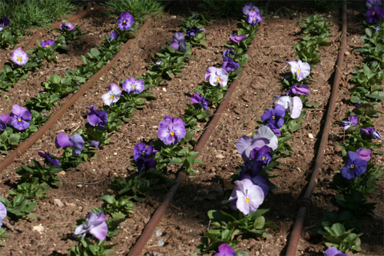
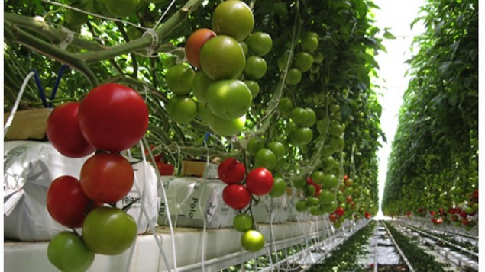
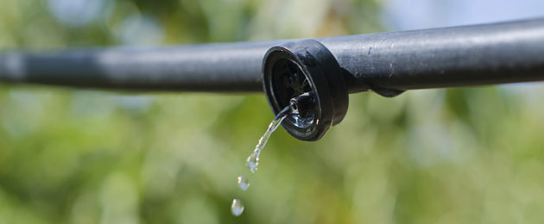

Slide 9
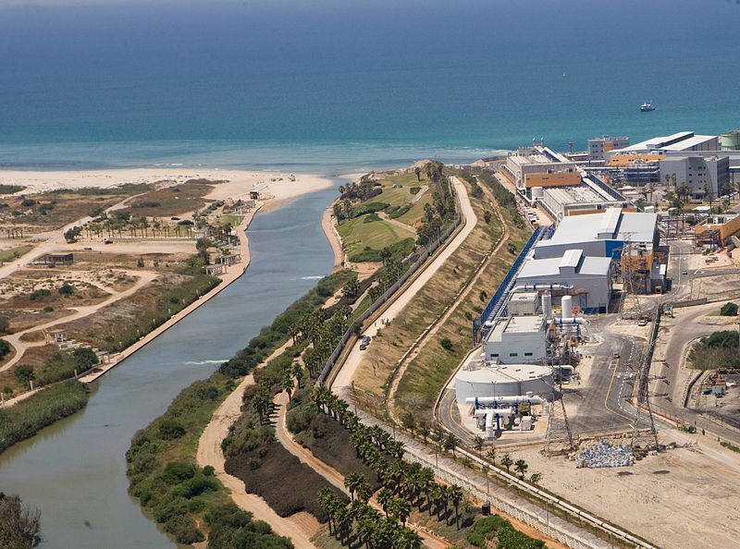
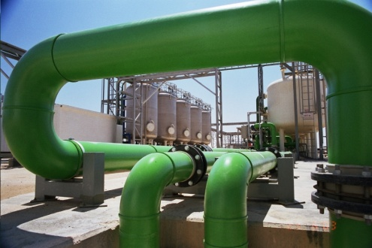
Desalination
The needs of the water market, and especially the constant water shortage in Israel, led “Mekorot” to expand its operations from the supply of water from natural sources to producing water from alternative sources as well. Desalination is one of the most prominent methods for producing water from these same sources.
Hadera Desalination Plant

Slide 10
Wastewater treatment and effluent reuse
Mekorot views the promotion of wastewater treatment and effluents reuse for agricultural and industrial purposes, a national mission. Water reclamation for agricultural purposes have three main targets: 1. Diverting more fresh water to households as a solution to the water crisis in Israel. 2. Increasing the quantity of water for agriculture while ensuring economic viability for farmers. 3. Protecting the environment by reducing the ecological damage that untreated wastewater may cause.

Slide 11
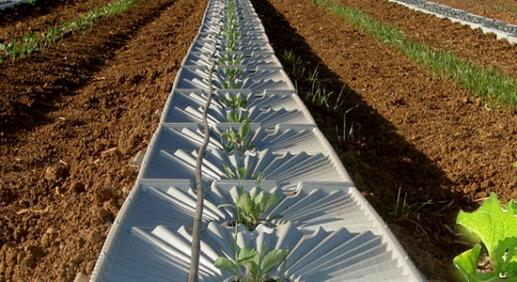
Tal-Ya “God’s Dew”

Slide 12
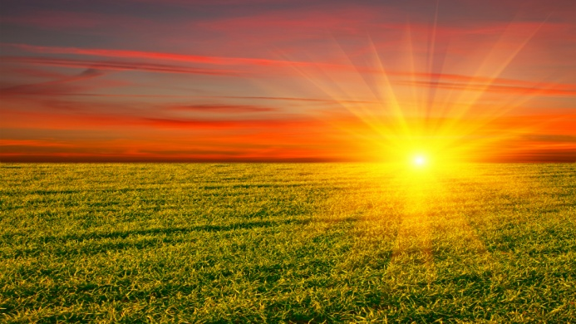
Solar energy
Israel has lots of sunshine, which offers excellent potential as an energy source. A tender for the construction of two thermal solar power stations at the Ashalim site in the Negev with a total capacity of 250 megawatts and a photovoltaic power station with a capacity of 30 megawatt is in the final stages of preparation. In addition, as a result of Government regulations introduced in 2008, the use of distributed photovoltaic systems connected to the electricity grid is expanding in Israel, and hundreds of megawatts of installations have been constructed to date.

Slide 13
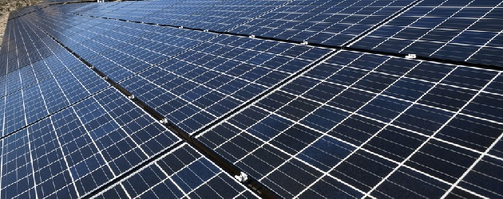
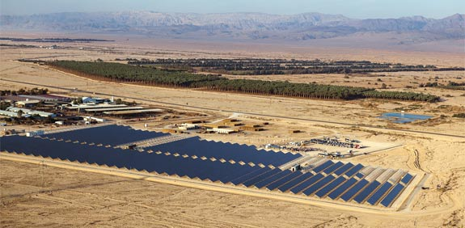

Slide 14
The jojoba oil
n 1989, Kibbutz Hatzerim decided to upgrade the process of growing Jojoba used both on the kibbutz and across Israel. A nursery was established for the mother plants; and consequently, Jojoba was established as an independent branch in the Negev and for the entire country. This process was crowned a success; and today, Israel produces the highest quality Jojoba in the world. This agricultural and agro-technological achievement positions "Jojoba Israel" at the forefront of international Jojoba growers, with an average harvest of 4,500 kg of seeds per hectare, using mechanized harvesting.

Slide 15
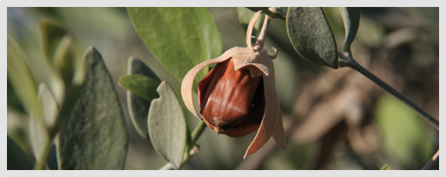

Slide 16
Onions, basil and dates
In the Judean Desert, near the Northern Dead Sea (the Megilot Region) farmers are able to make use of the minerals from the Dead Sea which can also be found in the soils and sands that lie on the ground which create especially strong-tasting crops including onions, and basil which is considered to be the best in the world, so much so, that even the Italians are importing it. The region has historically been a center for the growth of dates, and many of the dates found in grocery stores around the world come from here.

Slide 17
Peppers and Tomatoes in the Negev
One of the first vegetables to be adapted to the unique soil and climate of the western Negev was peppers. The first seeds were brought from Holland, and after experiments with forty different species, four were found to be suitable. Today, greenhouses that originally produced about ten tons of peppers per dunam now yield up to twenty or twenty-five tons per dunam, a worldwide achievement.
Tomatoes of all sorts and shapes are also one of the Negev's main crops, and the there new colors and tastes of tomatoes created all the time, along with planning harvests for those times of year when this popular vegetable is not available abroad. Cherry tomato is also an Israeli invention.

Slide 18
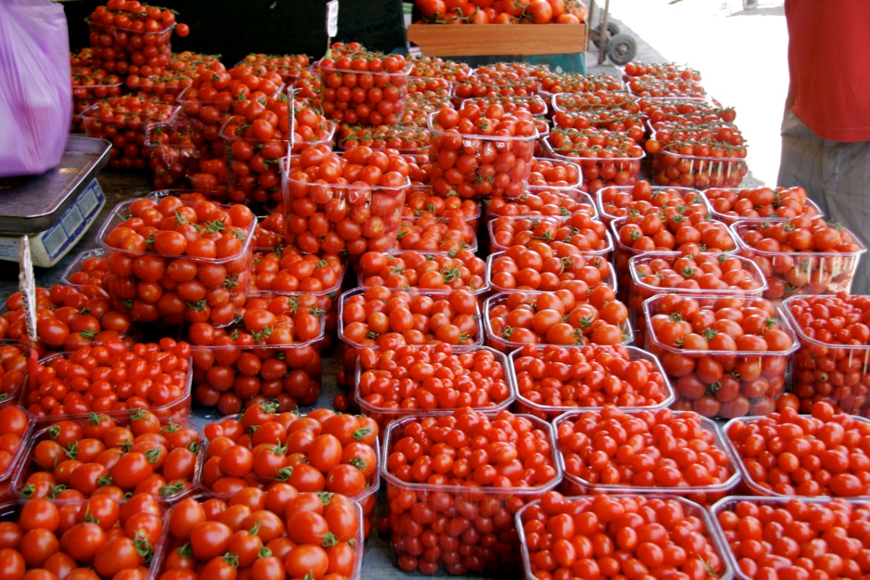
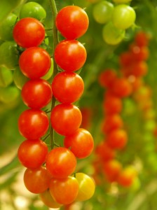
Among the most noteworthy crops grown in the Israeli desert are cherry tomatoes – the modern strain which are found in grocery stores around the world, was developed in the Negev. The cherry tomatoes grown in the Negev are 2-3 times sweeter than those found elsewhere due to the amount of water used, and the unique qualities of minerals found in the water.

Slide 19
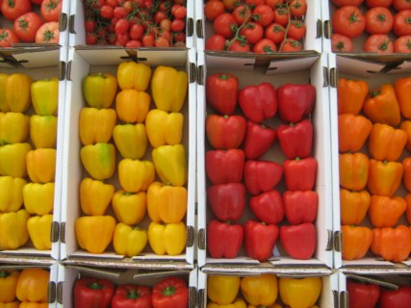
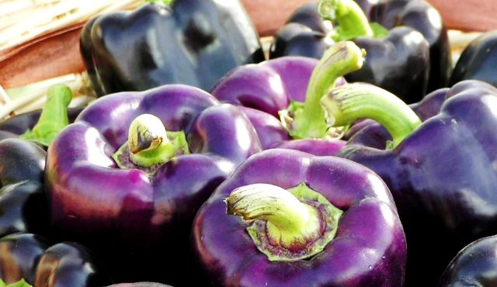
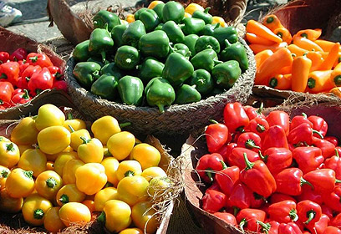

Slide 20
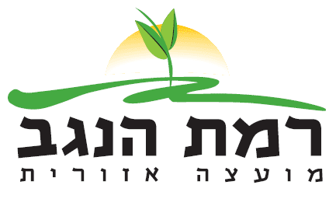
RAMAT NEGEV DESERT AGRO-RESEARCH
The Experimental Center was established about 50 years ago as part of the project of setting up regional R & D's. Its main purpose was to encourage the development of agriculture in the peripheral areas, taking advantage of the natural resources.
Today the farmers in the Nitzana area grow about 1500 dunam of tomatoes, 200 dunam of fresh herbs and about 150 dunam of flowers. This area also exports the largest quantity in Israel of cherry tomatoes on vines (about 15,000 tons per year). In addition, Ramat Negev has about 5,500 dunam of olive groves, irrigated with brackish water only; 300 dunam of pomegranates; 600 dunam of vineyards for wine (and 5 local winemakers); about 5000 dunam of potatoes. They also have an intensive fish growing pools

Slide 21
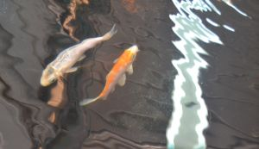
Fish farming
Okay, why study fish farming (and disease) in the middle of the desert? "Fish can be farmed anywhere there's water, and there's a vast aquifer of fossil saline water 800 meters under the Negev," Zilberg notes. (That brackish water is also tapped for agriculture in the Negev.)
Moreover, in the desert, land is cheaper and more available. Perhaps best of all, the fish farms are isolated from other water bodies – and diseases – so the fish can’t escape or interfere with the natural aquatic ecosystem.

Slide 22
Vegetables crops 2012/13 growing season

Slide 23
Yellow beet
Winter watermelon
Colorful prickly pear cactus
Heart shaped cucumbers
Beef tomato
Raisin tomato
Chocolate- mint herb
Black radish
Green pear cactus
Purple carrot
Angelo pepper
Pear tomato

Slide 24
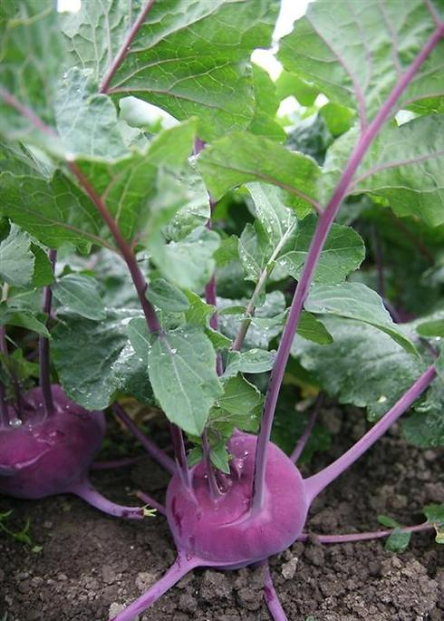
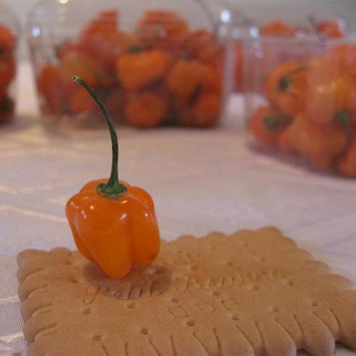
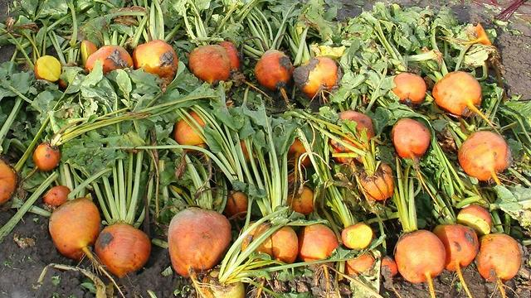
Orange beet
Habenero pepper- 3 times more spicier
Purple turnip cabbage

Slide 25
More food for thought…

Slide 26
Questions???

