Slide 1
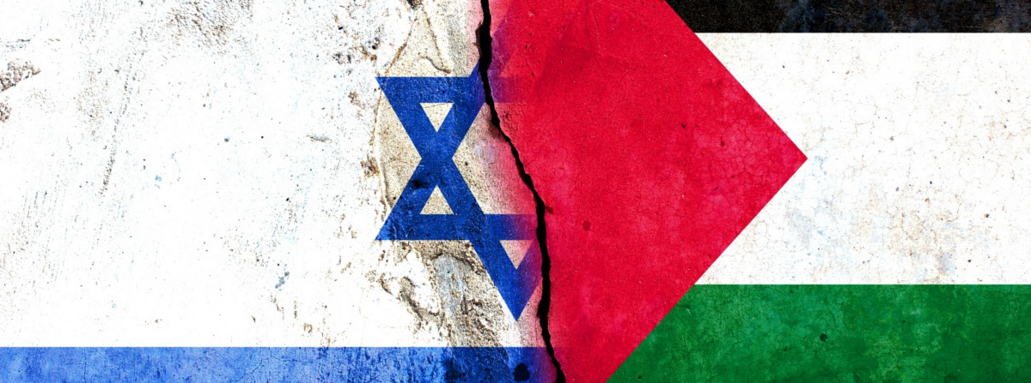

Presentation Title
Session 4:
WHAT ARE WE TALKING ABOUT
WHEN WE ARE TALKING ABOUT
Presentation Subtitle
THE CONFLICT
(Or WAWTAWWATATC for short)

Slide 2

Featuring:
Eliza
Tom
Notes:
Eliza introducing herself

Slide 3
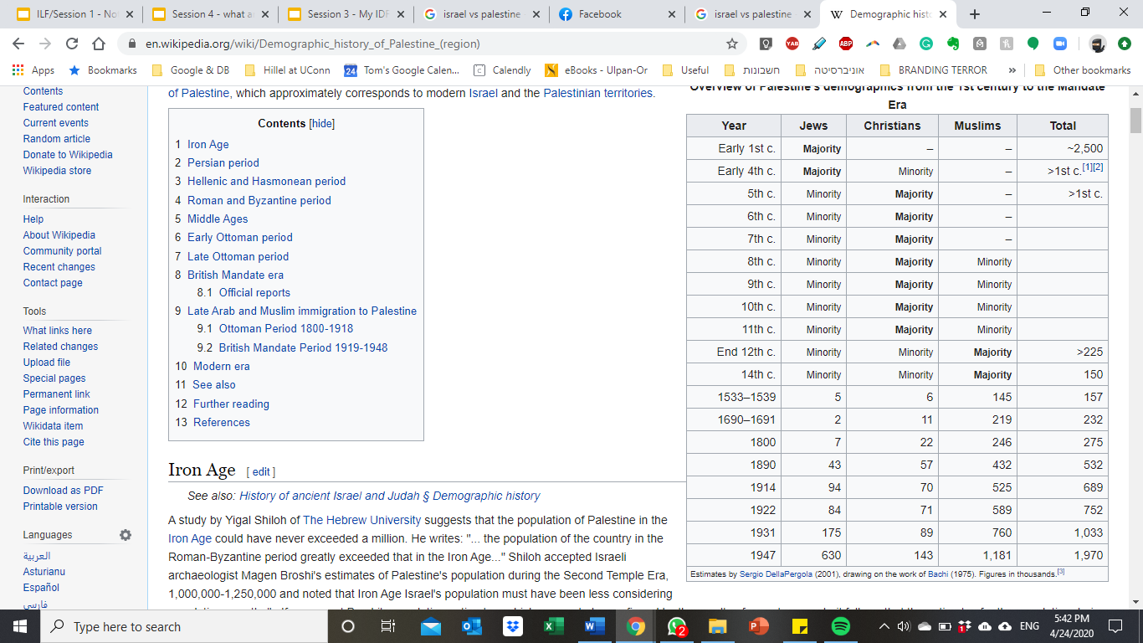
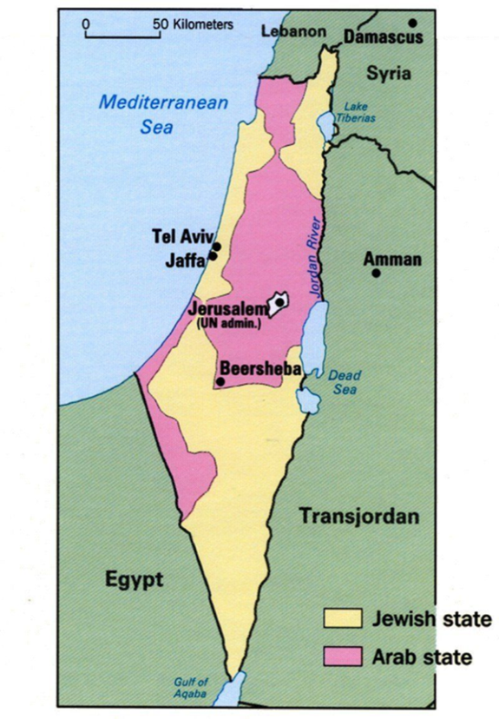

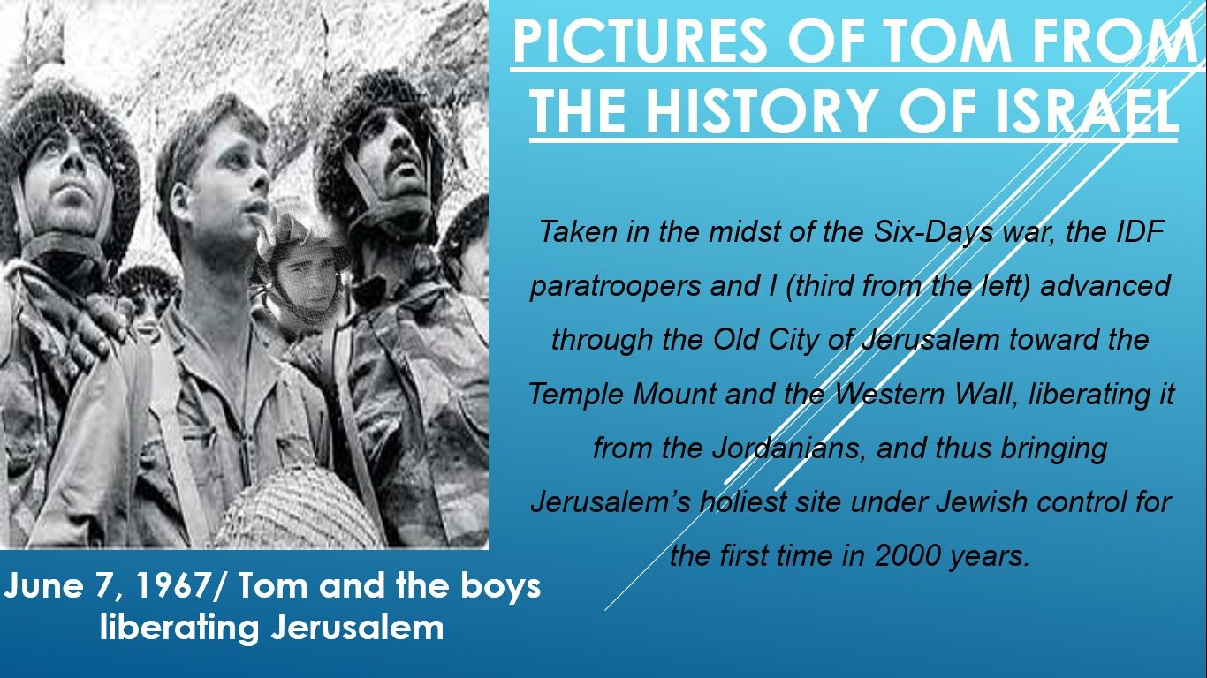
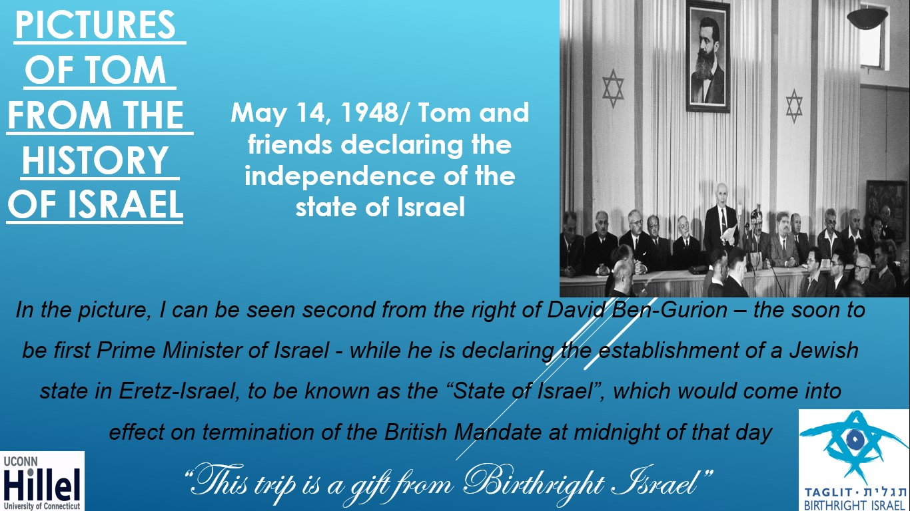
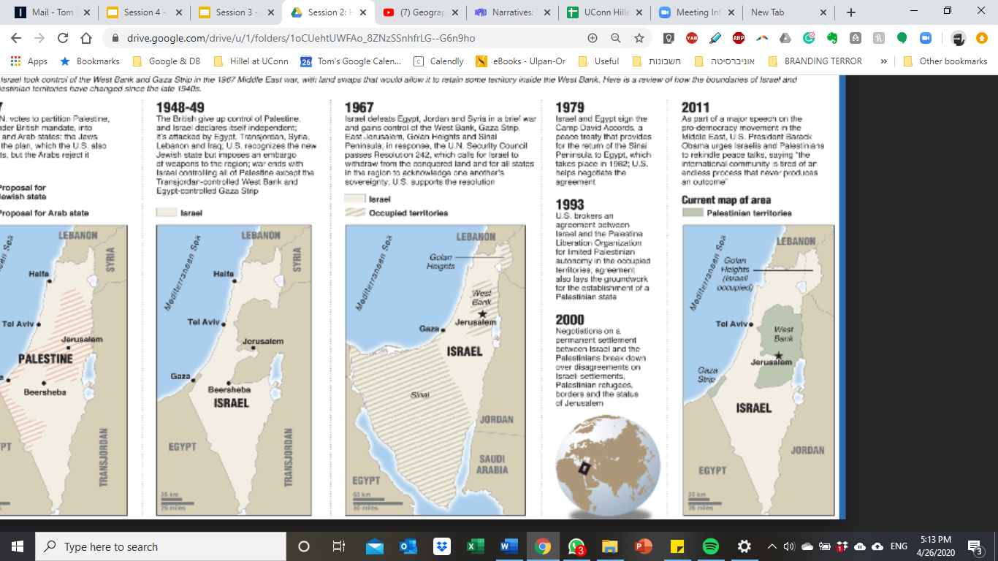
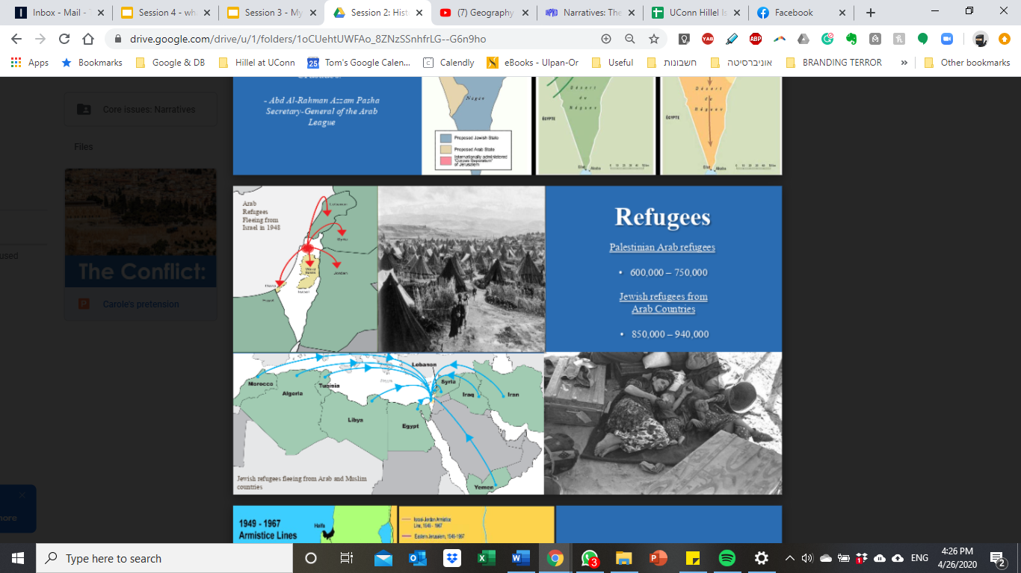
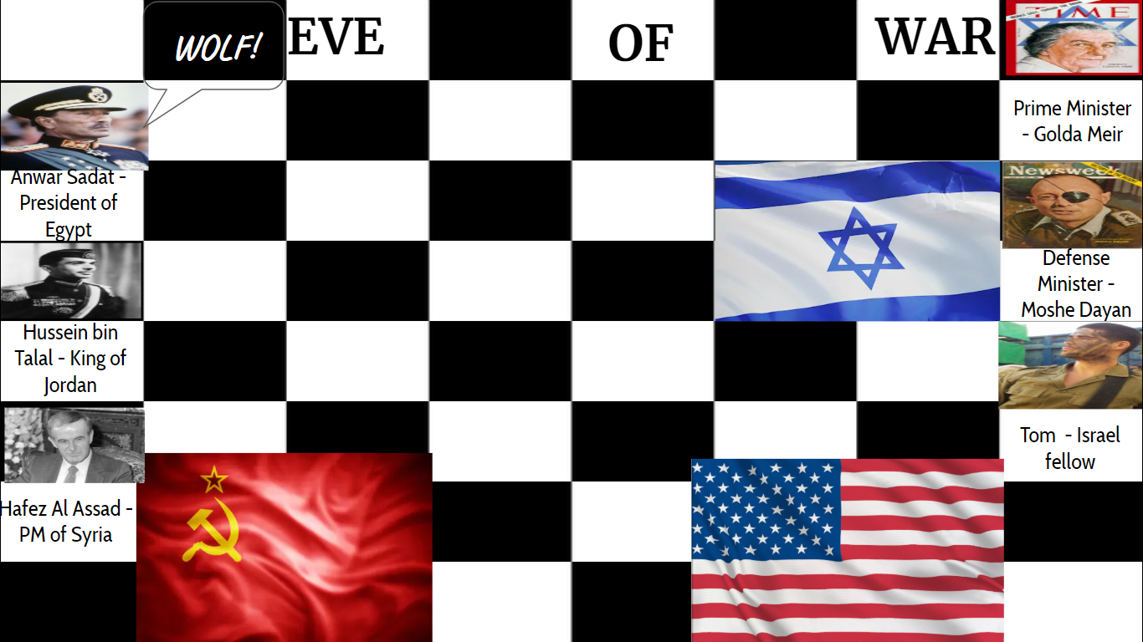
What do we know so far?
UN’s Resolution 181/ November 1947
May 15th, 1948/ Israel’s war of Independence/ The Nakba
June 7th, 1967/Liberation of Jerusalem during the 6-day-war
May 14th, 1948/ Israel’s Declaration of Independence
Khartoum resolution= NO X3 / September 1967
October 1973/ Yom Kippur War
Next Chapter...
Notes:
Ok, so before we jump into it, here’s a recap of the important takeaways from previous sessions that we discussed, within the context of the Israeli-Palestinian conflict.
So first of all, remember when we were talking in the first session about everything going down in Europe: Like Herzl's vision of a Jewish sovereignty, and the Dreyfus trial in France? So all the while that was happening, there were people living in Israel - than Palestine - some Jews, but most of the population were Arab-Muslims, affiliated with the Muslim Empire that was controlling the region. As a matter of fact, 4 waves of Aliyot - Jewish immigration to Palestine - wouldn’t change those numbers, and even in the light of mass Jewish immigration post WW2, Jews still comprised about 30% of all population in the region.
However, the UN’s “resolution 181” in 1947, to divide Palestine into a Jewish and an Arab state, followed by the Jews declaration of the state of Israel in May 14 in 1948, were supposed to reshuffle the deck, making a 100% Jewish population in Israel in a 100% Arab population in the would be Arab state, right? Wrong!
Because one day later, Israel’s surrounding arab nations would invade Israel to begin what would be known as “Israel’s war of Independence”, or “Nakba” - The Catastrophe”- to the defeated Arab side. In the midst of that war, around 700,000 Arab Palestinian fled from the region, trying to escape the immanent war. Most of them followed the advice of the Arab leadership outside of Israel, but around 15% of them, those who didn’t surrender, were forced out by the Israeli military. At the very same time, more than 850,000 Jews were expelled from Arab countries, although they would be absorbed and immersed in Israel.
19 years later, during the 6-Day-War, Israel would achieve it greatest victory to date, securing super important strategic locations such as the Sinai peninsula from Egypt, the Golan Heights from Syria, the west Bank and the holy city of Jerusalem from Jordan.
Immediately after the war, Israel reached out the Arab leadership in hope of securing a deal in which lands will be exchanged for genuine peace, but what they got instead were “The Khartoum resolution” of September 67: “No peace with Israel; No recognition of Israel; No negotiations with it”.
6 Years later, a false sense of Israeli security would almost cause the then 25 year old Israel to lose 1973’s Yom Kippur war, as sophisticated Egyptian army maneuvering in Israel’s southern border, alongside untrue - at the time - peace talks that even involved the US government, left Israel with a deep feeling of mistrust and suspicion regarding its neighboring Arab nations.
And this, is where we pick up our story…

Slide 4
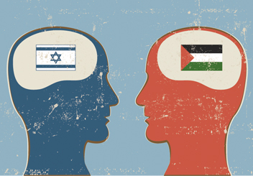
Issue #1 - SECURITY
Motives of Palestinian violence against Israelis:
  Land
  Religious jihad (Hamas and Palestinian Islamic Jihad)
Security Barrier
1993–2003: 303 Palestinian suicide bombers attacked Israel
Since 2003, Terrorist acts have declined by approximately 90%
Reduces ease of travel & increased checkpoints
“Apartheid Wall” - How the security barrier has added to the public opinion of the Arab-Israeli conflict
Security Forces
Gaza Border
  Hamas has fired 17,000 rockets and mortars at Israeli civilians since 2005
  Blockade requires Israeli inspection of shipments to ensure that terrorist groups are not importing weaponry
Israeli military
  Warns Palestinian civilians during military operations of impending attacks, abort operations if civilians are in target zones, and ensures the delivery of humanitarian goods
Israel’s terrorist enemies
  Use Palestinians as human shields, fight from civilian centers, and target Israeli civilians
Notes:
- Eliza’s slide: Security
The literal meaning of Jihad is struggle or effort, and it means much more than holy war. Muslims use the word Jihad to describe three different kinds of struggle: A believer's internal struggle to live out the Muslim faith as well as possible. The struggle to build a good Muslim society.

Slide 6
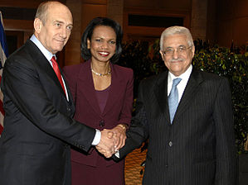
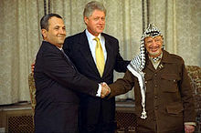
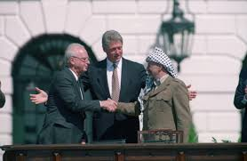
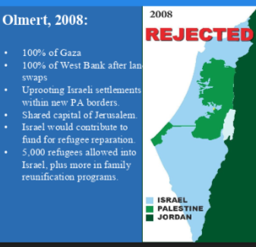

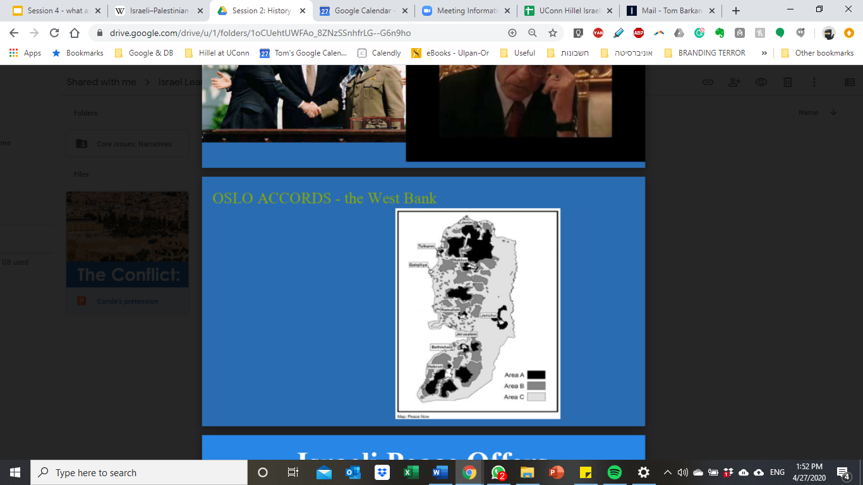
Issue #2 - PEACE NEGOTIATIONS VS LAND
December, 2008/ Annapolis Conference
July 2000/ Camp David summit
November, 1947/Resolution 181
September, 1993/ The Oslo Accords
Notes:
- Tom slide Peace Negotiations vs Land
So before we start talking about peace attempts, we need first to acknowledge the fact that the first attempt to establish two states was 73 years ago, following the UN’s resolution 181 1947…After the Arab nations basically said “we are not talking to you ever” at the Khartoum Resolution in 67, it would take 9 more years until Israel would make its first peace treaty with one of its Arab neighbors - Egypt in 1978.
Oslo accords, 1993: But when we are talking about peace attempts with the Palestinians, the first attempt happened only 27 years ago, in 1993 at Oslo, Norway. Which is amazing to think about given the fact that this dispute goes all way back to 1948. But actually, the meeting between then Israeli PM, Yitzhak Rabin, and Palestine Liberation Organization (PLO) president Yasser Arafat in September 1993, was the first face-to-face agreement between the Israeli government a Palestinian representative. In essence, the Oslo accords were an attempt to set up a framework that would lead to the resolution of the ongoing conflict, starting with the withdrawal of all Israeli forces from the Gaza Strip and West Bank. Those were to be replaced by a Palestinian Interim Self-Government Authority, which will become permanent after 5 years of trial period.
In those 5 years, all issues such as Jerusalem, Palestinian refugees, security vs borders etc. where to be resolved, and a permanent Palestinian authority, or a “Palestinian state” could be declared and recognized by the Israeli side. In return, the Palestinian side promised to recognize the right of the Israeli state to exit, and to stop all acts of terrorism and violence on their part. Unfortunately, only 2 years later, the Israeli PM would be assassinated by an ultra religious Jew. The assassination would ultimately bring the peace process to a halt. Soon after, The Jewish settlements' in the West Bank almost doubled, while Palestinian suicide bombing attacks and counter actions made by the IDF concluded the dying peace negotiations, which will resume only 7 years later.
Camp David , 2000: In 2000, US President Bill Clinton convened a peace summit between the Palestinian President who negotiated the Oslo accords, Yasser Arafat, and Israeli PM Ehud Barak. It is believed that Israeli side had offered 97% of the west bank and the entire Gaza strip to the palestinians after land swaps were to be made; Jerusalem would be a the shared capital of both Israel and the Palestinian state; and Finally, the issue of the Palestinian right of return would be solved through a significant monetary reparation, as Israel would accept 100,000 Palestinian refugees and will contribute to an international 30$ billion fund, that would help in the compensation of property lost by Palestinian refugees. Arafat rejected the Israeli offer as it did not fit the Palestinian terms, but sadly without making a counter counter-offer on the Palestinian behalf. Later on, Clinton would blame Arafat for the failure of the peace Summit.
Annapolis, 2008: 8 years later, we would see the last serious attempt for peace, at the Annapolis Conference in 2008. The conference aimed to revive the Israeli–Palestinian peace process by implementing a "Roadmap for peace" - a plan that would lay out the groundwork for a permanent peace understandings between an Israeli and a Palestinian state. Within those Agreements, Israel’s PM, Ohad Olmert, was willing to improve the former offer made to the Palestinian in 2000, by giving them 100% of both Gaza and the West Bank; with the additional offerings made by the Israeli government at 2000. This time, although the conference did end in mutual agreement to further the effort of establishing two states living peacefully side by side, it met with heavy push back from both the Israeli and the Palestinian public in the West Bank and Gaza. Shortly after, both sides withdraw from the resolution that was laid out to them by the UN.
Poll question 1 and 2

Slide 7
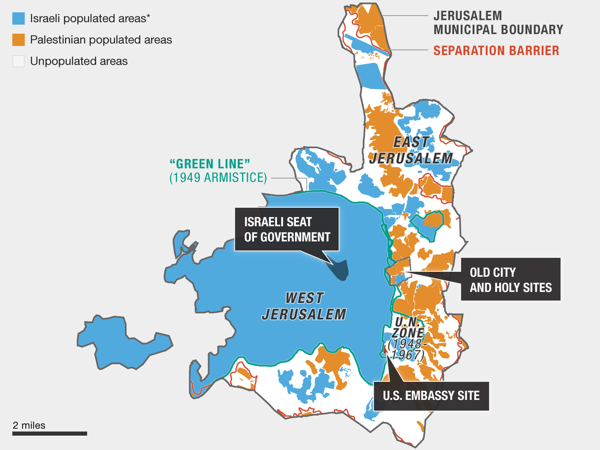
Issue #3 - JERUSALEM
“The heart of the
Arab-Israeli conflict”
Biblical significance:
Judaism - Former location of the Jewish temples on the Temple Mount and the capital of the ancient Israelite kingdom
Islam - The site of Mohammad's Night Journey to heaven, and the al-Aqsa mosque.
Christianity - The site of Jesus' crucifixion and the Church of the Holy Sepulchre
Social significance:
Total population: 789,000
  Jewish: 504,000
  Arab: 285,000
Israel considers Arabs living in East Jerusalem 'permanent residents' of Israel
Modern Day:
Trump moving the Embassy from Tel Aviv to Jerusalem
Notes:
- Eliza’s slide: Jerusalem
SEP UL KUR
Jerusalem is the "heart and soul" of the Jewish people's spiritual identity and national yearnings. On every occasion that the Jews have been an independent people in the Land of Israel, Jerusalem has been their capital. Jerusalem served as the Jewish people's historic capital since King David made it so in 1004 B.C.E. Jerusalem remained the capital until its destruction at the hands of the Romans in 70 CE and the subsequent loss of Jewish independence.
Jewish independence was renewed in 1948, with the establishment of the State of Israel. Shortly thereafter, the Knesset (Israel's parliament) determined that Jerusalem would be the capital of the State of Israel. Following this decision, government institutions were located in Jerusalem, including the President's Residence, the Government ministries, the Knesset and the Supreme Court. In 1980, the Knesset legislated the "Basic Law: Jerusalem, Capital of Israel", which enshrined its decision in law.
Most states have not respected Israel's sovereign right to determine its own capital city, and have refused to recognize Jerusalem as the capital of Israel. The reasons for this are essentially political, and are contrary to principles of international law. Israel should enjoy the same basic right as any other country in determining the choice of its capital.
Throughout the centuries, no other nation, other than the Jewish people, made Jerusalem its capital. While important to other faiths, Judaism is the only religion which places Jerusalem at the center of its belief.
Next year in Jerusalem - Passover
Israel considers Arabs living in East Jerusalem 'permanent residents' --This status gives residents the right to vote in local elections, but not in elections for Israel's legislature (the Knesset)
If residents meet certain conditions, including swearing allegiance to the State of Israel, demonstrating knowledge of Hebrew, and proving that they are not citizens of another country, they may apply for full Israeli citizenship.
For many people, those are questions with deep religious implications. To some ears, Trump’s decision to recognize the city as Israel’s capital offers support for one Israeli vision of Jerusalem as the “eternal and united” capital of Israel. That may sound like a peaceful, hopeful vision of the future. It could also sound like an outcome in which a future Palestinian state does not have jurisdiction over any part of Jerusalem, or in which Israel exercises much more control over the city and its Muslim holy sites — which, for many devout Muslims, is unacceptable.

Slide 8

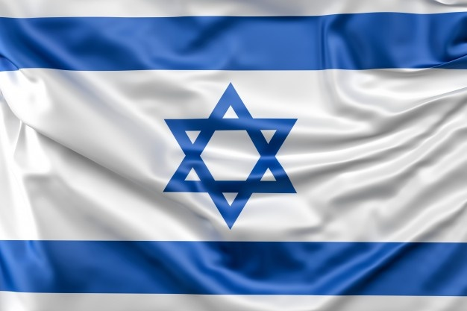
Issue #4 - REFUGEES
JEWISH OR DEMOCRATIC???
May 15th, 1948/ Israel’s war of Independence/ The Nakba
9,000,000 Palestinians
9,000,000 Israeli citizens
4,000,000 Palestinians in Gaza and the West Bank
+
(Today) UNRWA: 5,000,000 Palestinians Refugees
(Today) Israel: 520,000 Palestinians Refugees
Notes:
- Tom’s slide: Refugees
Last piller we are going to discuss - The refugee issue - begins right after 1948’s Independence war, or the Nakba - ends. Arab countries would later claim that after the war, around 900,000 Arab residents became refugees. Israel would claim that the official number is actually 520,000. Again, there were a lot of refugees on both sides, but the while Israel would be quick to absorb the Jewish refugees from Arab countries, the Arab refugees would not enjoy the same treatment from their neighboring countries .
Because of the humanitarian issue that was formed after the war on the Arab side things, the UN established The “United Nations Relief and Works Agency” AKA UNRWA, on December 1949, with the goal of support, relief and human development of Palestinian refugees. Back in 1949, UNRWA would set the total number of refugees at 726,000.
Now, would Israel have a serious problem absorbing 726,00 more citizens into Israel? Probaly not. However, according to the UN refugee agency, “A refugee is someone who has been forced to flee his or her country because of persecution, war or violence. A refugee has a well-founded fear of persecution for reasons of race, religion, nationality, political opinion or membership in a particular social group”. In other words individuals who currently don’t have anywhere else to go to. UNWRA definition however is different, stating that "persons whose regular place of residence was Palestine during the period 1 June 1946 to 15 May 1948, and who lost both home and means of livelihood as a result of the 1948 conflict.” Still, no problem here, but the organization’s continues to define Palestinian refugees as “The descendants of Palestine refugee males, including adopted children, are also eligible for registration as refugees”. And that is where we see the big difference in presented numbers of the two sides today.
Why the difference in definitions? Well, according to BADIL, the Resource Center for Palestinian Residency and Refugee Rights, the international community continues to classify children and grandchildren of Palestinian refugees as refugees because they are entitled to international assistance and protection, same as the refugees who originally fled Palestine. This situation would remain until the old and new generations of Palestinian refugees will be offered a choice of durable solution such as monetary repatriation, integration in their current host country or resettlement in third party states. But the main point, according to the the BADIL organization, is that regardless of the current status of old or new Palestinian refugees, they should be given the opportunity to decide where they want to live, since they were denied of that privilege for the last 72 years. Moreover, this definition does not apply only to Palestinian refugees, but also Bosnian, Guatemalan refugees and internally Displaced Persons or “IDPs worldwide.
But what if Israel would allow all 5,000,000 Palestinian refugees, as defined by ANWRA. to go back to Israel? Well, given that Israel consites today of 9,000,000 Israeli citizens, if you add the Palestinians who are living outside of Israel to the 4 million palestinian already living in Gaza and the West bank, Israel would longer have a Jewish majority. Hence, Israel would have to face the decision of whether it wants be a Jewish state or a democratic state - but it can’t be both.

Slide 9
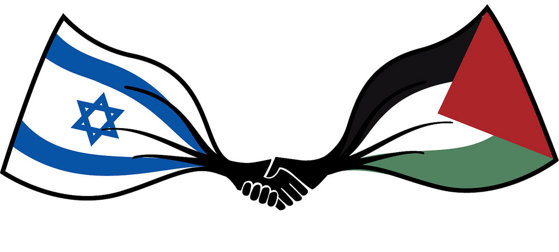
The Great Debate
Topic: Palestinian Refugees and the right of return
should Palestinian refugees and their descendants be provided or denied of a right to come back to Israel?
Eliza - Team Blue
Tom- Team Green
Notes:
This the part where we will divide into to two debate groups, on the topic of the Palestinian refugees and the right of return to Israel. Eliza will be the coach for the pro-Israeli Team blue, and I’ll take the Pro Palestinian, Team Green. By the end of it of the breakout period, you will have to come out with 2-3 main arguments on the topic of should Palestinian refugees and their descendants be provided or denied of a right to come back to Israel?
Eliza?:Each team will choose one representative for the debate which will play as follows: Starting team will have 2 minutes to lay their arguments/ then the Second team will have one minute to respond/ and then will switch roles. I will repeat the instructions again before we start. The last thing I’ll say before we will assign you into to breakout rooms iis that no matter how you feel about advocating for any of the sides, the best way to truly understand Palestinian-Israeli conflict is to listen to the argument rising from the two narratives.
State rules of debate before breakout:
Team green stars: 2 minute argument by leader
Team blue has 1 minute to respond, followed by a 2 minute argument
Team Green has 1 minute to answer

Slide 10
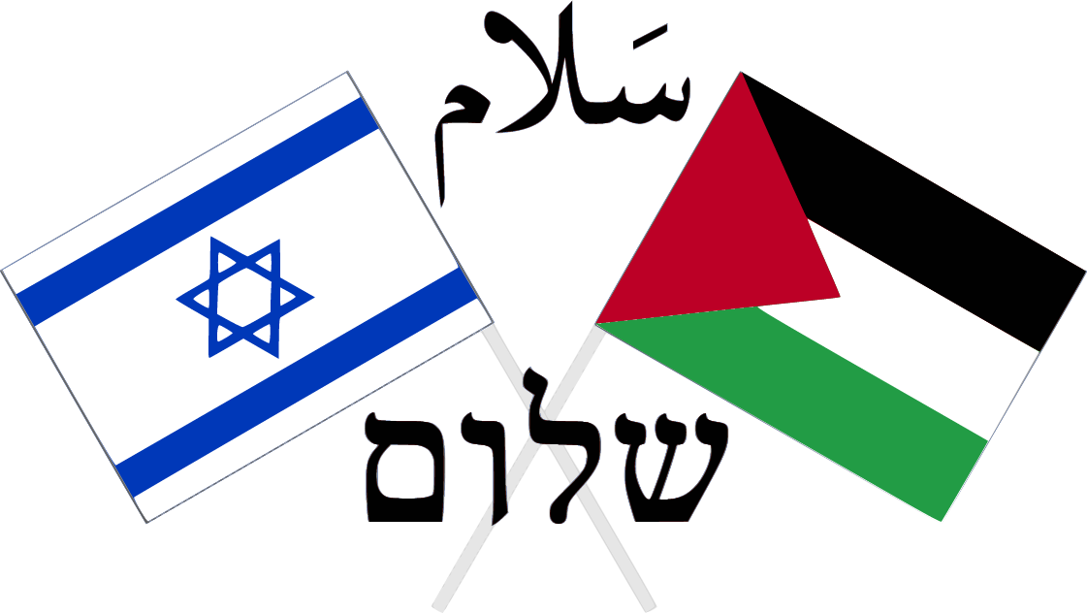
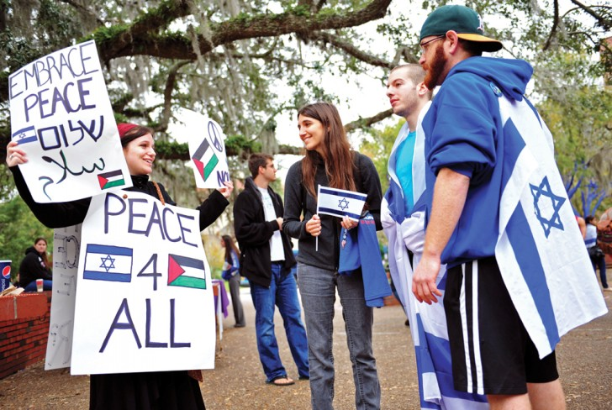
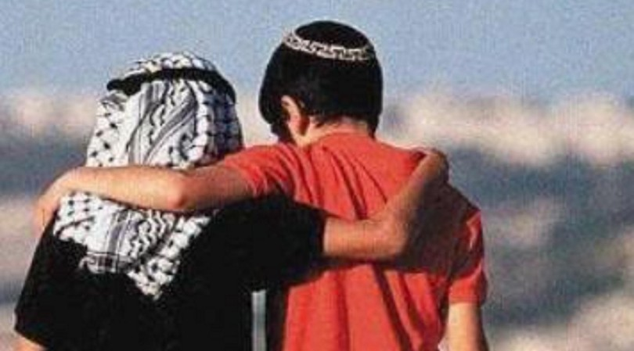
Where do we go from here?
Notes:
Tom closing notes: The main point of this session was to show the complexity of the situation, and to show that both side are right or wrong, depending on the point of view. So is there hope? Of course there is! it is by good intentions and communication form both sides we can see things take motion. A new generation is raising that is sick of the war, and it is through students like you, how deare to learn, form their own opinion and voice it to others, that we will see the end of this. Change could come for the oddest places, just like this fellowship. So in my eyes, you taking the time to learn, is more than just a fellowship in which you sit and get a stipend in the end - it is a step in right direction. One by one we are making a change. Thank you very much.
(Invite everyone to the service at 8 pm)
https://zoom.us/j/94261986960?pwd=L05FcG1aU3VMVUx6dmFLZTBhL3pJZz09
Eliza: SWU Answering Tough Questions bookle: https://121a6a94-37d0-4344-8957-8394c526443e.filesusr.com/ugd/46fc49_ebd89b346633456a9a858036a839f289.pdf

Slide 11



(The Israel fellow) SAGI GABAY IS COMING! (5/5; 5/7)
CAROLE IS COMING! (5/4)

