Slide 1
True or False?

Slide 2
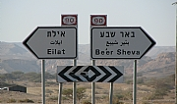
True or false?
Hebrew is the only official language in Israel
Notes:
False- Hebrew and Arabic are the official languages in Israel.
English is semi official.

Slide 3
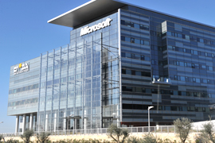
True or false?
Microsoft built their only foreign-based research and development facilities in Israel
Notes:
true

Slide 4
True or false?
An Israeli company is the world's largest generic pharmaceutical company
Notes:
True- Teva

Slide 5
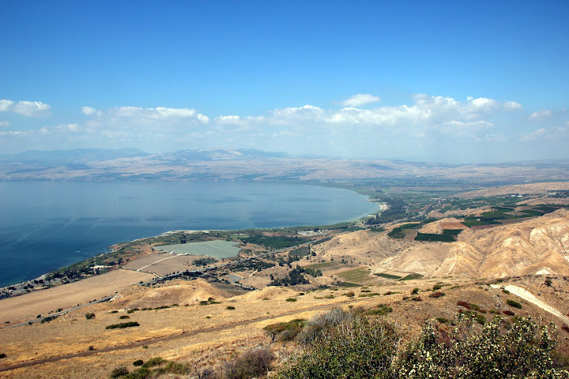
True or false?
In Israel there are 3 freshwater lakes
Notes:
False- just 1, The Kinneret

Slide 6
True or false?
Israel has the highest number of university degrees per capita in the world
Notes:
true

Slide 7
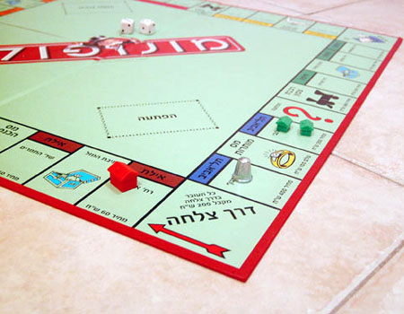
True or false?
The game monopoly was invented in Israel
Notes:
False. It was invented in the States.
But matkot (kadima) was.

Slide 8
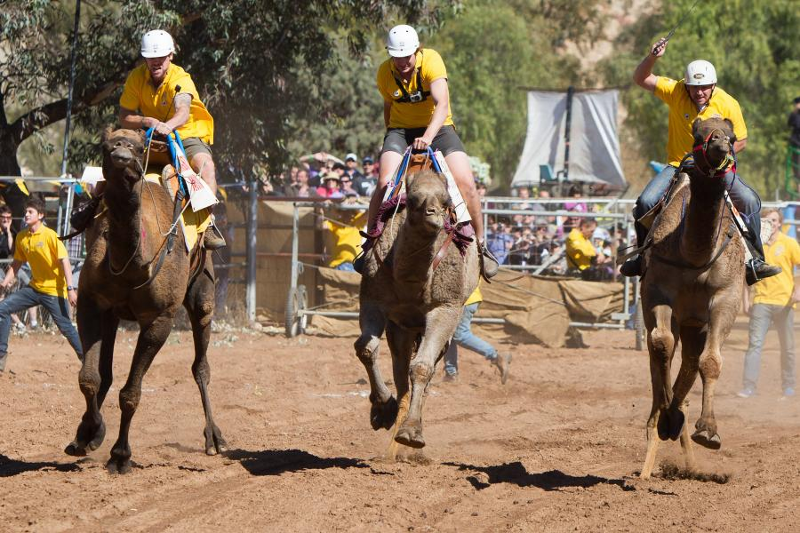
True or false?
In the Negev, it is customary to watch camel races
Notes:
False. It happens tho in akistan, Saudi Arabia, Egypt, Bahrain, Jordan, Qatar, United Arab Emirates, Oman, Australia, and Mongolia

Slide 9
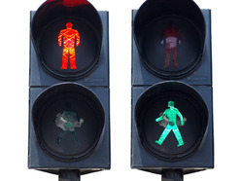
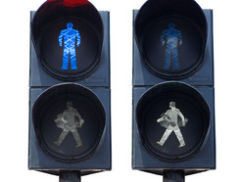
True or false?
Just like the Israeli flag, the lights of the pedestrian crossing are white and blue
Notes:
false

Slide 10
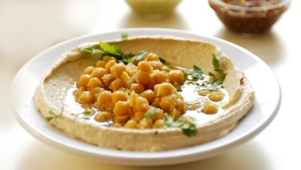
True or false?
The average Israeli consumes 17.5 pounds of hummus a year
Notes:
True (8 kilos) according to:
http://www.haaretz.co.il/news/health/1.1008978

Slide 11
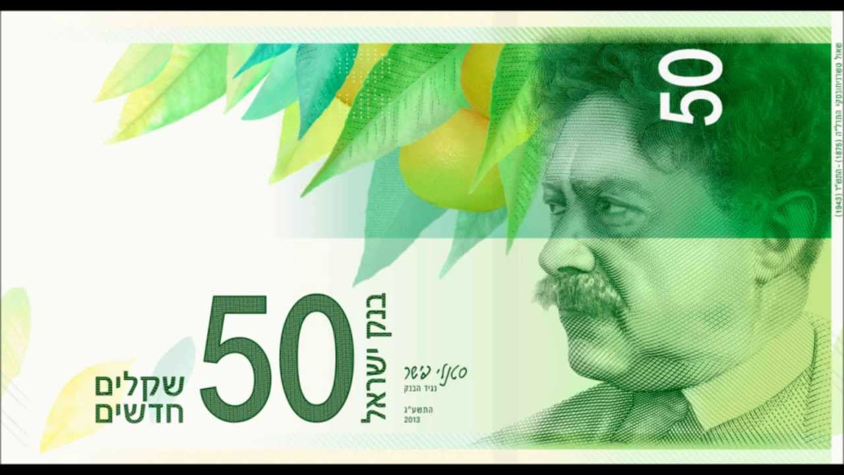
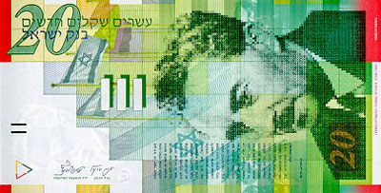
True or false?
The currency in Israel is dollar
Notes:
False- shekel (we do have green bills)

Slide 12
True or false?
Although television was commercially available in the 1920’s, it wasn’t until late 1960’s in Israel
Notes:
True. FirstTV broadcast in Israel- 1968

Slide 13
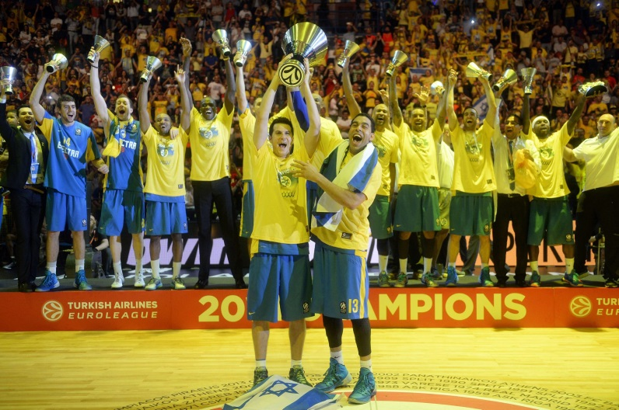
True or false?
An Israeli basketball team won last year’s European league
Notes:
True- Maccabi Tel Aviv

Slide 14
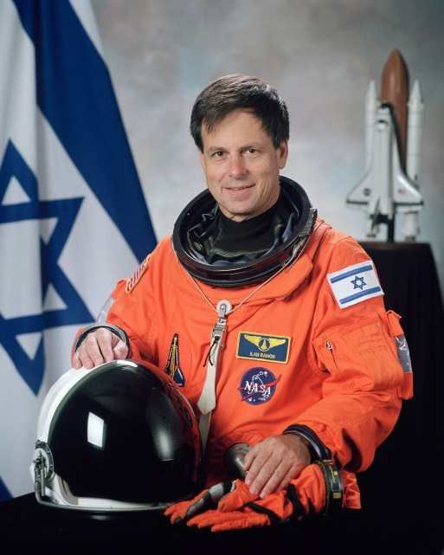
True or false?
There were 3 Israeli astronauts throughout history
Notes:
False- there was only one- Ilan Ramon

Slide 15
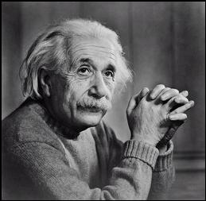
True or false?
Albert Einstein was offered to be Israel's president but he did not accept.
Notes:
true

Slide 16
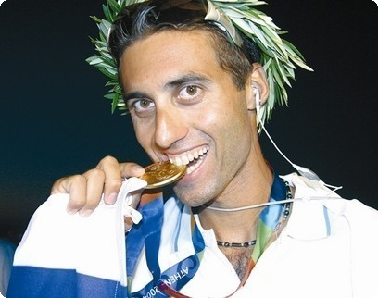
True or false?
No Israeli athletes have won Olympic gold medals
Notes:
False- but there’s only 1! (Gal friedman, wind surfing)

Slide 17
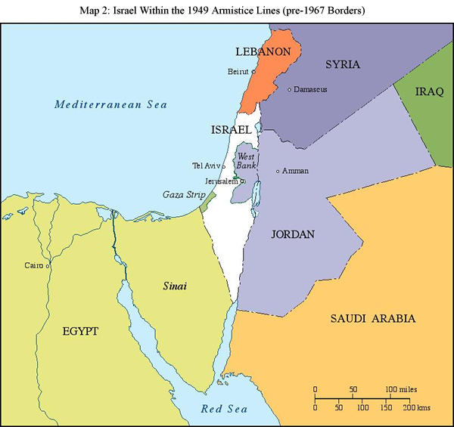
True or false?
Israel has peace agreement with Lebanon
Notes:
False- Israel only have peace with Jordan and Egypt.

Slide 18
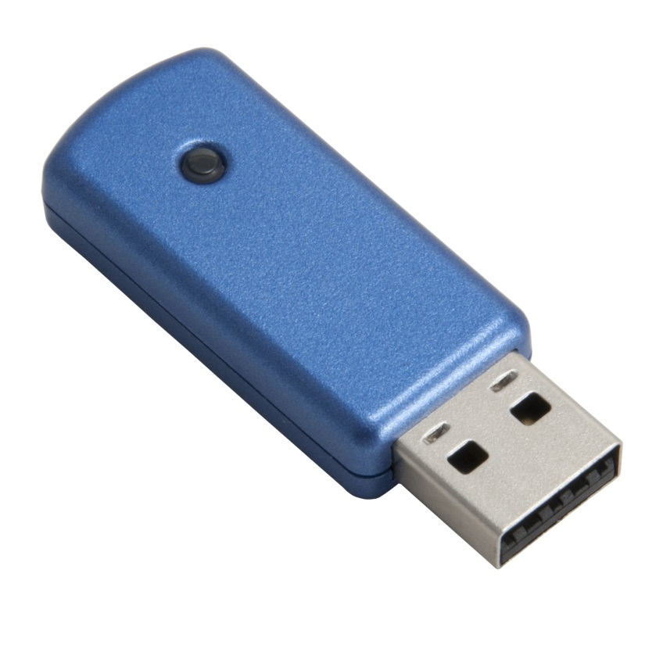
True or false?
The USB is an Israeli invention
Notes:
true

Slide 19
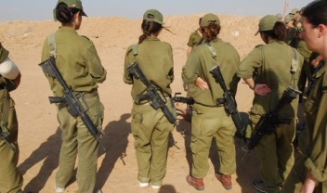
True or false?
In the IDF, women are not allowed to fight in direct combat
Notes:
false

Slide 20
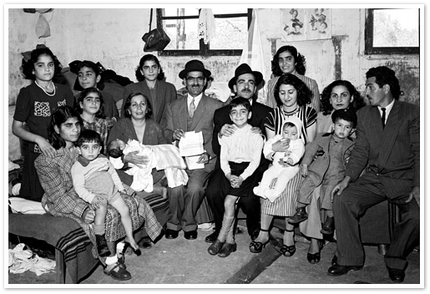
True or false?
There are Jews from Damascus, Syria
Notes:
True, most of them immigrated to Israel in the 1940s

Slide 21
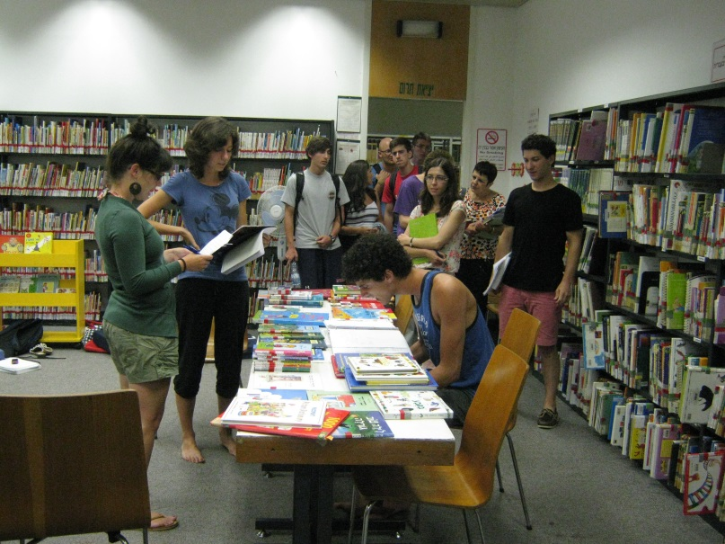
True or false?
Israel has the world's second highest supply of new books per capita
Notes:
true

