Slide 1
הוראות למדריך
כיצד להכין את הפעילות
הפעילות יכולה להתאים לקבוצה גדולה בחלוקה לקבוצות (כתחרות) או לקבוצה קטנה כפעילות ארוכה.
כל שצריך זה להדפיס את התמונות ולהדביק מאחור את הרמז
לאחר מכן יש לגזור לפאזל
במידה ועושים תחרות לכל קבוצה יש זמן מוגבל להרכיב את הפאזל לפתור את החידה ומקמם את העיר במקום נכון.
במידה ויש קבוצה אחת אפשר לתת את כל הפאזלים ביחד והם צריכים להרכיב את כולם ולמקם אותםעל המפה הריקה.
מטרת הפעילות היא השחניכים יחשפו למקומות שונים בארץ
על החניכים לזהות 10 מקומות בארץ ע"י הרכבת פאזלים שמאחוריהם יש רמז למיקום העיר שמופיעה על הפאזל.
השקופית השלישית היא מפתח.

Slide 2
Locations
ו.
ז.
ח.
ט.
י.
א.
ב.
ג.
ד.
ה.

Slide 3
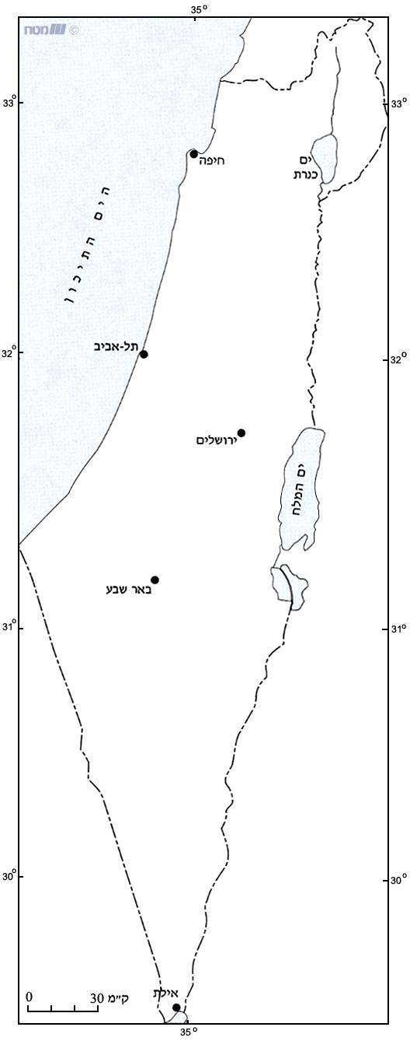
Maps numbers
Locations
א
ט
Kiryat Shmona
Tiberias
Beit Shean
Haifa
Tel Aviv
Jerusalem
Eilat
Beer Sheva
Nahariya
Ein Gedi
א
ב
ג
ד
ה
ו
ז
ח
ט
י
ד
ב
ג
ה
ו
י
ח
ז

Slide 4
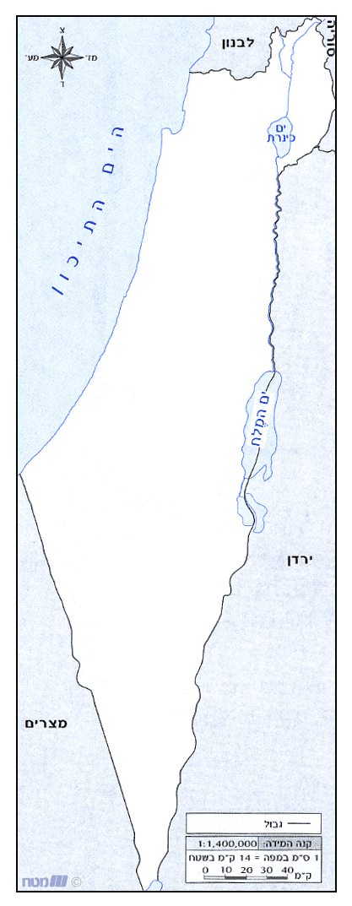
ה
ז
ח
ד
ו
ט
י
ג
ב
א

Slide 5
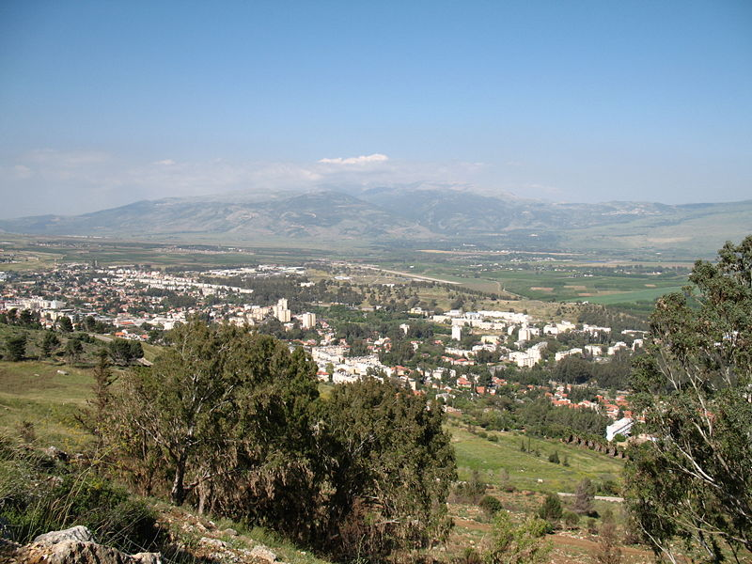

Slide 6
The city located in the North District of Israel on the western slopes of the Hula Valley on the Lebanese border. The city was named after eight people.
1

Slide 7
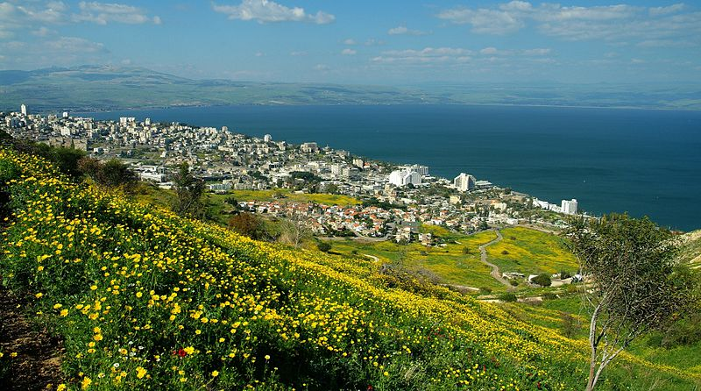

Slide 8
The city located on the western shore of the Sea of Galilee (also called the Kinneret). Its Established in 20 CE, and was named in honor of the emperor Tiberius.
2

Slide 9
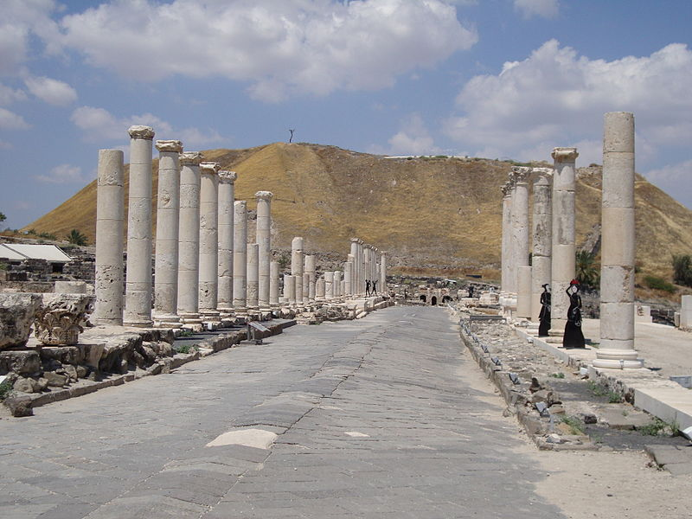

Slide 10
The city located in the North District of Israel which has played an important role historically due to its geographical location at the junction of the Jordan River Valley and Jezreel Valley. It has also played an important role in modern times, acting as the regional center for the numerous villages in the Beit She'an Valley Regional Council.
3

Slide 11
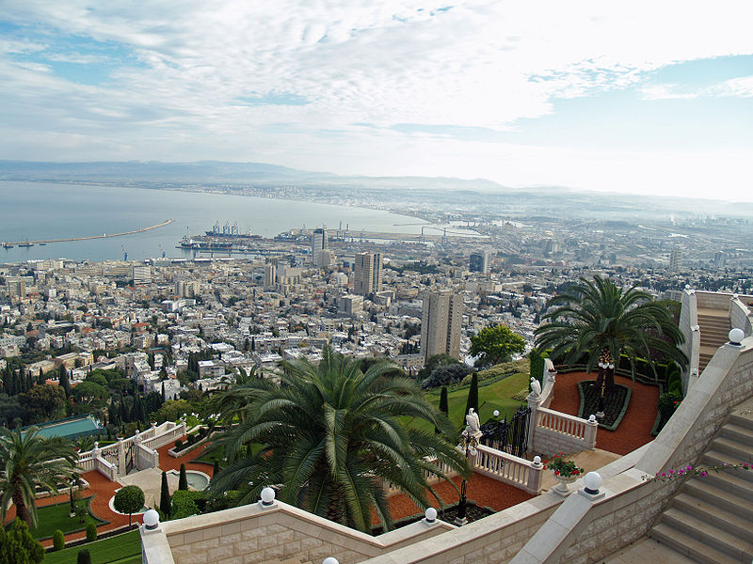

Slide 12
is the largest city in northern Israel, and the third-largest city in the country. its Built on the slopes of Mount Carmel, the history of the settlement at the site spans more than 3,000 years.
4

Slide 13
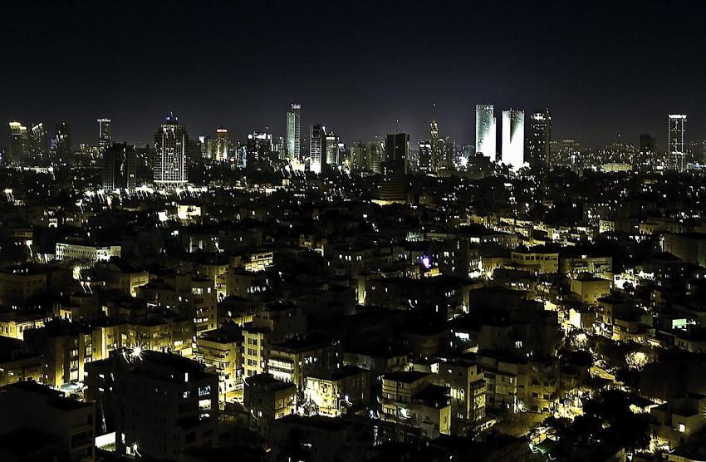

Slide 14
The city is located on the Israeli Mediterranean coastline in central-west Israel, its the second most populous city in Israel
Known as
"The City That Never Sleeps“
5

Slide 15
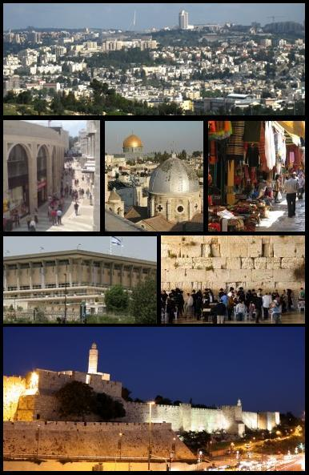

Slide 16
It is the capital of Israel,
one of the oldest cities in the world. It is located in the Judean Mountains, between the Mediterranean Sea and the northern edge of the Dead Sea.
its also a holy city to the three major religions—
Judaism, Christianity and Islam.
6

Slide 17
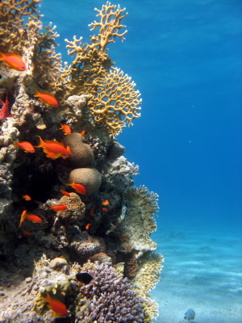
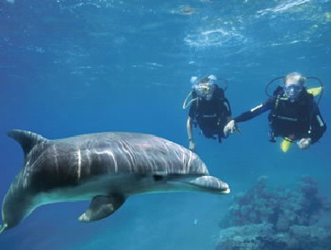
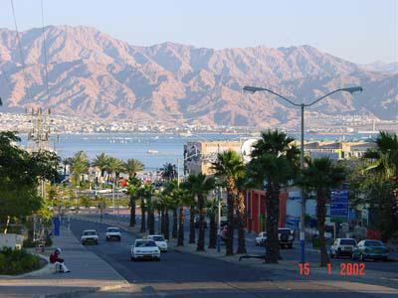

Slide 18
Its Israel's southernmost city, a busy port as well as a popular resort, located at the northern tip of the Red Sea. The city's beaches, nightlife and desert landscapes make it a popular destination for domestic and international tourism.
7

Slide 19
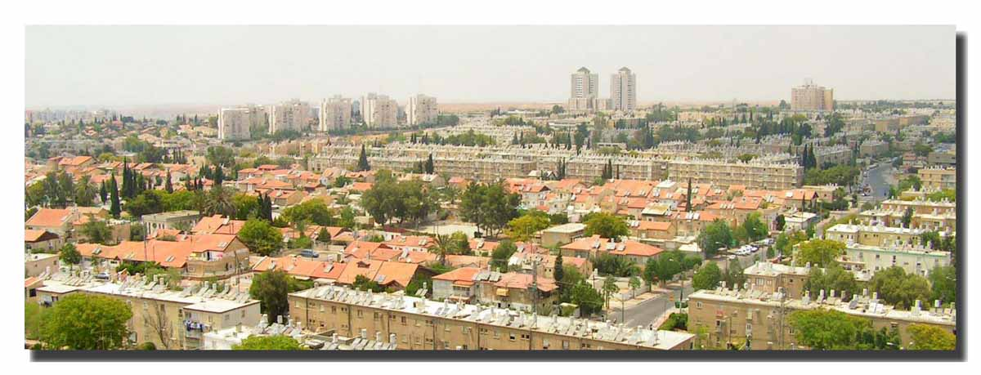

Slide 20
Its the largest city in the Negev desert of southern Israel. Often referred to as the "Capital of the Negev“. The town was founded by the Israelites during the 10th century BC, on the site of what is today referred to as Tel Be'er Sheva, after the land was conquered by King David. The ruins of the original Israelite settlement remain largely intact.
8

Slide 21
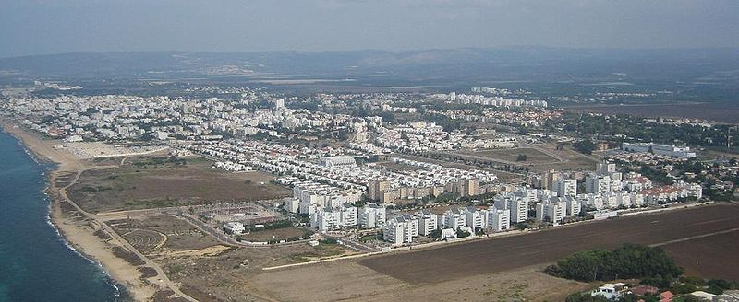

Slide 22
Its the northernmost coastal city in Israel.
takes its name from the river - nahar in Hebrew
9

Slide 23
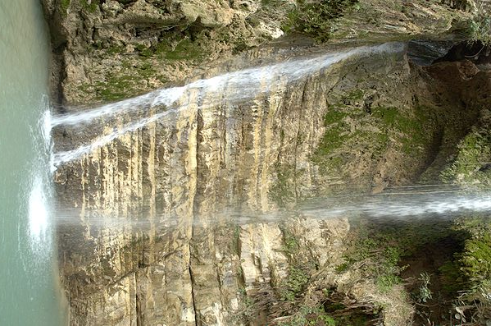

Slide 24
Its an oasis in Israel, located west of the Dead Sea, near Masada and the caves of Qumran.
The name composed from two Hebrew words: and means spring and a goat-kid
10

