Slide 1
Technology
“Israeli style”
May 2014
Israeli Shaliach/Emissary

Slide 2
Who are you ?
26 years old
Born and raised in Tel Aviv (rare thing)
Dad – Libyan (Good food)
Mom – Polish (Bad food)
Spent more time in Boy Scouts than in high school
Spent 6.5 years in the IDF (2006-2013)
What are you doing here ?

Slide 3
What are you doing here ?
The Shlichim Program

Slide 4
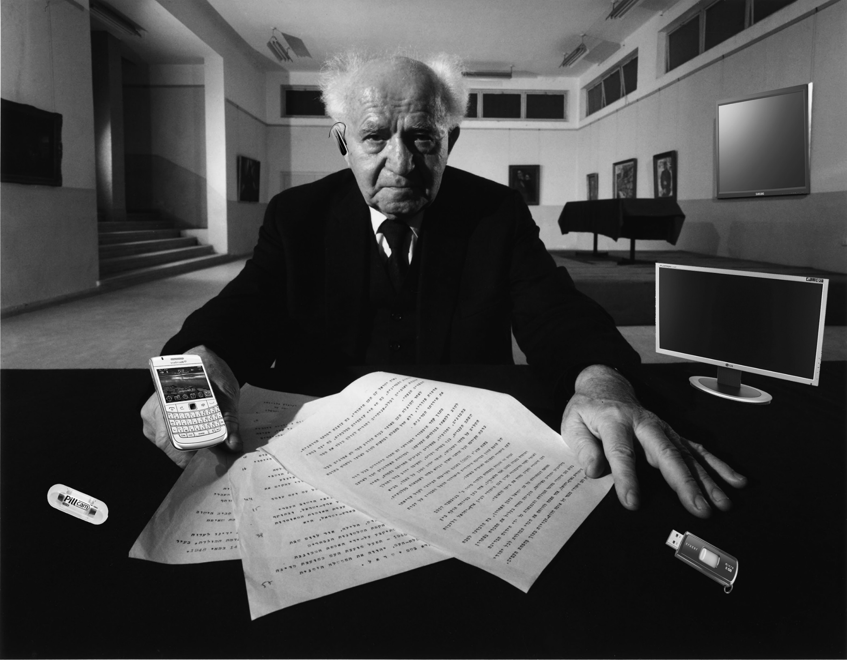

Slide 5
Technology
Israeli style
Size doesn’t matter

Slide 6
It’s in the education
Population of 8.1 million people
46% holds at least a bachelor degree (around 3.7 million)
Number 37 in the world education level of the U.N. (U.S is number 21, New Zealand, Finland and Denmark are at the top).
College tuition – from $3,200 to $10,200 per year (3 years).
New colleges open every year

Slide 7
Technology
Israeli style
Why should we invest ?

Slide 8
Who is buying (2005-2012)

Slide 12
Israel’s Main Trading Partners 2010 (US$ Billions, excluding diamonds)
Source: Central Bureau of Statistics

Slide 13
Technology
Israeli style
Israel inside…

Slide 14
The Israeli agricultural miracle
Overcome immense problems
Grow More With Less! We use Less Land.
80% of the water used is recycled water. Using waste water treatment for agricultural purposes.
Deploy intensive technologies
Focus on super intensive agriculture!

Slide 15
The Israeli agricultural miracle
Overcome huge problems such as limited water, limited land and often inhospitable and challenging climates
Grow More With Less! The Agricultural Paradox in the past 60 years
We use 60% Less water (80% recycled).
Israel is the first to use waste water treatment for agricultural purposes.
We use Less Land.
Deploy intensive technologies: Seed, irrigation, cover, fully integrated systems—Hot houses become “agricultural factories”
Focus on super intensive agriculture!

Slide 16
Why Israel ? It’s the Culture…
Israel is like a `Silicon Valley` - 2hrs drive to any deal
Informality is a way of life
Risk taking is everywhere
Failure tolerant
Pioneering ethos
International networks and experience
We go “global” from day one
Watch: Israeli invention

Slide 17
Why Israel ? It’s the Culture…
Everyone questions authority – “Lama Mee Ata”
Flat social organization (the coffee mug)
Strong academic environment - entrepreneurial universities
There are no “unknown millionaires” - a real community
Building startups has become the national sport; entrepreneurs-the new cultural heroes – It’s the conversation at the bar.
Watch: We won’t take `NO` for an answer

Slide 18
Serving in the Israel Defense Force
Best and the brightest – are picked up by tech units
Units are outfitted with the latest “toys”
Learn how to build products fast and cheap
Value placed on development and applied research
Team effort, taking risks and learn how to lead in a young age
Cutting edge technologies in communications, security, electro-optics, video, distributed networking, etc.
Meet friends and partners for life
When they come out-they are “ready for the world”
They are required to think outside the box
Not only the Tech units
What it means to start college late
The effect of not having a lot of money (100-200$ a month)

Slide 19
Your career start later
0-18
School
18-21
Military
21-23
Self Journey
23-26
College
Does it represent all Israelis?

Slide 20
Dare and dream !
Watch: The dream of one Israeli boy

Slide 21
About my brother Giyora
At 10 - First computer (Parents decison)
At 12 - First programs written
At 18 - Was picked by the IDF to a programing unit at 18 (from High school)
At 21 – A clear idea for building up a business (because of the service)
At 23 – Owns a solid productive business idea + partner
At 25 – Bought by the biggest Israeli company in that field
At 36 – Runs a successful business with 5 workers and 1500+ users

Slide 22
It starts at school
Israeli school kids regularly compete in nationwide competitions
on creating companies and building innovative products
10m distance
Small weight sensor
Placed under car seat
Alarm device goes off
when Baby is left in car
Forget-me-not System Diagram

Slide 23
Storm Clouds

Slide 24
Storm Clouds
Education;
Population has doubled since 1973 while available faculty positions have declined: Technion flat, HU down 14%, TAU down 21% -happening while student degrees increased 355%
Israel places 37th out of 57 in OECD Pisa Science Education Tests
20 out of 26 among OECD countries investment in higher education
$100M university research budget, MIT gets $950M from US govt
Brain Drain:
40,000 Israelis in Silicon Valley, 500K+ in US
MA and PhD’s:10% or physicists, 30% of computer
scientists, 6.9% overall (1995-2002) leave
25,000 high tech workers left in the past 7 years
Inequality:
Going up:20% of families, 36% of children live below
the poverty line
Need to bring underrepresented groups into the tech work
force: Arabs and Haredim quickly and massively
The social protest movement while encouraging as to the size and
passion of the protestors and the need to get our “social mojo” back
has the potential to overturn our hard earned capitalist ethos and
bring back bloated government “entitlements” and socialist spending

Slide 25
Poverty and inequality still a huge problem
Percentage of families (433,000) living below poverty line in 2010: 19.8%, down from 20.5% in 2009
Major part of problem due to Arabs and Haredim:
55% of Haredi families live below poverty line
53.2% of Arab families live below poverty line
Dimensions of real problem could be masked by large amount of “black economy”-failure to report income and economic activity
Head of NII reported on March 9,2012 that official poverty figures distorted due to lack of accurate economic reporting in the Arab and Haredi communities and real figure of overall poverty more like 11% (OECD average) rather than reported 20%
At 20% Israel ranks– along with the US, Mexico and Chile – as the OECD country with the biggest gap between the richest and poorest, at 11% we are average(let’s hope for average).
Low rate of labor participation: low unemployment only tracks those seeking jobs—actually only 80.5% of Israelis aged 35-54 employed vs. OECD average of 85.8% (largest part of the problem with Arab women and Haredi men)
Poverty and economic performance tied strongly to educational achievement: average income of Israelis aged 40-44 with academic degree in 2008 earned on average NIS 14,235 a month, compared to just NIS 7,036 a month for those with 12 years of schooling.
Yet Israel has the second highest percentage of Academic degrees in the OECD: 45%

Slide 26
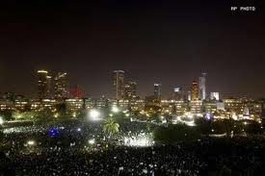
Can we bring “social justice” without harming entrepreneurial growth?
Need to make sure that the goal is social mobility—not handouts
Fighting monopolies is good-Fighting business is bad
Europe is not a model for Israel; Socialism is not the ideal
The only three OECD countries who became more equal last decade were: Greece, Spain, and France—and we do not want to go there….
How can we help others enter the party—without ending the party?
In a “flat world” we need to keep our competitive edge—capital and entrepreneurs are mobile
We need to harness the tremendous energies of the protest movement for social betterment? How can we do this?

Slide 27
Government begins to implement social policy changes
Increased taxes—20 to 25% on Capital Gains
Corp tax increased
Individual marginal rates increased
Populist moves : Gas tax reduction
Package of benefits totalling over 4B shekels in education, child care, etc.
Big Question: Can Israel maintain its torrid growth rate and promote equality and social justice at the same time

Slide 28
More further reading: Nocamels.com

Slide 29
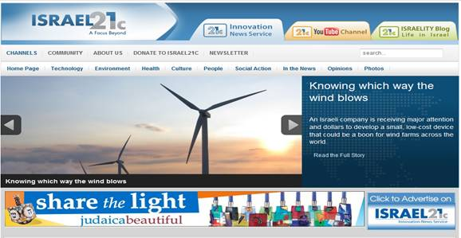
More Further Reading
www.Israel21c.org
Great Website-weekly updates on Israel’s contributions to the world

Slide 30
TODA
Thank You

