Slide 1
Teachers workshop
How to bring Israel into the classroom?

Slide 2
Nice to meet you!
Dana Kalishov
Community Shlicha
JCC of Northern Virginia
Email address: dana.kalishov@jccnv.org
Cell phone: 703-217-5566

Slide 3
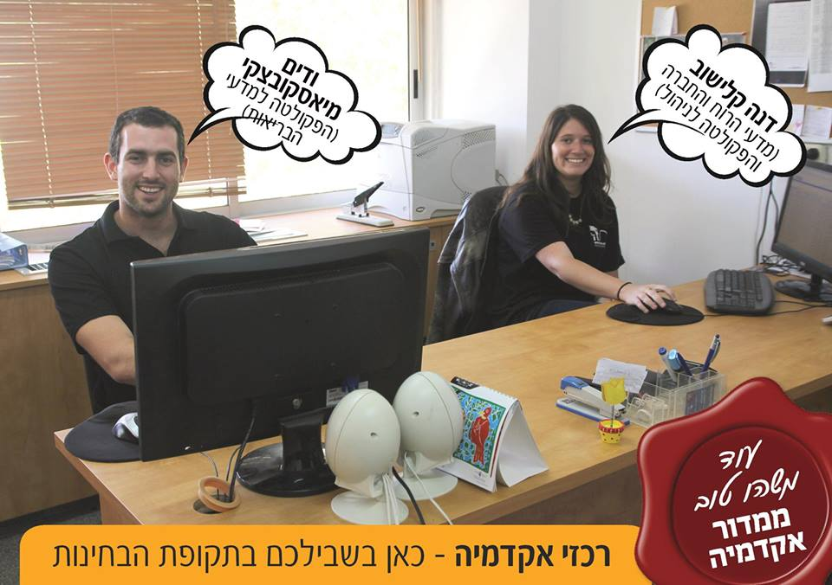
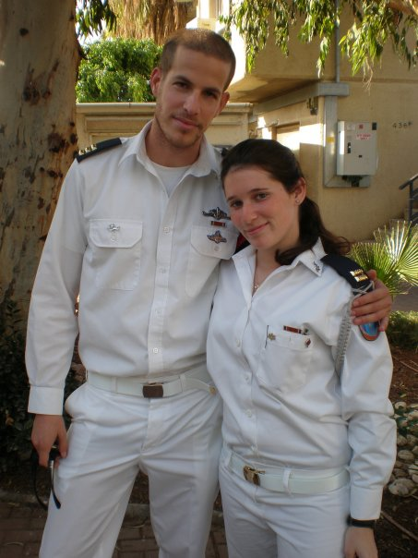
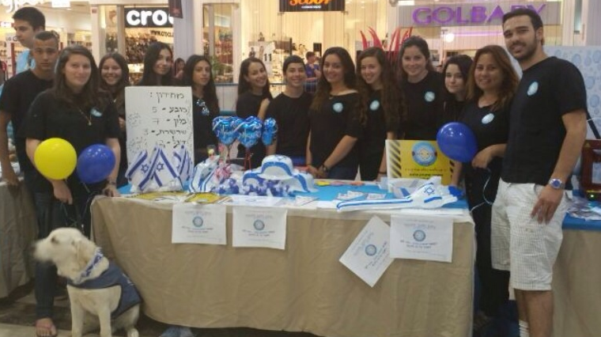
My educational Background
Member in the Israel Scouts
Young Leadership and a tour guide
Youth counselor at BBYO
Military Education officer
Substitute teacher in elementary school

Slide 4
What is your Israel??

Slide 6
Israel Resource Cards: Activities and Ice Breakers

Slide 7
Great Educational Resources:

Slide 8
Methods for daily/weekly use:
The map of Israel
The word of the day/ the week
using music or movies
A list of topics that retaliates to Israel
News review, news board
Teaching Israeli games as a way to practice Hebrew
Show and tell with objects

Slide 9
News websites:
Times of Israel: http://www.timesofisrael.com/
Jerusalem post: http://www.jpost.com
Jerusalem Online: http://www.jerusalemonline.com/general/subscribe
News related to Israel: http://leadershipactionnetwork.org
News about military and security: http://trailer.web-view.net/Show/0X3FFA71516506F5CD1C8F822C57BB4CD3D96899D4375D6A2B68BD5357C988FEFB.htm
Foreign Ministry website (in different languages): http://mfa.gov.il/MFAHEB/PressRoom/TopEvents/Pages/default.aspx
From the Embassy of Israel in Washington D.C: http://www.buzzfeed.com/israelinusa

Slide 10
Israeli websites with English version:
http://www.haaretz.com
http://www.ynetnews.com
http://www.israelnationalnews.com-
http://www.globes.co.il/serveen/globes/nodeview.asp?fid=942-
Different topics: Technology, Society, Sport, Health
http://nocamels.com
http://israel21c.org
http://rethinkisrael.org/
http://mfa.gov.il/MFA/AboutIsrael/Pages/default.aspx
Israel Advocacy:
http://mfa.gov.il/MFA/Pages/default.aspx
http://www.idfblog.com

Slide 11
Questions?

