Slide 1
Yalla Israel!
Star Dust
Once upon a time
Trip to Israel
Food for the soul
100
100
100
100
200
200
200
200
300
300
300
300
500
500
500
500

Slide 2
STAR DUST - 100
I am an Israeli actress, known for my part in the fast and the furious movies. Recently I was chosen to play wonder woman.
Who am i?

Slide 3
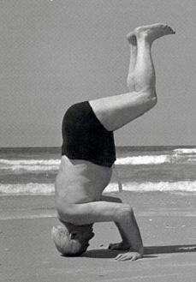
STAR DUST - 200
David Ben-Guryon (Israel first prime minister) used to stand on his head for his daily exercise.
Choose a representative from each group, and have a “head standing” competition!

Slide 4
STAR DUST - 300
What is the story behind this commercial? What happened to Scarlett after participating in this commercial?

Slide 5
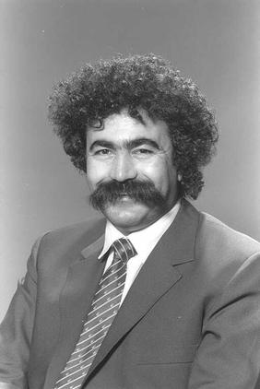
STAR DUST - 500
What am I famous for?

Slide 6
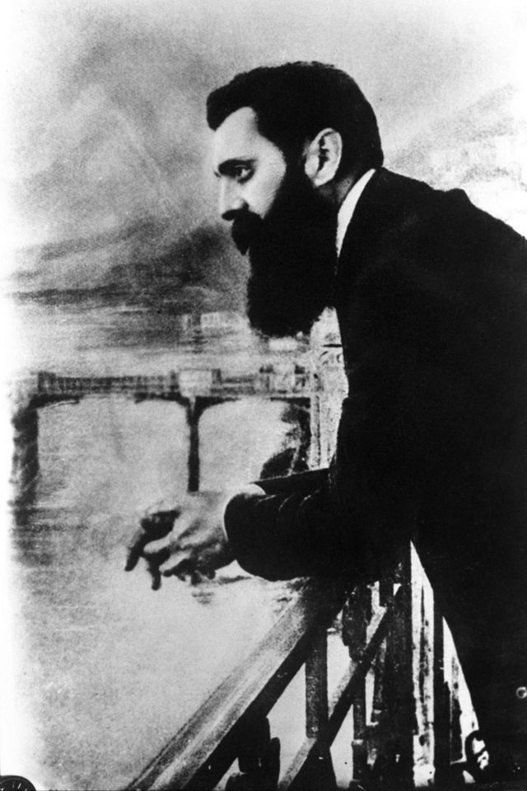
Once upon a time - 100
Who said:
“At Basel, I founded the Jewish State. If I said this out loud today, I would be answered by universal laughter. Perhaps in five years, certainly in fifty, everyone will know it.”

Slide 7
Once upon a time - 200
Listen, what historic moment is recorded?

Slide 8
Once upon a time - 300
Each group will get an historic picture, you have 5 minutes to remake the photo!
Be creative!

Slide 9
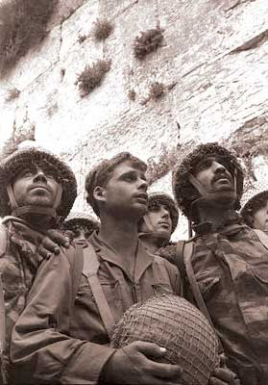
Once upon a time - 500
When and where was this photo taken?

Slide 10
Trip to Israel - 100
Create a human map of Israel! As fast as you can!

Slide 11
Trip to Israel - 200
To which of the following cities you can’t arrive by (any kind of) airplane?
Tel-Aviv
Eilat
Haifa
Ashdod

Slide 12
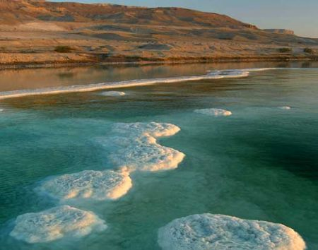
Trip to Israel - 300
Where was this picture taken? What is special about this place?

Slide 13
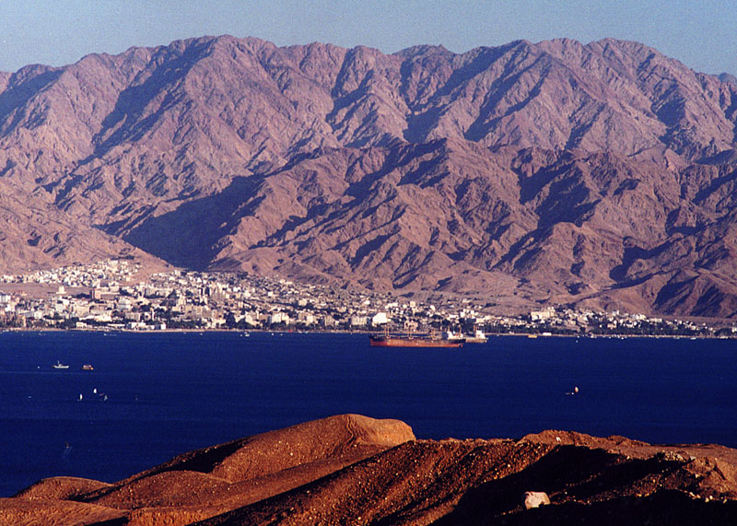
Trip to Israel - 500
With which countries the Eilat bay borders with?

Slide 14
Food for the soul - 100
Listen to the 4 songs, witch one of them you think was number 1 in this past year music charts?

Slide 15
Food for the soul - 200
Where does Sheldon what to build a replica of Jerusalem?

Slide 16
Food for the soul - 300
Taking turns, each group will say an Israeli invention, the group that will say the last one will win!

Slide 17
Food for the soul - 500
Watch and listen to the song, try to remember as much information as you can!

