Slide 1
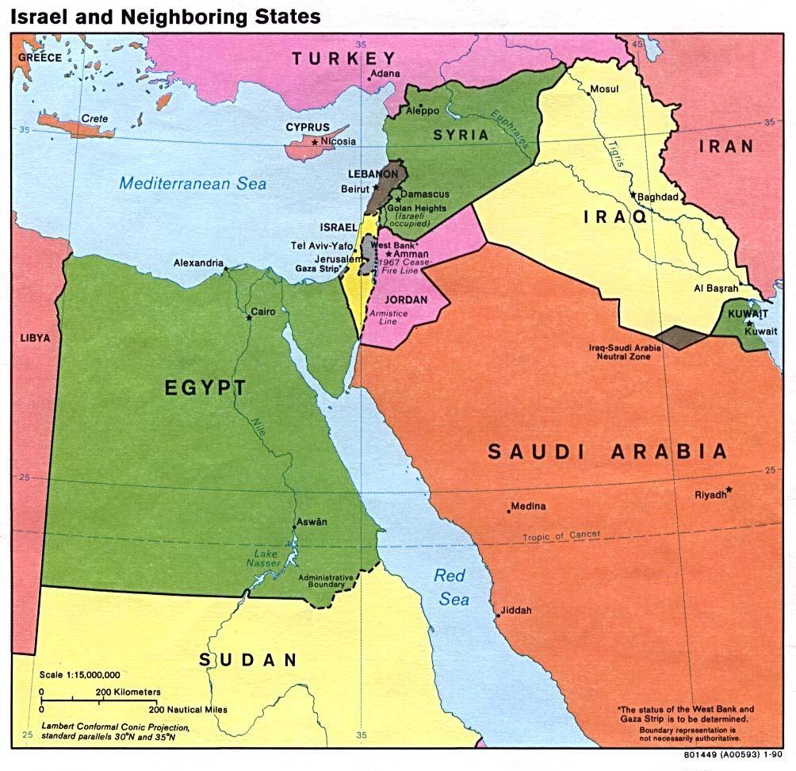
The Story of The Land Of Israel
Created b Arad Lerner

Slide 2
Biblical times
Israel & Judah 924 BCE → 720 BCE
Judah & Assyria-720 BCE → 597 BCE
Babylon-597 BCE → 538 BCE
Persia-538 BCE → 332 BCE
Greece-332 BCE → 164 BCE
Hasmoneans-164 BCE → 63 BCE
The Roman Empire-63 BCE → 395 CE
Byzantine-395 CE → 636 CE
Arabs-636 CE → 1099 CE
Crusaders-1099 CE → 1244 CE
Mamlukes-1244 CE → 1516 CE
Ottoman Empire-1516 CE → 1917 CE
Great Britain-1917 CE → 1948 CE
Notes:
After wondering 40 years in the desert, following the Exodus from Egypt, the people of Israel occupied the land of Israel under the leadership of Joshua (appointed by Moses before his death). The occupation was gradual and the Israeli tribes frequently suffered from wars with neighboring nations. Prosperity began as the tribes united to form the monarchy. Prosperity and peace peaked during the reigning of King Solomon. This enabled him to build the First Temple in Jerusalem. With his death the kingdom split.
For a summary on each and every one go to http://www.odyeda.com/en/ -> Control over the land of Israel

Slide 3
Theodor Herzl-"Visionary of the State"
1894-Herzl influenced by the Dreyfus Affair.
1896- Writes "The Jewish State”.
1897- The First Zionist Congress.
Notes:
1.Herzl is working as a journalist, covers the trial, sees the anti Semitism.
2.Brings the idea of a Jewish state in Palestine into mind, book spreads fast so is the idea
3. Coming to an understanding that we need to buy an earn legal rights on the land. Starting to rise money. כתבתי בקצרה נקודות לעצמי, ניתן להרחיב ללא ספק

Slide 4
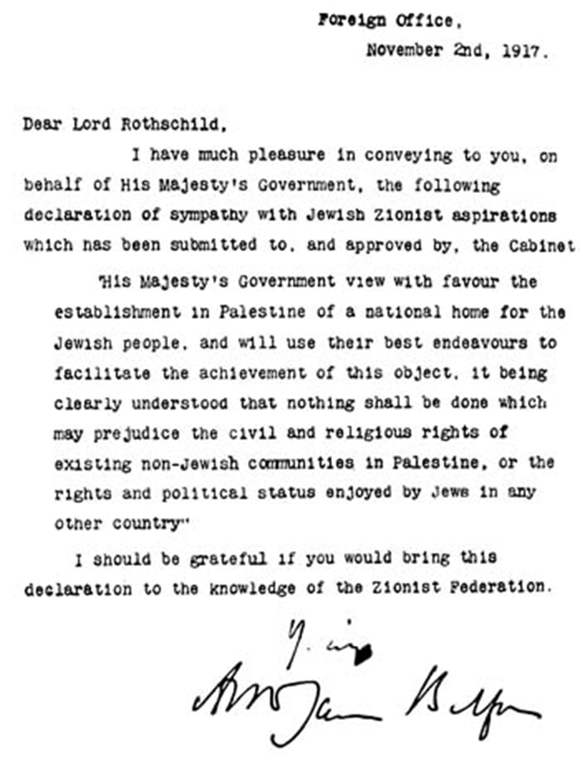
Balfour Declaration- 1917
Notes:
ביולי 1917 הגישו ד"ר חיים ויצמן ונחום סוקולוב לממשלת בריטניה הצעה להצהרה מדינית, שרואה בארץ ישראל את ביתו הלאומי של עם ישראל ומכירה בזכותו לבנות את חייו הלאומיים בה. שר החוץ הבריטי ארתור ג'יימס בלפור, שהיה חובב תנ"ך, וראש הממשלה דייוויד לויד ג'ורג' (שהספיק כבר לייצג כעורך דין את ההסתדרות הציונית בשנת 1903), ראו בעין יפה את ההצהרה מטעמים אסטרטגיים ודתיים, והאמינו כי "שיבתם של היהודים לציון היא מאורע היסטורי ממדרגה עליונה שנגזר מתוקף צו הבורא". להם נוספו שרים נוספים ומדינאים בכירים כמו מארק סייקס שהתקרב לרעיון הציוני הודות לחברותו עם הרברט סמואל.

Slide 5
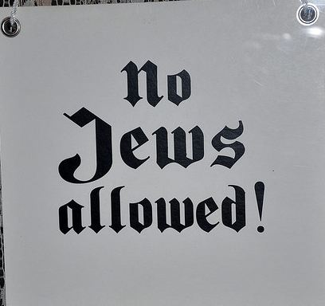
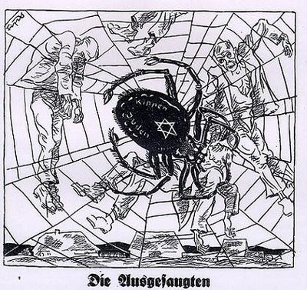
Anti-Semitism And The Holocaust
Notes:
How Jews patriated in Nazi propaganda, leads to actions (signs no Jews), leads to the Holocaust. Summary of the holocaust/personal story
Jews understand they need a Home
(Many of them had no Houses to go back to no property etc.)

Slide 6
The British Mandate:
Notes:
אבל הבריטים שלטו בארץ
זה השטח עליו שלטו
ניתן לשאול את הקהל אם הם זוכרים את המפות הקודמות ולחזור למפות הקודמות לשם השוואה

Slide 7
United Nations Resolution 181
Notes:
On November 29th, 1947, UN General Assembly voted to accept partition.
The Jews (the Zionist movement) accepts the UN Partition Plan.
In keeping with the partition plan, David Ben Gurion proclaimed the independence of a new Jewish state on May 14th, 1948.
The Arab leadership (in and out of Palestine) opposed partition and claimed all of Palestine.
Arab leaders threatened the Jewish population of Palestine, speaking of "driving the Jews into the sea"

Slide 8
1948 - The war of Independence
A day after Israel declare independence five Arab countries invaded the new nation.
Israel was forced to fight for its survival, and won.
Notes:
The Arabs of Palestine and the Arab countries refused to accept the partition plan. Five Arab countries invade Palestine in May 1948.
The Arabs declared their goal as to destroy the newly created Jewish state.
In the war that will be called later “Independence war” 10% of the Jewish population was killed – 6000 men and women. Arabs lost between 10,000-15,000 soldiers.
The Arabs who remained became Israeli citizens.
Jordaan in Jerusalem - and erected barriers preventing Jews access to their holy sites
Also, over 900,000 Jews were forced to flee Arab countries, more than a half came to Israel.

Slide 9
Aftermath
As a result of the war, approximately 600,000 Arabs fled/displaced and became refugees.
Jordan took control of the West Bank and East Jerusalem (the Old City); Egypt took control of Gaza strip.
The borders were resulted from cease-fire lines following the War of Independence.
The borders of Israel from 1948 -1967.
Notes:
Optional: Arab countries insist on impossible pre-conditions to peace negotiations including the “right of return” of all the refugees of 1948. The result - no peace.
Egypt and Jordan sponsor terrorism against Israel in 1950 that killed 270 Israeli civilians. After the Egyptian blockade of Eilat, Israel takes part in 1956 Sinai Campaign with France and Great Britain to alleviate blockade and end terror.

Slide 10
1967- The Six Day War
On May 1967, Egypt re-imposes the blockade of Israel’s southern port of Eilat cutting off Israel’s trade from Asia. This is a clear act of war by international law.
The war lasted 6 days, in which Israel captures territories in Sinai Peninsula, The Golan Heights, The West Bank and East Jerusalem.
Notes:
Optional-Egypt-Jordan-Syria create joint military command. Left with no alternative, Israel attacks in a pre-emptive strike.
-was fought between June 5 and 10, 1967 by Israel and the neighboring states of Egypt (known at the time as the United Arab Republic), Jordan, and Syria.
ישראל החזירה לעצמה את השליטה על ירושלים
The Arab world sais: “No peace with Israel. No negotiations with Israel. No recognition of Israel.”
ישראל הגדילה את שטחה פי 3
Egypt masses troops on Israel’s borders; expels UN Peace Keeping Force.
President Nasser of Egypt threatens destruction of Israel.
Israel offered to return land it captured in exchange for peace treaties and recognition of its right to exist. It removed the barriers in the Old City and allowed all religions control of and free access to their holy sites.
Political stalemate leads to
Egyptian-Syrian attack on
Israel on Yom Kippur,
October 6, 1973. אין שקופית על יום כיפור – לא נעשה שינוי בשטח

Slide 11
1979 – Israel and Egypt’s peace Agreement
Israel signs a peace agreement with Egypt in return of giving Sinai peninsula back to Egypt.
Notes:
להראות במפה הקודמת את השטח שהוחזר
ניתן להזכיר ששטח זה הוא טריטוריה חשובה כמעבר סחורות(בין הים התיכון לים האדום) בנוסף שטח עשיר במשקעים כגון נפט וכו'
הוחזר אך ורק מכיוון שישראל שוחרת שלום!!

Slide 12
Israel Today
Notes:
Fits into the State of Alabama 5 times!
Size of New Jersey

Slide 13
The Birth Of The Palestinian Liberation Organization
In 1974, the Arab world designates the PLO (Palestinian Liberation Organization) headed by Yasser Arafat as the sole representative of the Palestinian-Arab people.
The Goal of Arafat and PLO – Total destruction of Israel.
Result: political stalemate and terror sponsored by PLO inside and outside Israel.
“We plan to eliminate the state of Israel and
establish a purely Palestinian state. We will make
life unbearable for Jews by psychological
warfare and population explosion.
We Palestinians will take over everything,
including all of Jerusalem.”

Slide 14
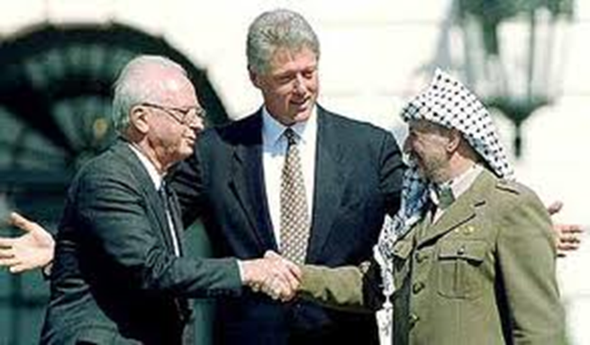
-1993The Oslo Agreements:
Declaration of Principles on Interim Self-Government Arrangements for the Palestinians signed by Israel and PLO, as representative of the Palestinian people.
Declaration of Principles on Interim Self-Government Arrangements for the Palestinians signed by Israel and PLO, as representative of the Palestinian people.
Notes:
The Oslo Accords were a set of agreements that began in 1993 when Israel and the PLO signed a Declaration of Principles (DOP).
Oslo accords call for mutual recognition between Israel and the PLO.
PLO agrees to abandon terror and recognize Israel’s right to exist.
Israel recognizes PLO headed by Arafat, creates the Palestinian Authority (PA) and gives 40% of the West Bank and most of Gaza to the PA.
At Camp David 2000, Israeli Prime Minister Ehud Barak offers the creation of a Palestinian state in 92% of the West Bank, all Gaza and shared Jerusalem as capital of both states. Arafat refuses the offer.
In December 2000, US President Bill Clinton offers creation of a Palestinian state in 95% of West Bank, all of Gaza and a shared Jerusalem as a capitol of the two states. Israel agrees, the PA refuses.

Slide 15
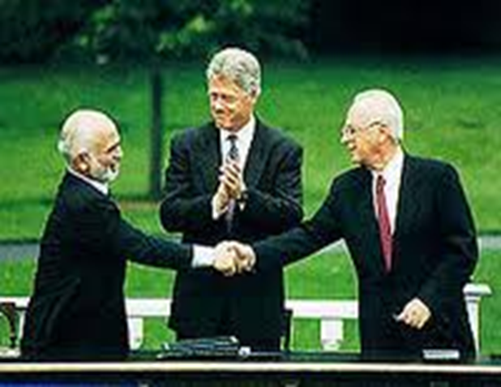
1994 – Jordan and Israel’s peace agreement
Israel signs a peace agreement with Jordan who agrees that Jerusalem and West the Bank stay part of Israel.
1995 – Israeli prime minister Yitzhak Rabin was assassinated by an Israeli who disagreed with the compromises that were part of the peace process
Notes:
As with the 1979 peace treaty between Egypt and Israel, the United States led a difficult but successful diplomatic process to help Jordan and Israel achieve peace. In 1994, Jordan became the second Arab country to recognize Israel. Trade, business relations, tourism, cultural exchanges, and scientific cooperation between the two nations have increased since the agreement was signed, but at a slower pace than hoped for initially

Slide 16
Camp David 2000 and the second Intifada
Secret talks of Israelis and Palestinians mediated by American President in Camp David in July 2000.
The Americans attributed the failure of the talks to Arafat’s refusal to compromise.
There was widespread frustration at the lack of progress in the peace process. Israelis were terrorized by numerous suicide bombers who killed hundreds of civilians. In response, Israel’s military carried out operations against terrorist targets.
Notes:
This was the first major attempt to negotiate a comprehensive final status agreement between Israel and the Palestinians
Blockade , terrorists, suicide bombers. (אפשר לדבר על אירועים אחרונים)
-סרטון של ערביה שנעצרה במחסום עם מכנסי נפץhttps://www.youtube.com/watch?v=TbiQjXXP4w0
-ישראל מעבירה מזון,תרפות,חשמל,כסף, כל מה שצריך על מנת שרצועת עזה תשגשג וכל הכסף הולך לטרור ומנהרות במקום לבתי חולים ובתי ספר
-ילדים נשים וגברים בכל יום מגיעים לקבל טיפול רפואי בבתי חולים בישראל ( כולל בתו של הנייה ואבו מאזן עצמו)

Slide 17
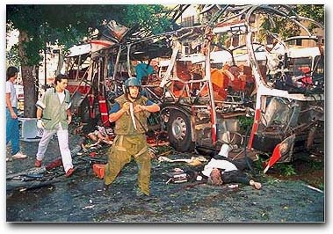
Notes:
Photos that are engraved in each and every Israeli, the sound of a special news broadcast, sounds of sirens.

Slide 18
Disengagement - 2005
In 2005, Israel initiated the ‘Disengagement’ plan, evacuating the 8,800 Israeli civilians who lived in the area.
Following the complete evacuation of the strip, the Palestinian authority, then governed by the PLO (Palestine Liberation Organization) assumed control of the strip.
Notes:
אנשים נעקרו מבתיהם
נגרם קרע בעם
הכל בשביל השלום

Slide 19
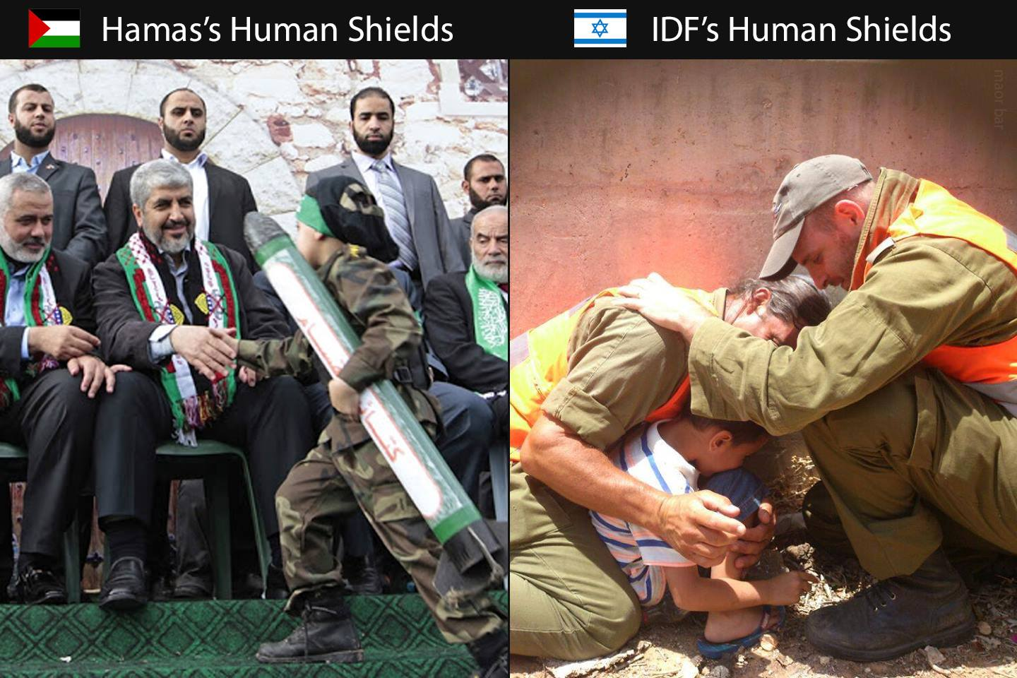
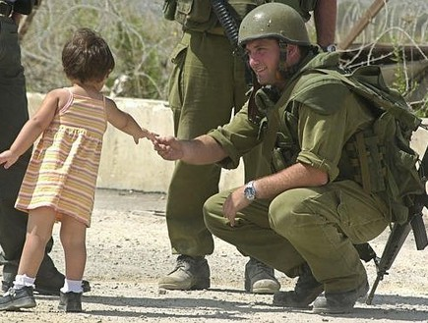
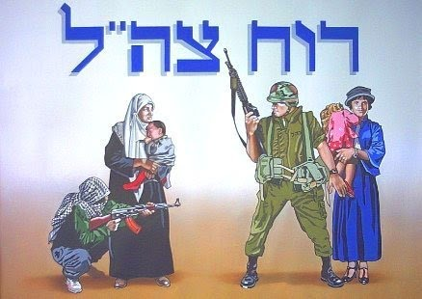
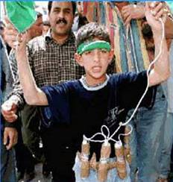
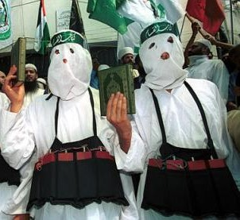
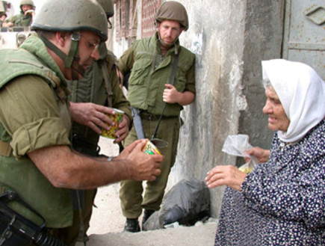
Sanctity Of Death Vs. Sanctity Of Life
Notes:
הערך שלנו לחיים אל מול הערך שלהם למוות

Slide 21
Notes:
במידה וניסוג נושמד

Slide 22
March of the living
Notes:
מאז השואה העם היהודי הבין שהוא אחראי לגורלו, לא ניתן לאף אחד להשמיד אותנו, אנחנו עומדים איתנים מול כל האיומים אף על פי שאנו לא מעוניינים להתעמת, אך אסור לנו לנהוג בחוסר זהירות כאשר מדובר בגורלנו

