Slide 1
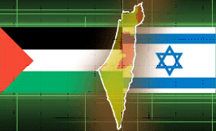
The Israeli Palestinian Conflict
2014

Slide 2
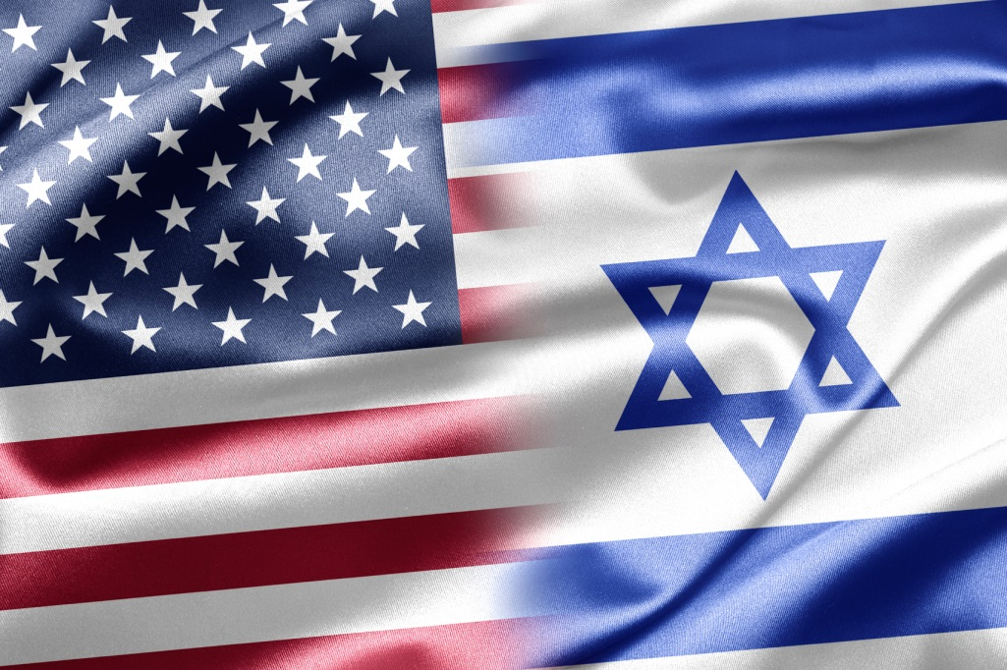
Why Should You Care?
70% of US Aid to Israel is required to be spent on purchases from American companies.
Military and Intelligence Cooperation
THE ONLY TRUE DEMOCRATIC ALLY IN THE MIDDLE EAST
Notes:
$75 billion, $65 billion and $3.25 billion will be spent on military operations and aid in Afghanistan, Iraq and Pakistan -2010
70% מה- 3.4 מיליארד
his provides real support for US high- tech defense jobs and contributes to maintaining our industrial base
http://www.jpost.com/Opinion/Op-Ed-Contributors/Benefits-of-US-aid-to-Israel-exceed-cost
http://www.jpost.com/Opinion/Op-Ed-Contributors/Benefits-of-US-aid-to-Israel-exceed-cost

Slide 3
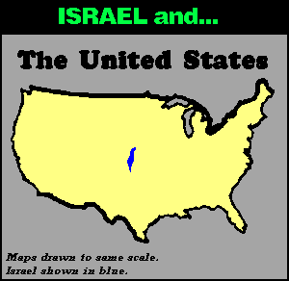
Notes:
In the size of new jersey
Israel almost as Maricopa county - arizona
Israel Size comparisons
Sizes:
Israel – 8,019 sq. miles
New Jersey – 8,729
Maricopa County - 9,224
Massachusetts - 10,554
Lake Michigan – 22,400
Michigan – 97,990
California - 163,696 sq. miles
USA – 3,794,100 sq. miles

Slide 4
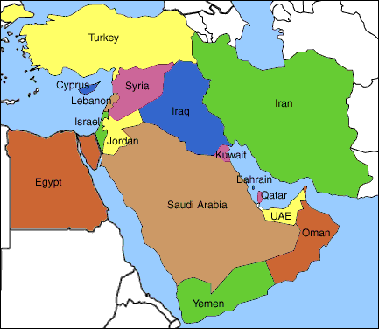
6.5 Million Jews in Israel surrounded by
850 Million Arabs

Slide 5
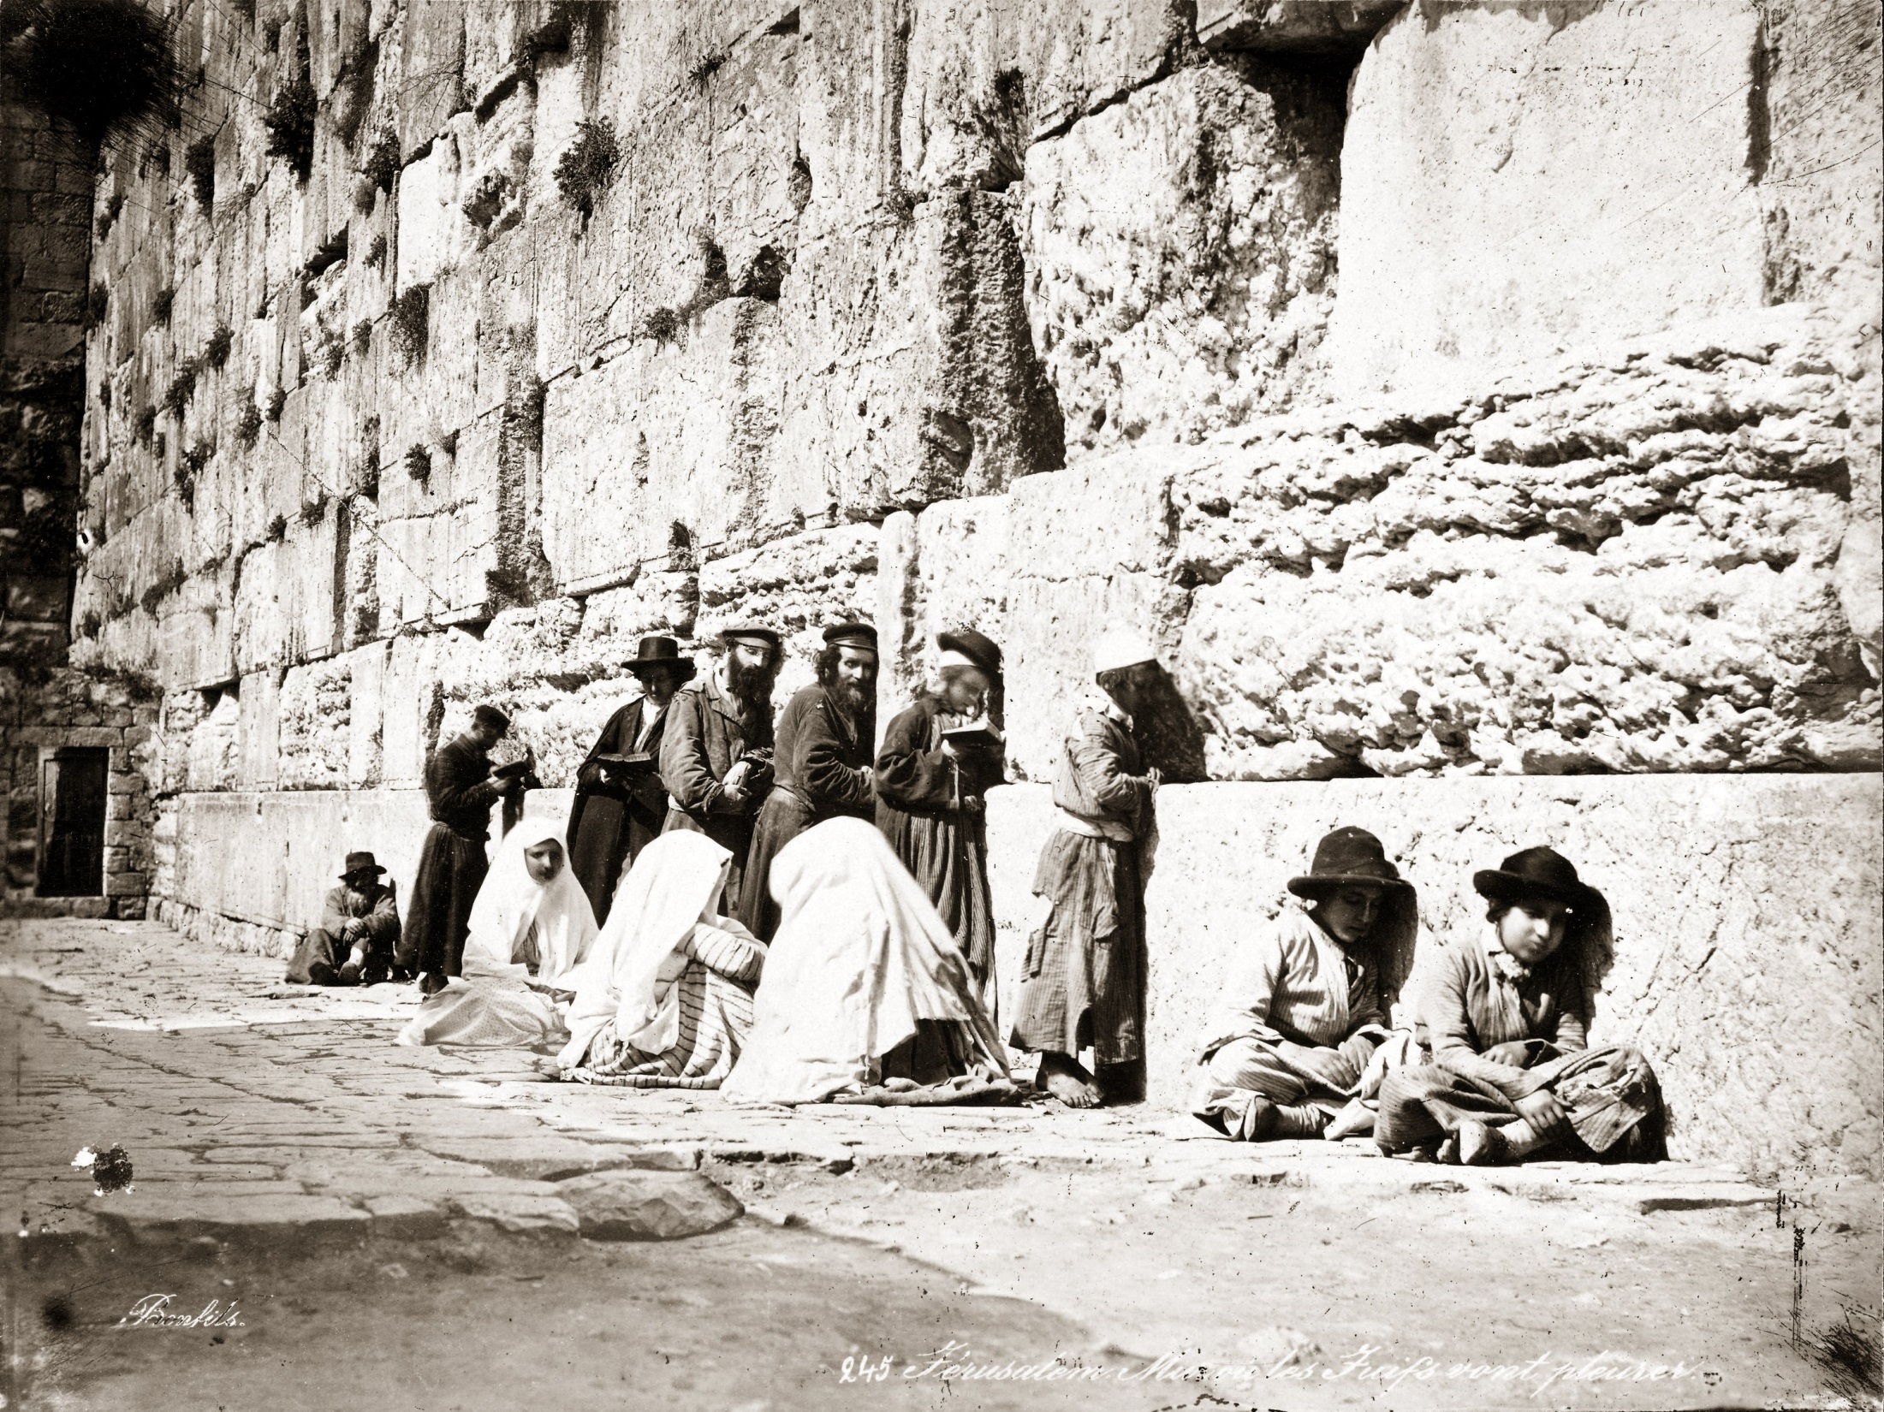
History of the Jewish People in the Land of Israel
Notes:
THERE IS A VIDEO, PRESS IN THE MIDDLE OF THE TITLE (( https://www.youtube.com/watch?v=KGs75M5LpPc ))
Min 1:15- meet abraham – 3:38 (welcome to diasphora
Jews were in israel before counting, there was a great jewish kingdom in JUDEA AND SAMERIA , we all know that when jesus was born the jewish people lived in the land of israel. Through out history , despite expeltions by the romans and others, there were always jews in israel.

Slide 6
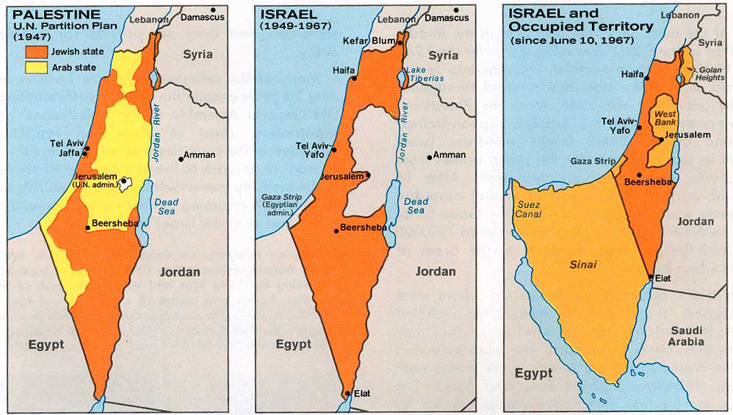
1947 1949 1967
Notes:
47- didn’t want an agreement
48- 5 arab countries attack israel. Not the other way!
67 – israel stayed in the west bank – a jordanian territory before the war

Slide 7
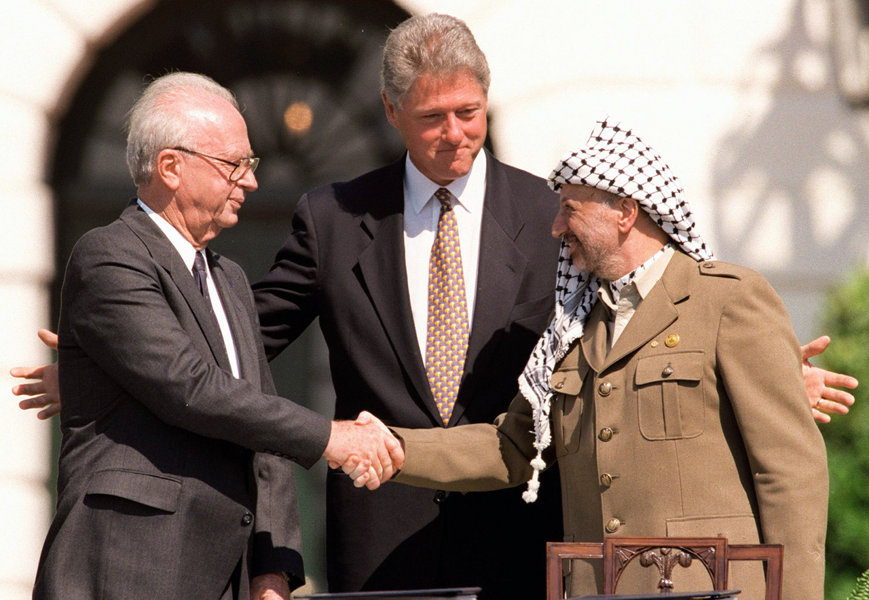
The Oslo Accords 1993 - 1995
Notes:
Hope for peace for a new beginning

Slide 8
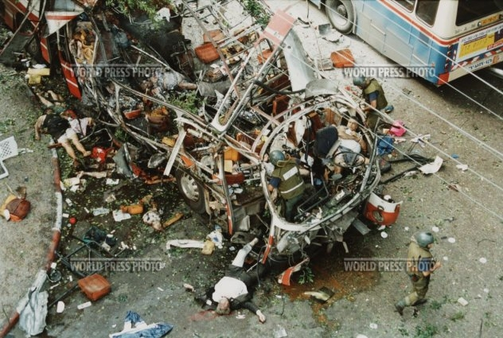
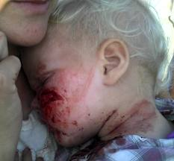
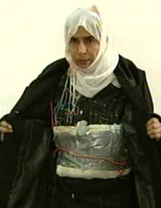
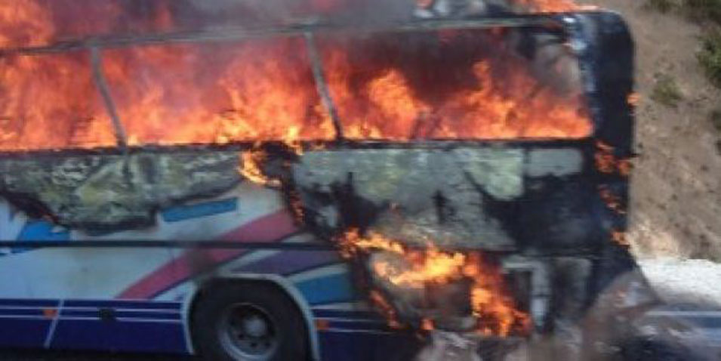
1994 -1997, 2001- 2008- Suicide Bombers
Notes:
Bat chen shahak was 15 on her way to the mall

Slide 9
WHY CHECK POINTS AND SECURITY FENCE?

Slide 10
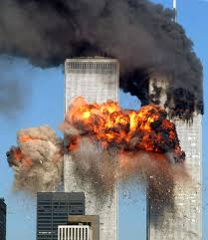
Notes:
What’s better- having to stand in line for your flight or the chance of innocent people dying?

Slide 11
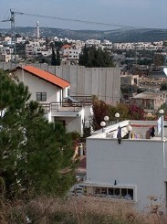
Security Fence Decreases Terror Attacks
Notes:
97% is chain-link fence and 3% is a wall
This picture is from a village near my home in Israel.
Do u think I want to see a wall when I open my window?
It’s a necessity to save lives.

Slide 12
Security Fences Used World Wide
USA: Illegal Entry, drugs
Spain: Illegal Immigration from Morocco & Sahara Desert
India: Terror Attack Prevention from Pakistan
Thailand: Terror Attack Prevention from Malaysia
Pakistan: Prevent Taliban & Al- Queda Attacks from Afghanistan

Slide 13
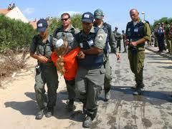
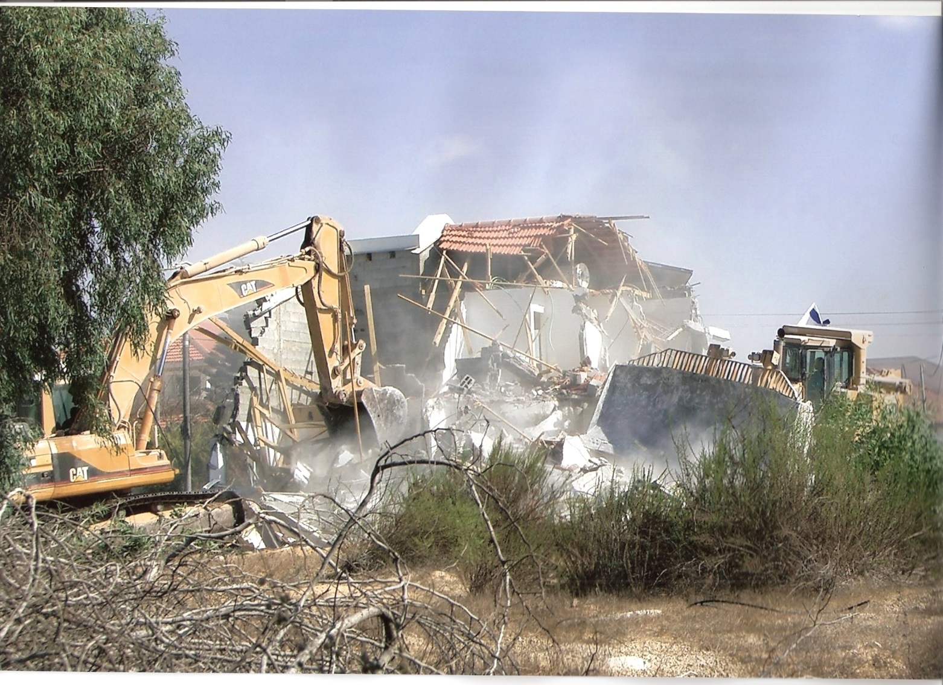
2005 Israel Shows Will for Peace
10,000 Israeli Civilians were Evacuated & Resettled from the Gaza Strip
Notes:
Was Not easy for us, not everybody agree to that in israel
but israel wants to show the our Palestinian neighbors that we are ready to make hard sacrifices

Slide 14
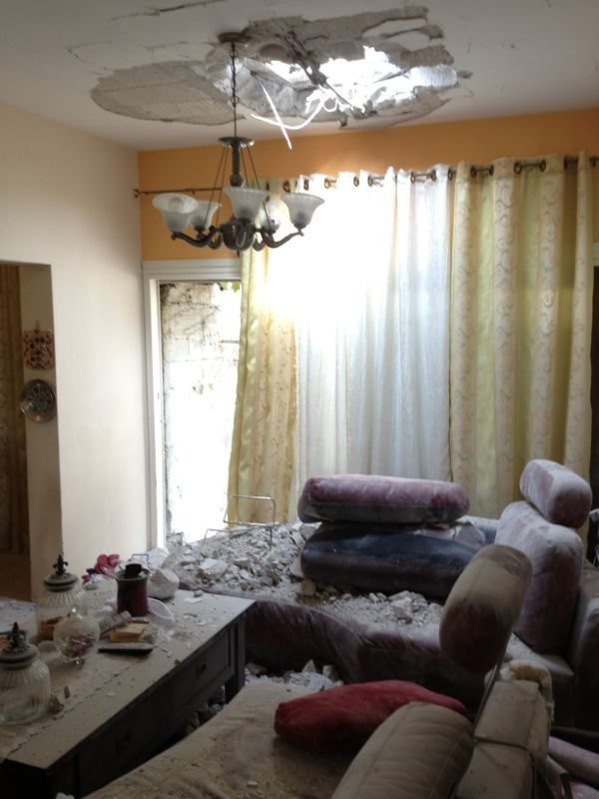
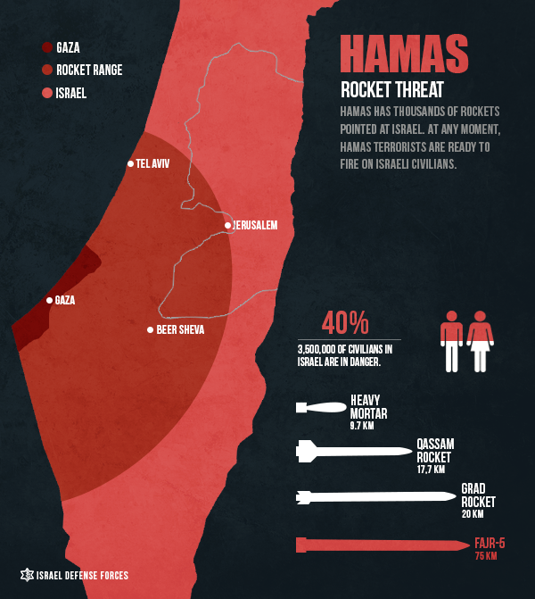
Did We Get Peace?
More than 12,800 rockets fired from the Gaza Strip to cities in Israel
Notes:
Think you are sitting in your living room with your PlayStation and suddenly a rocket hits you…
Would the US let Mexico fire rockets AT HER CIVILIANS?
Hamas’s missiles cover today more than 40% of civilians in israel

Slide 15
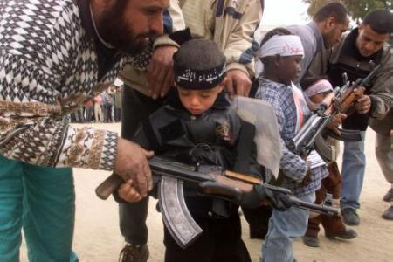
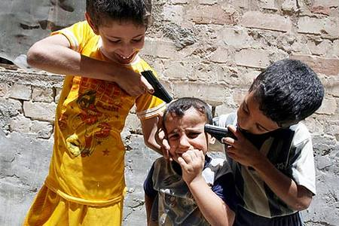
WHAT WOULD YOU DO? Using Human Shields Educate for Hate
Notes:
Israel is not perfect. Israel makes a lot of mistakes ,we aknowledge the suffering of the Palestinian people. We do not deny that. But - we are always in a search to find a better way to deal with almost an impossible situation. And I want to share with you some of the dillemas that we deal with on a daily basic almost-
Using human sheild- THERE IS A VIDEO, KLICK ON THE BLUE TITL (starting at 00:10)– https://www.youtube.com/watch?v=giJlG3KXq8c
not just humans also non- military structures are been used for ammunition storage , shooting from houses, schools at civilian villages in israel
2. Educate for hate - Summer camp – becoming a shaid, in school books no israel in the map

Slide 16
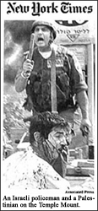
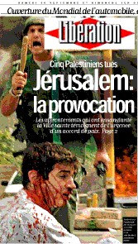
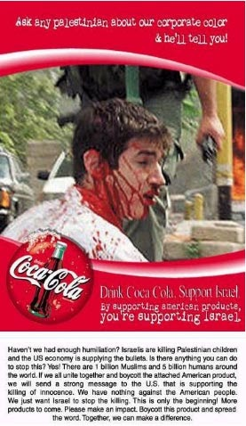
In the foreign media
In a campaign to boycott Coca-Cola
This image appeared in the New York Times.
Notes:
Check the information you get in a few sources - not everything you see or here actually happened that way.
2 examples: above and next slide

Slide 17
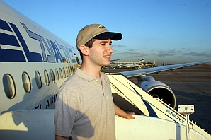
Media Bias/Falsification on Israel
But the kid in the picture is not a Palestinian… his name is Tuvia Grossman and he is being protected by the Israeli policeman from a crown of Palestinians trying to kill him!

Slide 18
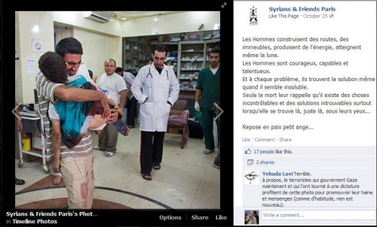
But it was taken 3 months earlier in Aleppo, Syria…
In the last Gaza conflict Hamas tweeted this picture of a dead child in his fathers arms… it was used in the World media

Slide 19
Notes:
Lets talk on positive things too- saves a childs heart
50% from the patients are from Palestinian authority
The grandchild of hamas prime minister was treated in hospital in israel few months ago

Slide 20
Notes:
We talked about the palastinian in west bank and gaza so far..
20% from israeli citizen are arabs they are a part of the divers israeli society
ד"ר יוסף ג'בארין - הפקולטה למשפטים - אוניברסיטת חיפה
Salim jubran – supreme court judge
Tibi and zuabi surve the political system even though do not agree with existing of israel as a Jewish state
Asala shahada wins medal gold at the macabbia games
Rana raslan – beauty queen
Reality shows – last week won as israel’s top

Slide 21
Comparing Human Rights – Israel and Other Middle Eastern Countries
Economist Intelligence Unit (Democracy Index) rating of the Palestinian National Authority compared to Syria, Jordan, Egypt, and Israel[2011]
Country | Number (in the rating) | Index | Category Full democracy (1-26), Flawed democracy (27-79), Hybrid regime (80-111), Authoritarian regime (113-167)
Palestine | 99 | 5,44 | Hybrid regime
Syria | 152 | 2,31 | Authoritarian regime
Jordan | 117 | 3,74 | Authoritarian regime
Egypt | 138 | 3,07 | Authoritarian regime
Israel | 36 | 7,46 | Flawed democracy
Notes:
Source- http://www.sida.se/Global/About%20Sida/S%C3%A5%20arbetar%20vi/EIU_Democracy_Index_Dec2011.pdf
Arabs in israel enjoy more democratic and human right than any other arad or muslim state!
(Only israel gave Palestinian citizenship )

Slide 22
Notes:
Israel is longing for peace. Currently, the other side still don’t want to recognize that we are there to stay as much as they are,
and we need to find a way to live next to each other with no violent
(( optional - IF THE ARAB WOULD PUT THEIR WEAPON THERE WOULD BE PEACE – IF ISRAEL WOULD PUT DOWN THEIR WEPON THERE WOULD BE NO MORE ISRAEL ))
This is the end – the next slides are optional

Slide 23
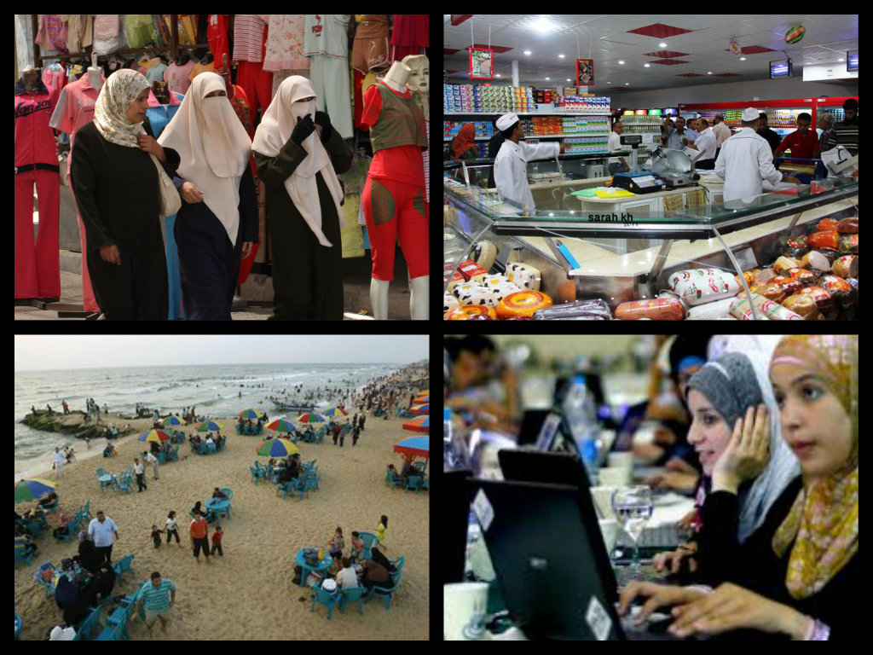
26 February, 2010
United Nations Middle East envoy Robert Serry, who met with President Shimon Peres in Jerusalem on Wednesday, said, "There is no humanitarian problem in Gaza."
Notes:
At no point in gaza siege israel closed the borders for humanitarian aid
Actually israel is supplyes electricity to gaza, sending tons of goods and humanitarian aid from government and non profit israeli organizations

Slide 24
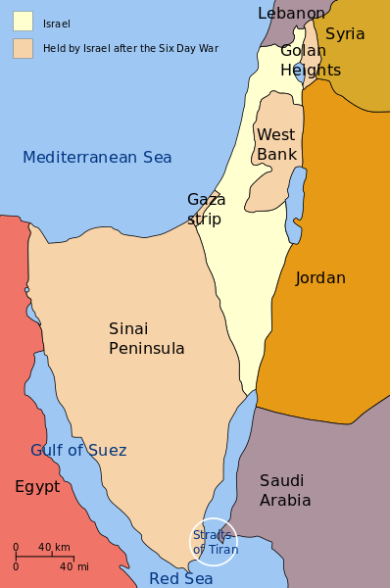
RESOLUTION 242 UNITED NATIONS
1. Affirms that the fulfilment of Charter principles requires the establishment of a just and lasting peace in the Middle East which should include the application of both the following principles: (ii) Termination of all claims or states of belligerency and respect for and acknowledgment of the sovereignty, territorial integrity and political independence of every State in the area and their right to live in peace within secure and recognized boundaries free from threats or acts of force;

Slide 25
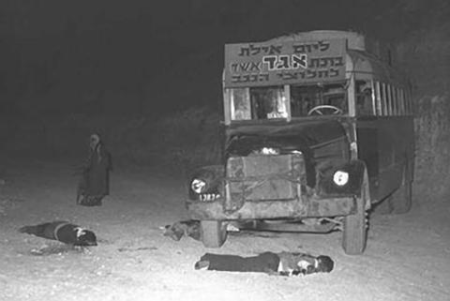
TERROR STARTED BEFORE 67’
The Massacre in Maale – Akrabim march 17th 1954
Ashaf – was founded in 1964
Mission: determination of israel to have a Palestinian state
Notes:
Are the settlements an obstacle for peace? (Argument – the terror started after 67’)
There are 300,000 jews in west bank , also 1.5 milion arabs in israel (thei cities are getting bigger, very few actually get permeation to built more)

