Slide 1
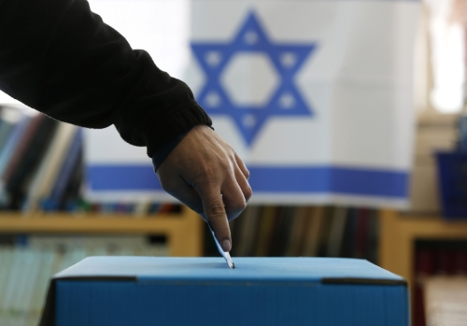
Israeli Election 101
April 9 2019
Israel on
Campus
Ottawa

Slide 2
Rules
Please respect everyone’s opinions and ideas.
All that is said here is from the Internet and from my personal knowledge/ opinion* and analysis and do not represent any other person/ group or organization.
There may be people here who know better than me – you are invited to correct me. If there is a subject that I didn’t touch and you would like to talk, I would love to.
Try to keep the questions for the discussion part.
The conversation is not about the conflict, but about the elections. If there will be a demand from for it we will offer programs that deal with other specific issues.
* I will try to be as balance as I can

Slide 3
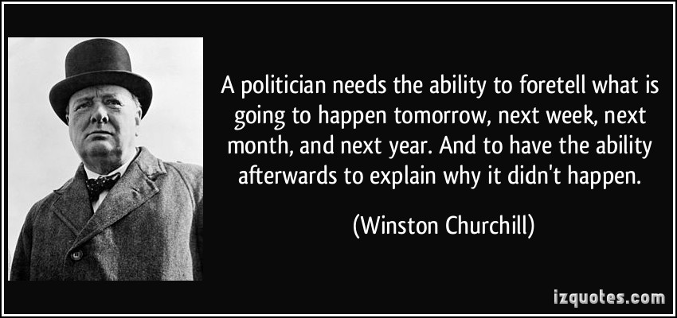

Slide 4
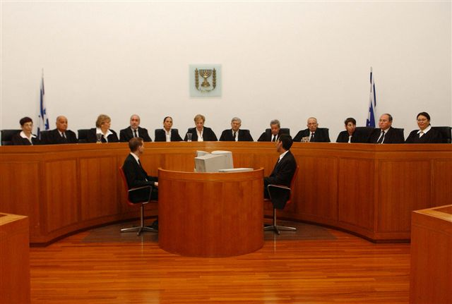
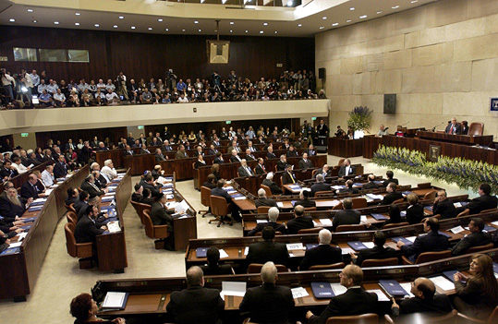
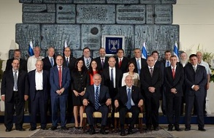
The Israeli Democracy System
Separation of powers - a governmental principle according to which the powers of the government must be divided into separate and independent authorities, that balance between them. The purpose of the principle is to prevent a single branch of government from having absolute power.
Supreme Court Interprets the laws
The Knesset
Determines the laws
The Government
Executes the laws

Slide 5
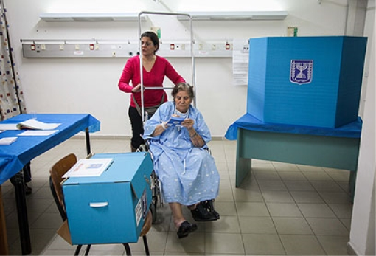
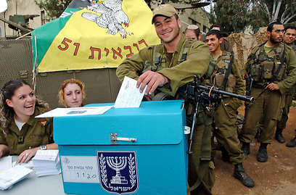
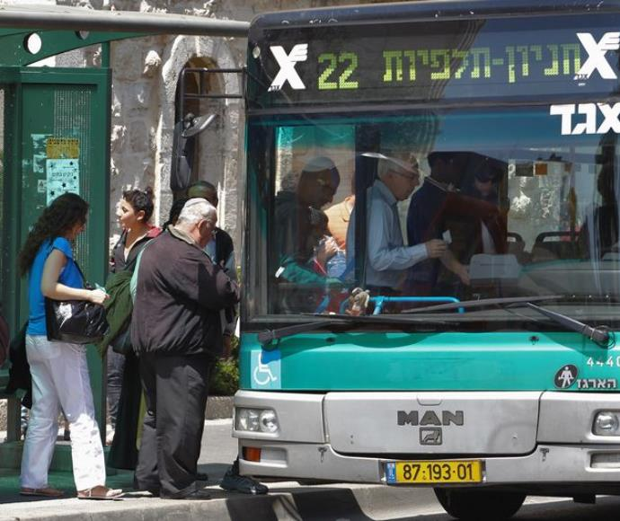
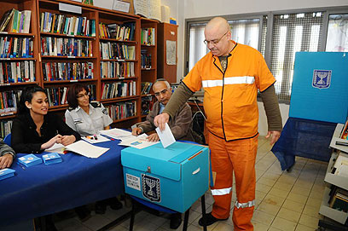
Who Can Vote?
Age 18
Israel citizen
Permanent residency
Has to be in Israel in the election day*
Election day is a holiday in order to enable all to participate
Free public transportation to the polls
Soldiers on active duty vote in special polling stations in their units Special
Arrangements have also been made for prison inmates to vote, as well as for those confined to hospital

Slide 6
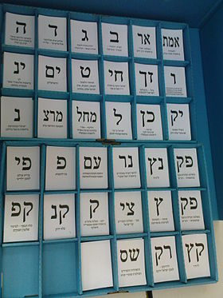
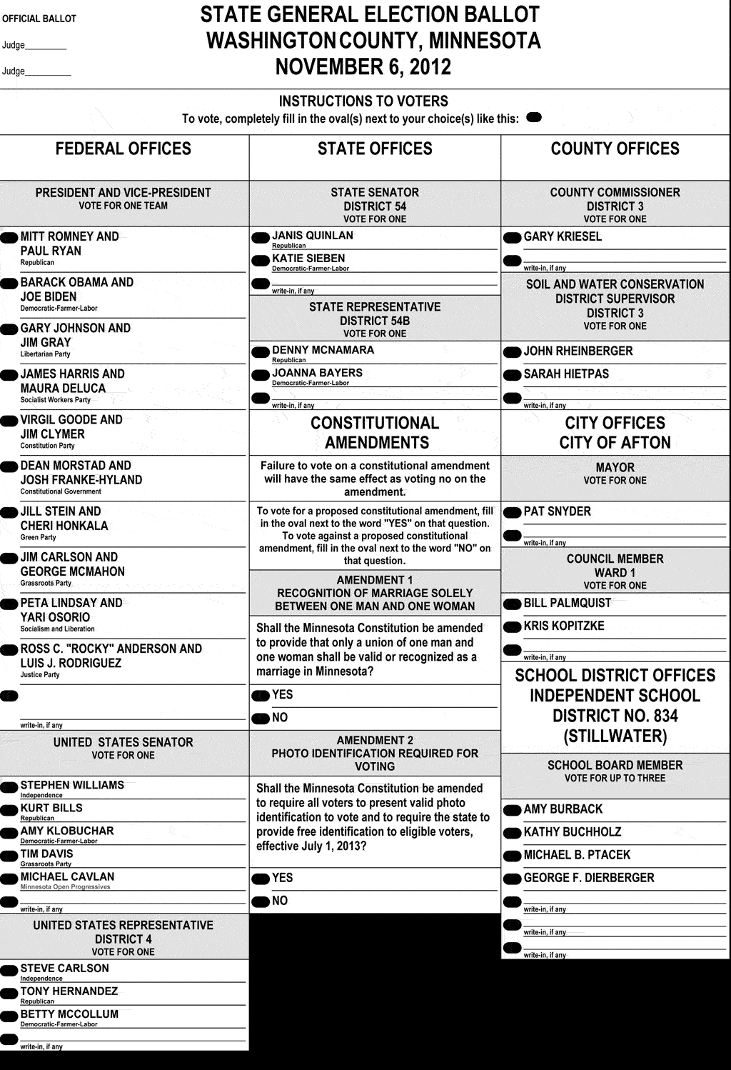
Easy process as part of equality
Notes:
תהליך ישראלי פשוט מאוד . דוגמא האותיות להקל על בחירת המפלגה

Slide 7
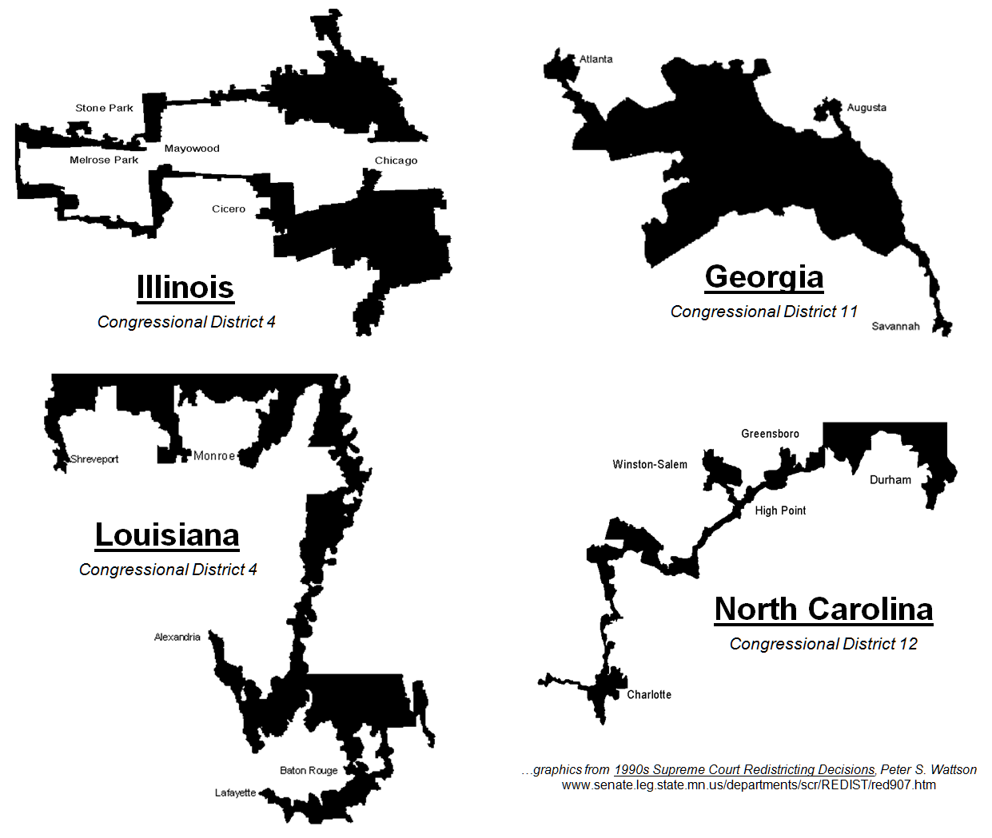
Principles
National: The entire country constitutes a single electoral constituency
(voting for a list not person)
Notes:
לדבר על האחוז חסימה שעלה מ2% ל4%.. כוח המפלגות הערביות 11 מנדטים בסקרים

Slide 8
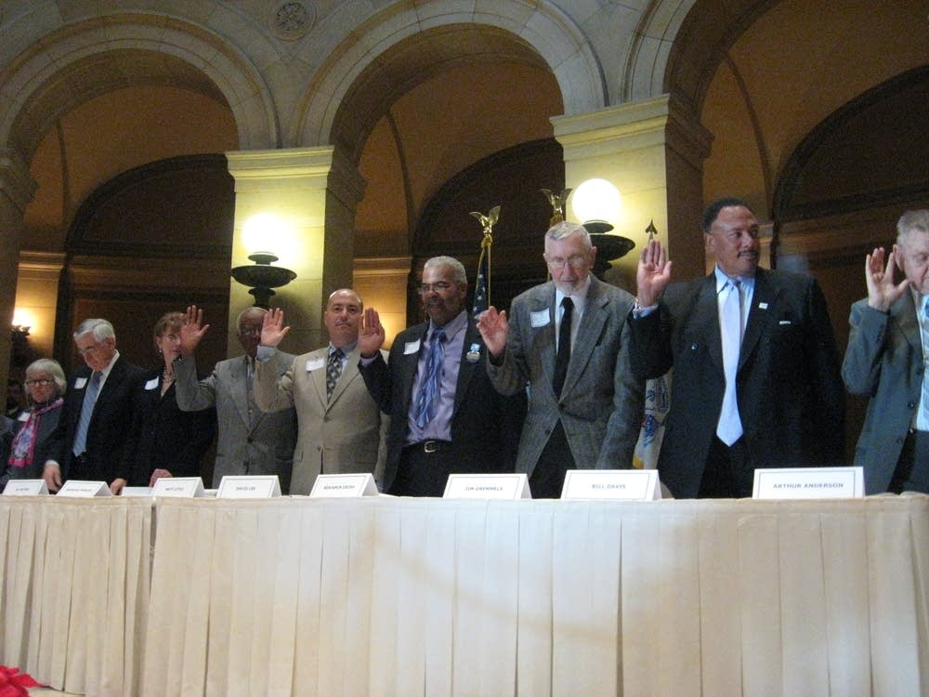
Principles
National: The entire country constitutes a single electoral constituency
Direct: The Knesset, the Israeli parliament, is elected directly by the voters, not through a body of electors
Minnesota's 10 electoral college members MPR Photo/Curtis Gilbert
Notes:
לדבר על האחוז חסימה שעלה מ2% ל4%.. כוח המפלגות הערביות 11 מנדטים בסקרים

Slide 9
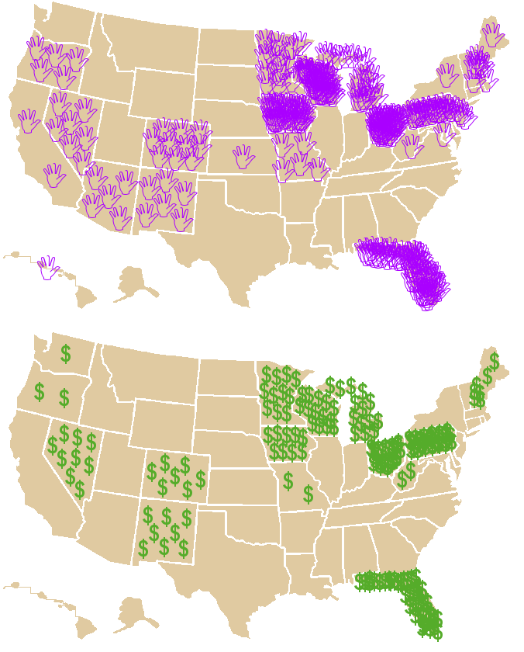
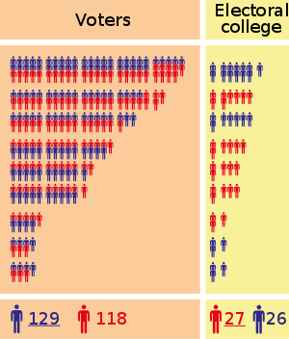
Principles
National: The entire country constitutes a single electoral constituency
Direct: The Knesset, the Israeli parliament, is elected directly by the voters, not through a body of electors
Equal: All votes cast are equal in weight
Notes:
לדבר על האחוז חסימה שעלה מ2% ל4%.. כוח המפלגות הערביות 11 מנדטים בסקרים

Slide 10
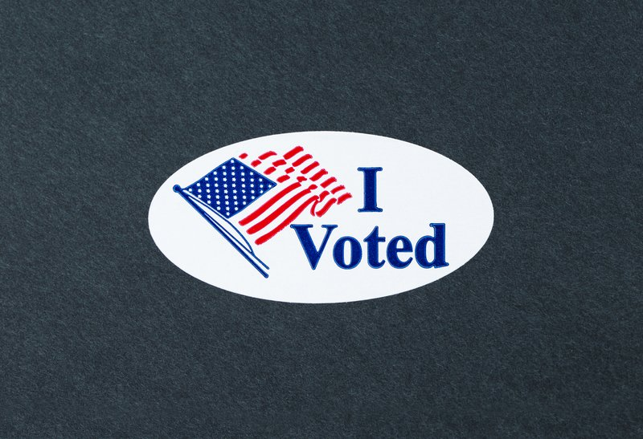
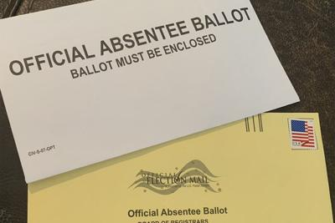
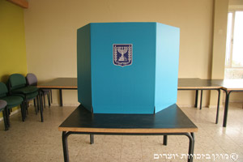
Principles
National: The entire country constitutes a single electoral constituency
Direct: The Knesset, the Israeli parliament, is elected directly by the voters, not through a body of electors
Equal: All votes cast are equal in weight
Secret: Elections are by secret ballot
Notes:
לדבר על האחוז חסימה שעלה מ2% ל4%.. כוח המפלגות הערביות 11 מנדטים בסקרים

Slide 11
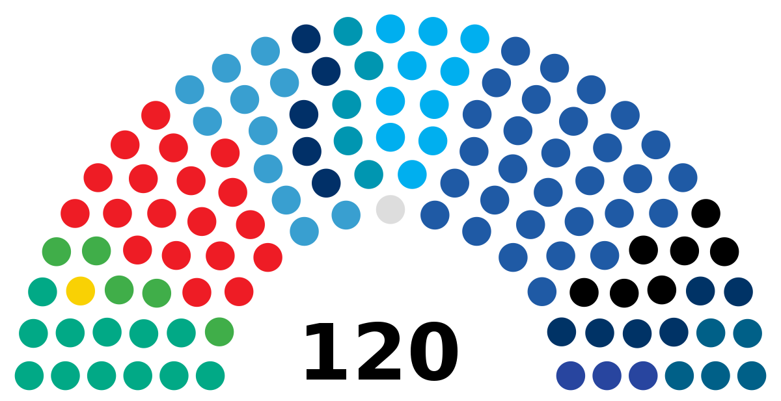
Principles
National: The entire country constitutes a single electoral constituency
Direct: The Knesset, the Israeli parliament, is elected directly by the voters, not through a body of electors
Equal: All votes cast are equal in weight
Secret: Elections are by secret ballot
Proportional: The 120 Knesset seats are assigned in proportion to each party's percentage of the total national vote
Notes:
לדבר על האחוז חסימה שעלה מ2% ל3.25%.

Slide 12
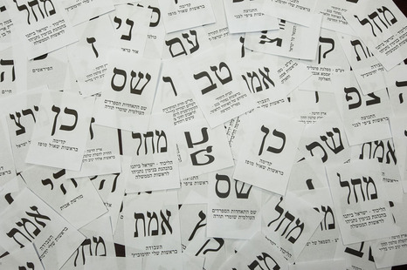
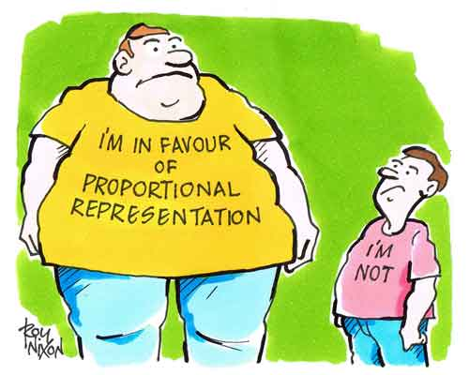
The Israeli voting system
parliamentary democracy
based on nationwide proportional representation (PR)-
For example:
On the last elections in 2013, we hade 3,792,742 votes.
To see how many votes represent every Knesset (Parliament) member, split this number in 120- the number of the Knesset members.
3,792,742 / 120= 31,606votes for every Knesset member (Mandate)
Notes:
הדמוקרטיה בארץ היא דמוקרטיה פרלמנטרית. אנחנו מצביעים עבור מפלגות, וראש המפלגה הגדולה ביותר (לרוב) שנבחרה על ידי העם, הוא ראש הממשלה.
חלוקת חברי הפרלמנט נעשית בצורה של PR- הדוגמא מסבירה את זה טוב. לא כדאי להיכנס למה עושים עם השארית וכו', אלא להישאר עם הבסיס של חלוקת סך הקולות הכשרים ב120 ולפי זה מחלקים את המנדטים.

Slide 13
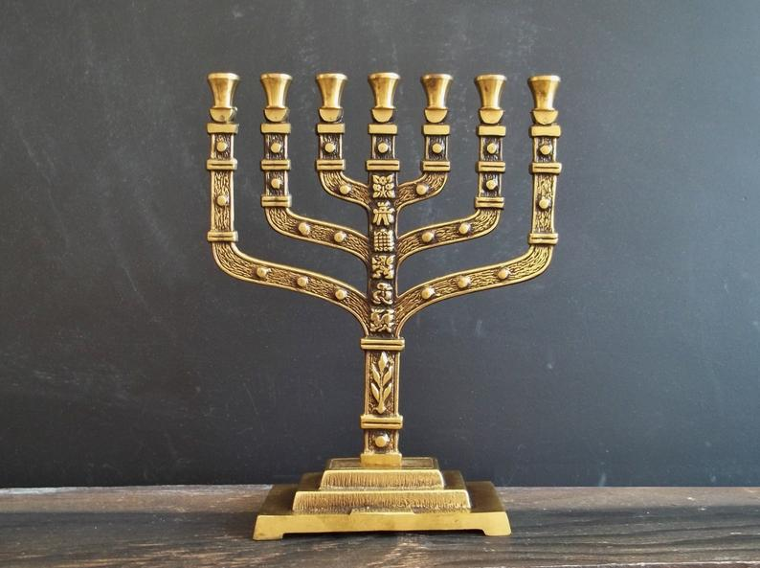
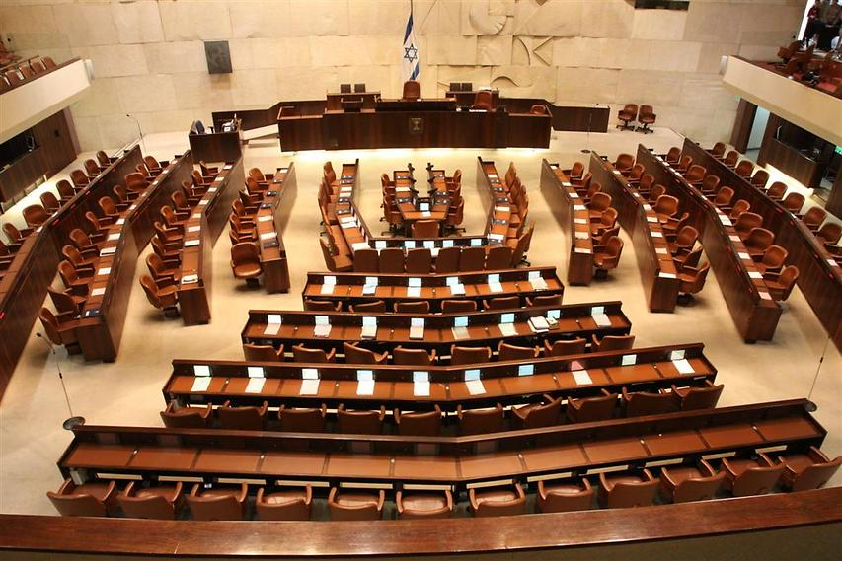
Who are we voting for?
What is this shape?
Knesset elections are based on a vote for a party rather than for individuals
The many political parties – 41 which compete for election to the Knesset reflect a wide range of outlooks and beliefs
The coalition is all the parties who support the government.
The opposition are the parties who run against the government
The coalition must be more than half (61 seats) of the Knesset

Slide 14
Numbers to remember!
3.25% to be part of the game (4 Knesset mandates)

Slide 15
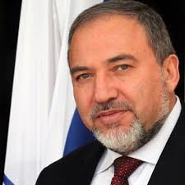
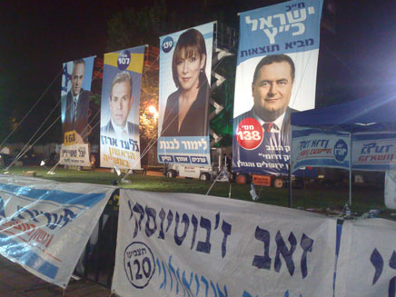
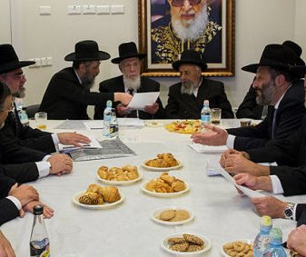
Who Picks The Party List?
Party leader
Primaries
Committee

Slide 16
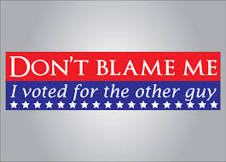
Quick quiz to begin!!
Find out what political party you support!
Link: https://israelpolicyforum.org/elections/#quiz

Slide 17
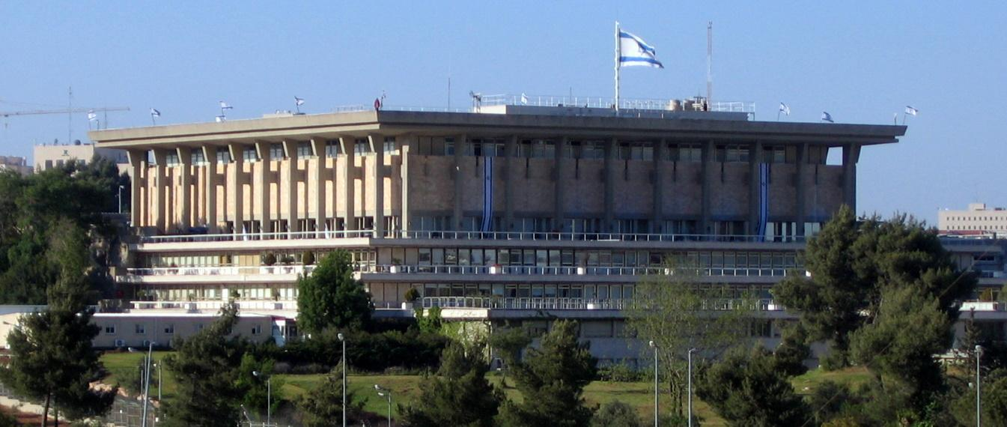
The political parties
Notes:
להסביר שהתפיסה של ימין ושמאל בישראל כפי שאנחנו מכירים אותה היום היא תוצאה של 67. עד אז ההבדלים היו בעיקר כלכליים, אבל היום כשתשאלו את הישראלי הממוצע מה ההבדל בין ימין לשמאל, תשמעו שהנושא העיקרי הוא ארץ ישראל השלמה אל מול שטחים תמורת שלום, ובכלל, הסכסוך הישראלי פלסטיני הוא העיקר.

Slide 18
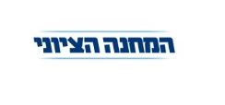
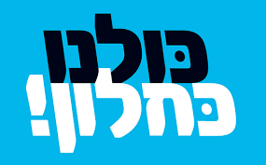
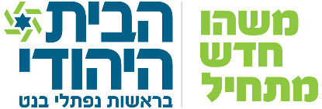
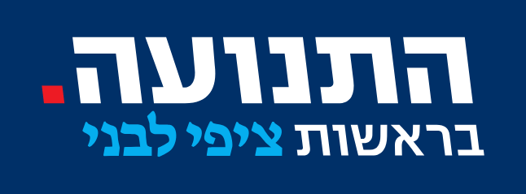
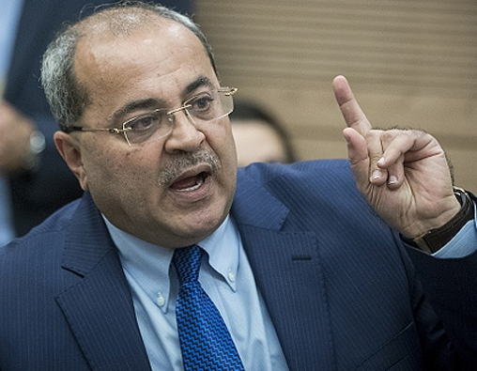
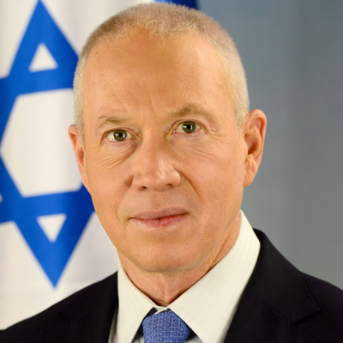
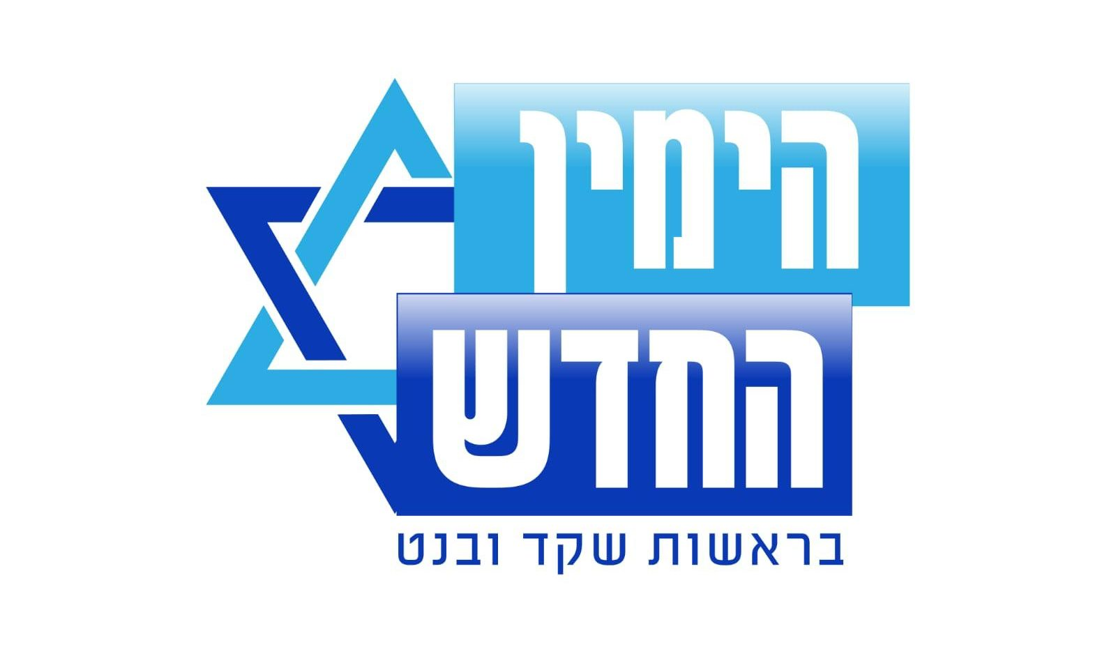
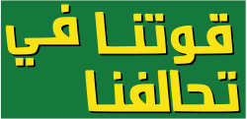
What is Going on Now?

Slide 19
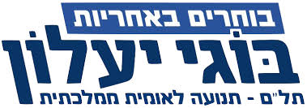
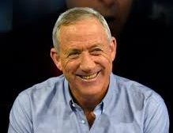
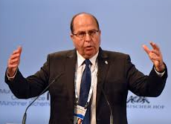
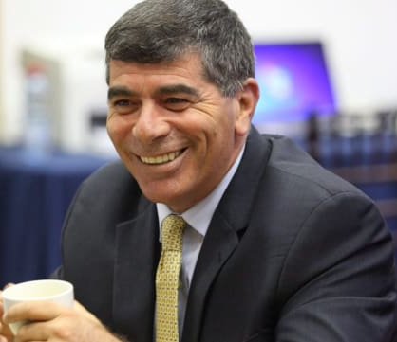
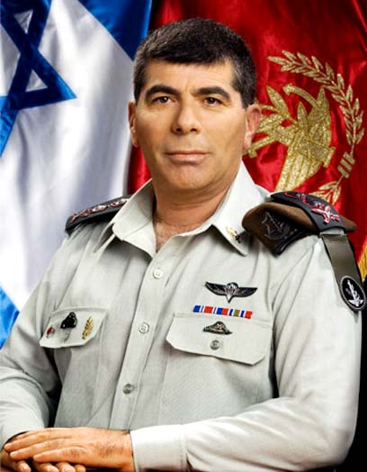
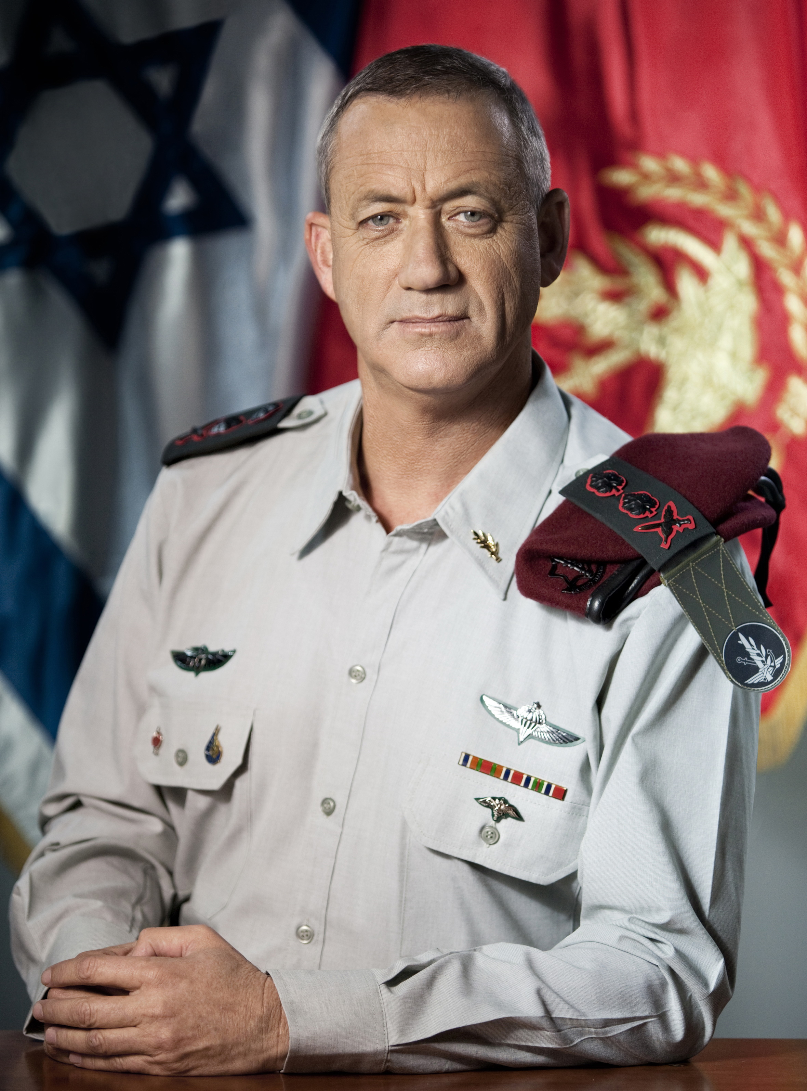
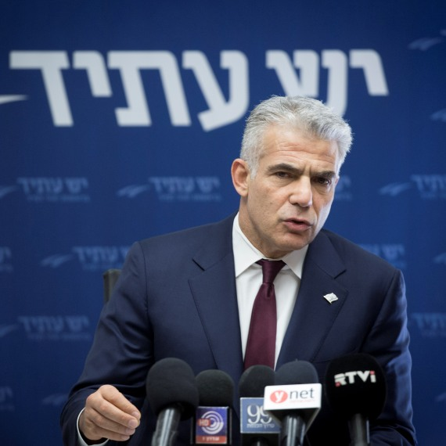
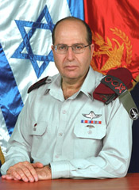
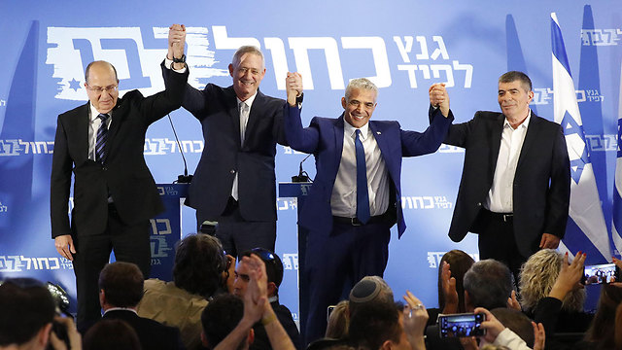
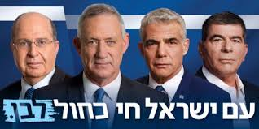

Slide 20
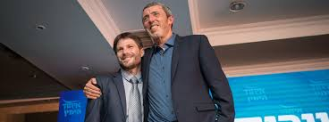
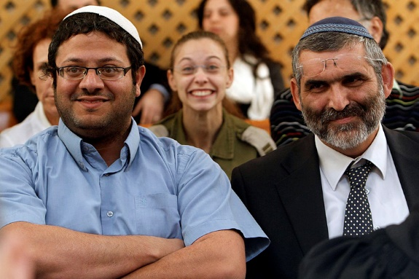
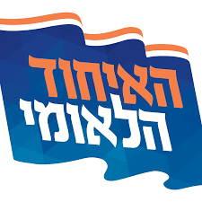

Slide 21
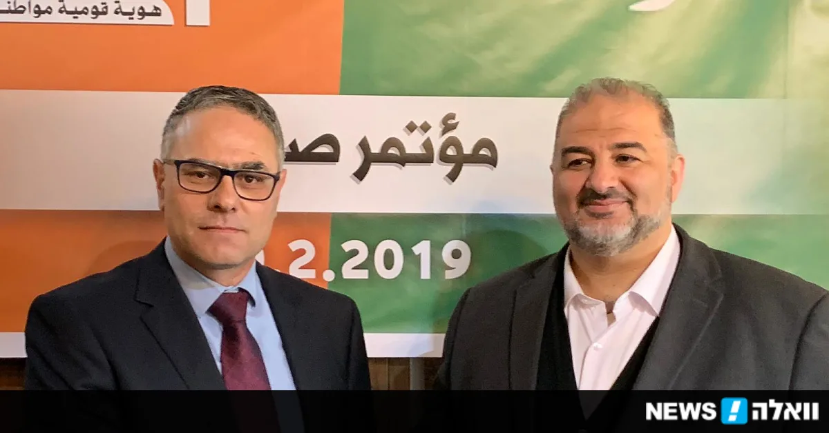
United Arab List
(Ra’am)
Balad
Hadash
Ta'al
2015
2019
United Arab List
(Ra’am)
Balad
Hadash
Ta'al
Notes:
חדש- קומונוסטי לניניסטי.
רע"ם- איסלאמית. מנסור עבאס
תע"ל – טיבי (גאווה לאומית וחילוניות מיינסטירים).
בל"ד – לאומית (כל אזרחיה). מטאנס שחאדה

Slide 22
United Arab List
(Ra’am)
Balad
Hadash
Ta'al

Slide 23
Survey
Notes:
This is based on recent polls (24/2) and things can still change.
It is important to note that the threshold is 4 seats, and there are currently 4 parties on that verge of not passing the threshold and disappearing, so these elections will not be decided necessarily at the top but rather at the bottom- who will the large parties have to form a coalition with.

Slide 24
A glimpse to Israeli society –

Slide 25
Deeply divided society
Overlapping divisions
Cross divisions

Slide 26
Notes:
https://www.themarker.com/news/1.2593960

Slide 31
The rate of participation of Arab citizens of Israel in the elections, 1949-2009

Slide 32
One option to divide
In an interview with journalist Daniel Ben Simon, immediately after the 1996 elections, shimon Peres was asked about the results of the 1996 elections.
Peres's answer: We lost.
Ben Simon: Who are we?
Peres: We are Israelis.
Ben-Simon: And who won?
Peres: Anyone who does not have an Israeli mentality.
Ben-Simon: Who are these?
Peres: Call it "Jews."
Arthur Jay Finkelstein
Notes:
32

Slide 33
What next?
Notes:
After we know who all the members of Knesset are, we need to form a government.
In order to do that a majority in the Knesset is required- all the parties recommend to the president who they think should be the one to form the government.
Based on those recommendations, the president gives the right to form a coalition to the one with the highest chances of succeeding.
Usually the head of the largest party is the one that forms the coalition. Is it always like that? Of course not, back in 2009 “Kadima” party got 1 seat more than Netanyahus’ Likud, but Tzipi Livni the head of Kadima was unable to form a coalition and the duty was passed over to Netanyahu while Kadima was sent to the opposition.

Slide 34
The main issues for this elections
Netanyahu – anyone but Netanyahu.
Right wing – left wing bloc.
Security
The small parties and the threshold.
Attorney General recommend to charge Netanyahu
Trump peace deal ?!@
Religionization (הדתה)
Jewish power party
Judicial system
Nation state law
Ethnic devotion – Mizrahi Ashkenazi etc’
Economic issues- Housing, cost of living, hospitals etc.
Connection with the diaspora.
What do you want to talk about?
Notes:
קריקטורות:
https://www.haaretz.co.il/opinions/caricatures
https://www.inn.co.il/Album.aspx/1/114730
https://www.israelhayom.co.il/caricatures?date%5Bvalue%5D%5Bdate%5D=2018-10-13

Slide 35
Connection with the diaspora.
I am
Jewish
I am
Israeli
I am
Zionist

Slide 37
1000 (Cigars) -Fraud and breach of trust
2000 (Yedioth Ahronoth) - Fraud and breach of trust
4000 (Walla + Bezeq)- Taking bribes, fraud and breach of trust
Avichai Mandelblit the Attorney General of Israel.

Slide 40
Nation state law
Basic Law: Israel - The nation state of the Jewish people
1. The State of Israel
a) Israel is the historic homeland of the Jewish people in which the State of Israel was established.
b) The state of Israel is the nation-state of the Jewish people, in which it fulfills its natural, religious, and historic right to self-determination.
c) The fulfillment of the right of national self-determination in the State of Israel is unique to the Jewish people.
2. National symbols of the State of Israel
a) The name of the state is Israel.
b) The flag of the state is white, two blue stripes near the edges, and a blue Star of David in the center.
c) The symbol of the state is the Menorah with seven branches, olive leaves on each side, and the word Israel at the bottom.
d) The national anthem of the state is "Hatikvah"
e) [Further] details concerning the issue of state symbols will be determined by law.
Notes:
https://www.justice.gov.il/StateIdentity/ProprsedBasicLaws/Pages/NationalState.aspx

Slide 41
3. [The] unified and complete [city of] Jerusalem is the capital of Israel.
4. The Language of the State of Israel
a) Hebrew is the language of the state.
b) The Arabic language has a special status in the state; the regulation of the Arab language in state institutions or when facing them will be regulated by law.
c) This clause does not change the status given to the Arabic language before the basic law was created.
5. The state will be open to Jewish immigration and to the gathering of the exiled.
6. The Diaspora
a) The state will labor to ensure the safety of sons of the Jewish people and its citizens who are in trouble and captivity due to their Jewishness or their citizenship.
b) The state will act to preserve the cultural, historical and religious legacy of the Jewish people among the Jewish diaspora.

Slide 42
7. The state views Jewish settlement as a national value and will labor to encourage and promote its establishment and development.
8. The Hebrew calendar is the official calendar of the state and alongside it the secular calendar will serve as an official calendar. The usage of the Hebrew calendar and of the secular calendar will be determined by law.
9. National Holidays
a) Independence Day is the official holiday of the state.
b) The Memorial Day for those who fell in the wars of Israel and the Memorial Day for the Holocaust and heroism are official memorial days of the state.
10. Saturday and the Jewish Holidays are the official days of rest in the state. Those who are not Jewish have the right to honor their days of rest and their holidays. Details concerning these matters will be determined by law.
11. This Basic Law may not be altered except by a Basic Law that gained the approval of the majority of the Knesset members.

Slide 43
One way to put it:
State of all its citizens
There isn’t a Jewish expression to the state
Cultural Nation State
Expression of Judaism in symbols, holidays, civil laws and language
Religious National State
Religious laws in public
Halachic State
Religious laws in private and in public

Slide 46
Netanyahu – anyone but Netanyahu.

Slide 50
Ethnic devotion – Mizrahi Ashkenazi etc’

Slide 51
Religionization (הדתה)

Slide 53
Jewish power party

Slide 54
Judicial system

Slide 55
The small parties and the threshold.

Slide 56
Trump peace deal ?!@

Slide 57
Economic issues- Housing, cost of living, hospitals etc.

Slide 58
Right wing – left wing bloc.

Slide 59
United Arab List
(Ra’am)
Balad
Hadash
Ta'al

