Slide 1
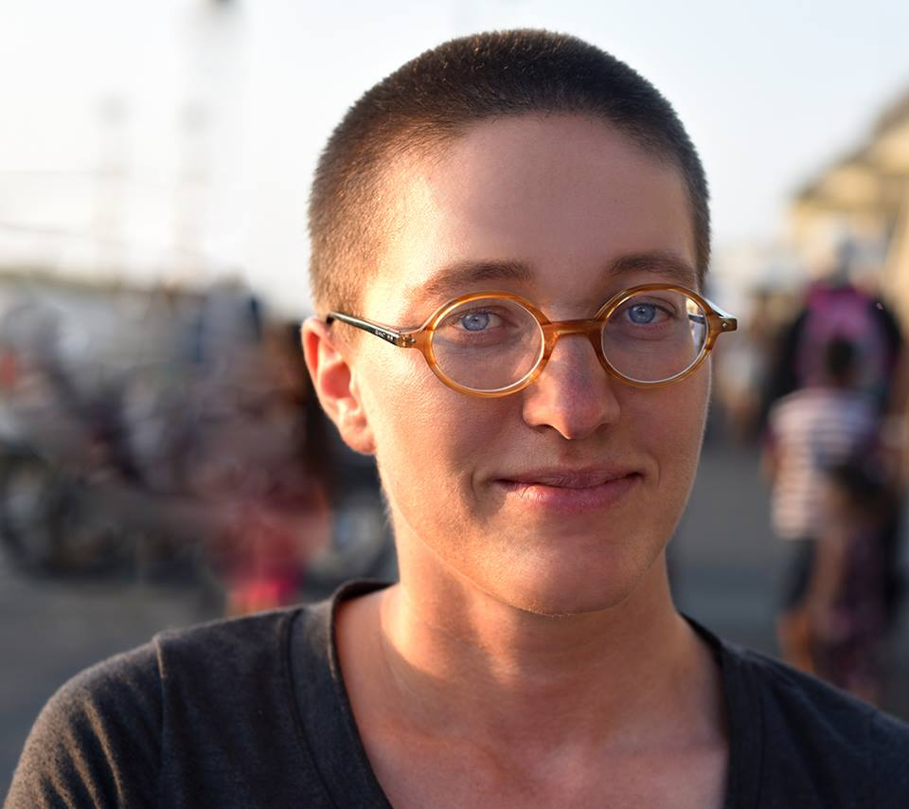
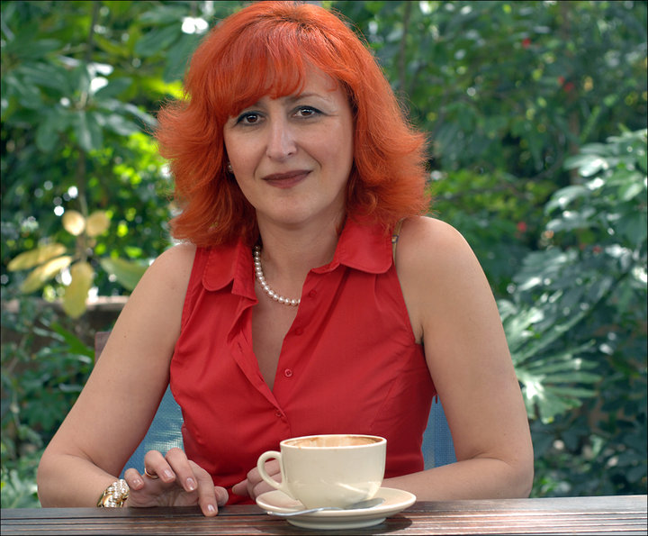
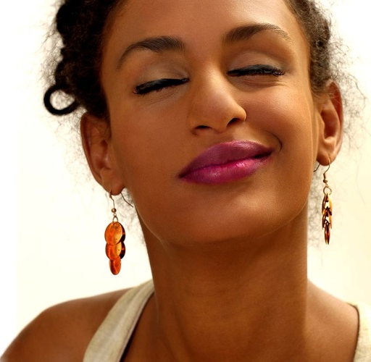
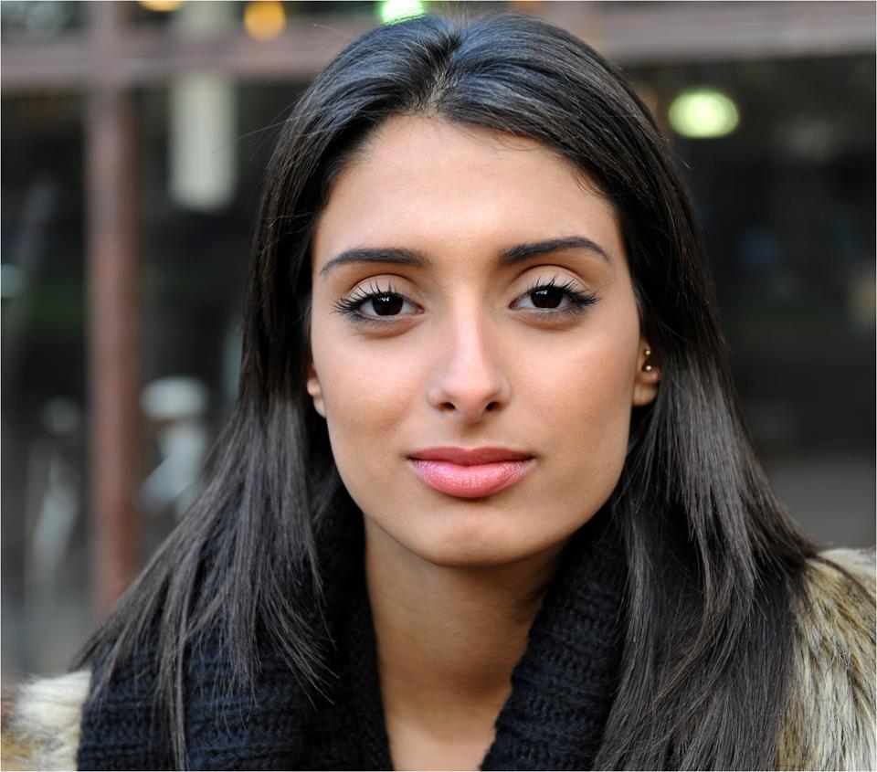
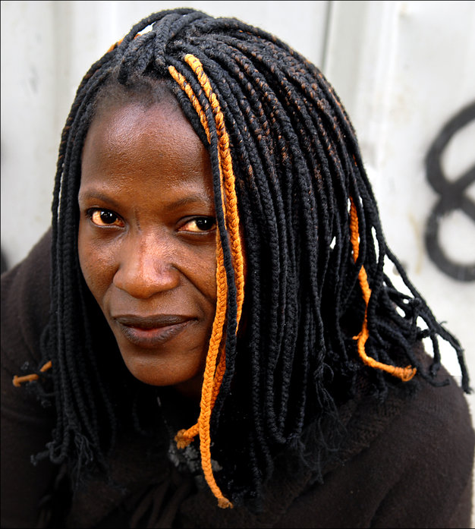
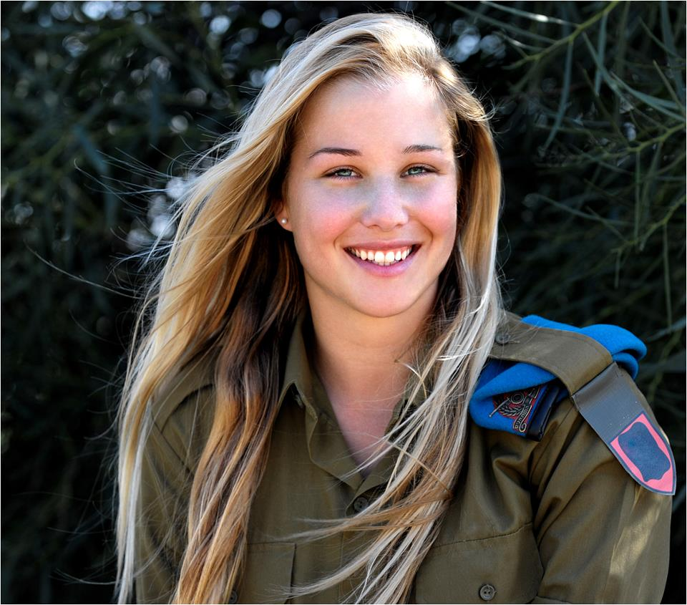
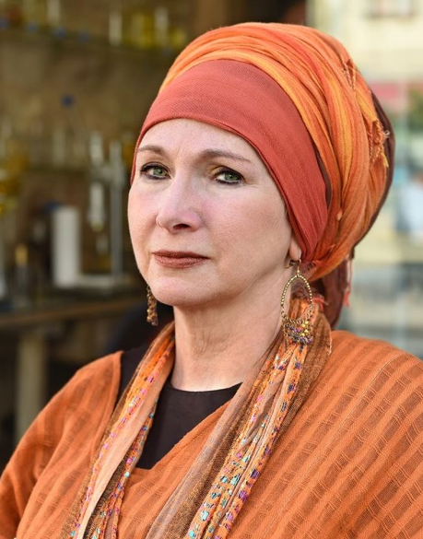
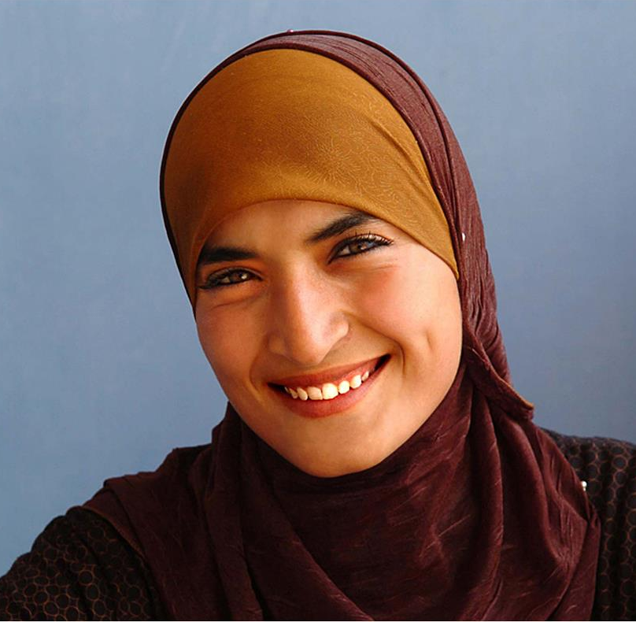
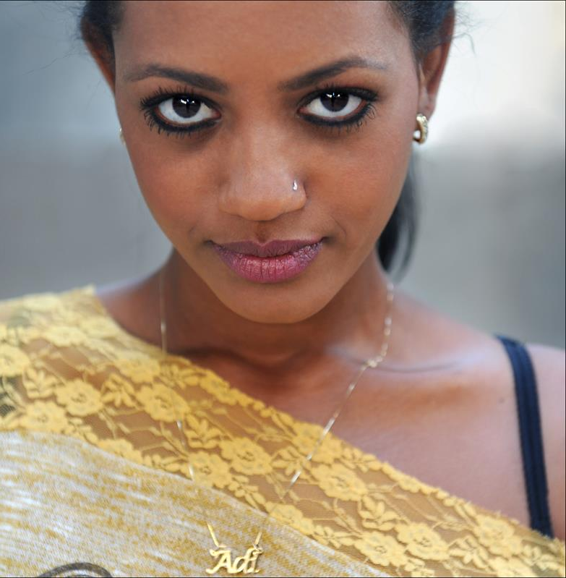
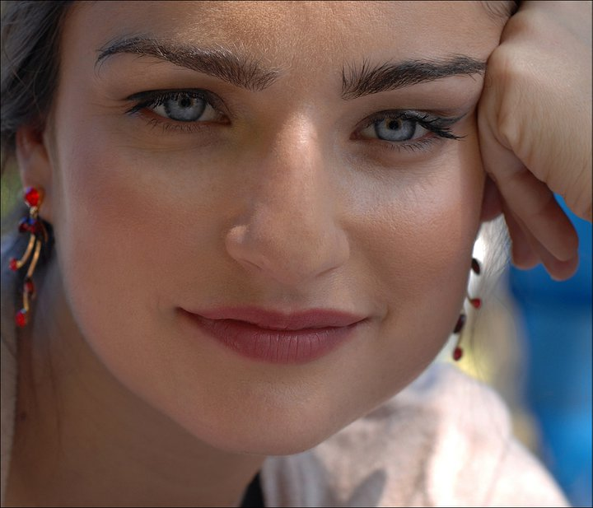
Women In Israel

Slide 2
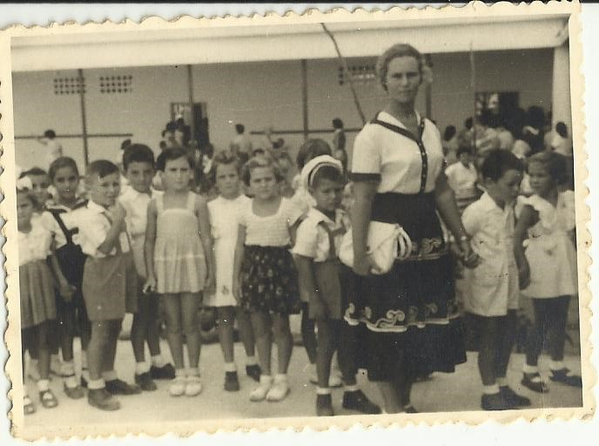
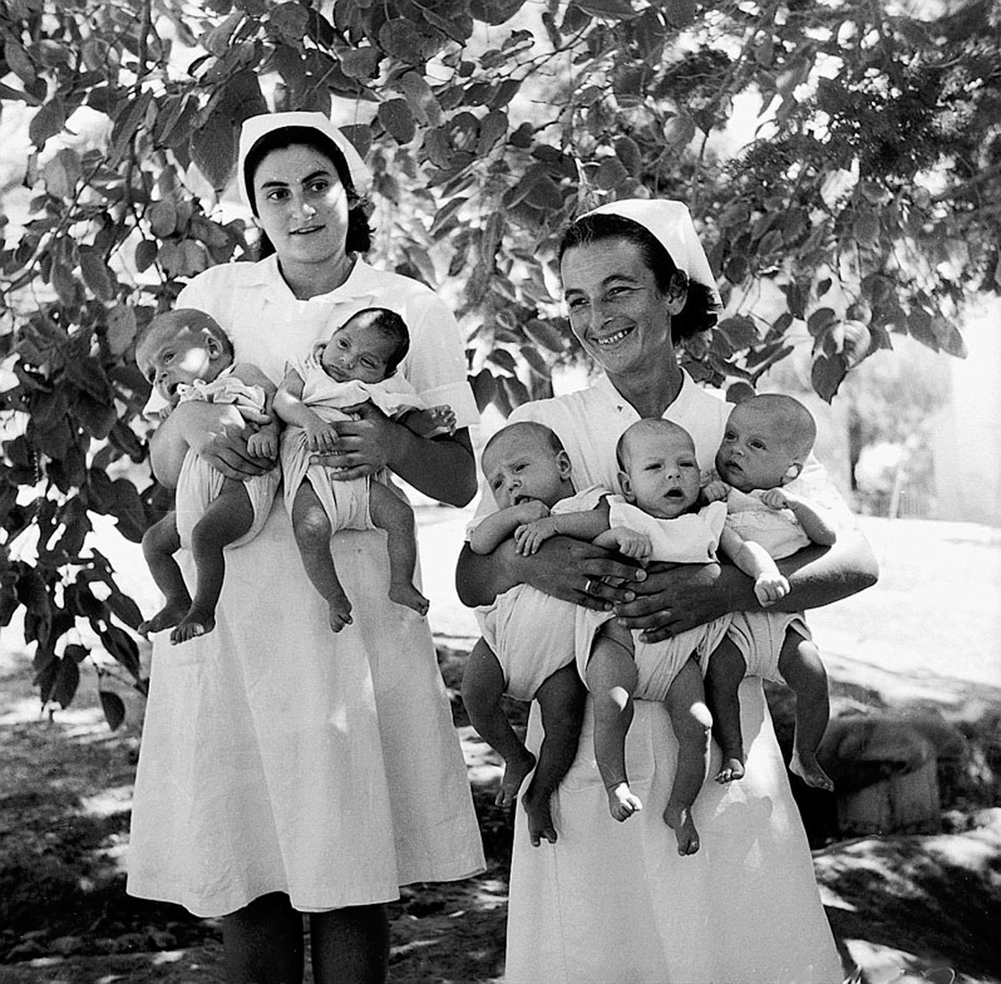
First Aliyah 1882 - 1904

Slide 3
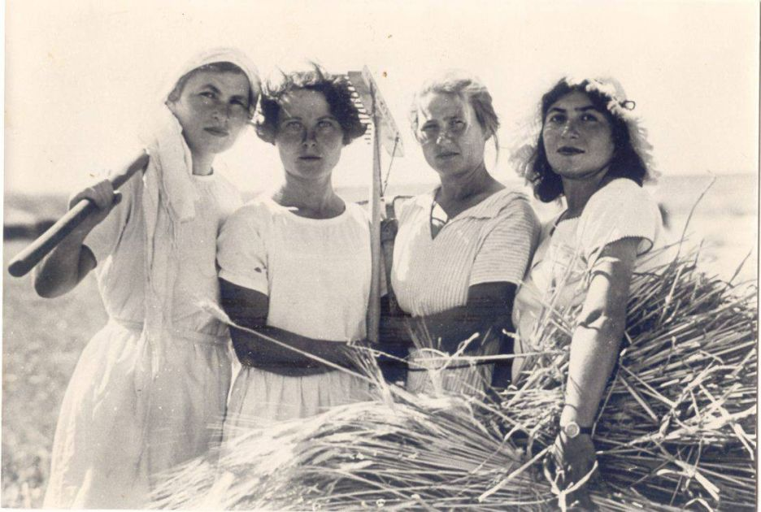
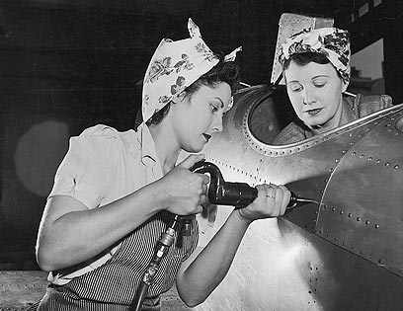
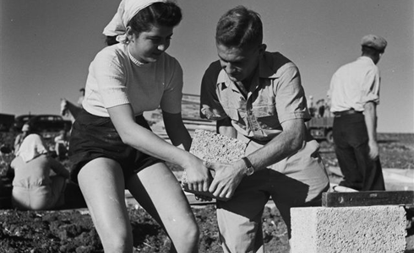
Second Aliyah
1904 - 1914

Slide 4
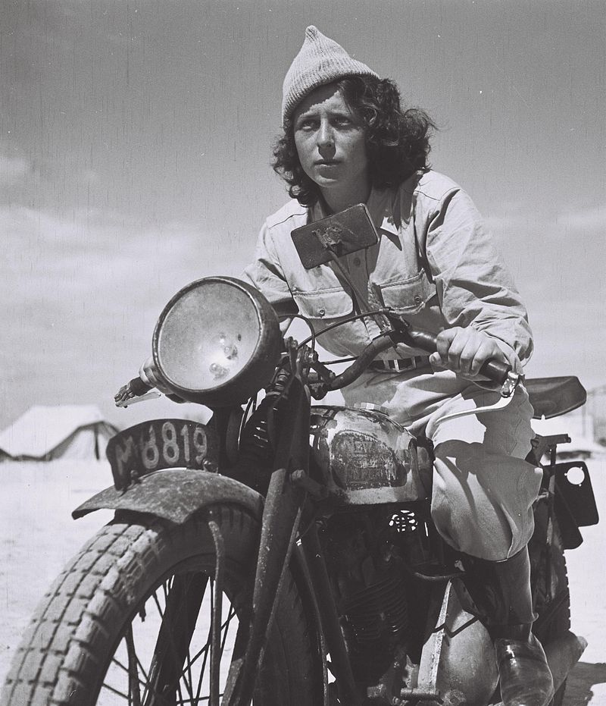
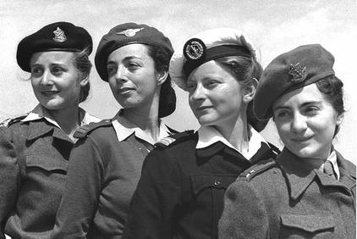
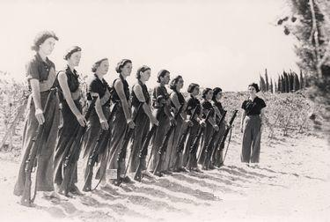
Before the establishment of the state, women served in combat roles in the militias that would become the Israel Defense Forces

Slide 5
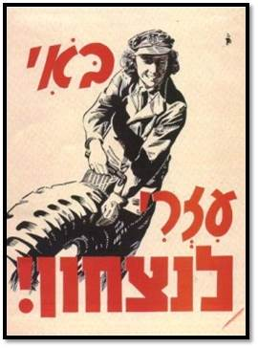
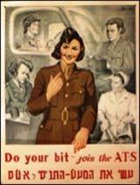

Slide 6
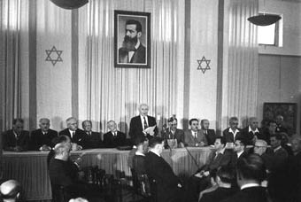
THE DECLARATION OF THE ESTABLISHMENT OF THE STATE OF ISRAEL: May 14, 1948
“…will ensure complete equality of social and political rights to all its inhabitants irrespective of religion, race or gender;”

Slide 7
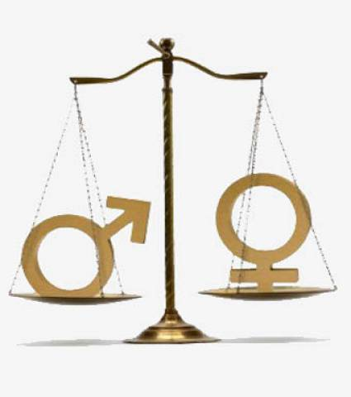
Women's Equal Rights Law -1951 : The purpose of the law, as its name indicates, is “to create equality between men and women, and to prevent and eradicate all legal discrimination against women"
1954 - Employment Women Law
• 1996 - Equal Pay Law
• 1988 - Equal Opportunity in Employment Law
• 1998- The law against sexual harassment

Slide 8
Na'amat in Israel נעמ"ת‎
The largest Israeli women's organization
Founded in 1921
Has a membership of 800,000 women, (Jews, Arabs, Druze and Circassians) representing the entire spectrum of Israeli society
100 branches in cities, towns and settlements all over the country

Slide 9
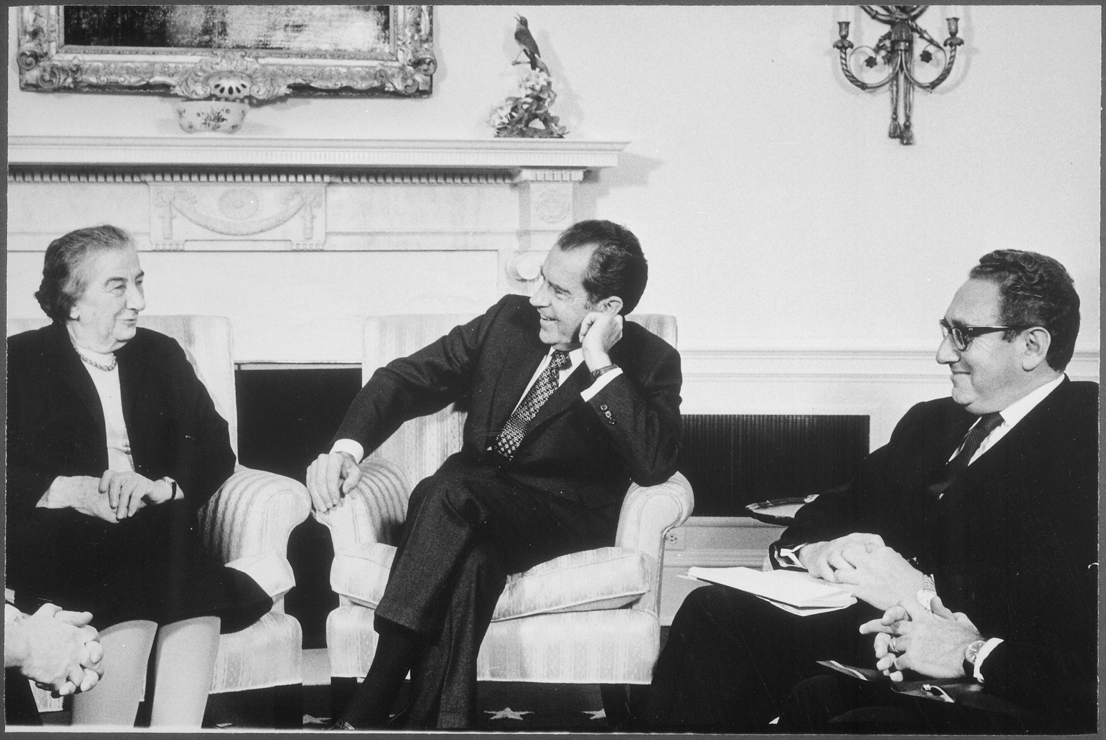
Political leadership

Slide 10
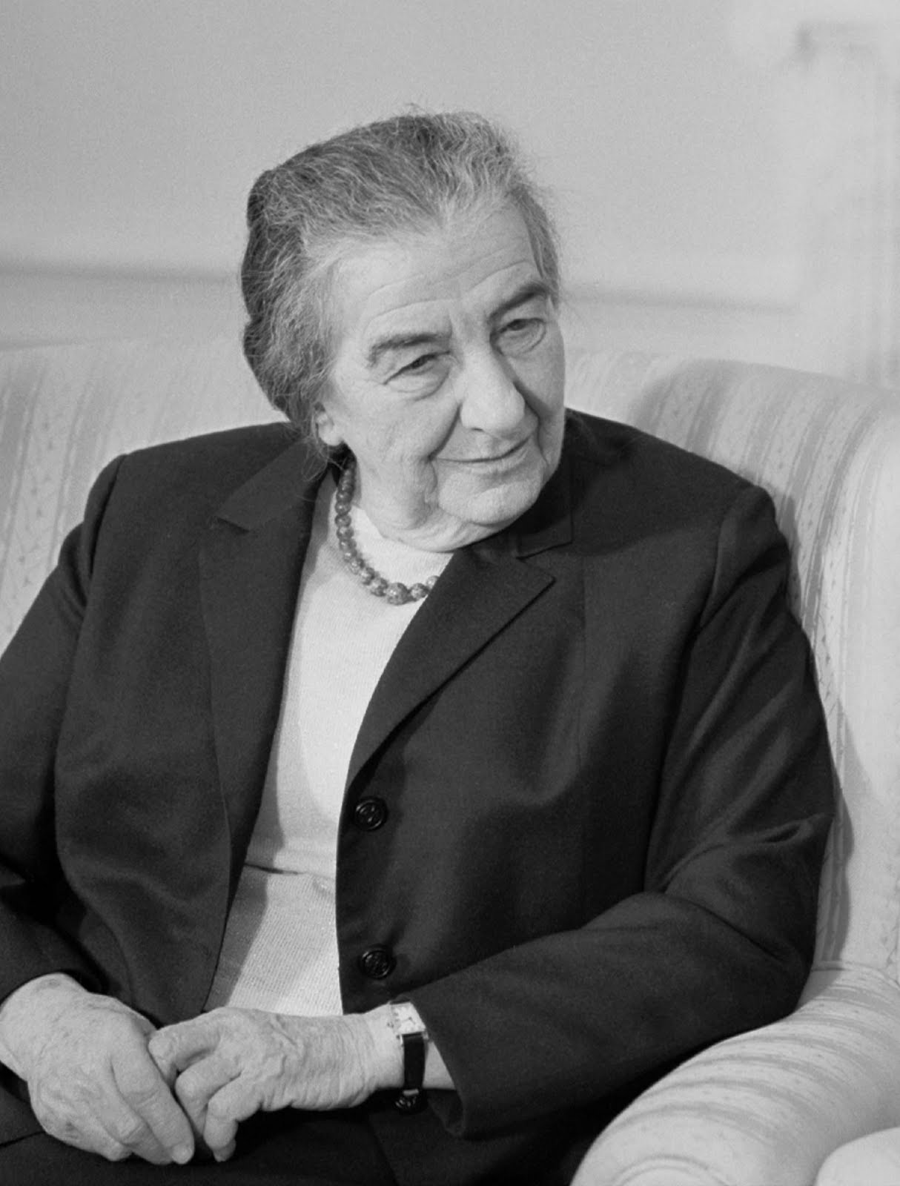
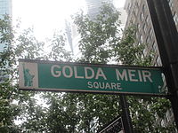
Golda Meir
The fourth Prime Minister of Israel 1969-1974
First female Israeli prime minister
Third female prime minister in the world
Golda Meir Square is designated in New York City south of Times Square

Slide 11
Percentage of Women in Knesset

Slide 12
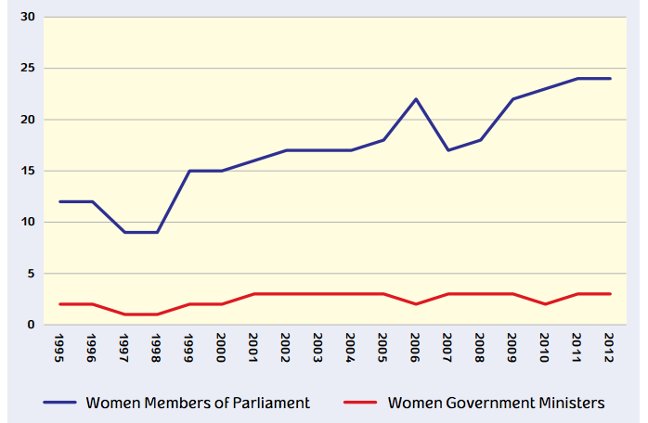
Although the percentage of women in Knesset has increased over the last 30 years, the percentage of women ministers has not

Slide 13
How Does Israel Compare?
Percentage of Women in National Governments 1990-2014

Slide 14
Women on Party Lists
Party | Total Seats | Number of Women
Likud | 30 | 6
Zionist Camp | 24 | 8
Habayit Hayehudi | 8 | 1
Shas | 7 | 0
United Torah Judaism | 6 | 0
Arab Parties | 13 | 2
Yesh Atid | 11 | 3
Kulanu | 10 | 4
Meretz | 5 | 3
Israel Beiteinu | 6 | 2

Slide 15
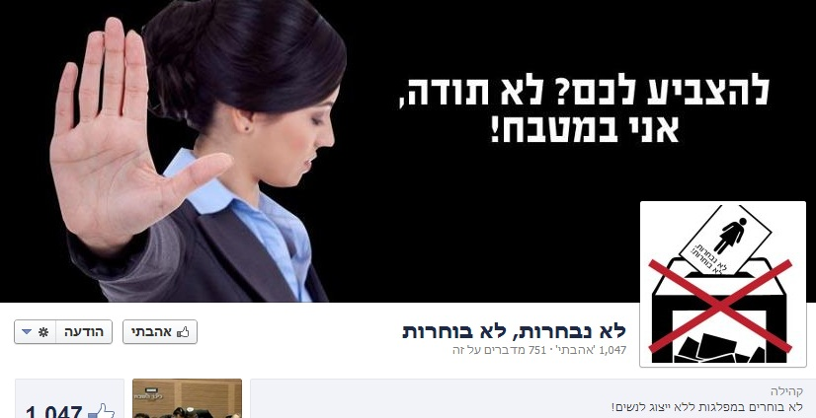
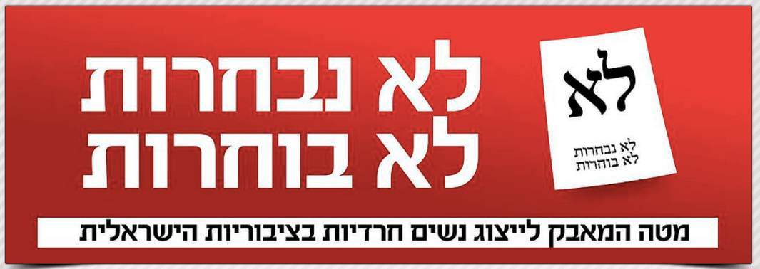
Lo Nivcharot, Lo Bochorot No Representation, No Voting
A campaign of Ultra Orthodox women
Demand: Haredi women want representation on lists of existing Haredi parties or they won’t vote for them

Slide 16
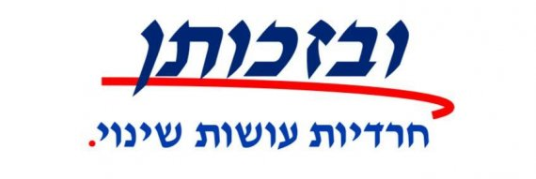
B’Zhutan: Haredi Women Making a Change
“We want to preserve our identity and demonstrate that women can be educated, be leaders and stay Haredi”

Slide 17
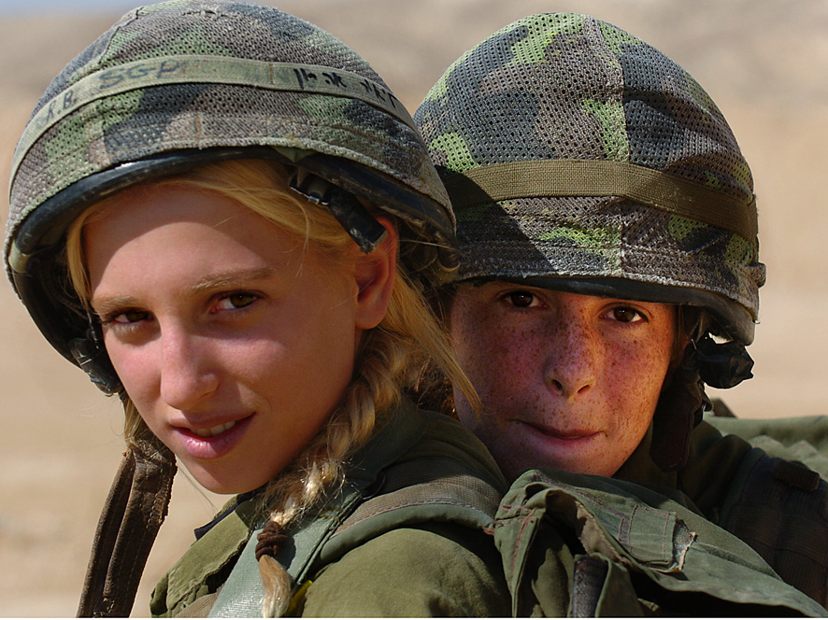
Women in the military

Slide 18
1994
Alice Miller

Slide 19
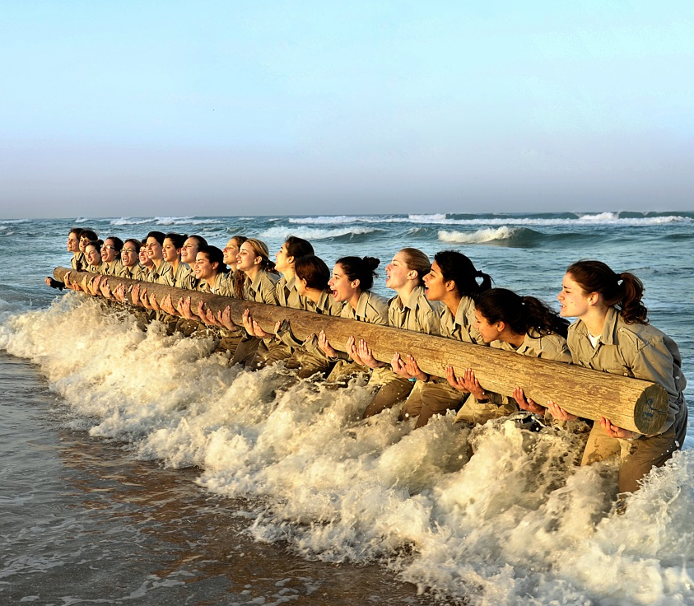
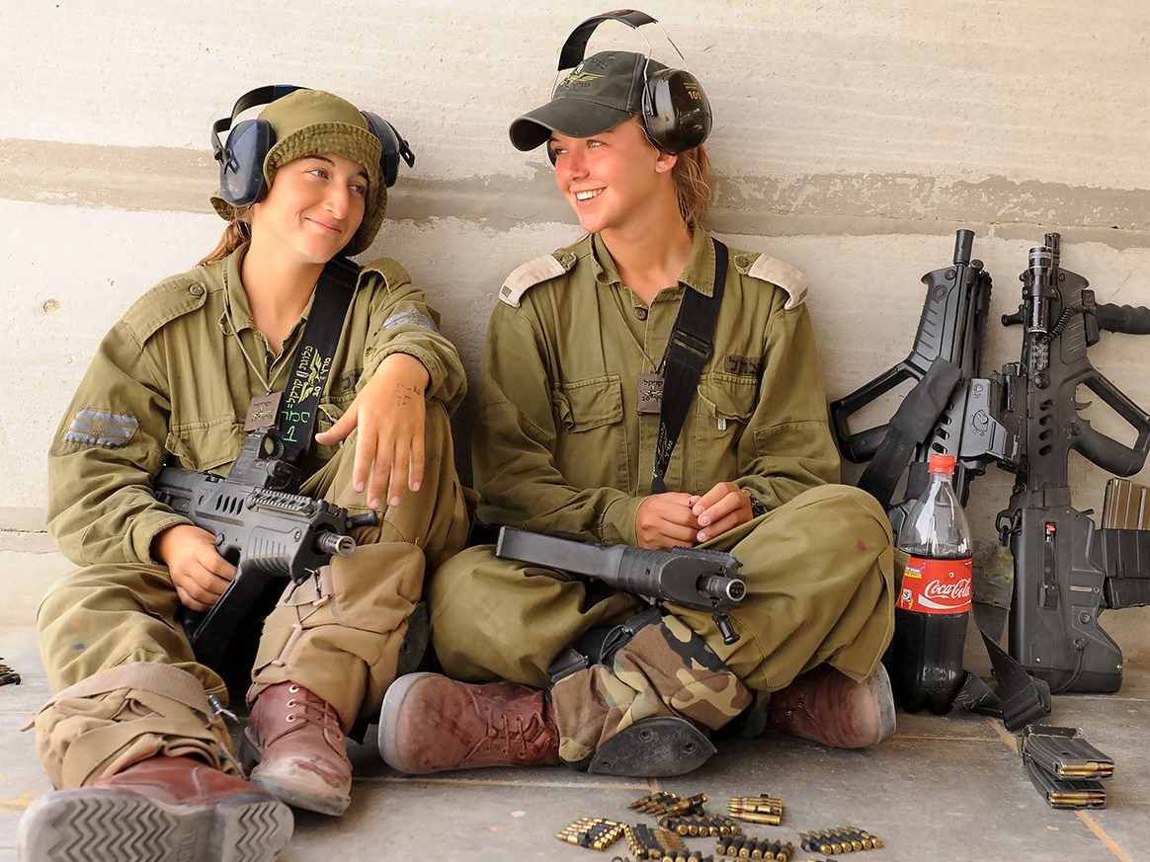
Today, 92% of positions in the IDF are open for woman

Slide 20
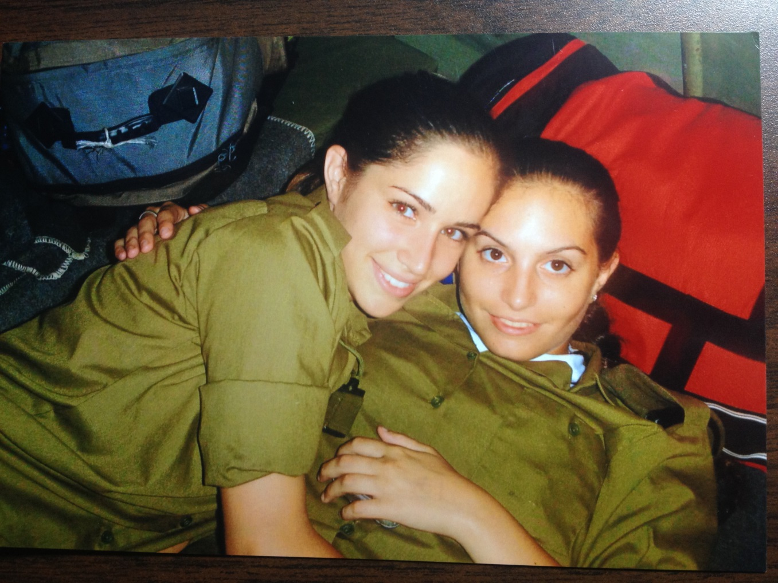
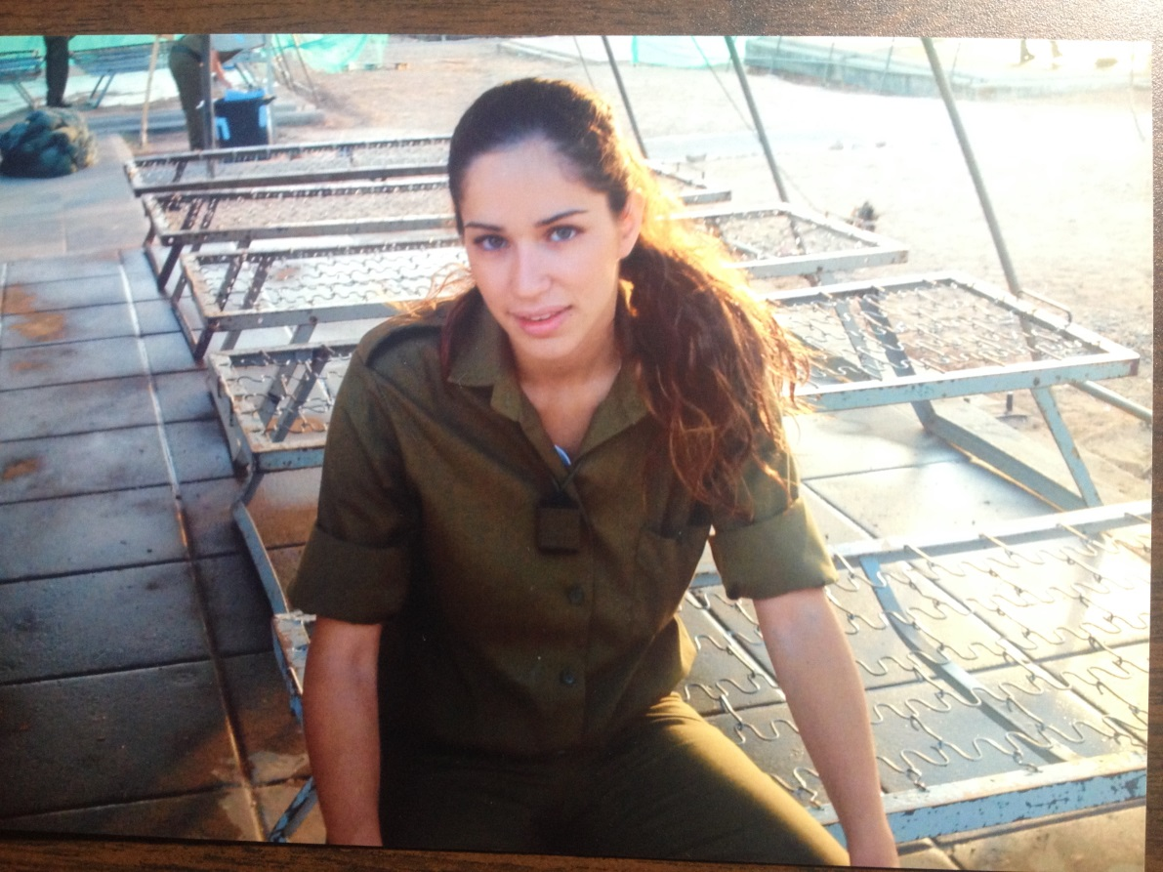
2006

Slide 21
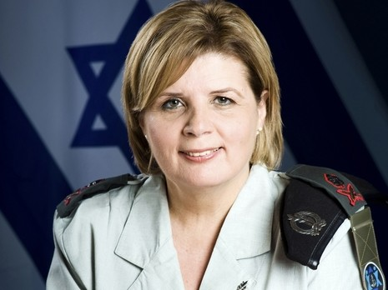
Orna Barbivai
The first (and only) female Major-general in the Israel Defense Forces (IDF’s second highest rank)

Slide 22
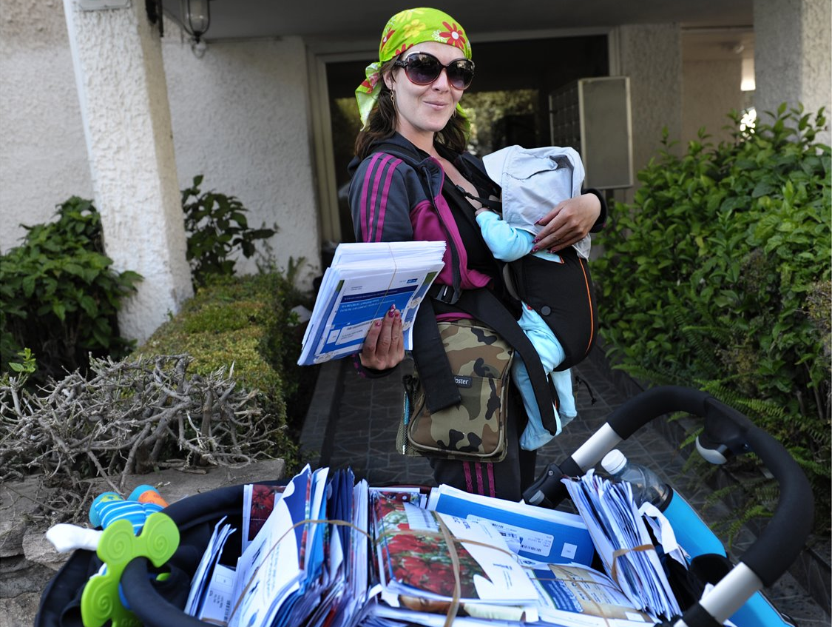
Women in the workforce

Slide 23
Wage gaps in Israel - Hourly wages
2013

Slide 24
There are significant wage disparities between men and women
Since 1948, the representation of women among the members of the Knesset, relative to men, was low
Although there are more women than men in higher education institutes, women concentrate in "feminine" professions and not in those considered to have high earning potential
Israeli law prohibits discrimination in employment and wages, and provides for class action suits
Israel was the third country in the world to be led by a female prime minister
Israel has always had at least one woman on its Supreme Court – 2 female presidents
Majority of military positions are open for women.

Slide 25
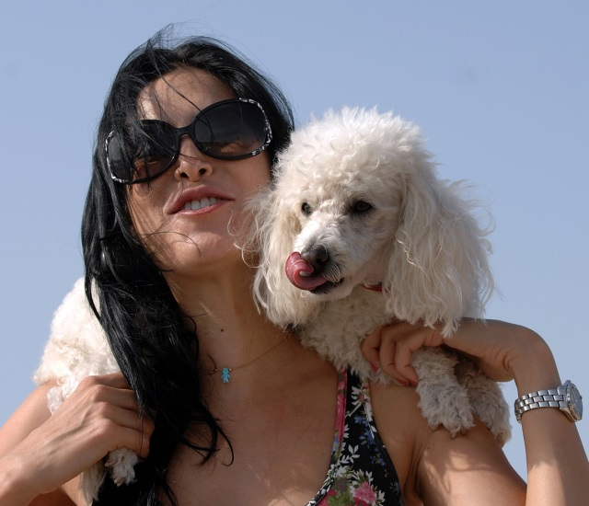
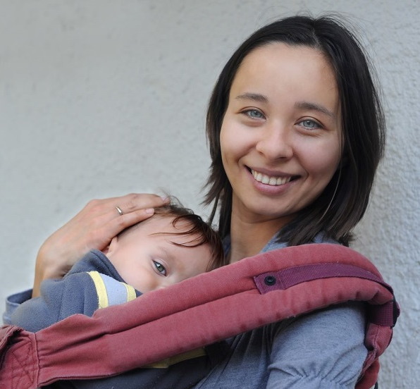
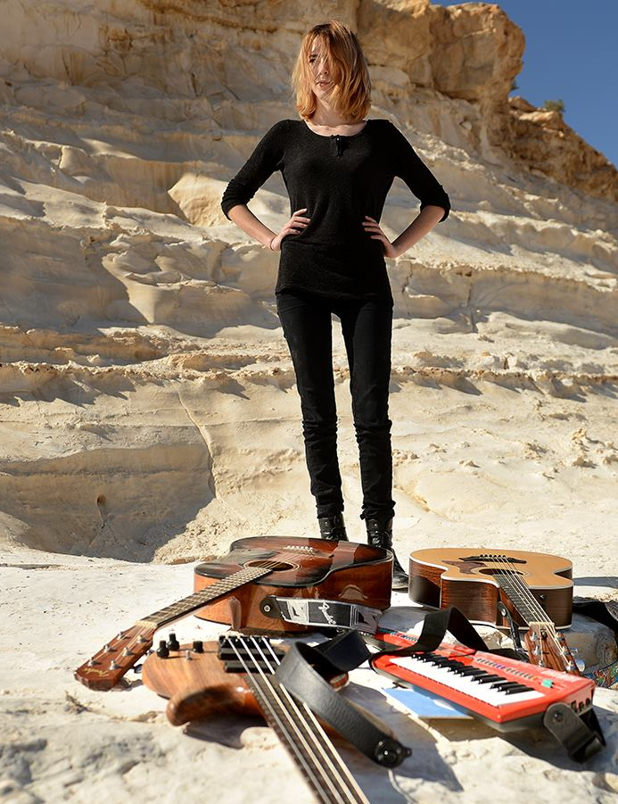
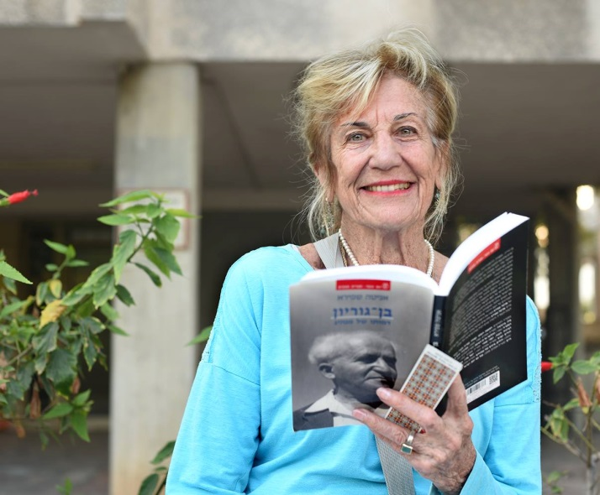
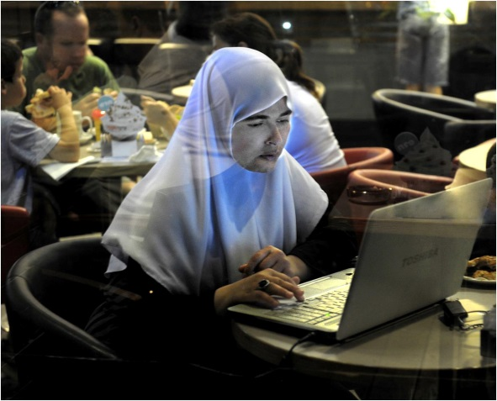
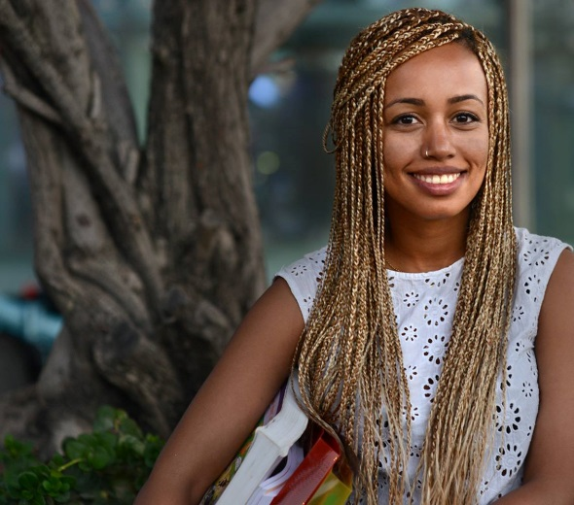
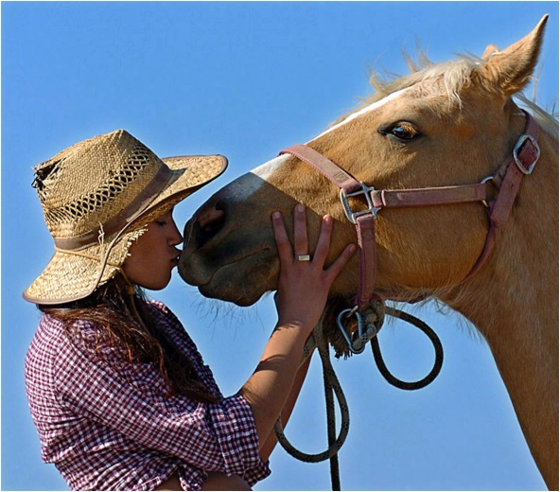
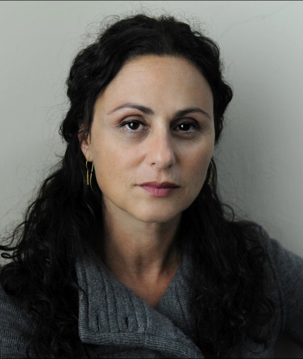
Thank You

