Slide 1
Technology
“Israeli style”
טֶכְנוֹלוֹגְיָה בְּיִשְׂרָאֵל
March 2015
JCC Israeli Shaliach/Emissary
Yoni Alon – יוני אלון

Slide 2
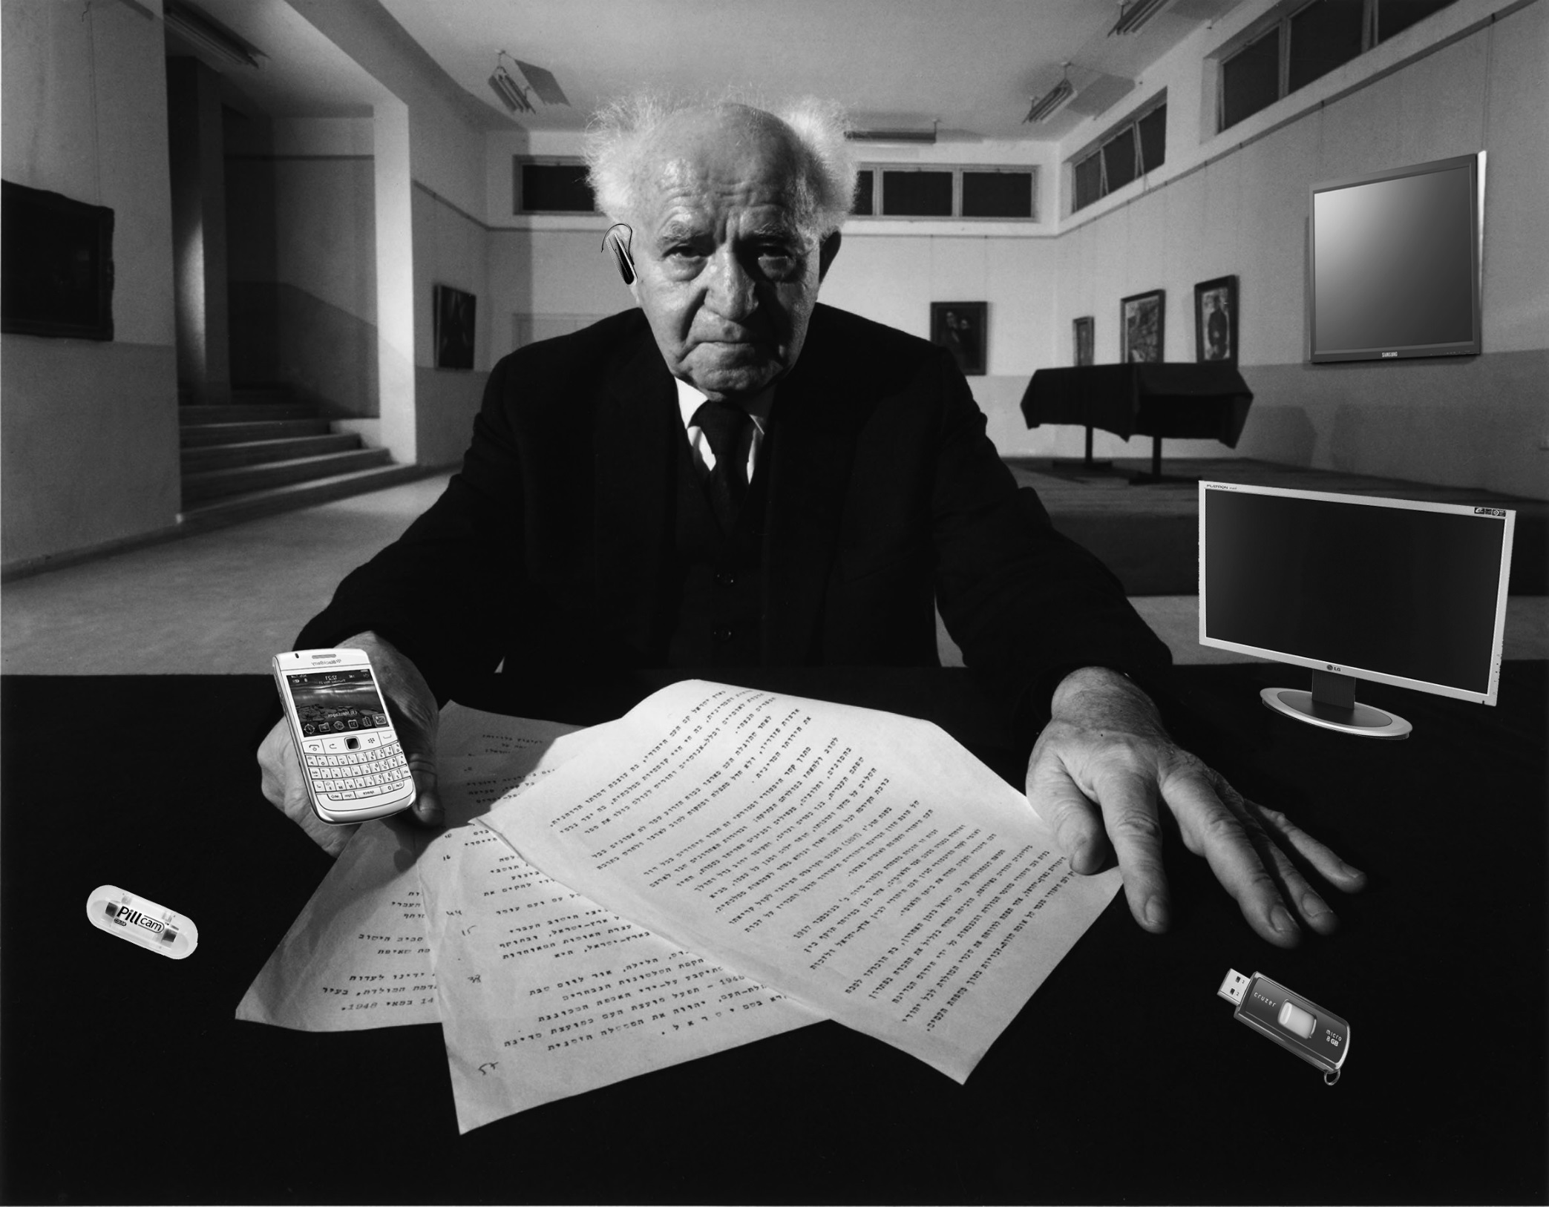

Slide 3
Group 1 | Group 2 | Group 3 | Group 4
IRON DOME | PillCam | Flash Drive | ReWalk

Slide 4
It is in the education

Slide 5
It is in the education
46% holds at least a bachelor degree (around 3.7 million)
Number 37 in the world education level of the U.N.
College tuition – from $3,200 to $10,200 per year (3 years).
New colleges open every year

Slide 6
Who is buying (2005-2012)

Slide 10
Technology
Israeli style
Israel inside…

Slide 11
Why Israel ? It’s the Culture…

Slide 12
Why Israel ? It’s the Culture…
Israel is small ! - 2hrs drive to any deal
Informality is a way of life
Risk taking is everywhere
The Israeli Pioneers
Everyone questions authority – “Lama Mee Ata?!”
Watch: Israeli invention

Slide 13
Serving in the Israel Defense Force
Best and the brightest – are picked up by tech units
Units are outfitted with the latest “toys”
Learn how to build products fast and cheap
Value placed on development and applied research
Team effort, taking risks and learn how to lead in a young age

Slide 14
Serving in the Israel Defense Force
Cutting edge technologies in communications, security, electro-optics, video, distributed networking, etc.
Meet friends and partners for life
When they come out-they are “ready for the world”
They are required to think outside the box

Slide 15
Serving in the Israel Defense Force
Not only the Tech units
What it means to start college late
The effect of not having a lot of money (100-200$ a month)

Slide 16
Your career start later
0-18
School
18-21
Military
21-23
Self Journey
23-26
College
Does it represent all Israelis?

Slide 17
Dare and dream !
Watch: The dream of one Israeli boy

Slide 18
This is your goal, Make:
An outdoor Falafel making machine
Budget: 1,000,000 $
Think of:
How it will work?
How it will look like?
What is the power source?
How to make people buy it?
What is the name of the product?

Slide 19
More further reading: Nocamels.com

Slide 20
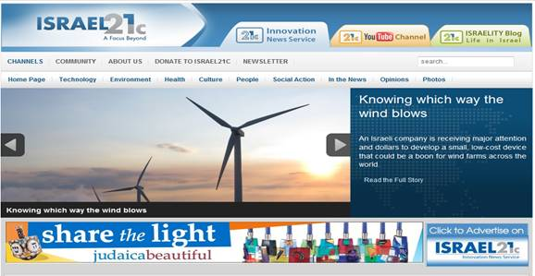
More Further Reading
www.Israel21c.org
Great Website-weekly updates on Israel’s contributions to the world

Slide 21
Toda Friends!

Slide 22
מסמך וורד הנלווה למצגת

