Slide 1
Hebrew: the language that was reborn
Mor Sofer
Universities Emissary

Slide 2
Am Israel has not had yet, since they left their ancient homeland, the unity they needed. (Am) Israel will live in Hebrew in its own homeland. If we won’t speak, even little, Hebrew in our homes, while traveling around, while going to the grocery shop – our hope will be lost

Slide 3
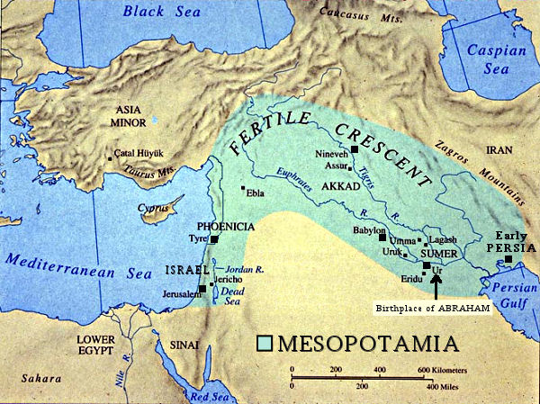

Slide 4
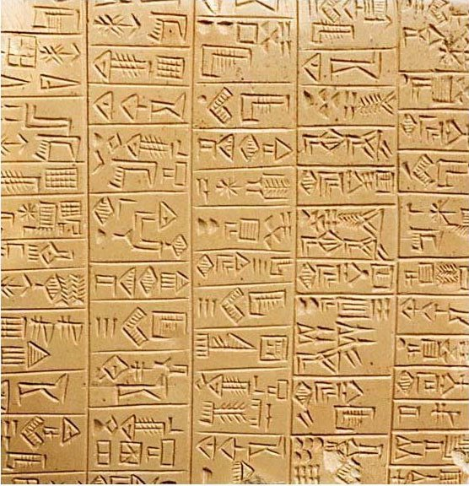
Shomeri text
Hieroglyph

Slide 5
ע
עין - Ayin

Slide 6
ר
רֵשְ - Reish

Slide 7
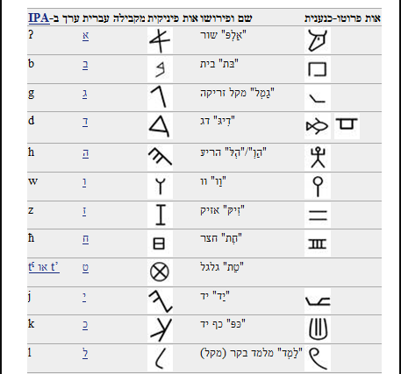
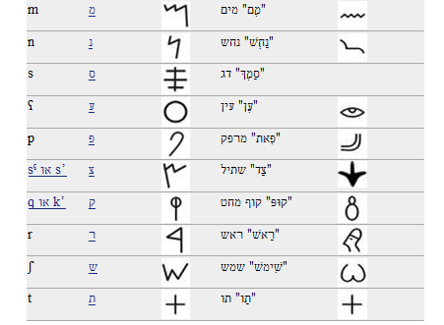
The progress of our language

Slide 8
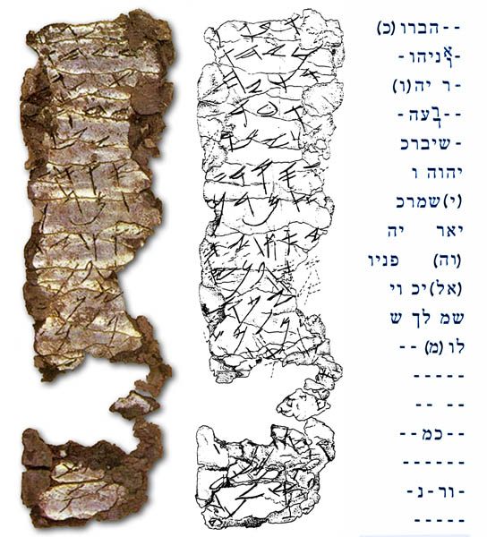
Birkat Cohanim
Was found in Jerusalem at the 1980’s
Was written at around 600 B.C in Ancient Hebrew

Slide 9
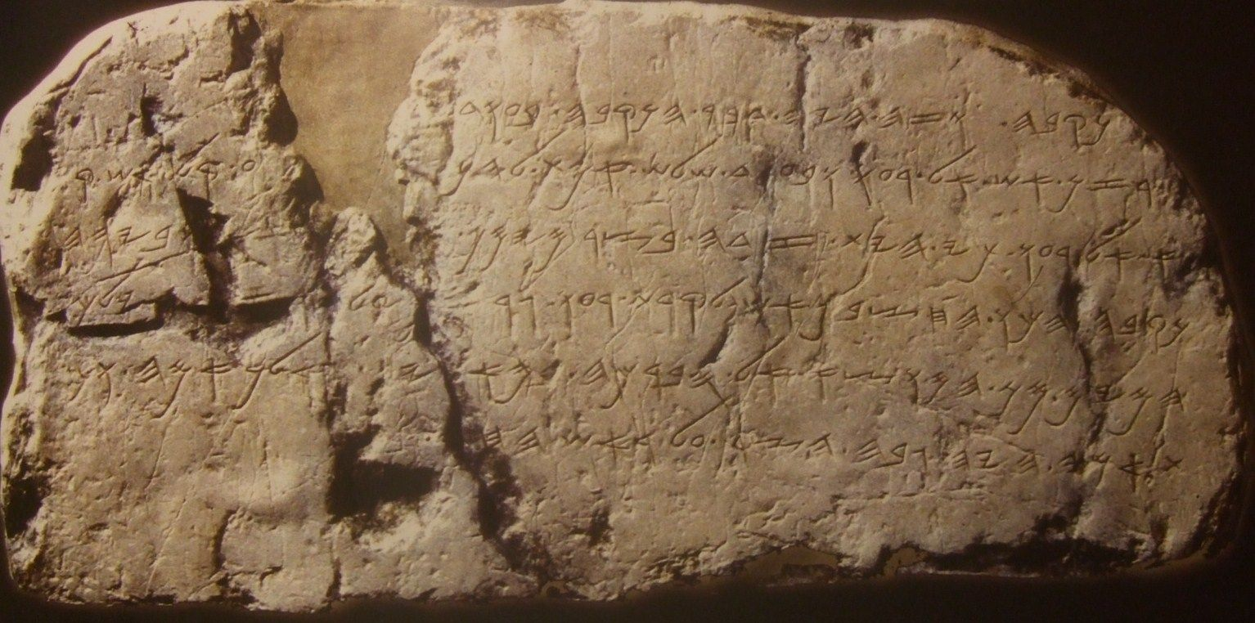

Slide 10
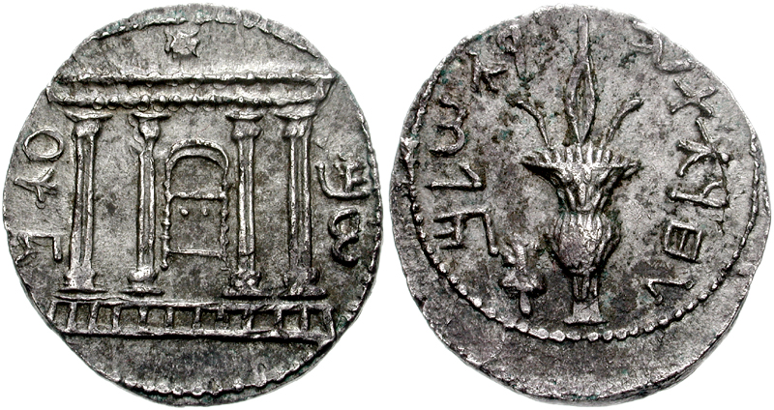
Bar Kochva revolt (132-135 A.D)

Slide 11
י ה ו ה

Slide 12
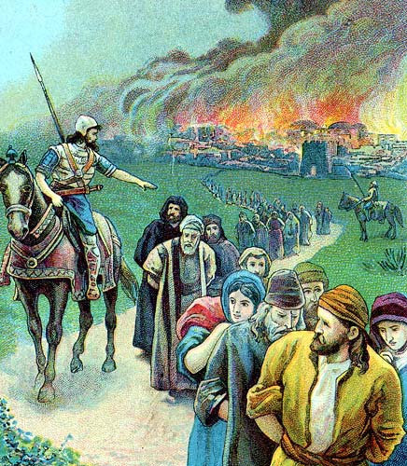
Assyrian & Babylon exiles
Assyrian: Israel kingdom Is falling and the upper-class society is all being exiled to Assyria (733 B.C)
Babylon: Holly temple is being destroyed and the Jews are exiled to Babylon (586 B.C)

Slide 14
The results of leaving your own country

Slide 15
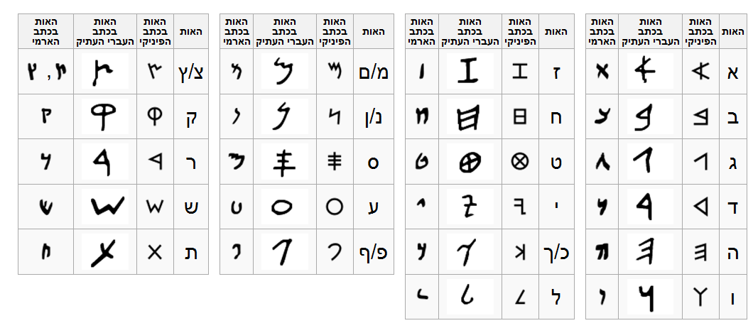
Aramaic
Ancient Hebrew
Phoenici / Hebrew

Slide 16
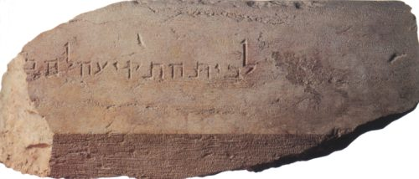
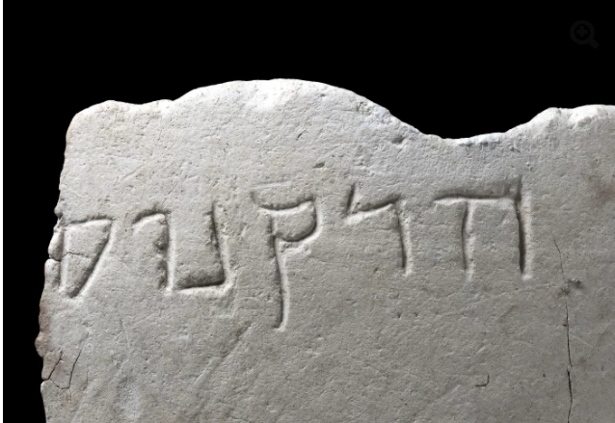

Slide 17
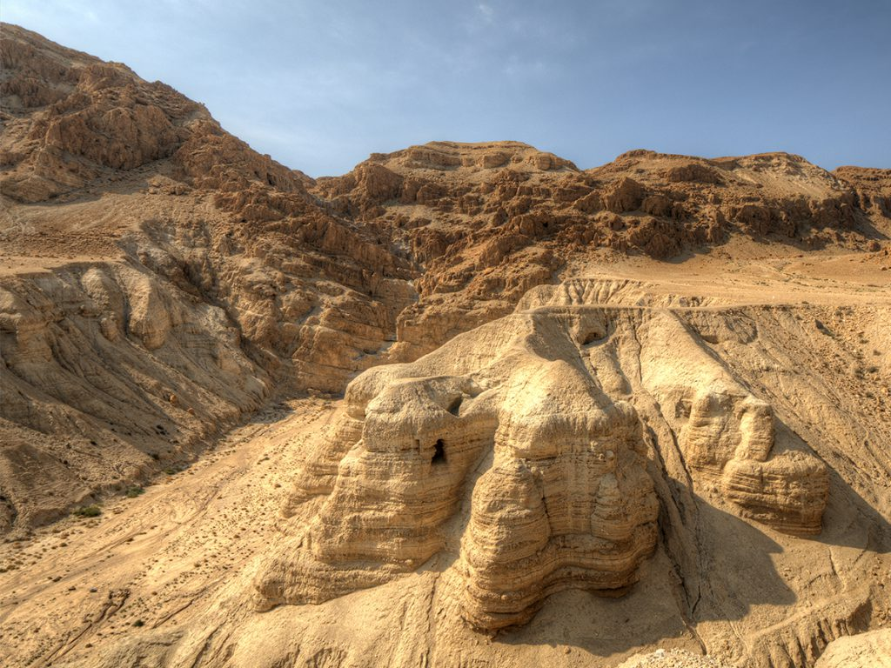
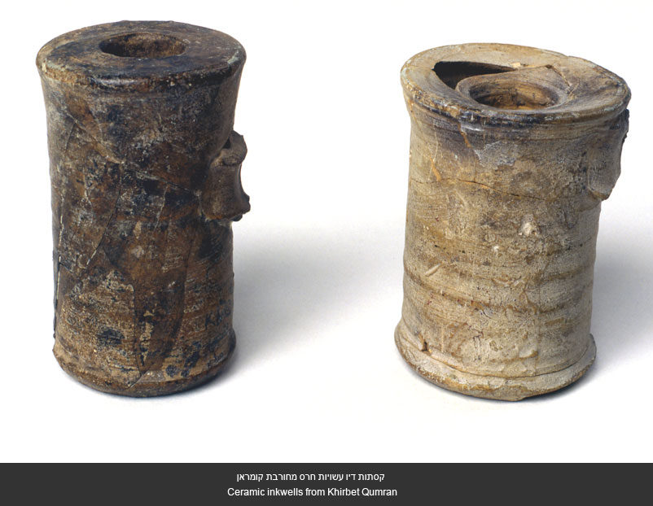
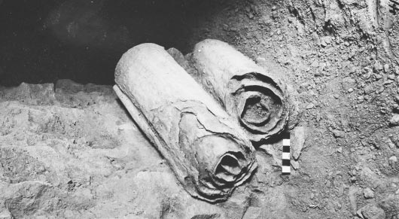

Slide 18
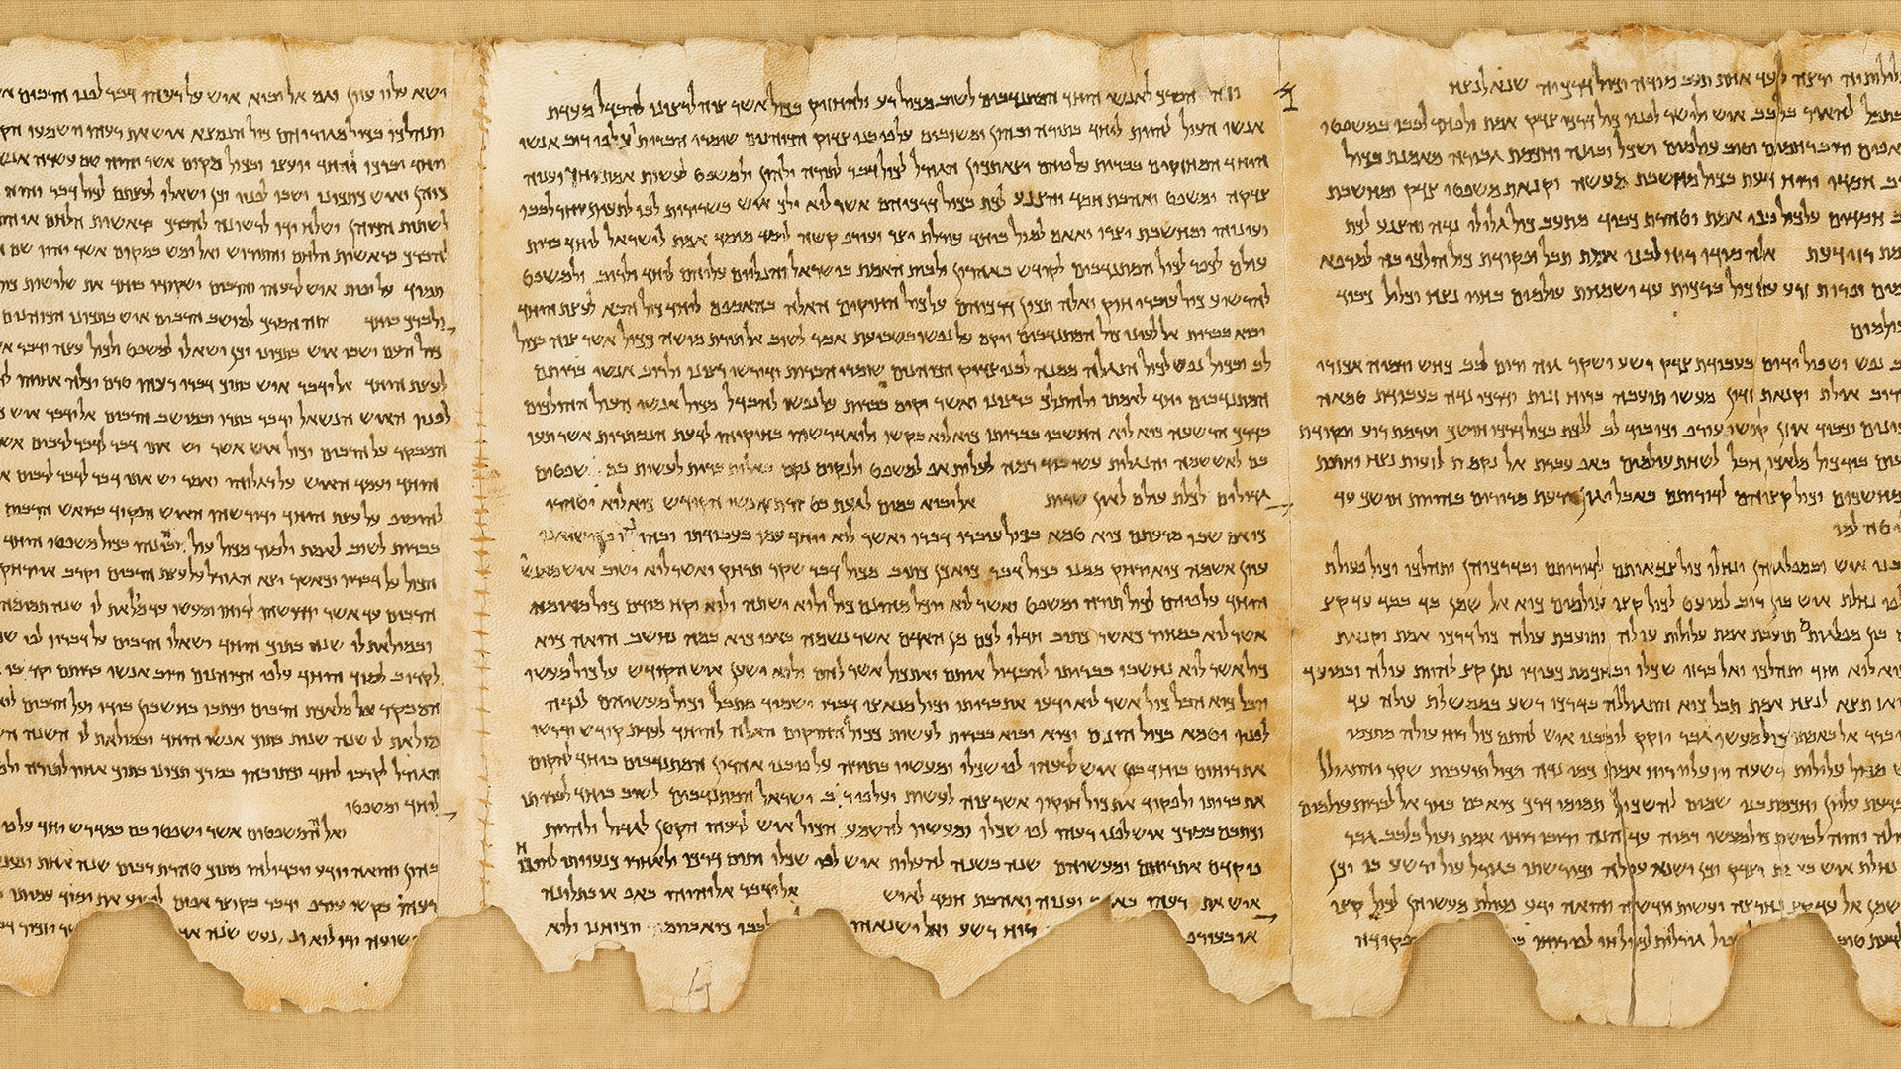

Slide 19
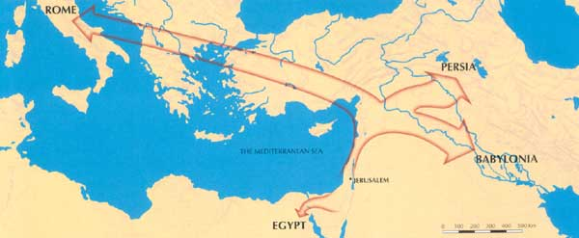
The Roman exile (70 A.D)

Slide 20
Zionism means the right to self determenation of the Jewish people in their ancient homeland

Slide 21
Tradition that was kept
History which was never forgotten
A dream
WHAT ELSE DO WE NEED?

Slide 22
Language!
A nation who’s sharing the same language cannot be unite

Slide 23
Am Israel has not had yet, since they left their ancient homeland, the unity they needed. (Am) Israel will live in Hebrew in its own homeland. If we won’t speak, even little, Hebrew in our homes, while traveling around, while going to the grocery shop – our hope will be lost
Eliezer Ben Yehuda

Slide 24
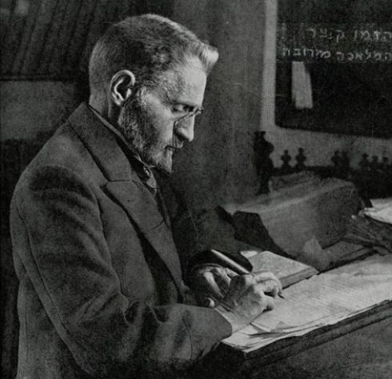
Meet Eliezer Ben Yehuda

Slide 25
Eliezer Ben Yehuda’s work
1881: Making Aliya
Writing magazines in Hebrew
Speaking only hebrew at home
Creating hundreds of new words

Slide 26
We are living in a modern world. What should we do now?

Slide 27
Words that Eliezer Ben Yehuda renewed
Avion
Gelato
Brush
Nasal
אַווירוֹן
גְלּידה
מִבְרֵשֶת
נָזֶלֵת

Slide 28
1+1=2
Chai (living) +Dak (thin) = Chaidak
Shal (catching) + Dag (fish) = Shaldag (Kingfisher)
Remez (Hint) + Or (light) = Ramzor (Traffic light)
חֲי+דַקְ = חָידַקְ
שָלְ+דַגְ = שלדג
רַמָזְ+אוֹר = רמזור

Slide 29
The Hebrew language will go from the synagogue to the house of study, and from the house of study to the school, and from the school it will come into our home and will become a living language
Eliezer Ben Yehuda

Slide 30
Thanks!
Any questions?
Mor Sofer

