Slide 1
Tikun Olam
From theory to practice…
What is Tikun Olam?
Cases from the world-
Crisis situations/ humanitarian aid missions
Agriculture
Medical aid and welfare
and much more…

Slide 2
Aleinu leshabei'ach - Siddur
“ עַל כֵּן נְקַוֶּה-לָּךְ ה' אֱלֹהֵינוּ, לִרְאוֹת מְהֵרָה בְּתִפְאֶרֶת עֻזָּךְ, לְהַעֲבִיר גִּלּוּלִים מִן הָאָרֶץ, וְהָאֱלִילִים כָּרוֹת יִכָּרֵתוּן, לְתַקֵּן עוֹלָם בְּמַלְכוּת שַׁדַּי ... וְהָיָה ה' לְמֶלֶךְ עַל-כָּל-הָאָרֶץ. בַּיּוֹם הַהוּא יִהְיֶה ה' אֶחָד וּשְׁמוֹ אֶחָד“
Fix the world

Slide 3
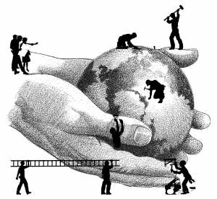
The term was modified...

Slide 4
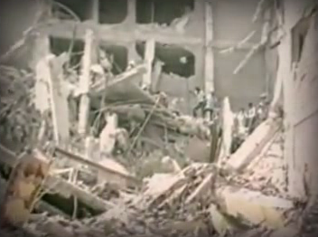
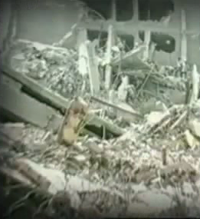
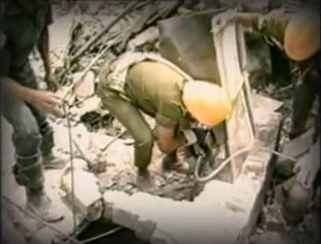
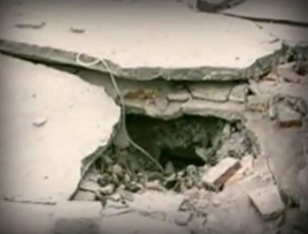
Tikun Olam – crisis situations/ humanitarin aid missions
1985 - Mexico
2 Fierce earthquakes – Mexico city

Slide 5
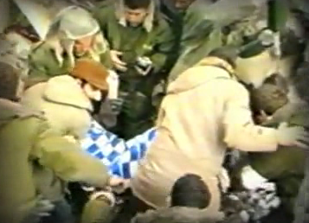
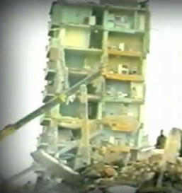
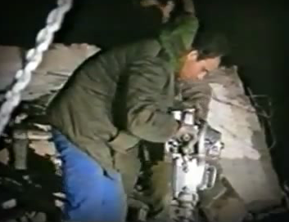
Tikun Olam – crisis situations/ humanitarin aid missions
1988 - Armenia
Earthquake

Slide 6
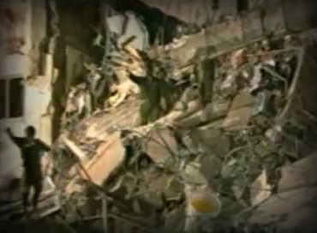
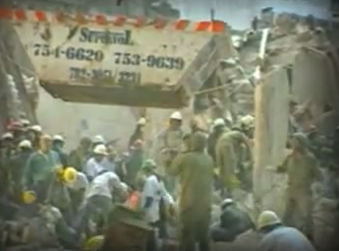
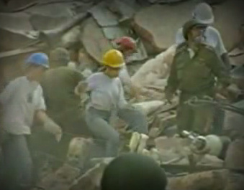
Tikun Olam – crisis situations/ humanitarin aid missions
1992 - Argentina
Attack on Israeli Embassy

Slide 7
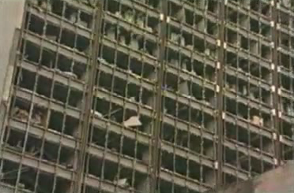
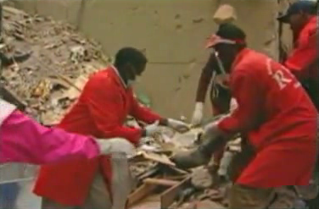
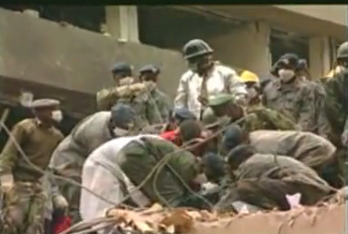
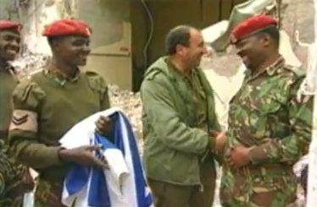
Tikun Olam – crisis situations/ humanitarin aid missions
1998- Kenya/Tanzania
U.S embassy bombing

Slide 8
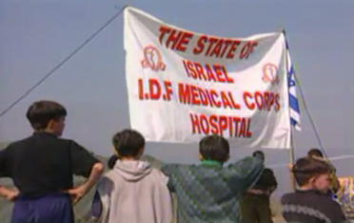
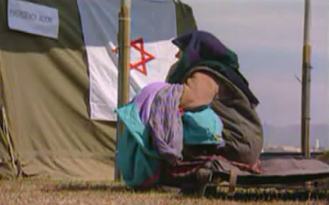
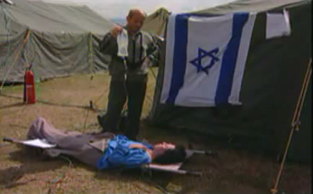
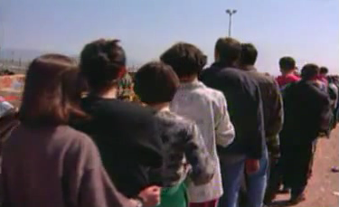
Tikun Olam – crisis situations/ humanitarin aid missions
1999- Macedonia
Refugees from Kosovo

Slide 9
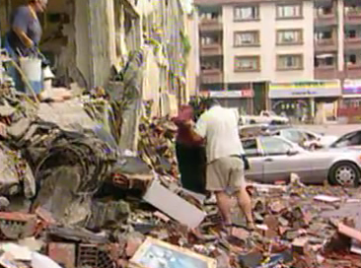
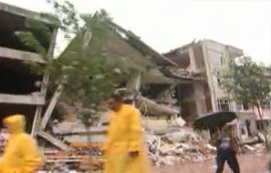
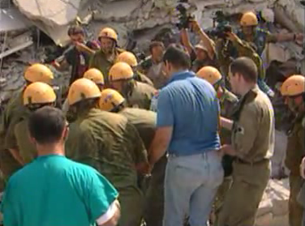
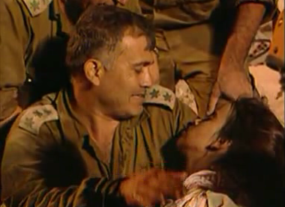
Tikun Olam – crisis situations/ humanitarin aid missions
1999- Turkey
Earth Quakes

Slide 10
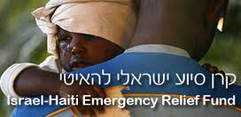
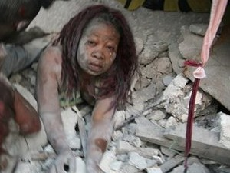
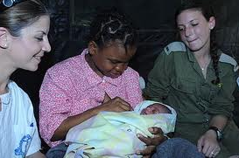
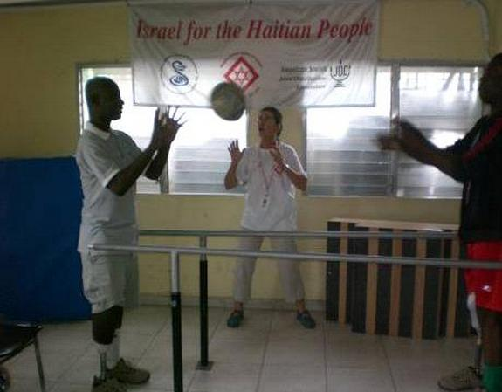
Tikun Olam – crisis situations/ humanitarin aid missions
2010 - Haiti
Earth Quake

Slide 11
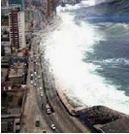
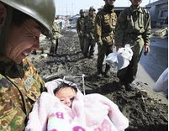
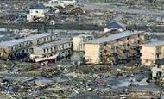
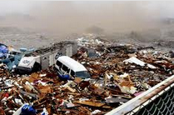
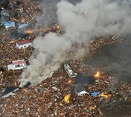
Tikun Olam – crisis situations/ humanitarin aid missions
2011- Japan
Tsunami

Slide 12
Tikun Olam – crisis situations/ humanitarin aid missions
More Humanitarian missions
* Sicily, earth quake, 1968
* Kampuchea, refugees, 1979
* Congo, refugees, 1994
* Myanmar, Cyclone ‘Nargis’, 2008
* Georgia, refugees from Russia-Georgia,
2008
* India, Mumbai, terror Attack, 2008
and (unfortunately) much more…

Slide 13
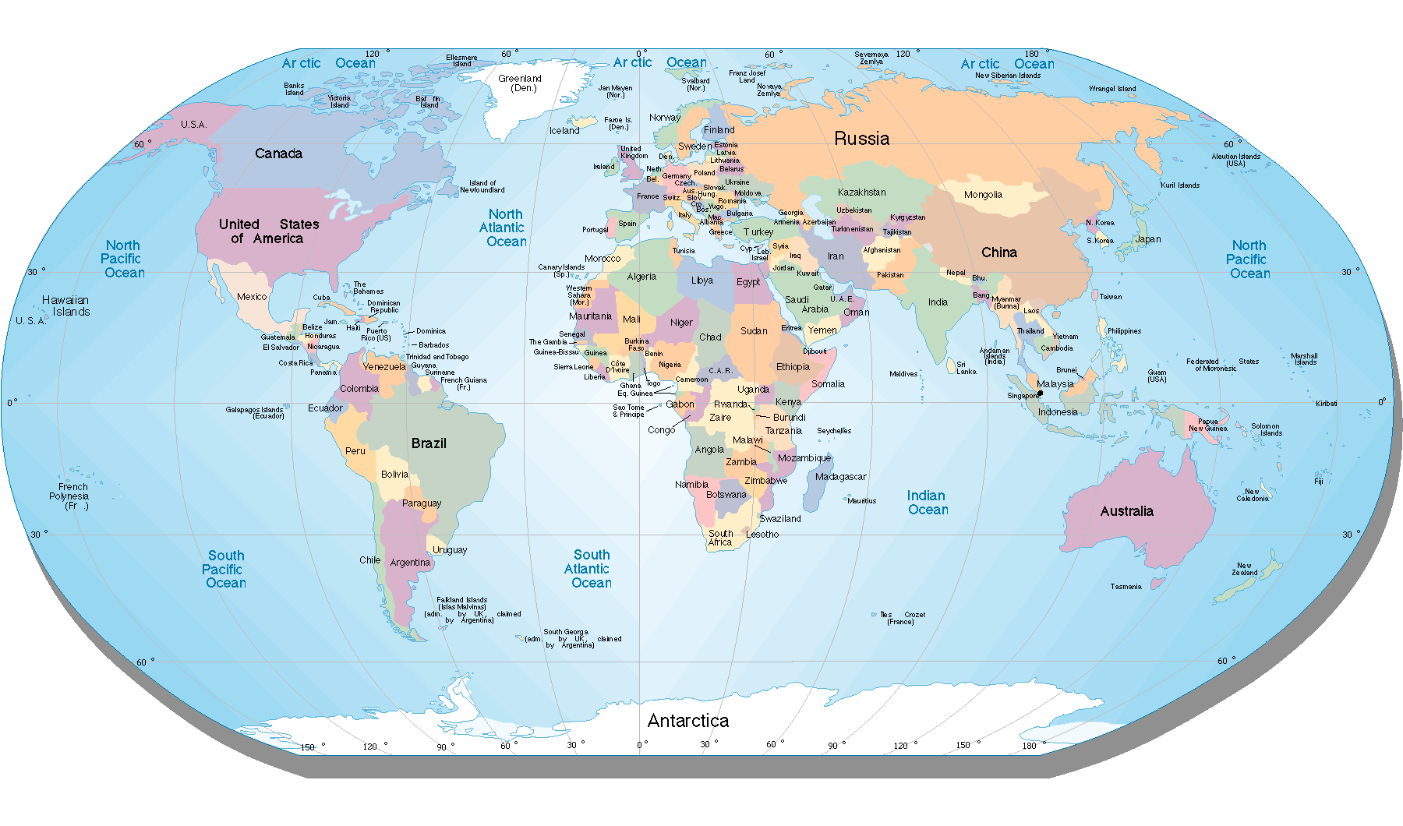
Crisis – Humanitarian Aid

Slide 14
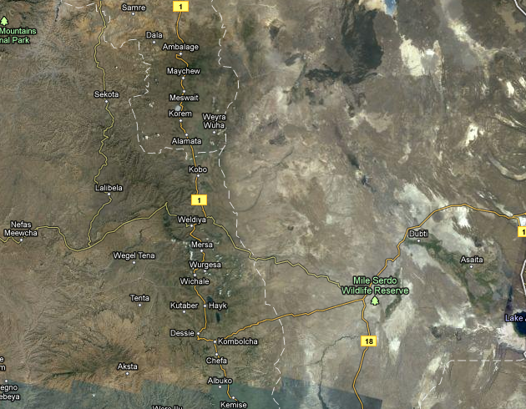
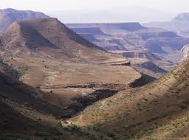
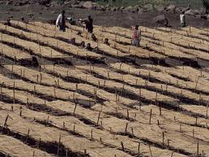
Tikun Olam – Agriculture
Ethiopia, Wollo province

Slide 15
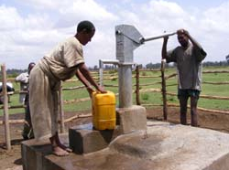
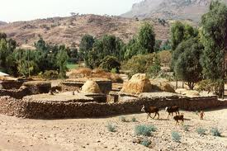
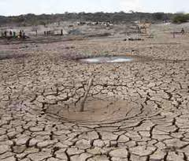
Tikun Olam – Agriculture
Ethiopia, Wells and wellness

Slide 16
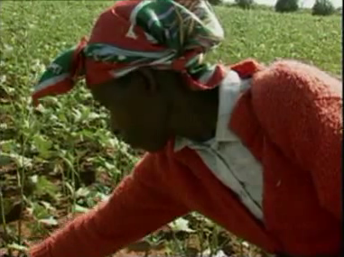
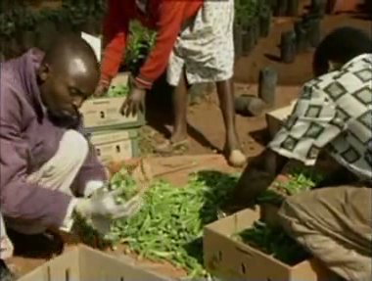
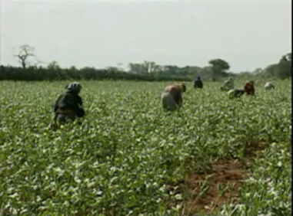
Tikun Olam – Agriculture
Kenya

Slide 17
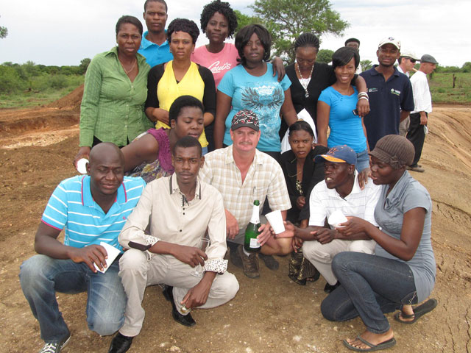
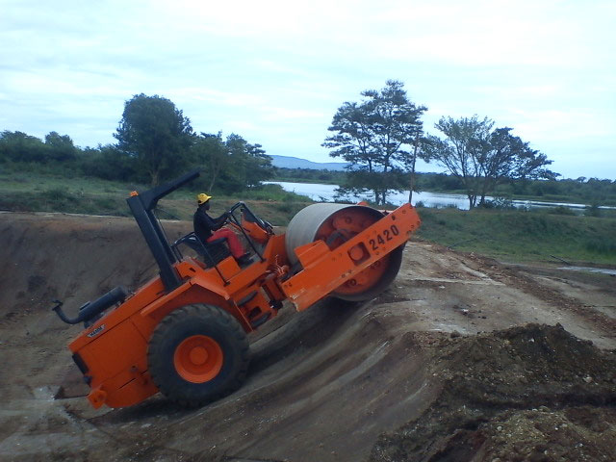
South Africa, 2011
community of N’wamitwa
10-day course on Fish Farming.
Train on breeding Tilapia - a fish characterized by its large size and rapid growth and for being an excellent source of protein.

Slide 18
Agriculture

Slide 19
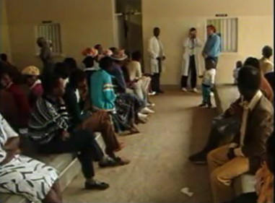
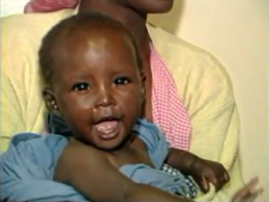
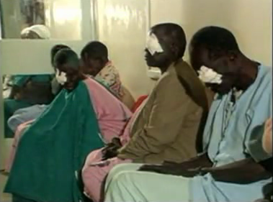
Tikun Olam – Medical Aid and welfare
Africa, Asia, Latin America Ophthalmology

Slide 20
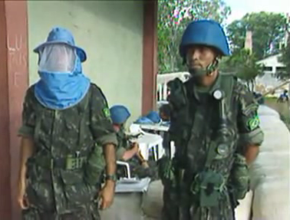
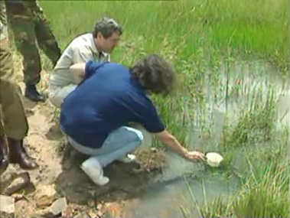
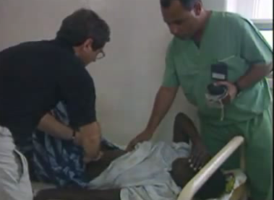
Tikun Olam – Medical Aid and welfare
Angola, 1996 – Fighting the Malaria

Slide 21
Tikun Olam – Medical Aid and welfare
Rwanda, 2009, building a village for the Orphans

Slide 22
Tikun Olam – Medical Aid and welfare
Nepal, April 2009
Teaching tourist about street children crisis.
Notes:
משלחת ישראלית ללימוד על בעיית הילדים שגרים ברחוב. בדגש על ניצול, עבדות ילדים, בריאות ועוני.

Slide 23
Tikun Olam – Medical Aid and welfare
MDA - Azerbaijan
Training the AZrc.
Notes:
משלחת שת"פ והכנה ובנייה של הצלב האדום האזרי

Slide 24
Tikun Olam – Medical Aid and welfare
Operation “Abraham” – circumcisions in Africa
Research in Kenya-
N = 2,784
53% less Infected HIV
Research in Uganda-
N = 4,996
48% less Infected HIV
Who + UNAID – Recommend Circumcision

Slide 25
Tikun Olam – Medical Aid and welfare
Operation “Abraham” – circumcisions in Africa

Slide 26
Save a child's Heart
Providing life-saving cardiac surgery and other life saving procedures for children from developing countries at the Wolfson Medical Center in Holon, Israel;
Providing a full outreach training program for the medical personnel from these countries in Israel;
Leading surgical and teaching missions to partner countries in the developing world;
Holding pre-operative and follow-up cardiology clinics in Israel and abroad.

Slide 27
Ethiopia
Tigist Dinku Tesfu
Tigist is a thirteen year old girl from Jimma, Ethiopia. She lives with her mother, father and two younger sisters in a mud house. Her mother is a housemother, and her father works in agriculture. Tigist is in eighth grade at school. In the future, she wants to become a professor of cardiology. Tigist enjoys playing sport and running, but she often becomes tired and has to stop. Her favourite food is chicken. In Jimma, Tigist was diagnosed and treated by Prof. Abraham Haileamlak Mitek, who recommended that she come to Israel for treatment. Prof. Abraham completed his cardiology training program in the Wolfson Medical Centre through SACH in August 2010.

Slide 28
Palestinian Authority
Ameer is a three month old baby boy from Hebron in the West Bank. Ameer has a twin brother, Samir. Samir was born healthy and was sent home from the hospital ten days after his birth, but Ameer had to stay in the hospital for three more months. He was constantly monitored and received facilitated oxygen. Ameer had a hole in his heart that affected his breathing. The hole did not heal on its own and so Dr. Rulla referred him to Save a Child’s Heart for treatment. At home in Hebron, Ameer’s family lives on a private floor of his father’s family’s house. He has six other siblings including four brothers and two sisters. His mother is a housewife and his father works for a large mattress manufacturing company. Ameer’s family is anxiously awaiting his recovery so that he may come home for the first time.

Slide 30
Medical aid and welfare

Slide 31
Tikun Olam

Slide 32
A picture is worth 1000 words, a movie is worth 1000 pictures

