Slide 1
Yom Yerushalayim!
Celebrating
Jerusalem Day

Slide 2
Name and sing a line of two songs which have the word ‘Jerusalem’ in it
How many temples were built in Jerusalem?
Name a religion for which Jerusalem is NOT a holy city
What is the name of the University of Jerusalem?
Which year was the Mount Scopus campus reopened at the Hebrew University?

Slide 3
When did the University first open?
1918 / 1925
Name 5 major sites and/or museums in Jerusalem
List 5 words in Hebrew that rhyme with Yerushalayim
According to tradition, who established the city as the capital of the United Kingdom of Israel?
Kind David of course
How many times was Jerusalem besieged?
23

Slide 4
How many people live in Jeruslaem?
What’s the percentage of Jews?
62%
What’s the percentage of Christians?
Around 3%
What’s the percentage of Muslims?
Around 34%
Where in the bible is Jerusalem first mentioned?
Joshua
State three more names for the city of Jerusalem

Slide 5
Name the countries that controlled Jerusalem since 1900 until now
When was the neighbourhood Mishkenot Sa'ananim established?
1860
By whom?
How many famous gates are in the city of Jerusalem?
Name three gates in the city
New Gate (north-west); Damascus Gate (Sha’ar Shchem); Herod’s Gate (Sha’ar Haprachim); Lion’s Gate; Dung Gate (Sha’ar HA’ashpatot); Zion Gate; Jaffa Gate
Who inhabited Jerusalem before the Israelites?
Rechabites Hittites Amorites Jebusites

Slide 6
Which body of water is closest to Jerusalem?
Which animal is the symbol of the city?
What is the name of the city in Arabic?
What does it mean?
When were the stones surrounding the city built?
16th century (Ottoman)

Slide 7
Where does the city rank in its holiness in Islam?
Third, after Mecca and Medina
What artefact is only display at the Israel Museum’s Shrine of the Book?
Dead Sea Scrolls
What’s the name of the big football stadium?
Who was it named after?
What collapsed in 2001, killing 23 people and injuring around 300?
Versailles Hall

Slide 8
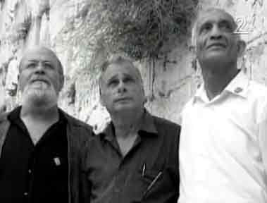
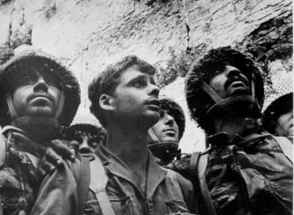
Who are the men in the picture?
Zion Karasenti, 64, now a director and choreographer, living in Afula
Yitzak Yifat, 64, now an obstetrics and gynaecology surgeon
Haim Oshri, 63, emigrated from Yemen to Israel in 1949

Slide 9
Team who’s one of its members have been most recently to Jerusalem gets a point
Team with a picture on a member’s Mobile-phone from Jerusalem gets a point
Who is the current mayor of Jerusalem?
Nir Barkat
Where in Jeruslaem is Herzl Burried?
Who resides at Heychal Shlomo?
The chief Rabbi

Slide 10
How old is AL-Aktsa Mosque?
Approximately 1360 Y
Name a hospital in Jerusalem
Hadassah, Sharei Zedek, Bikur Holim
Which gate is next to the Tower of David?
What is Machane Yehudah famous for?
What is the name of the zoo in Jerusalem?
One point for the team who has the most members who’ve been there

Slide 11
Who built the first temple?
King Solomon of course
What is the big building at Malcha? Name both purposes
What was the Hebrew date of the destruction of both temples?
Who built the second temple?
King Herod
Name the former mayor of Jerusalem who’s recently been sent to prison and his charges

Slide 12
In which tribe’s allocation is Jerusalem?
Binyamin
Where is the Frank Sinatra building located?
Mount Scopus – Hebrew U
How long ago was Jerusalem established?
Around 3000 years ago
Why did they name the park opposite Montefiore’s Windmill, Liberty Park?
It contains a replica of the liberty bell park
Which famous Israeli Prime-Minister is not buried in Mount Herzl?
Why?

Slide 13
What are the four quarters of the city of Jerusalem?
Jewish, Armenian, Muslim and Christian
When was Yom Yerushalyim first celebrated and established?
When were the two biggest waves of development to Jeruslaem?
When was the “Basic Rule” of “Jerusalem, the capital of the State of Israel”, enacted?
1980
Which famous neighbourhood was the fifth built outside the walls of the old city?
And today is populated by ultra-orthodox Jews?

Slide 14
And the winner is....

Slide 15
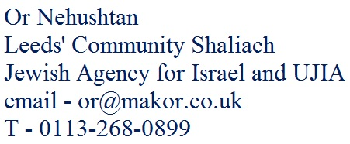
Yom Yerushalayim!
Celebrating
Jerusalem Day
Thank you for coming!

