Slide 1
Ancient Israel
& Why it Matters
Inbal Lev & Rabbi Keilah Lebell

Slide 2
“We hold these truths to be self-evident, that all men are created equal, that they are endowed by their Creator with certain unalienable Rights, that among these are Life, Liberty and the pursuit of Happiness.”
Philadelphia July 4, 1776

Slide 3
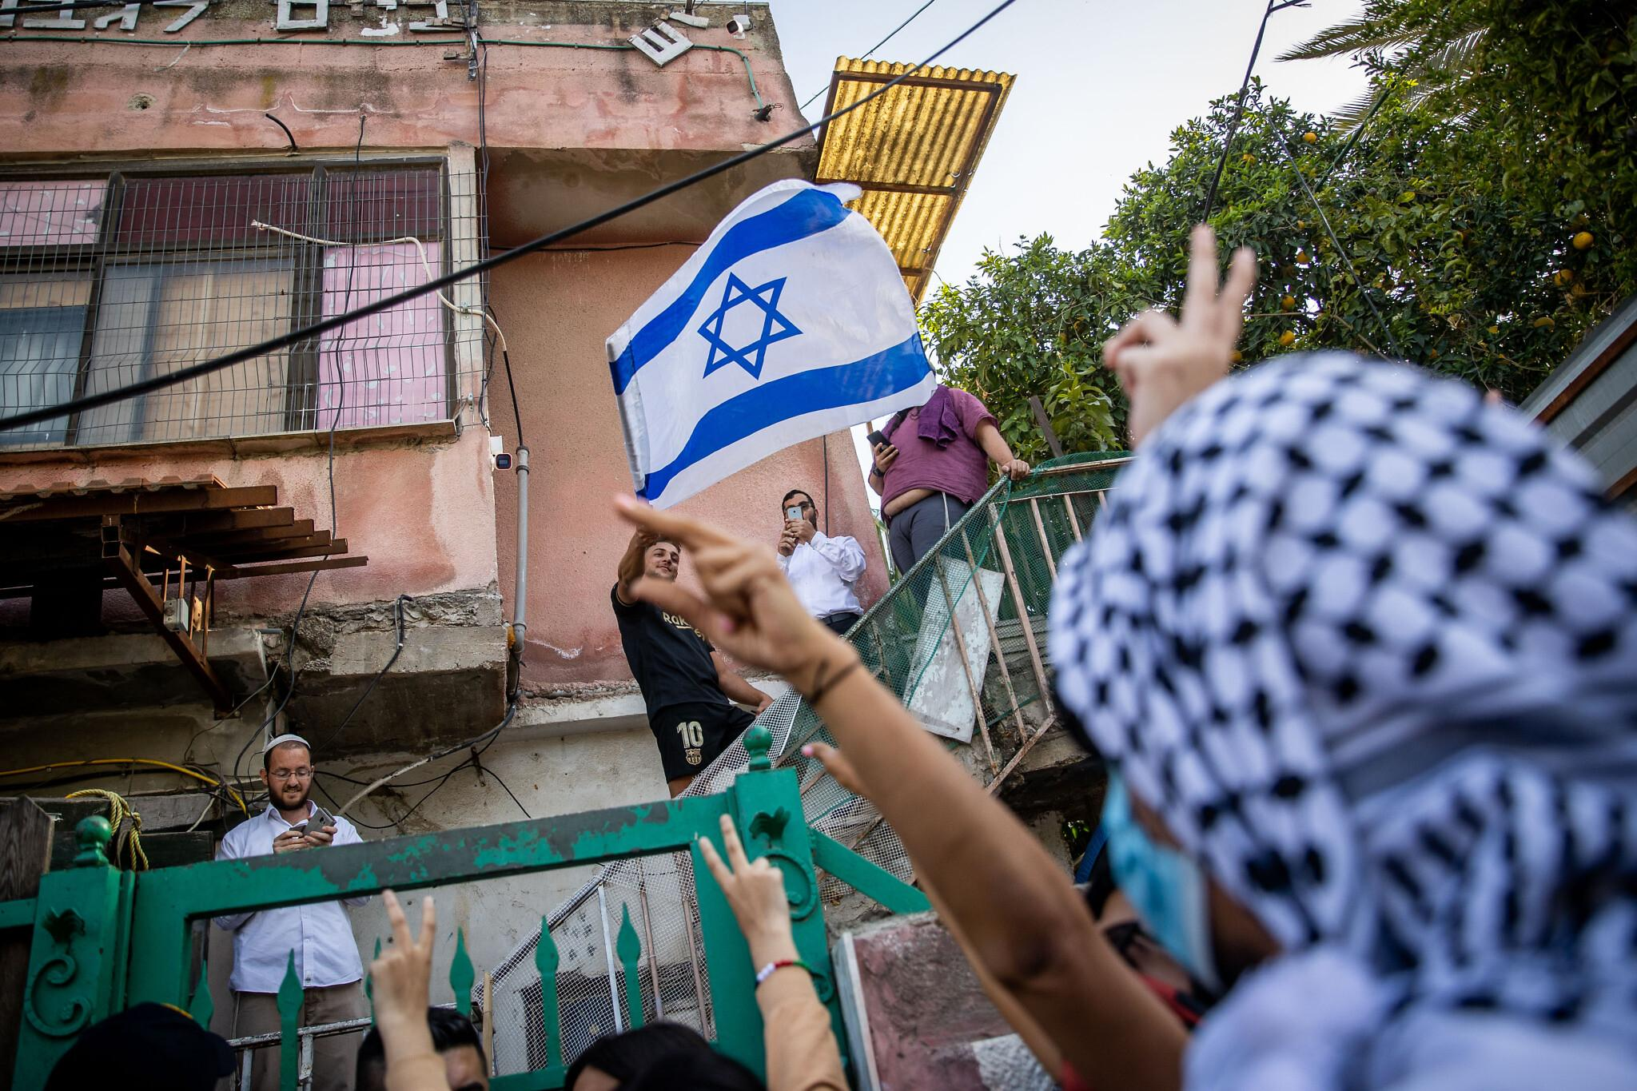
East Jerusalem (Sheikh Jarrah) May 6, 2021
Notes:
https://jewishunpacked.com/sheikh-jarrah-the-story-behind-the-story/

Slide 4
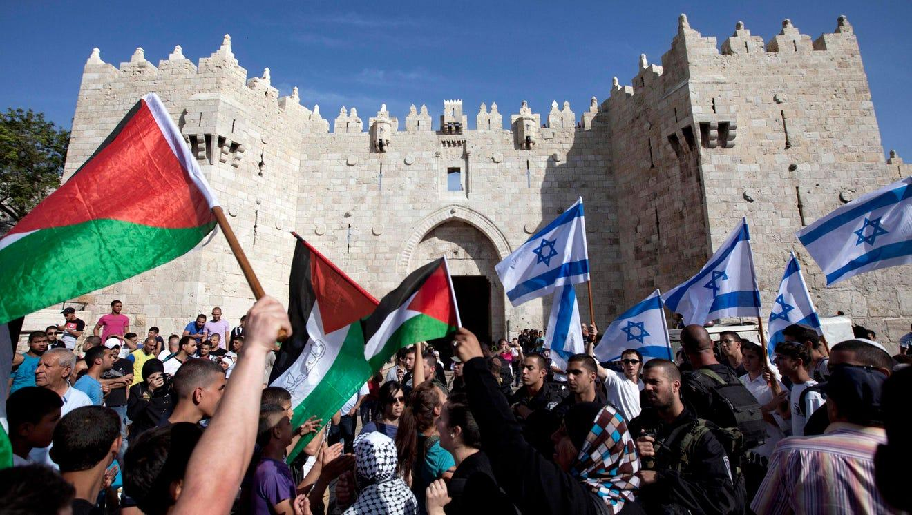
Damascus Gate, Old City of Jerusalem

Slide 5
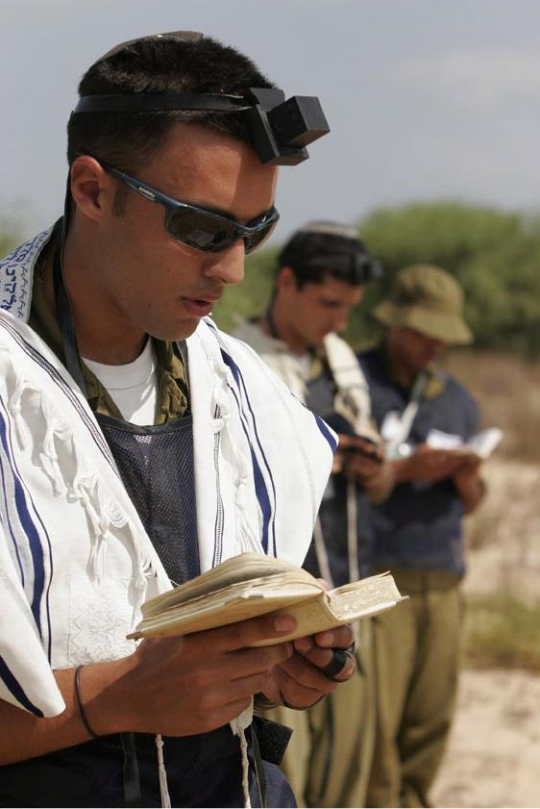
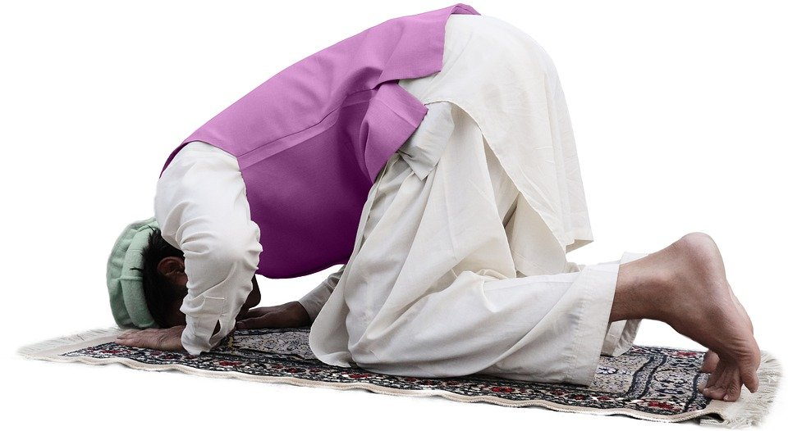
The Three Abrahamic Religions
Judaism | Christianity | Islam

Slide 6
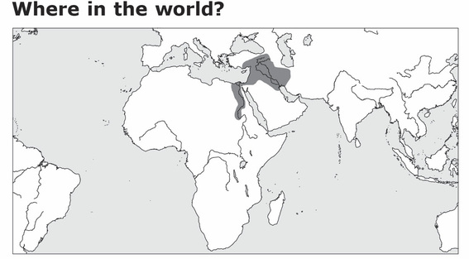

Slide 7
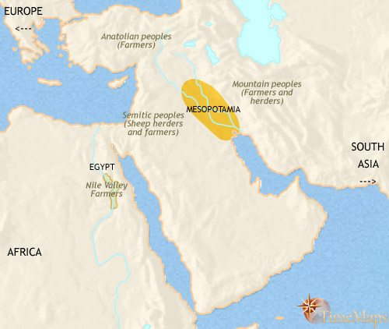
Ancient Middle East in 3500 BCE

Slide 8
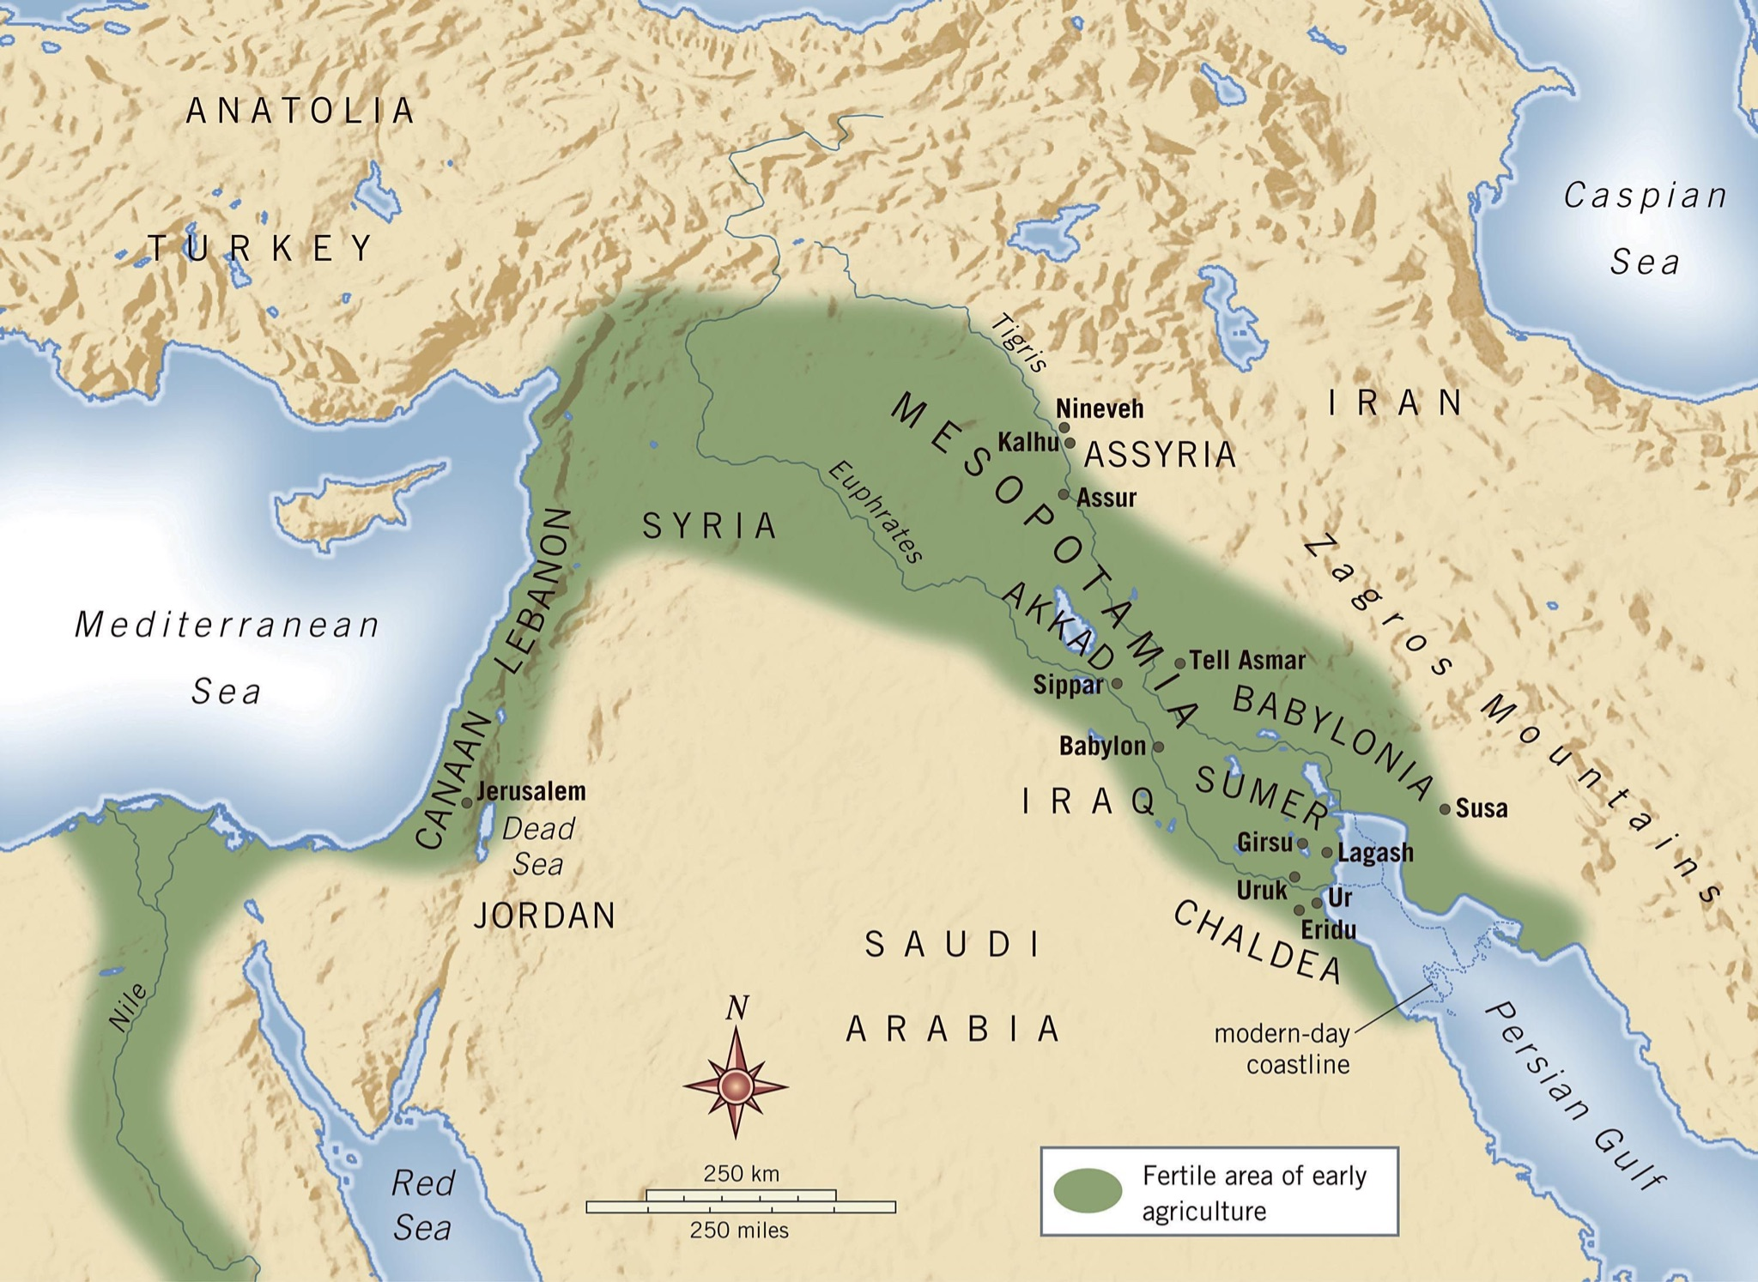
The Fertile Crescent

Slide 9
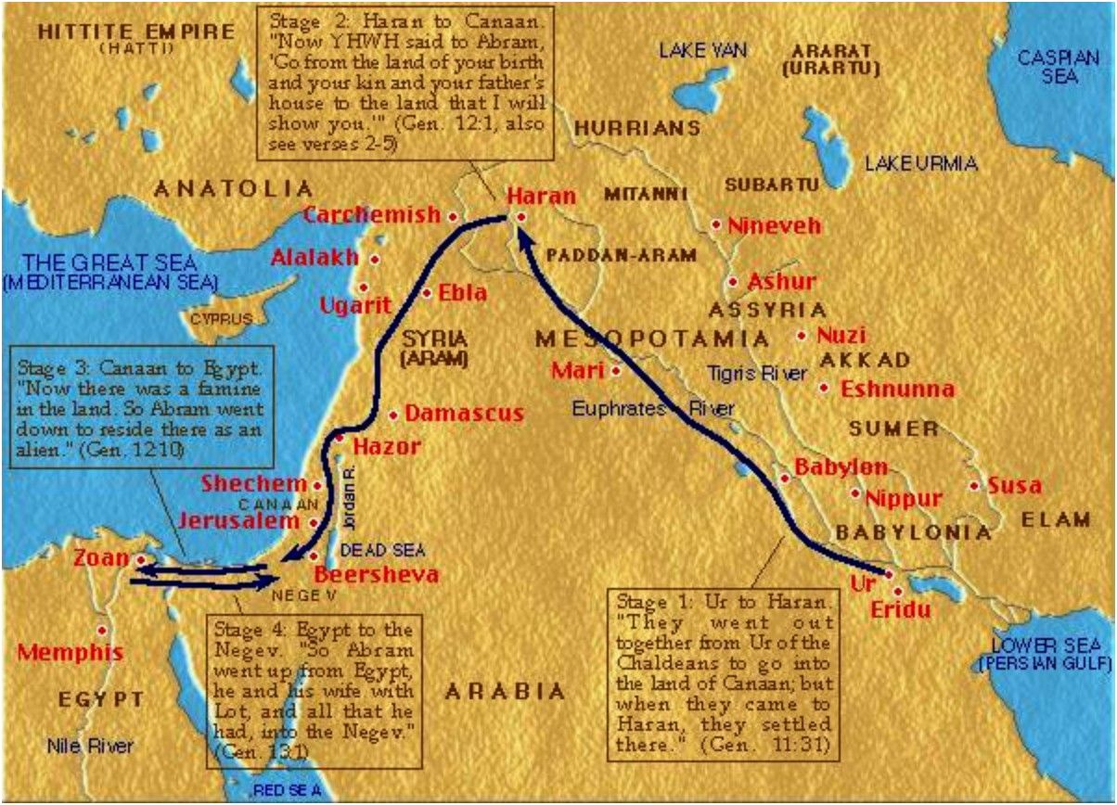
Abraham’s Travels

Slide 10
Abraham
Sarah
Hebrew Patriarchs
Isaac
Rebecca
Leah
Jacob
Rachel
Zilpah
Bilhah
Reuven
Shimon
Levi
Judah
Dan
Naftali
Gad
Asher
Issachar
Zevulun
Joseph
Benjamin
Ephraim
Menashe

Slide 11
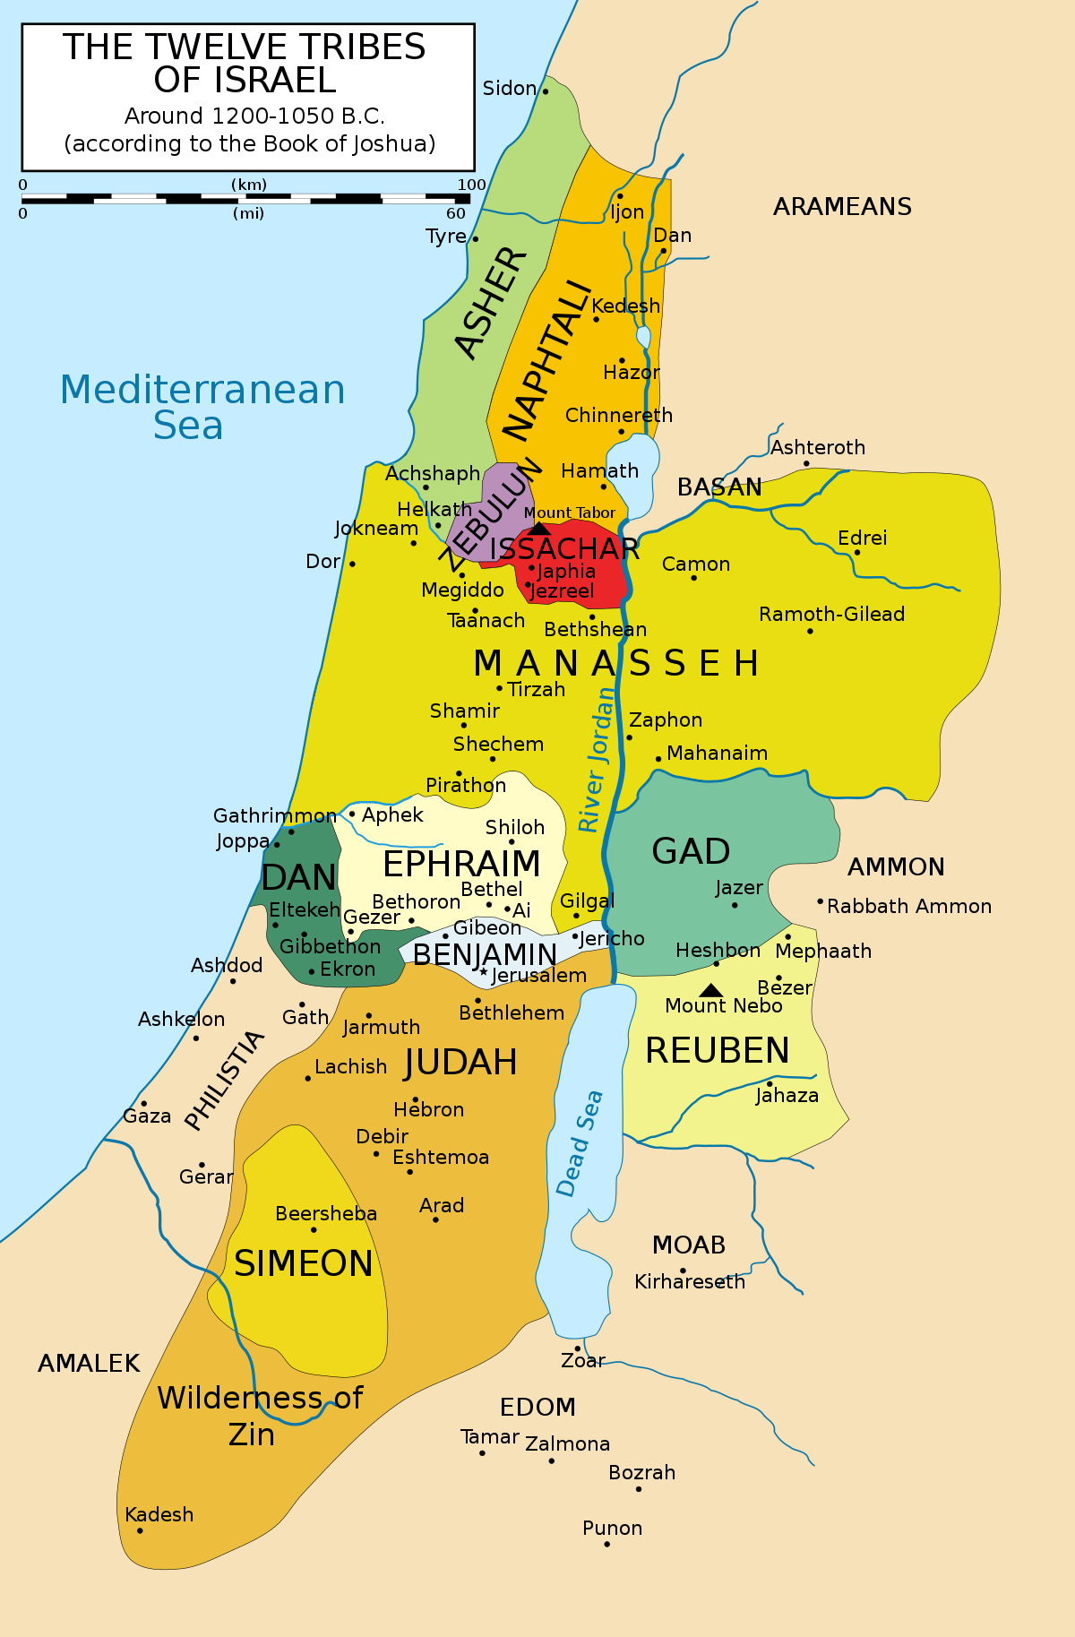

Slide 12
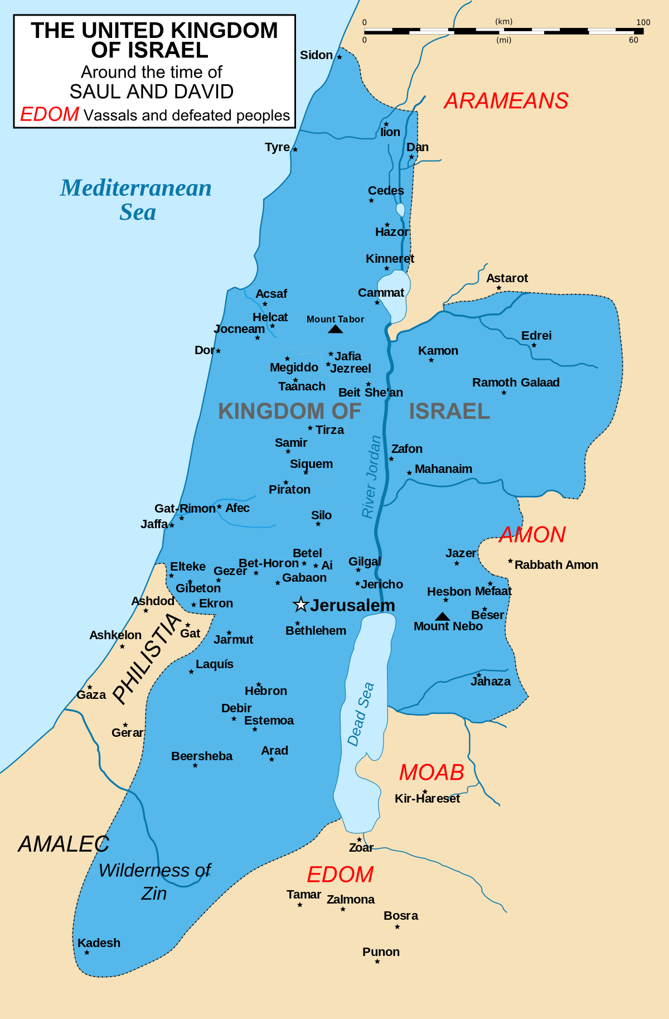

Slide 13
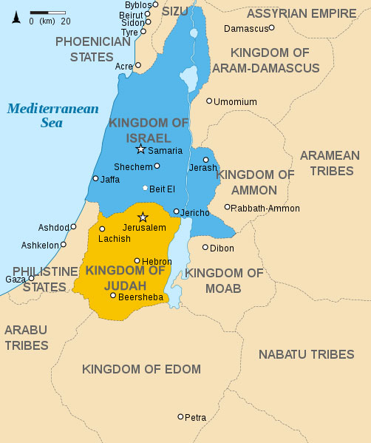
Notes:
The kingdom was divided after Solomon’s death into two kingdoms. Northern Tribes were frustrated with king’s extravagance and having to pay for it. They established their own capital and kingdom in the North and called themselves Israel. The southern kingdom of Judah consisted primarily of the tribe of Judah and was ruled by the Davidic family. The Northern Kingdom, also known as Israel, consisted of the remaining tribes and was ruled by a series of dynasties. // Western campaigns of Assyria (Iraq) that eventually brought about the demise of the Northern Kingdom in 722 BCE. In 586 BCE, the Babylonian heirs to the Assyrian empire ravished Judah. The fall of Judah resulted in the exile of a significant population from Judah. Some were led off to Babylonia and some fled to Egypt, but many also remained in Judah. It would be almost 50 years before the exiles were allowed to return to their homeland.

Slide 14
