Slide 1
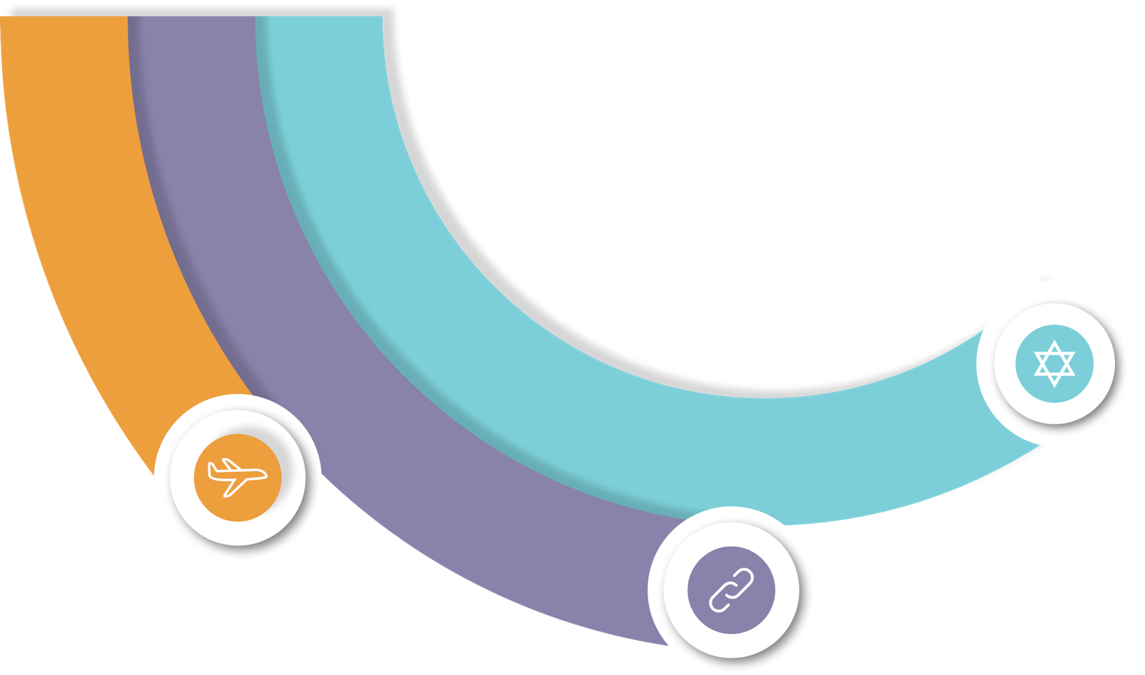



Slide 2

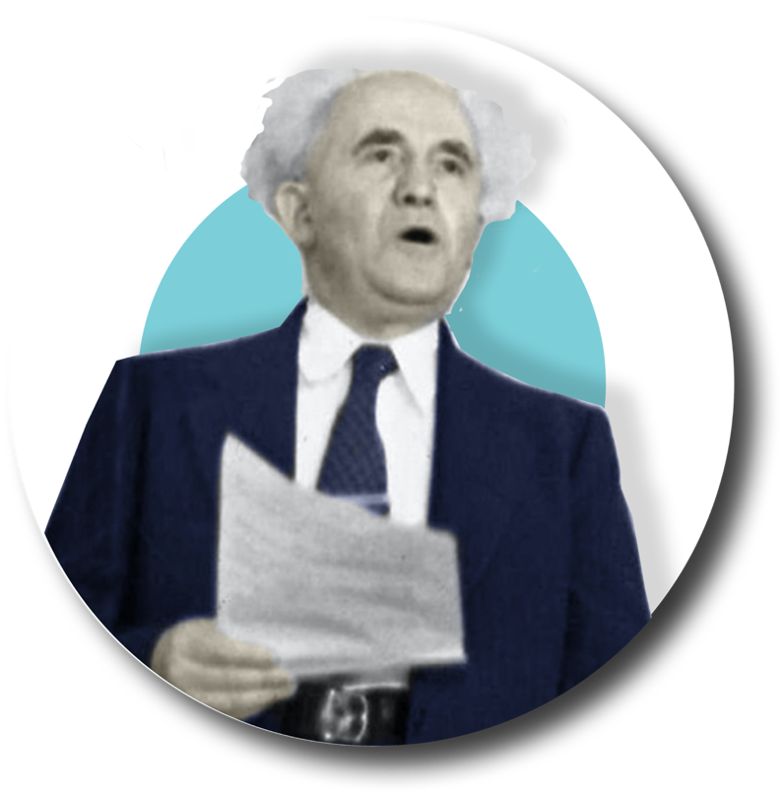


Our roots
2

Slide 3
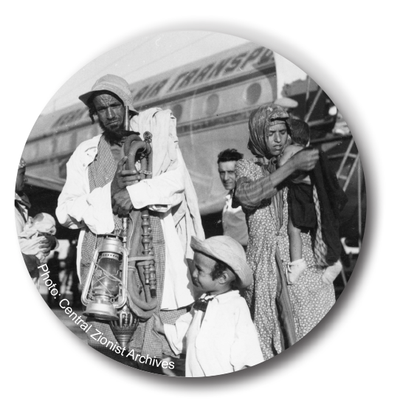
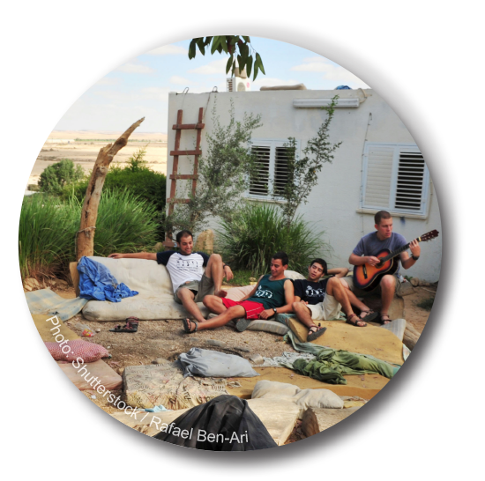
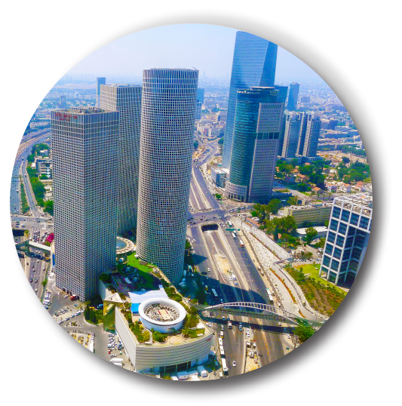
3
Notes:
Rough notes
Bringing Jews of the world to live in Israel
-Operation Red Carpet, Moses, Solomon to flights from France, Aliyah and Mexico in the last few months
Developing the country economically with direct support from world Jewry
- From El Al, the Bank of Israel and Tel Aviv’s north port to 400 villages and kibbutzim
Keeping us together as a People with Israel at the center
- Shlichim as country managers since the beginning; formal and informal education in the FSU, Latin America, Europe, Africa and Australia; Project Renewal

Slide 4


Who we are
The Jewish Agency for Israel represents Jews the world over and is the global platform to address the most important issues of our time
4
Notes:
In 65 countries
Living bridge– the 6 ways to answer why us – unique about us.

Slide 5




Our mission is inspired by…
Collective responsibility
The global Jewish family
Israel as our homeland
Doing good for the world
5

Slide 6
In the last 10 years, The Jewish Agency for Israel…
250,000 immigrants made Aliyah to Israel
267,000+ young world Jews on immersive Israel experiences
14,800 shlichim (Israeli emissaries) in 30 countries
250 communities protected with security equipment
400 communities and 700 schools in and out of Israel worked in partnership
65,000 Israeli children and parents in mentorship and life skills programs
6

Slide 7
Three
Impact
Areas
Aliyah
Connect
Israeli Society
7
Notes:
In 65 countries
Living bridge– the 6 ways to answer why us – unique about us.

Slide 8




Aliyah
Whether you’re fulfilling a dream or are in need of rescue…
The Jewish Agency is here to bring you to Israel
8
Notes:
We’re doing 3 things: Aliyah
[next slide] Connecting
[next slide] Israeli Society

Slide 9
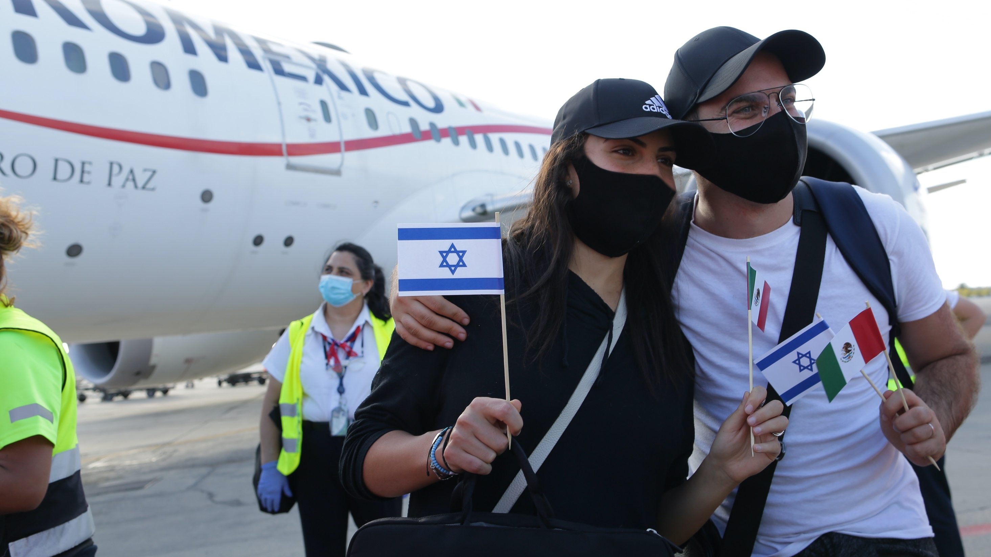
What’s most important
Global preparedness
Aliyah of responsibility
Ethiopia
Countries of concern
Job opportunities for olim (immigrants)
9

Slide 10

10

Slide 11
Connect
We connect Jews to each other and to Israel
And we strive for Israel to remain a homeland that represents all Jewry
11
Notes:
We are a global Jewish family.

Slide 12
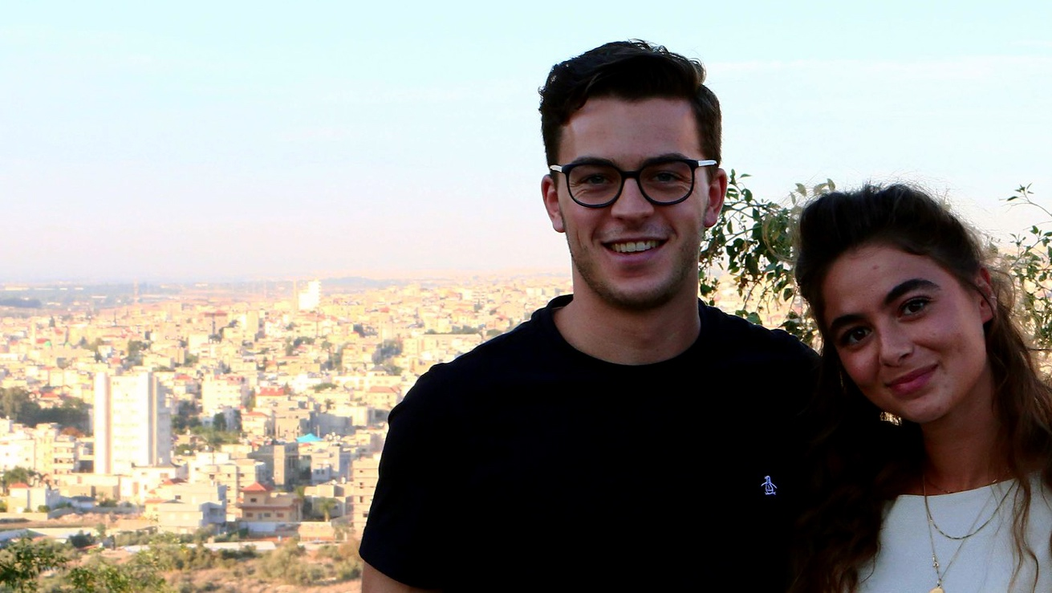
How we do it
Global Jewish Table
Face-to-face real & virtual meetups
Immersive experiences in Israel
Peoplehood for Israelis
Photo: Masa Israel Journey
12
Notes:
We’re the only organization in the Jewish world where all voices are heard and all perspectives are discussed. The only place where the full range of Jewish expression and experience come to the table. We are the Global Jewish Table.

Slide 13

Photo: Masa Israel Journey
13

Slide 14
Israeli Society
We empower all of Israel’s citizens to build a bright future for themselves and their communities
Boosting resilience enables Israel to thrive
14
Notes:
Foundation for stronger communities
Thriving communities that better represent Israeli society
Creating mechanisms

Slide 15
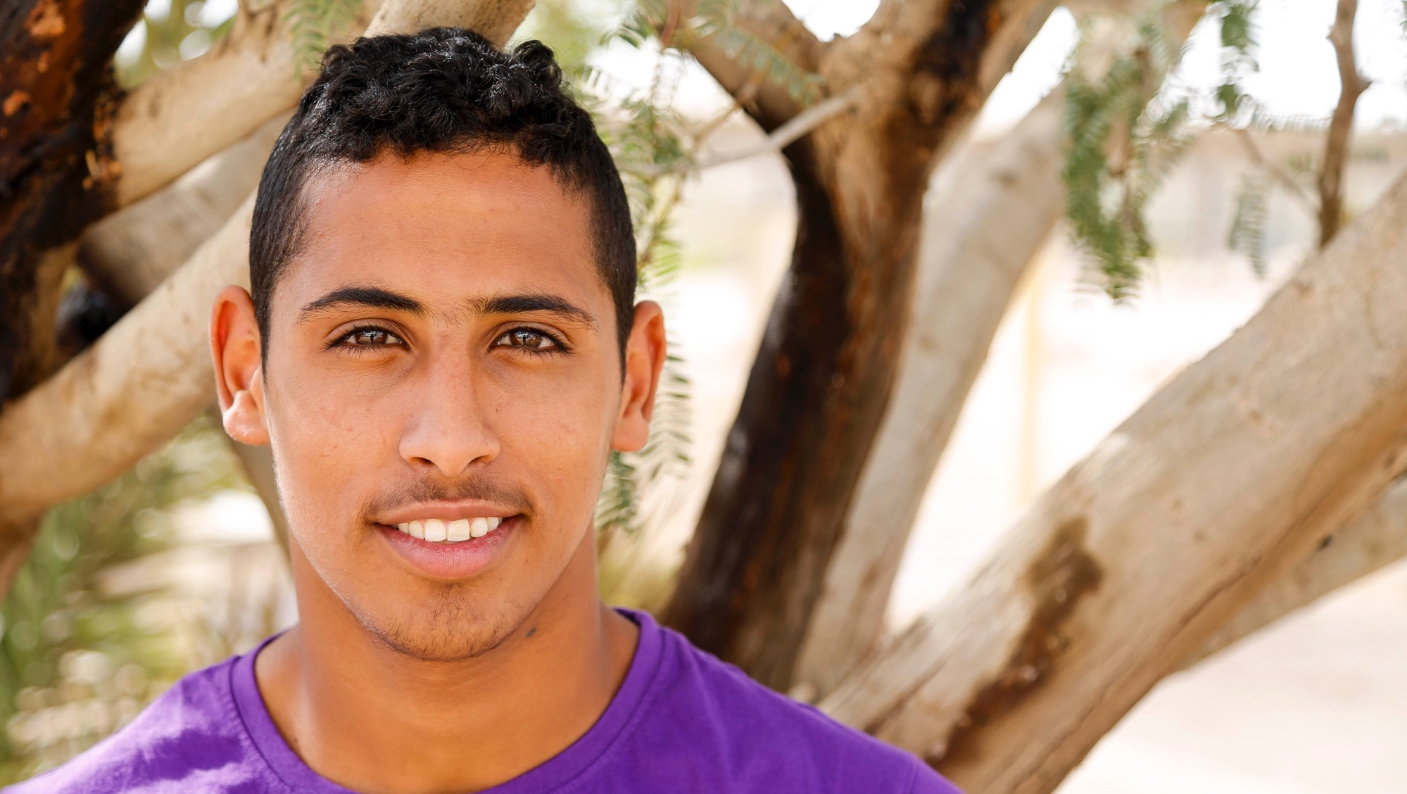
Investing in Israelis
Change agents
Leaders of tomorrow
Skills for building resilience
Create strong communities
15

Slide 16

16

Slide 17
Budget sources
Total budget: $345M*
53%
33%
Unrestricted funding
14%
Fee for service
Designated funding
* If there’s a larger decrease in the income than currently expected, there will be a change in these figures. This does not take into account a potential increase in the number of new olim.
17

Slide 18
Program budget by Impact Area*
Total budget: $330M**
43%
34%
23%
Aliyah
Connecting the Jewish People
Israeli Society
* Distribution according to preliminary classification of the new Impact Areas. Some classifications and distribution may change.
** If there’s a larger decrease in the income than currently expected, there will be a change in these figures. This does not take into account a potential increase in the number of new olim.
18

Slide 19
Program budget by region*
Total budget: $330M**
48%
Israel
North America
21%
FSU, Eastern Europe
Western Europe
14%
Latin America
6%
7%
4%
Australia, South Africa, Other
* Distribution by region is preliminary and based on 2019-2020 data.
** If there’s a larger decrease in the income than currently expected, there will be a change in these figures. This does not take into account a potential increase in the number of new olim.
19

Slide 20
In the last 10 years, The Jewish Agency for Israel…
250,000 immigrants made Aliyah to Israel
267,000+ young world Jews on Israel experiences like Masa Israel Journey
14,800 shlichim (Israeli emissaries) in 30 countries
250 communities protected with security equipment
400 communities and 700 schools in Partnership2Gether (P2G)
65,000 Israeli children and parents in Youth Futures and Youth Villages
A1
Notes:
Same slide as shown earlier in the deck but with program names

Slide 21
The Jewish Agency for Israel
touches more Jewish lives than any
organization in the world
1.2 million Jews every year
21
Notes:
David Ben-Gurion grappled with the creation of the State. Today we strive to create opportunities for all Jews to have a connection to Israel and to support one another.
The story of The Jewish Agency for Israel continues to be as relevant today as when Ben-Gurion led it more than 90 years ago.

Slide 22
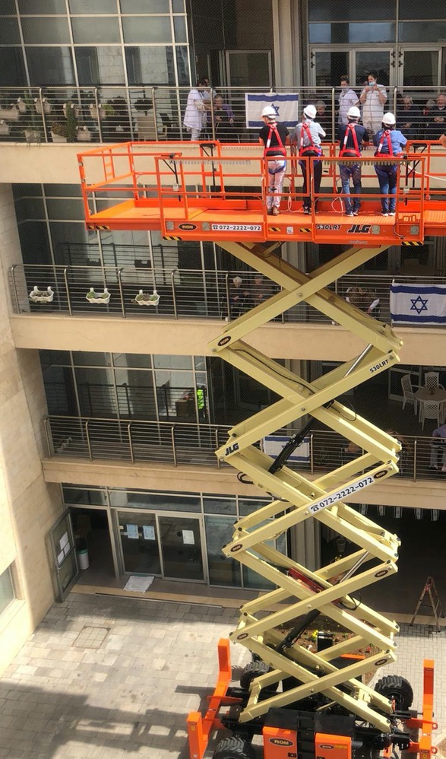
Our COVID-19 response
Aliyah under difficult circumstances
Seniors in Amigour homes
Thousands of youth-at-risk and their families
Shlichim and shinshinim (Israeli emissaries)
Loan Fund for Communities in Crisis
Global table for the day after
22

Slide 23
Global reach, influence & capacity
Living bridge between world Jews & Israelis
Global footprint in 65 countries
Special covenant with the Government of Israel
First responder in times of crisis
Voice of the Jewish People in Israel
A2

Slide 24

Thank you!
תודה רבה!

Slide 25
Appendix

