Slide 1
Israel in a picture

Slide 2
My Jewish Life in a picture

Slide 3
I wonder what does _sport\music\lgbtq+\food\Christianity…____ look like in IL

Slide 4
I have a Question!
_____________________________________________________
_____________________________________________________
_____________________________________________________
_____________________________________________________
_____________________________________________________
_____________________________________________________
_____________________________________________________
_____________________________________________________
_____________________________________________________
_____________________________________________________
_____________________________________________________
_____________________________________________________

Slide 5
I think I know a lot about…
The middle east politics
The IL-Palestine relationship
The IL-Palestine timeline
LGBTQ in IL
Israeli food
Israeli nature
IDF
‘Occupied territory’
Life in Gaza
IL and US Relationship

Slide 6
I want to know more about…
The middle east politics
The IL-Palestine relationship
The IL-Palestine timeline
LGBTQ in IL
Israeli food
Israeli nature
IDF
‘Occupied territory’
Life in Gaza
IL and US Relationship

Slide 7
Something I love about IL

Slide 8
Someone told me this about ISRAEL

Slide 9
it’s a Hard Knock Life.. Something difficult in My Relationship with Israel

Slide 10
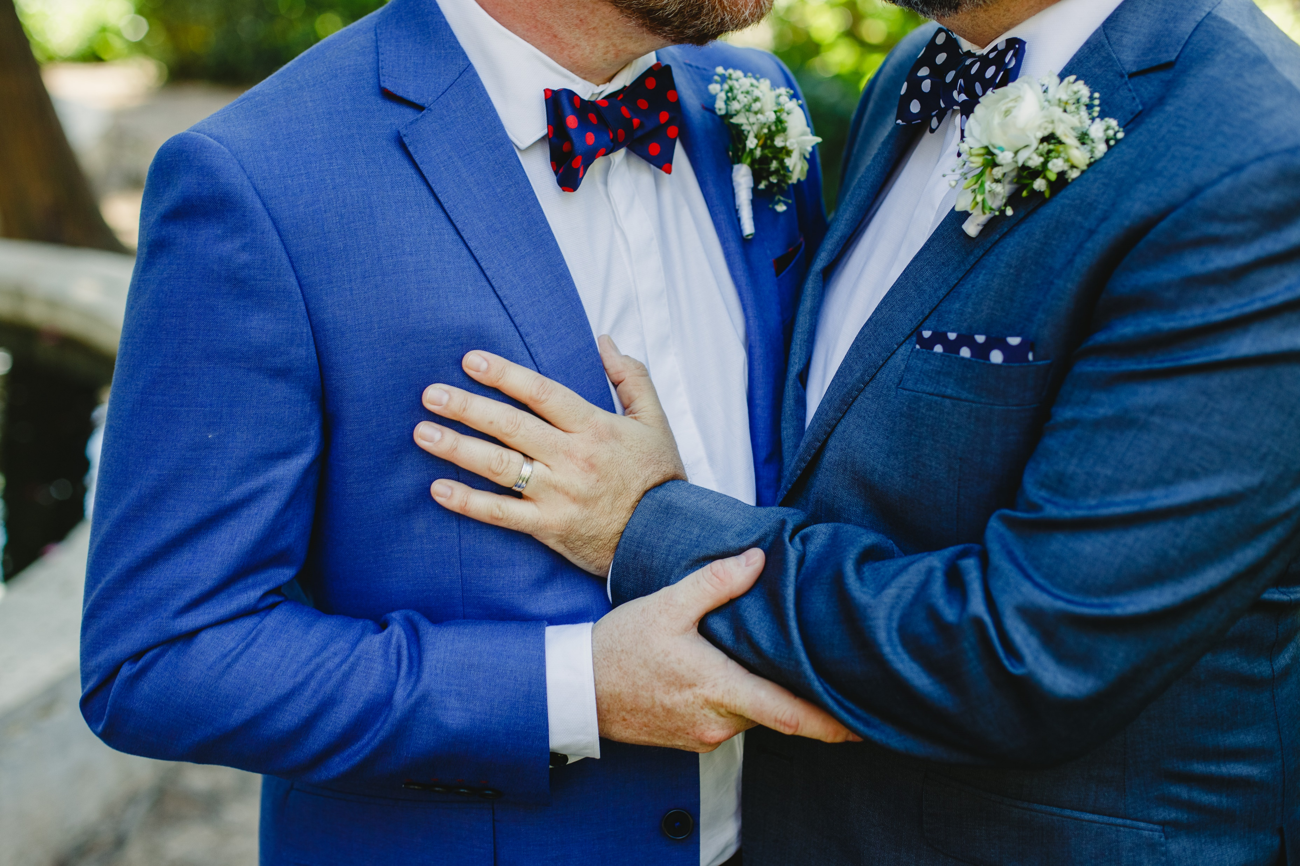
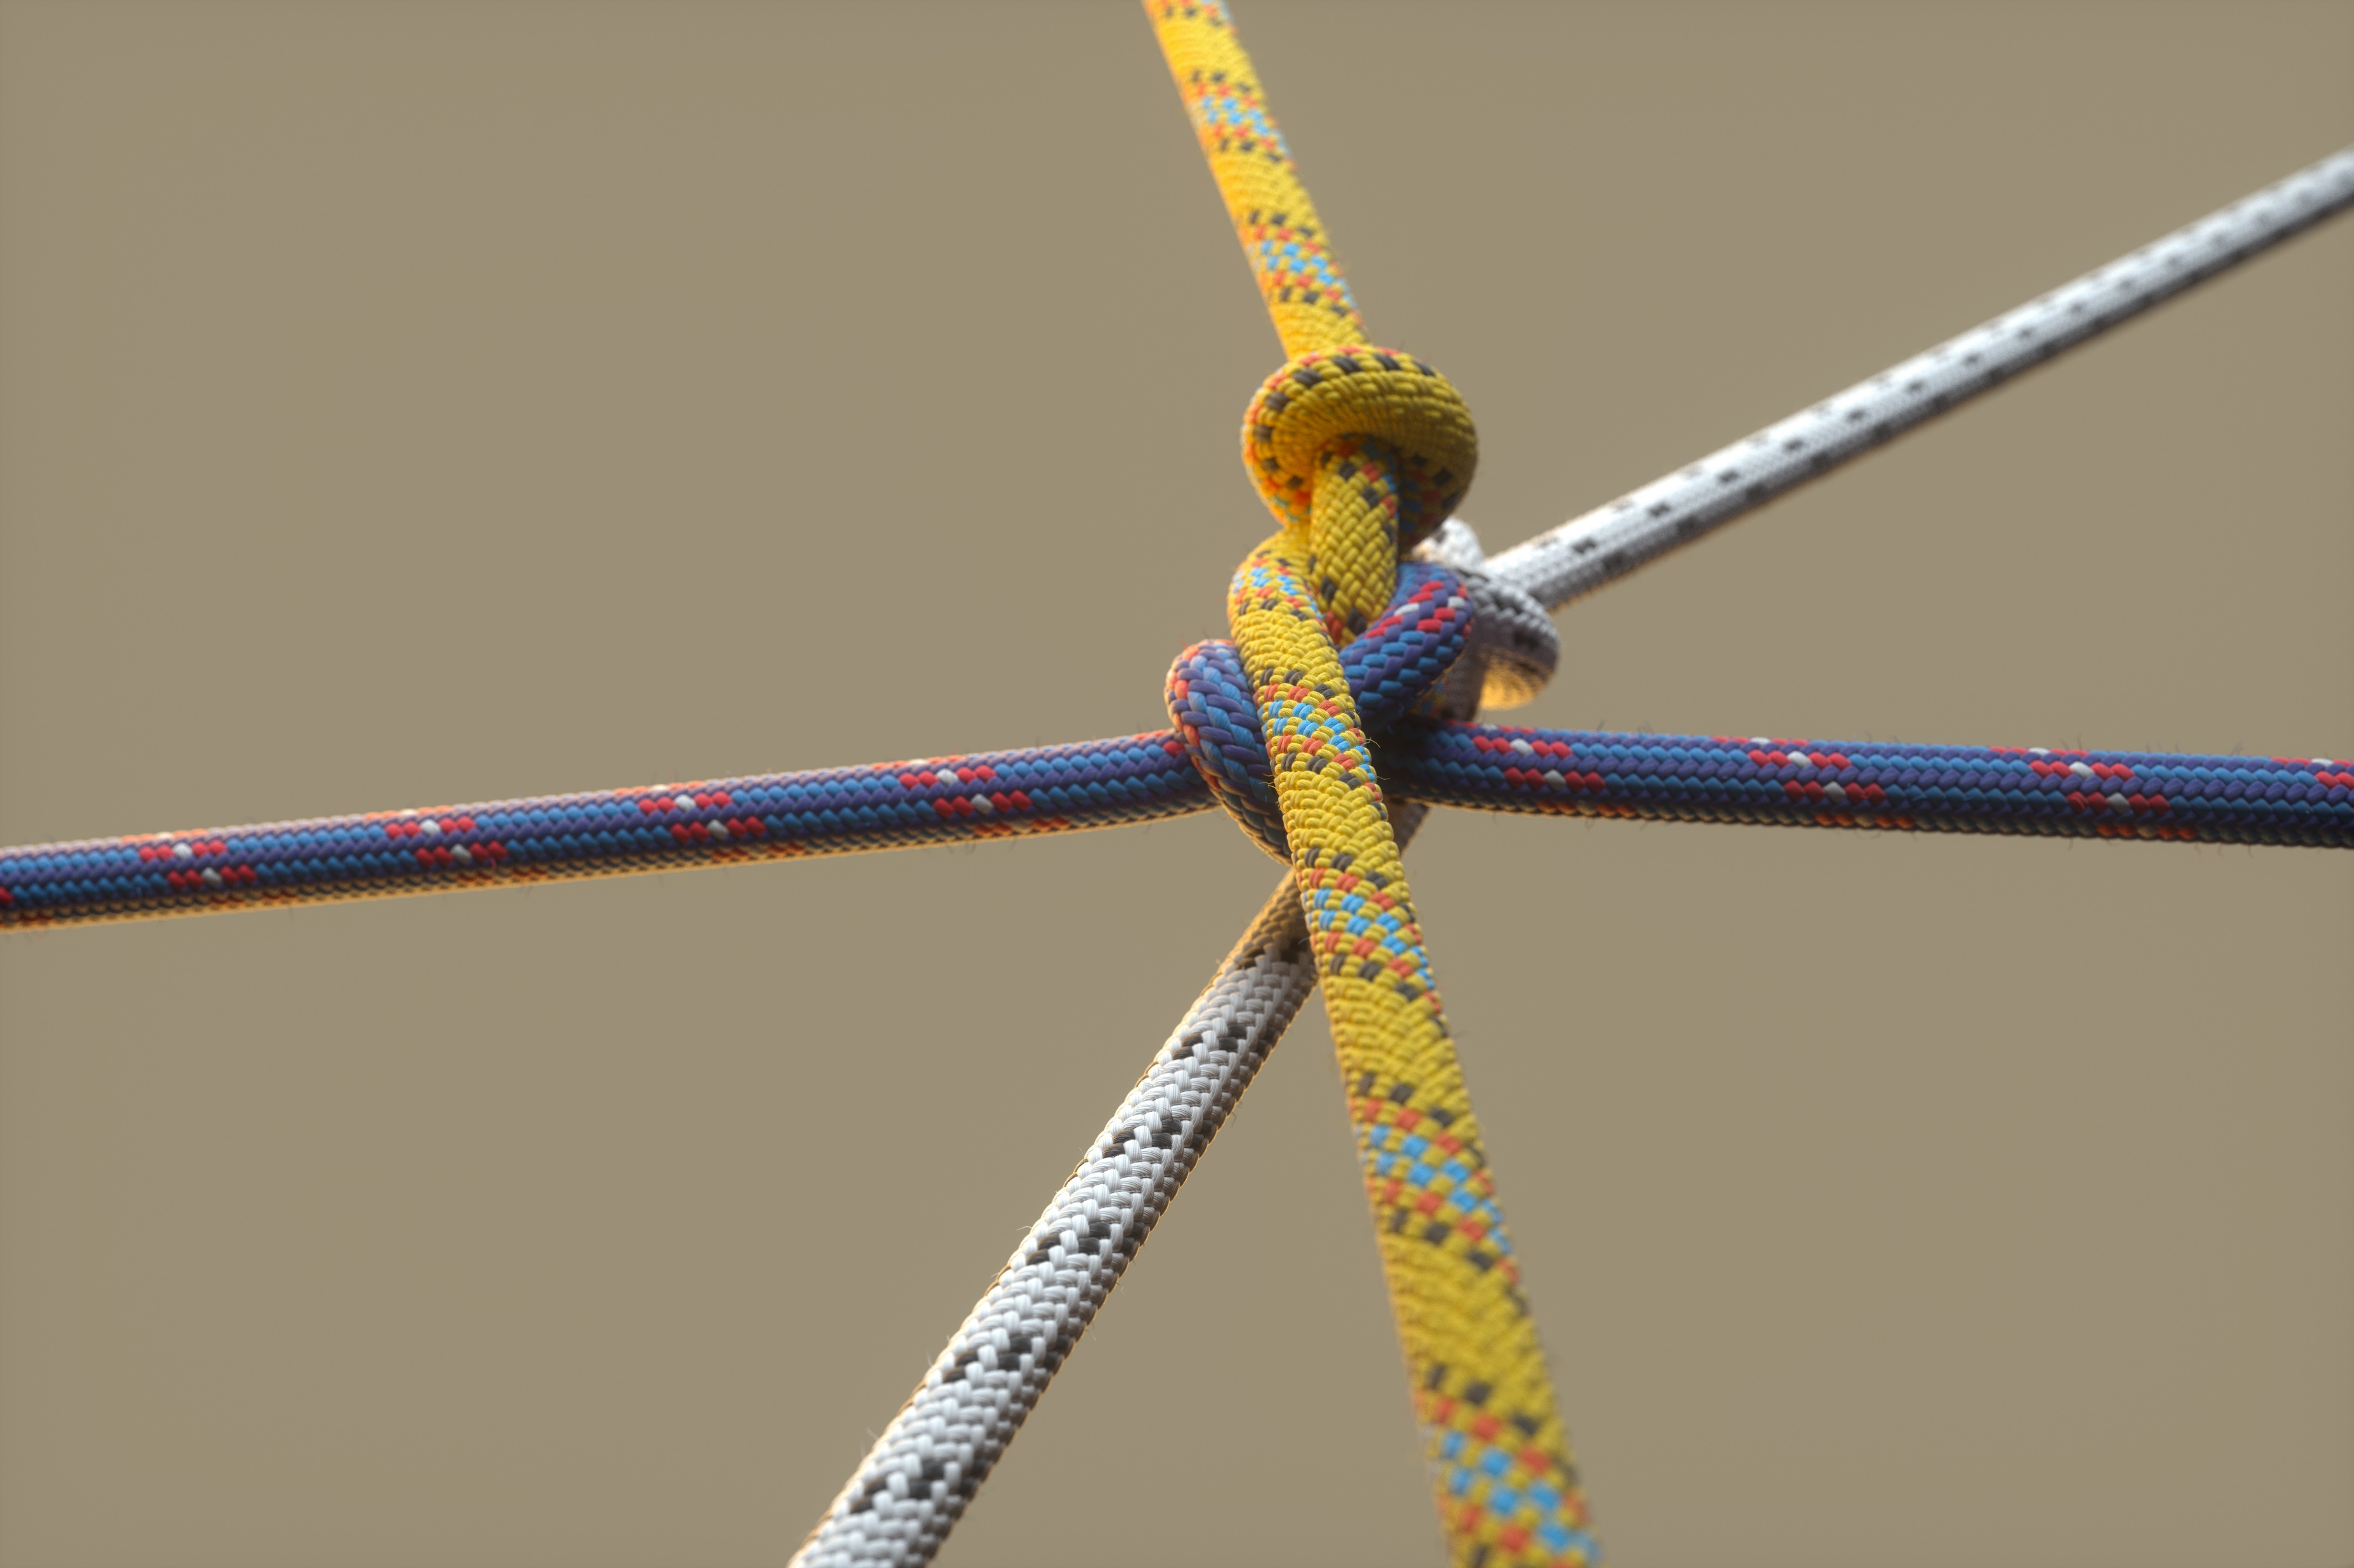
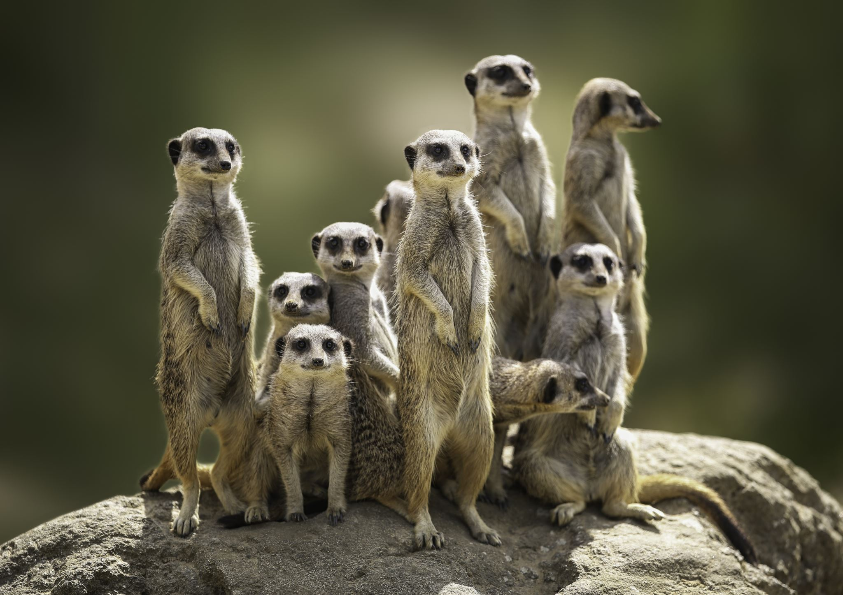
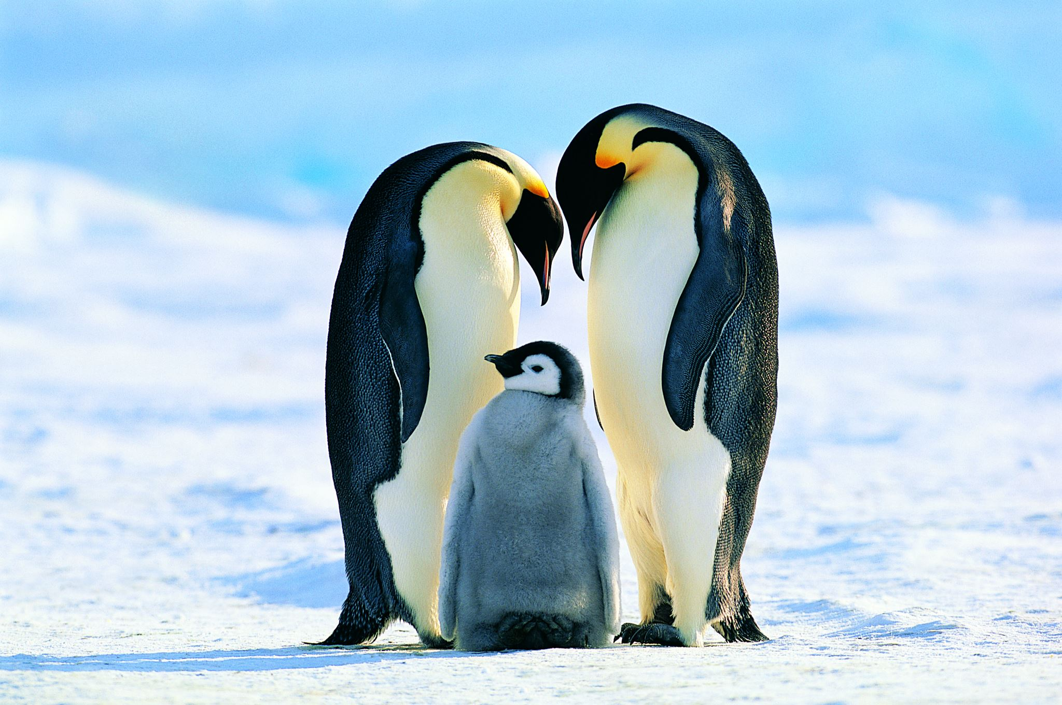
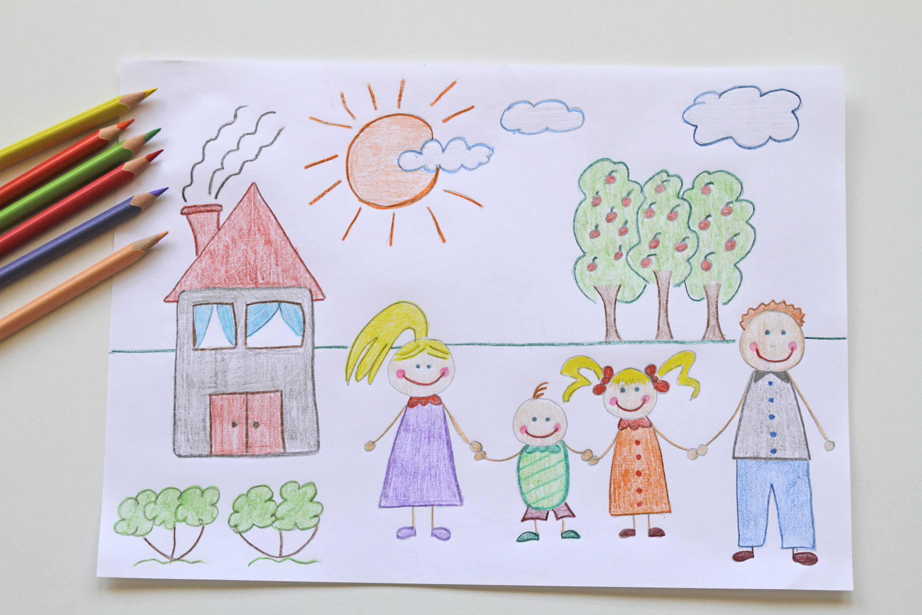
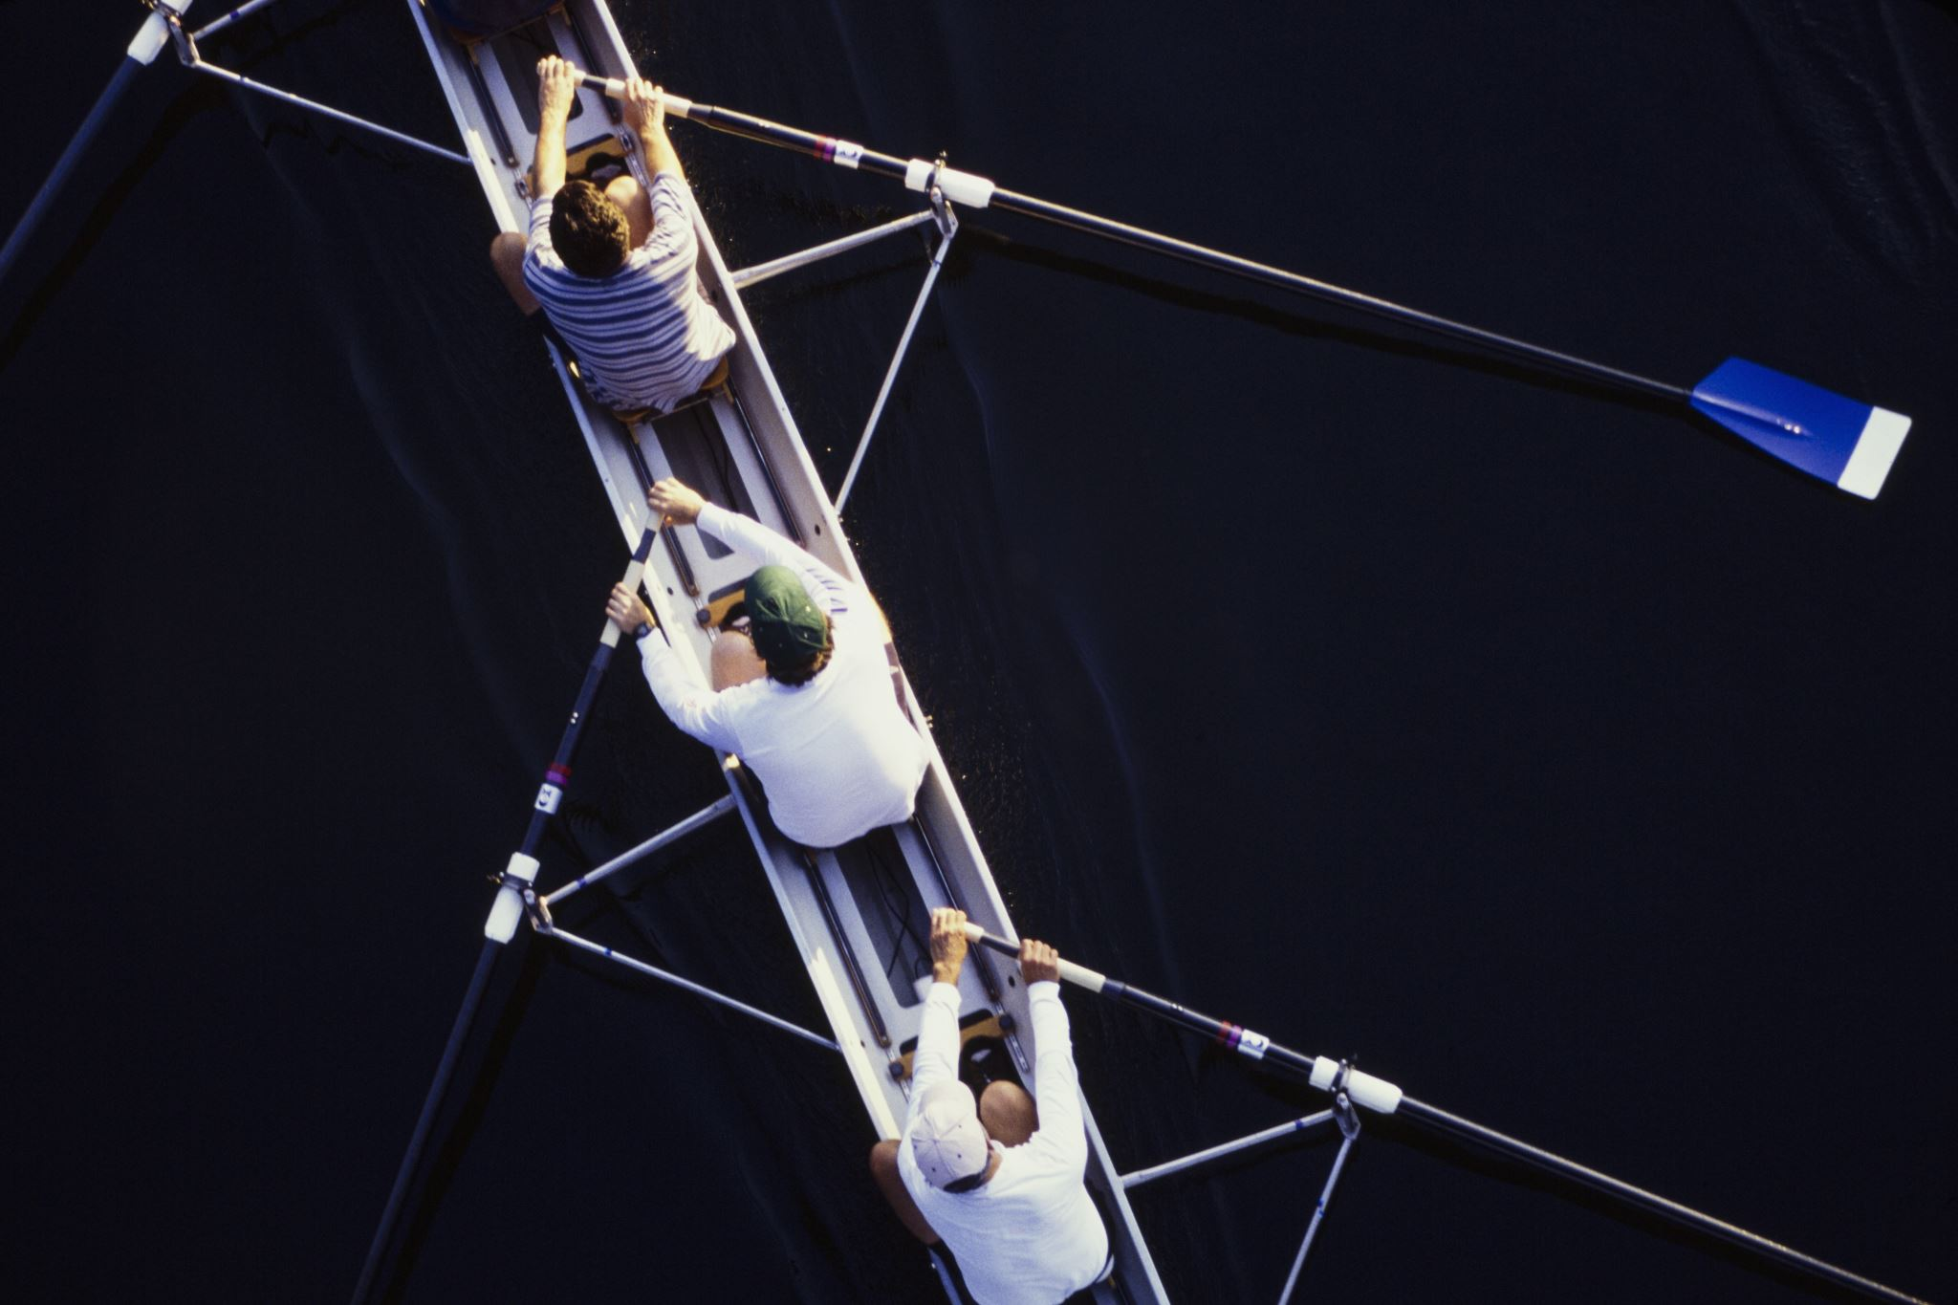
Me & Israel is Like..

Slide 11
My Jewish Identetity is…
What’s yours?

Slide 12
Coming Up Next.. What would you like to read about?

