Slide 1
HAPPY ROSH HASHANA שנה טובה!!!

Slide 2
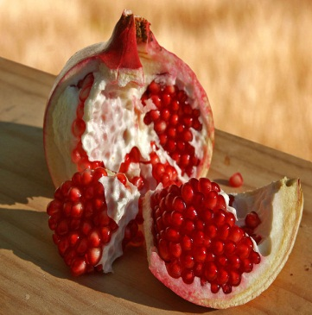
WHAT KIND OF FOOD WE EAT
Pomegranate:
Pomegranates are said to have 613 seeds, the same number of mitzvot in the Torah. On Rosh Hashanah we eat a fresh pomegranate preceded by the blessing:
יהי רצון מלפניך אדוני אלוהינו שנהיה מלאים זכויות כרימון"
Yehi Ratzon Mil’fa’necha, Adonai Eloheinu she nihiye meleim mitzvoth ke rimon”
May if be your will Adonai our God that our merits increase like the seeds of a pomegranate

Slide 3
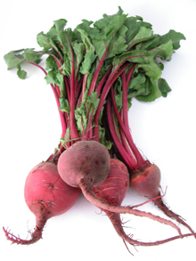
Beets:
The Aramaic for beets is “silka” which sounds like the Hebrew word “siluk.” ”Siluk” means removal. We pray that our enemies will be removed.
"יהי רצון מלפניך אדוני אלוהינו שיסתלקו אויבינו ושונאינו"
Yehi ratzon milfanecha Adonai Eloeinu she istalku oyevenu ve soneiynu.
May it be your will Eternal God that our enemies and haters will be removed.

Slide 4
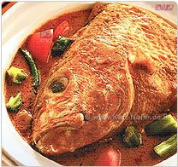
Head of a fish
It is a very ancient tradition to bake and present at the table the head of a ram. This is done to symbolize a desire for the Rosh Hashanah celebrants to be leaders, not followers.
"יהי רצון מלפניך אדוני אלוהינו שנהיה לראש ולא לזנב"
”Yehi Ratzon Mil’fa’necha, Adonai Elohein She niyeh le rosh velo le zanav”
“May if be your will Adonai our God that we will be the head and not the tail”.

Slide 5
Rosh Hashana from the Tel-Aviv Streets
http://www.youtube.com/watch?v=kUzXdKj_9yc

Slide 6
BE’ROSH HA’SHA’NA- NEOMI SHEMER
BE’ ROSH HA’SHA’NA BE’ROSH HA’SHA’NA
PAR’CHA SHO’SHA’NA ETS’LY BA’ GI’NA
In the head of the year
In the head of the year
In my garden bloomed a rose

Slide 7
BE’ROSH HA’SHA’NA- NEOMI SHEMER
BE’ROSH HA’SHA’NA
CI’RA LE’VA’NA’
A’GNA’ LA’BA’HOF’
PIT’OM
In the head of the year
A white sailboat
Suddenly set anchor by the shore

Slide 8
BE’ROSH HA’SHA’NA- NEOMI SHEMER
BE’ ROSH HA’SHA’NA BE’ROSH HA’SHA’NA
LI’BE’NU A’N’A
BE’T’PHI’LA’ NO’SHA’NA
SH’YA’PHA’ VE’SHONA’
TE’ HE’ HA’SHA’NA’
A’SHER MAT’HI’LA’ LA HA’YOM
On Rosh Hashanah, on Rosh Hashanah, Our heart responded in ancient prayer: May the year beginning anew today Be wonderful and special in every way.

