Slide 1
The New Israeli Government: Opportunities and Challenges

Slide 2
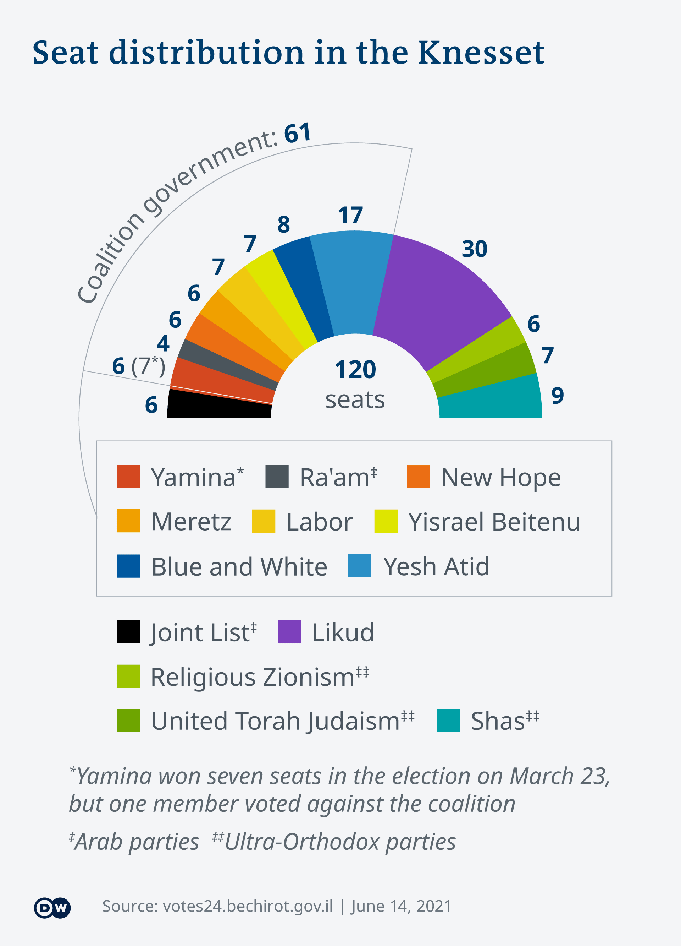

Slide 3
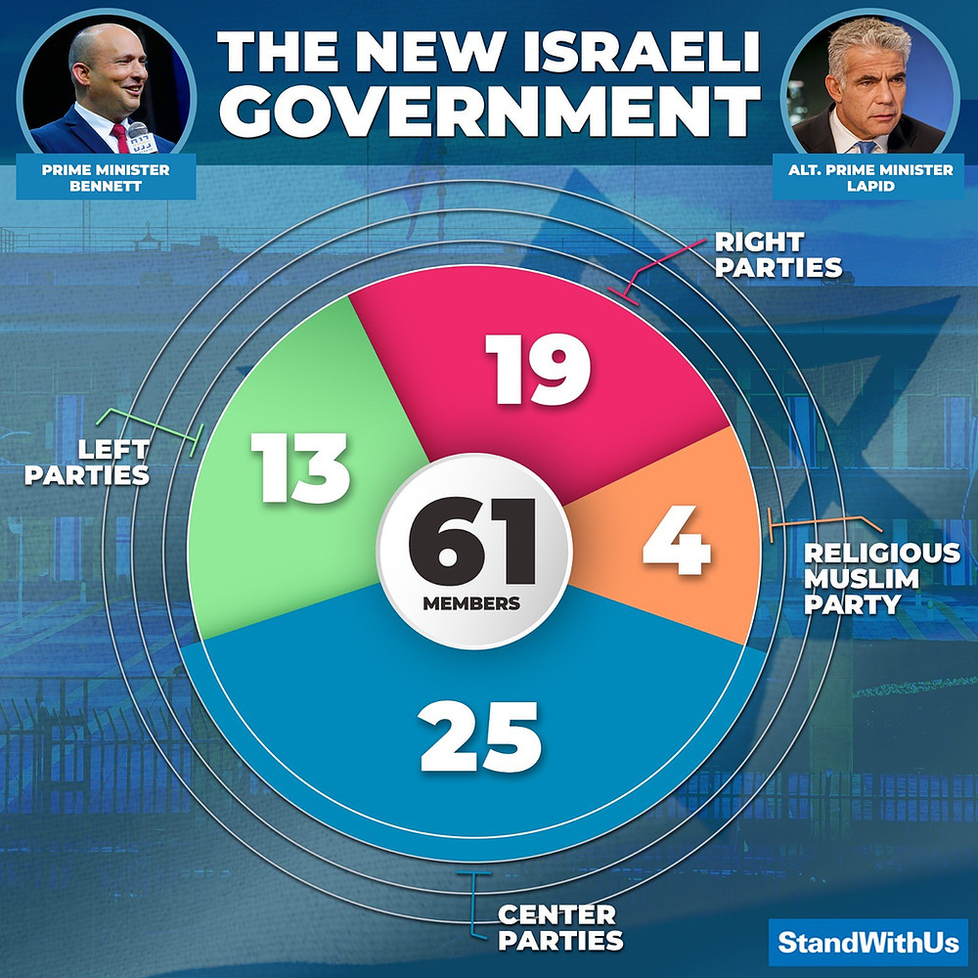

Slide 4
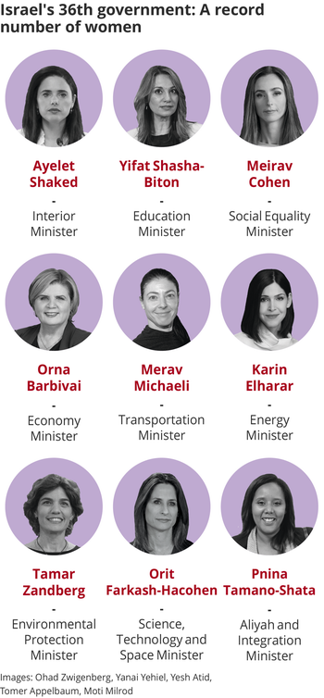
Records
First-ever religious Prime Minister
Third Israeli-American PM
First-ever Reform Rabbi Knesset Member
9 female Ministers
First-ever Ethiopian-Israeli female Minister
Gay Ministers
Second-ever Muslim Minister

Slide 5
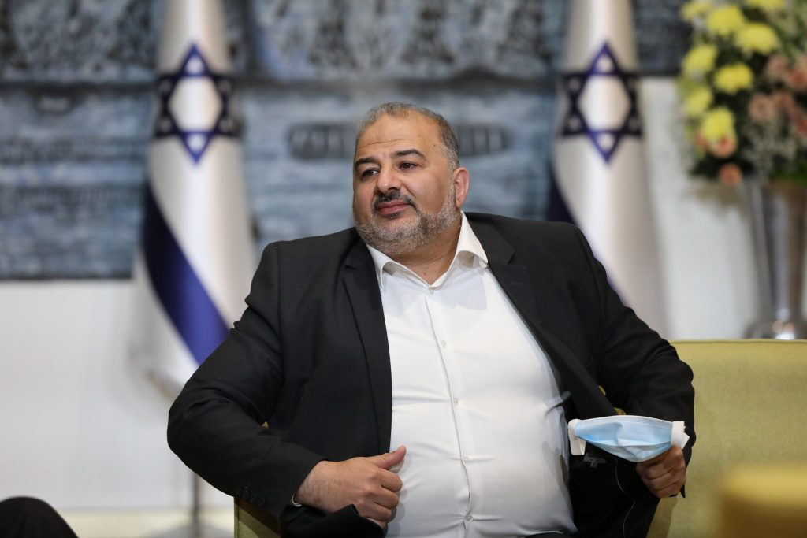
Opportunities
A Muslim religious party is included in the coalition
Approving a state-budget for the first time since 2018
Stability – no more elections (at least till 2024)
A new model of government
Promoting pro LGBTQ and environmental legislation

Slide 6
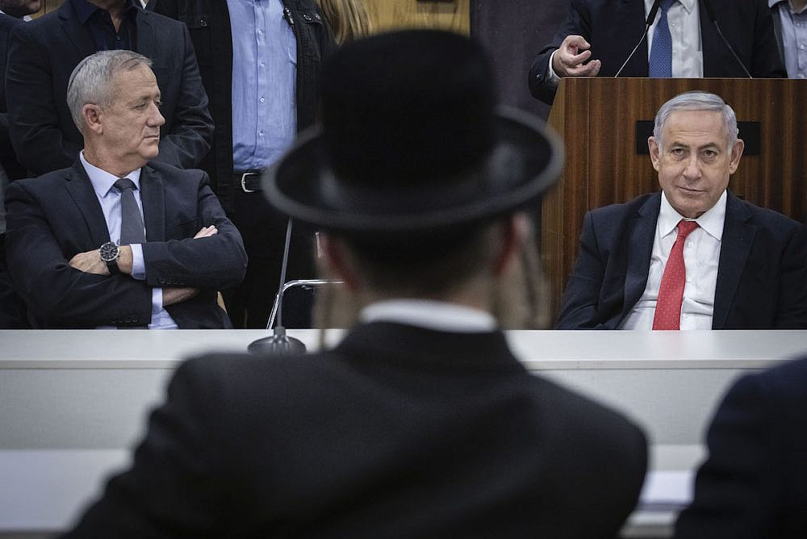
Challenges
Diverse Government
Gantz’s position in the Government
Netanyahu
The PM party has only 6 Knesset seats
Wide spectrum of ideologies and agendas

Slide 7
Thank you!

