Slide 1
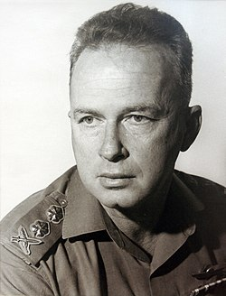
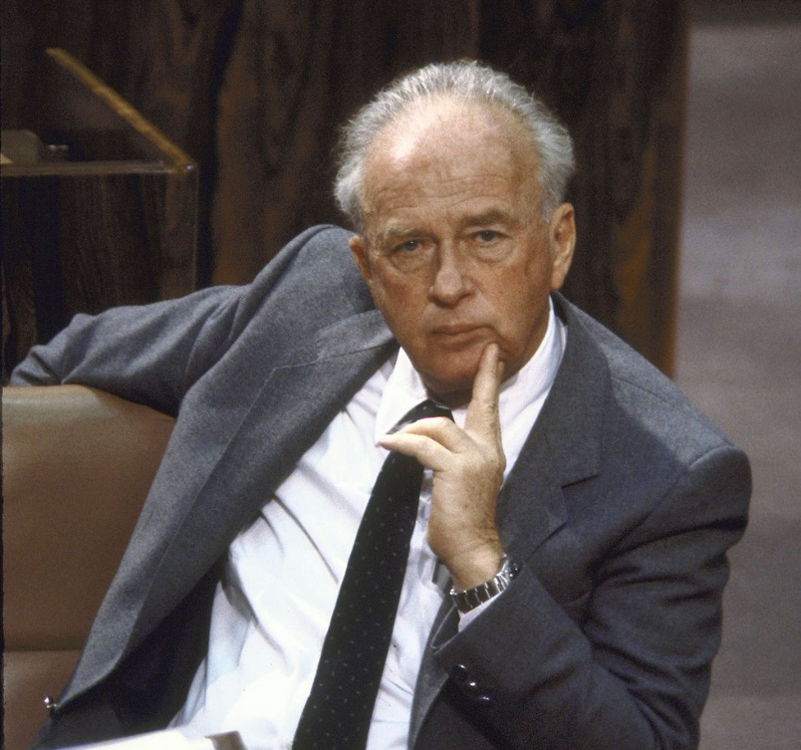
Rabin Memorial Day
1922-1995

Slide 2
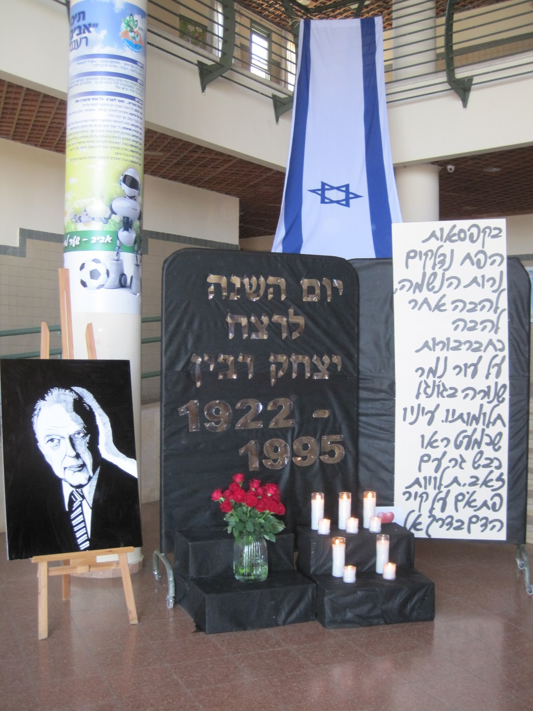

Slide 3
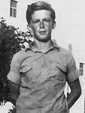
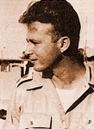

Slide 4
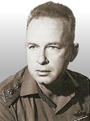
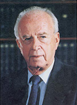

Slide 5
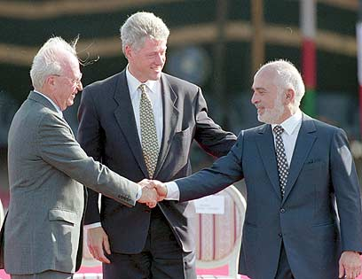
Rabin also oversaw the signing of theIsrael-Jordan Treaty of Peace in 1994.

Slide 6
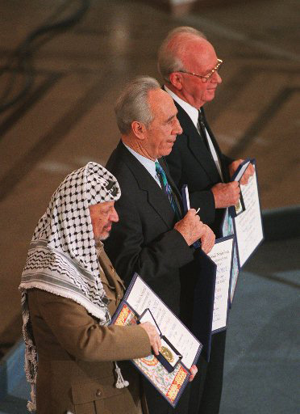
For his role in the creation of the Oslo Accords, Rabin was awarded the 1994 Nobel Peace Prize, along with Yasser Arafat and Shimon Peres.

Slide 7
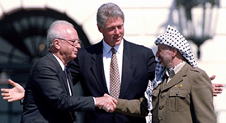

Slide 9
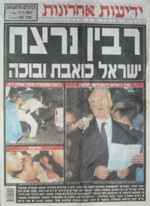
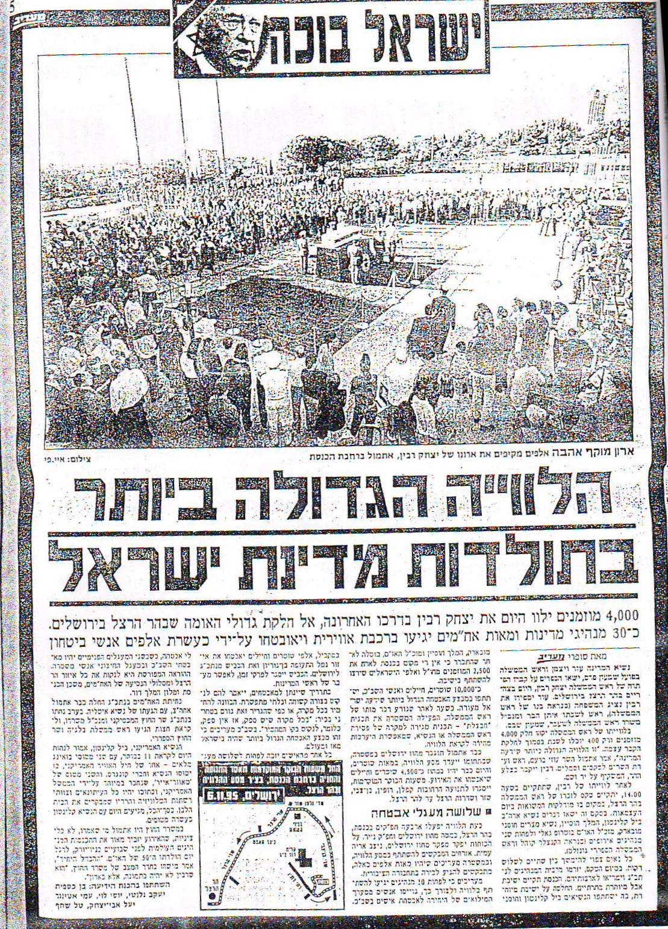
Israel is crying

Slide 10
שיר לשלום A SONG FOR PEACE

Slide 12
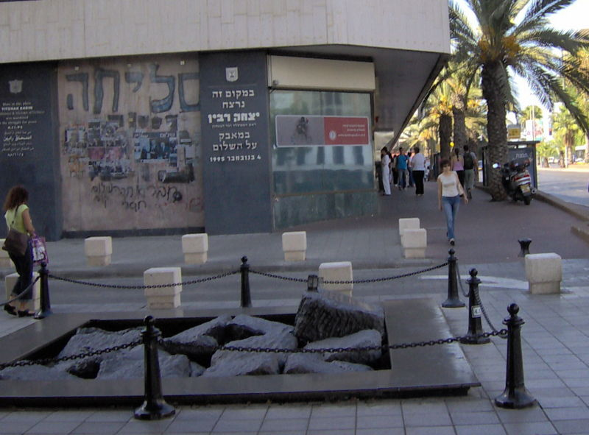

Slide 13
